Slide 1


English
Date: 07.01.21
‘Pleasant Sounds’ by John Clare
Lesson 2
Comprehension

Slide 2

Re-read the poem below from yesterday’s lesson or click the sound button to hear it being read to you:
Pleasant Sounds
The rustling of leaves under the feet in woods and under hedges;
The crumpling of cat-ice and snow down wood-rides, narrow lanes, and every street causeway;
Rustling through a wood or rather rushing, while the wind halloos in the oak-top like thunder;
The rustle of birds’ wings startled from their nests or flying unseen into the bushes;
The whizzing of larger birds overhead in a wood, such as crows, puddocks, buzzards;
The trample of robins and woodlarks on the brown leaves, and the patter of squirrels on the green moss;
The fall of an acorn on the ground, the pattering of nuts on the hazel branches as they fall from ripeness;
The flirt of the ground lark's wing from the stubbles - how sweet such pictures on dewy mornings, when the dew flashes from its brown feathers.
by John Clare

Slide 3
Click on the sound button to hear activity 1 explained to you.
Activity 1
Answer the following comprehension questions about the poem. Click the sound button above to hear the questions being read to you.
You might have to flick back to the previous slide to find the answers in the text. Remember to write in full sentences when answering each question.
Questions:
List three ‘pleasant sounds’ from the poem.
What time of year is the poem set? How do you know?
Which are your favourite descriptions from the poem? Why do you like them?

Slide 4
Answers
Three pleasant sounds in the poem are:
  the rustling of leaves
  the crumpling of cat-ice
  rustling through a wood
  the halloos from the wind
  the rustle of birds’ wings
  the whizzing of larger birds overhead
  the trample of robins and woodlarks
  the patter of squirrels on the green moss
  the fall of an acorn on the ground
  the pattering of nuts on the hazel branches
  the flirt of the ground lark's wing
(Choose 3)
Click on the sound button to hear the answers read to you.
Move on to the next slide for answers to questions 2 and 3

Slide 5
Click on the sound button to hear the answers read to you.
Answers continued
I think it must be winter because it says the leaves are ‘under the feet’. This would suggest that the trees have lost their leaves and they are lying on the ground. The weather also suggests that it might be winter because it says that it is windy and that there is ice down every road.
You can choose but you must give a reason. For example:
  My favourite descriptions from the poem are ‘The crumpling of cat-ice’ and ‘Rustling through a wood or rather rushing’ because they both use alliteration. The first example repeats the C sound and the second example repeats the R sound. I like how these sentences roll off the tongue.

Slide 6
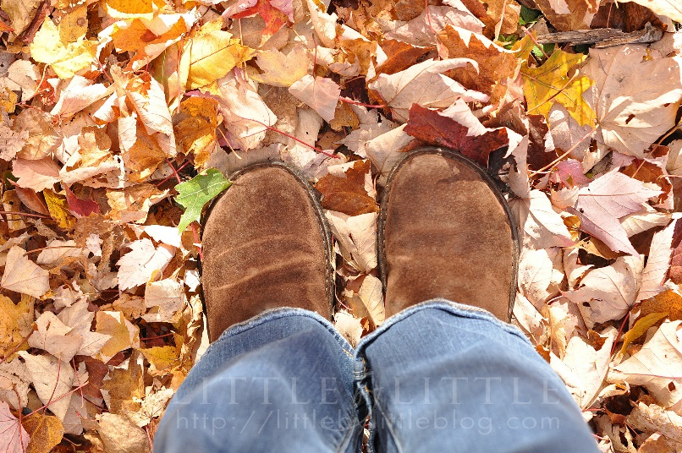
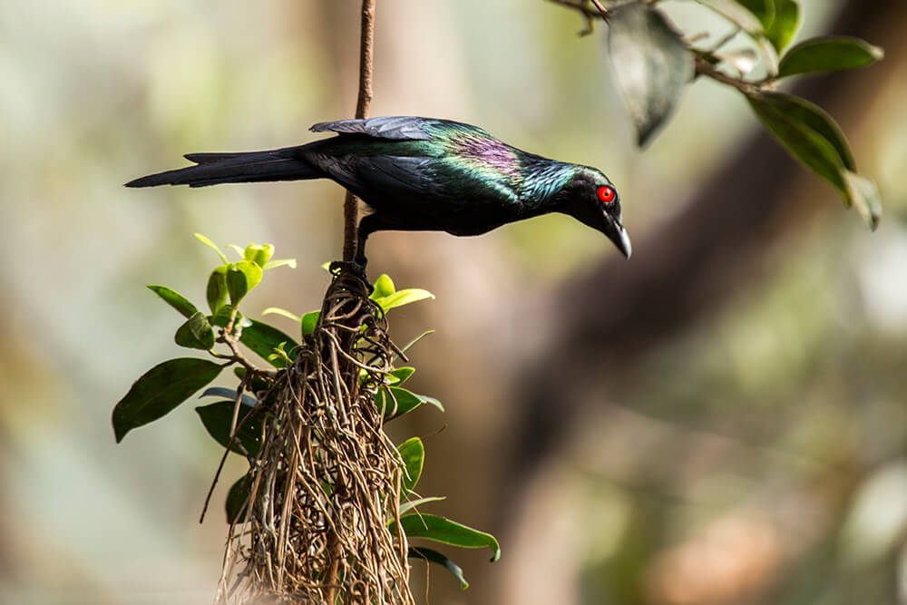
Click on the sound button to hear activity 2 explained to you.
Activity 2
Choose your favourite description from the poem and illustrate it (draw a picture of it).
The rustling of leaves under the feet in woods and under hedges
The rustle of birds’ wings startled from their nests

Slide 7
