Slide 1

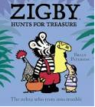

What sort of treasure do you think Zigby and his friends will find on Parrot Island?

