Slide 1

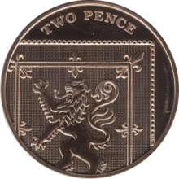
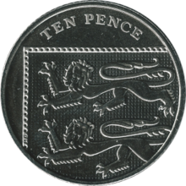
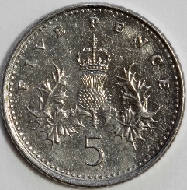
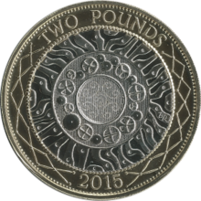
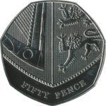
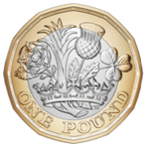
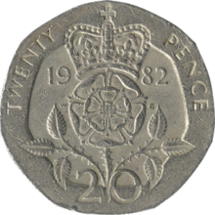


DAY TWO
Morning Starlings
Today you need to ask your grown up for some more money (just promise them you’ll give it back!). If you don’t have any you can cut out coins from the sheet attached.
You will need all the coins that we use in the United Kingdom: 1p, 2p, 5p, 10p, 20p, 50p, £1 and £2
Today’s focus will be understanding that a coin has a value which is independent of its size, shape, colour or mass.

Slide 2
Have a look and feel in turn the coins and, like yesterday, look at the pictures/dates on the coins and describe what you see. Can you tell the value of each coin? How?
Did you know that we don’t have 3p, 4p, 6p etc. coins? Is there a 40p coin? £3 coin?
Now take one of each different coin and line them up in order from smallest to biggest value (how much they’re worth) and then biggest to smallest value. What do you notice about the size and colour? Which coin is the most valuable? Which is the least valuable?
The size of the coins doesn’t matter (look at the size of the 5p – although it’s smaller than the 2p it’s worth more money)
Can you describe the colours of the coins? We call the lower value (1p and 2p) copper and the higher values silver (5p, 10p, 20p and 50p) and gold (£1 and £2)

Slide 3
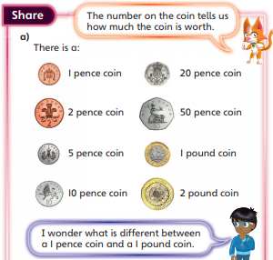
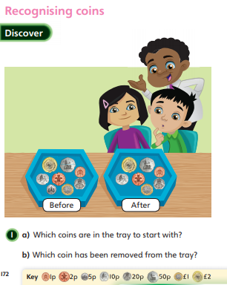
Can you answer Ash’s question? Which is more valuable 1p or £1?
Did you know that there are 100p in £1?
Challenge: How many pennies are there in £2?

Slide 4
