Slide 1
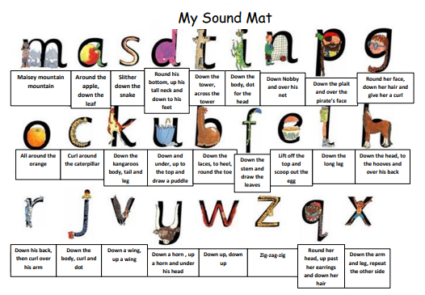

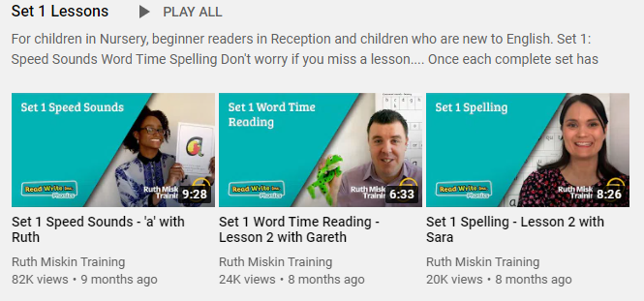

Read Write Inc
Red Group
Please follow the link below to your Read Write Inc lesson today. Each day you will need to click on the video’s shown in the screen shots below. Please remember that although the screen shot says /a/, the sound will change each day but will be found in the same place.
https://www.youtube.com/channel/UCo7fbLgY2oA_cFCIg9GdxtQ
Video 1: Please watch ‘Set 1 Speed sound’ lesson.
Video 2: Please watch ‘Set 1 Word Time’ lesson.
Video 3: Please watch ‘Set 1 Spelling’ Lesson
Please complete all video’s each day ☺

Slide 2
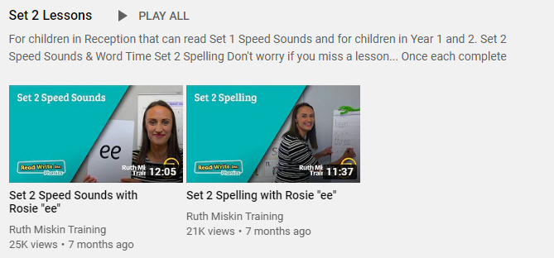

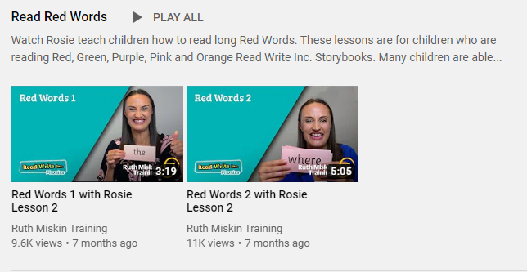
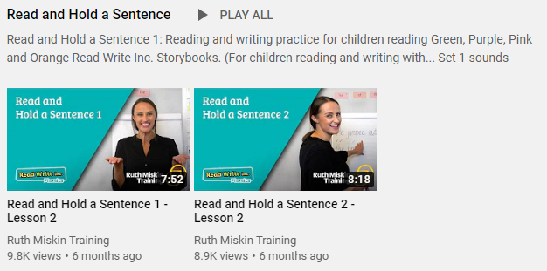
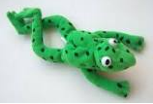
Read Write Inc
Set 2 Group
If you are currently reading green books, please follow the link below to your Read Write Inc lesson today. Each day you will need to click on the video’s shown in the screen shots below. Please remember that although the screen shot says /ee/, the sound will change each day but will be found in the same place. https://www.youtube.com/channel/UCo7fbLgY2oA_cFCIg9GdxtQ
Video 1: Please watch ‘Set 2 Speed sound’ lesson.
Video 2: Please watch ‘Set 2 Spelling’ lesson.
Please complete all 4 video’s each day ☺
Video 3: Please watch ‘Red words 1’ lesson only.
Video 4: Please watch ‘Read and Hold a sentence 1’

Slide 3
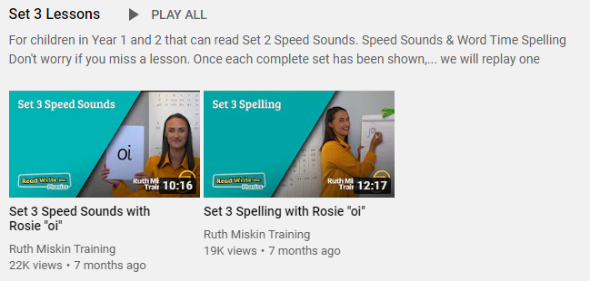
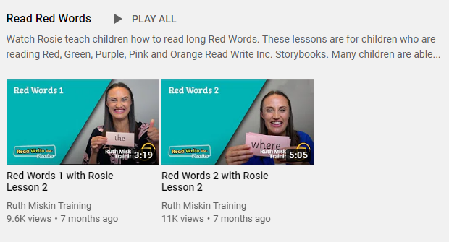
Set 3 Groups
If you are currently reading pink, yellow, or blue books, please follow the links below to your Speed Sound lesson, red word focus lesson and hold a sentence activity for today. Each day you will need to click on the video’s shown in the screen shots below. Please remember that although the screen shot says /ee/, the sound will change each day but will be found in the same place. https://www.youtube.com/channel/UCo7fbLgY2oA_cFCIg9GdxtQ
Video 1: Please watch ‘Set 3 Speed sound’ lesson.
Video 2: Please watch ‘Set 3 Spelling’ lesson.
Video 3: Please watch ‘Red words 2’ lesson only.
Video 4: Please watch ‘Read and Hold a sentence 2’

