Slide 1

Starlings English Home Learning
Thursday 7th January

Slide 2



Slide 3


Today we are learning to put the main events of Little Red Riding Hood in order.
That means you will
Look at the version of the story I read to you yesterday.
Put the jumbled up pictures back in order.
Write a label for each picture to explain what is happening in the picture.

Slide 4
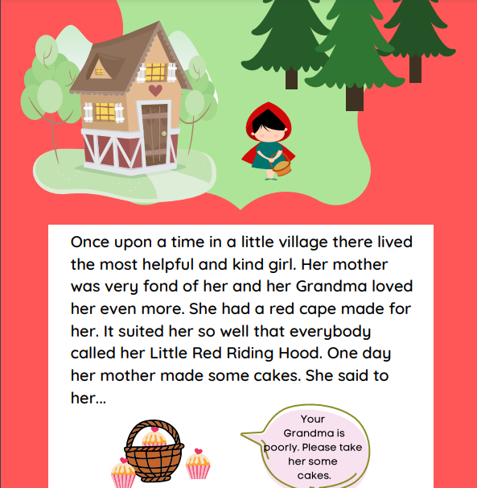

Slide 5
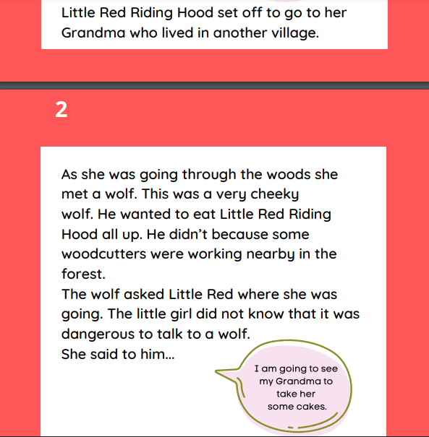

Slide 6
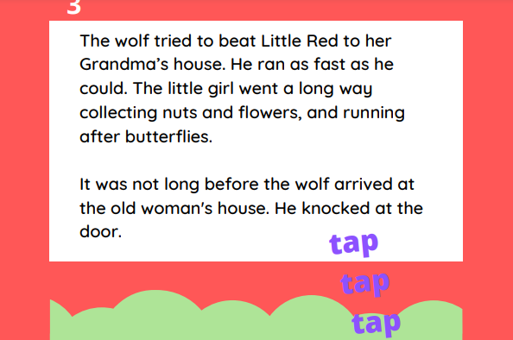
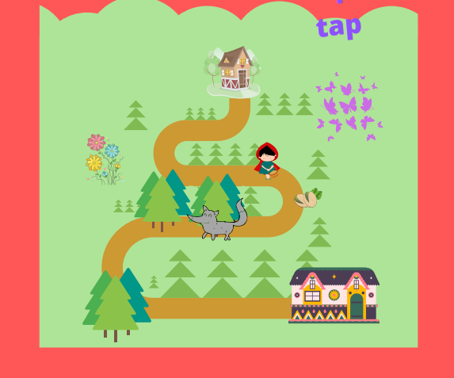

Slide 7
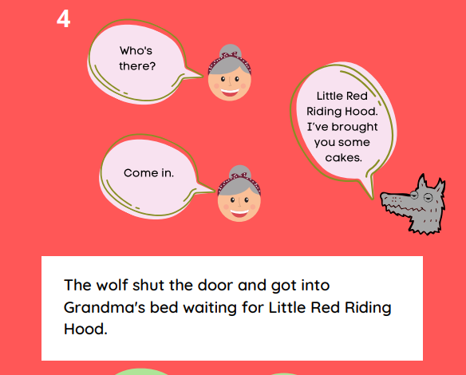

Slide 8
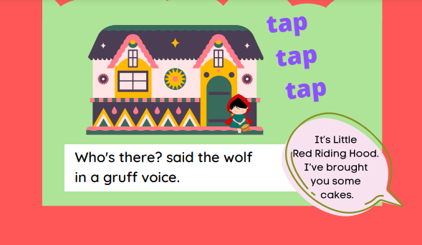

Slide 9
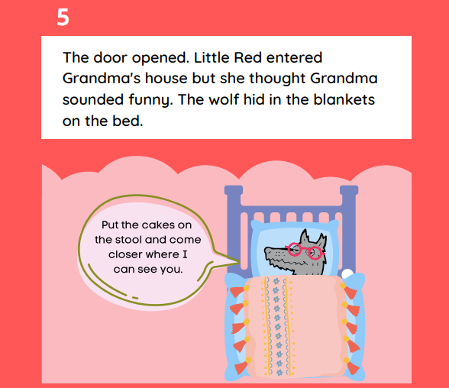

Slide 10
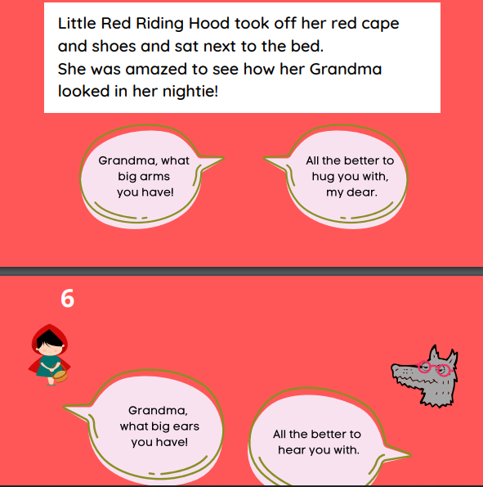
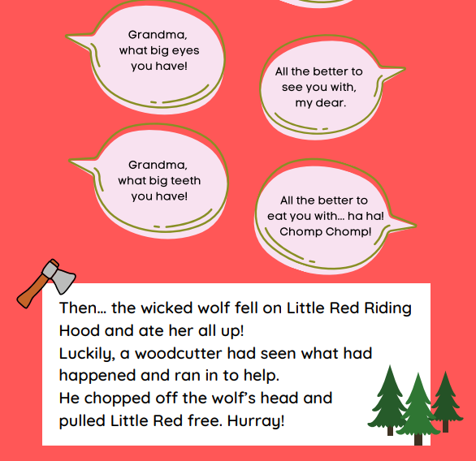

Slide 11
O
H
G
S
I
O
L
R
R
H

Slide 12
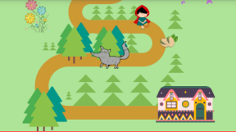
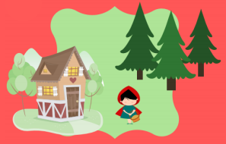
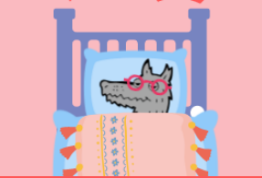
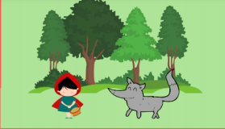
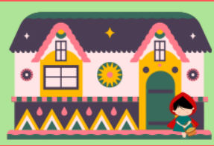

Slide 14
Little Red riding Hood
Wolf
The wolf is in grandma’s bed.

Slide 15
Little Red Riding Hood
Wolf
The wolf is in Grandma’s bed.

Slide 16
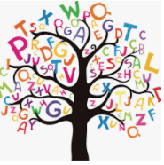
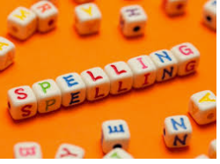



Words of the day!
she he me
Can you write the word she 5 times stocking your tongue out?
Can you write the word he 5 times as small as you can?
Can you write the word me 5 times as tall as you can?

