Slide 1



English
Year 2 Swallows Class
Thursday 7th January 2021

Slide 2
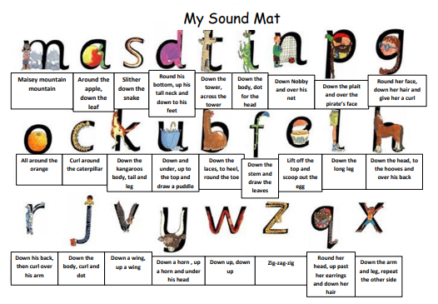

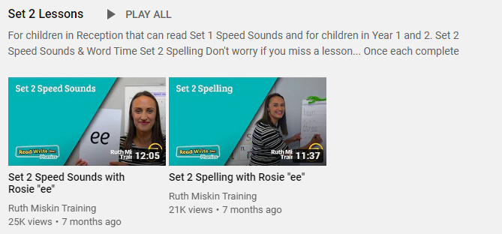
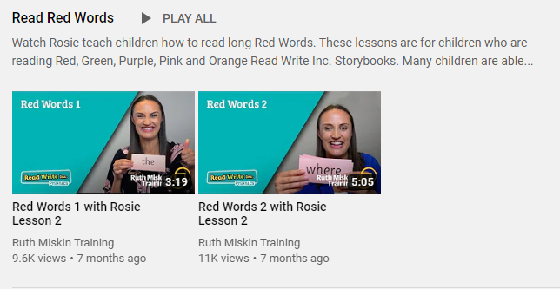
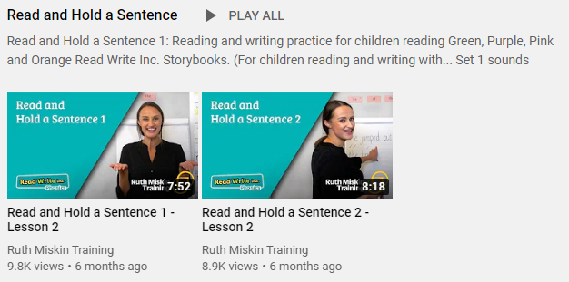
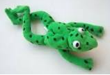
Read Write Inc
Set 2
If you are currently reading green books, please follow the link below to your Read Write Inc lesson today. Each day you will need to click on the video’s shown in the screen shots below. Please remember that although the screen shot says /ee/, the sound will change each day but will be found in the same place. https://www.youtube.com/channel/UCo7fbLgY2oA_cFCIg9GdxtQ
Video 1: Please watch ‘Set 2 Speed sound’ lesson.
Video 2: Please watch ‘Set 2 Spelling’ lesson.
Please complete all 4 video’s each day ☺
Video 3: Please watch ‘Red words 1’ lesson only.
Video 4: Please watch ‘Read and Hold a sentence 1’

Slide 3
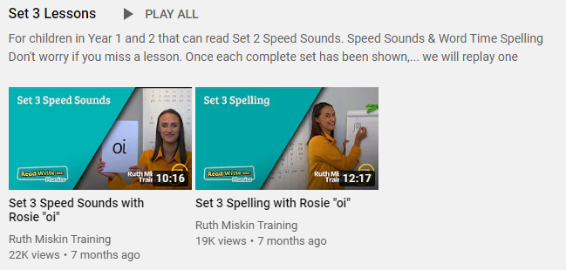
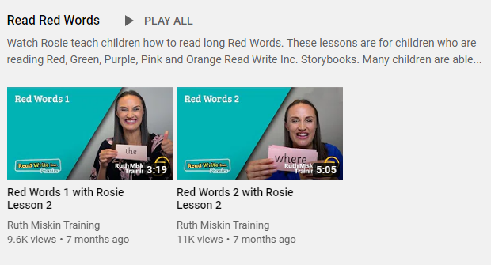
Set 3
If you are currently reading pink, orange, yellow, blue or grey books, please follow the links below to your Speed Sound lesson, red word focus lesson and hold a sentence activity for today. Each day you will need to click on the video’s shown in the screen shots below. Please remember that although the screen shot says /ee/, the sound will change each day but will be found in the same place. https://www.youtube.com/channel/UCo7fbLgY2oA_cFCIg9GdxtQ
Video 1: Please watch ‘Set 3 Speed sound’ lesson.
Video 2: Please watch ‘Set 3 Spelling’ lesson.
Video 3: Please watch ‘Red words 2’ lesson only.
Video 4: Please watch ‘Read and Hold a sentence 2’

Slide 4
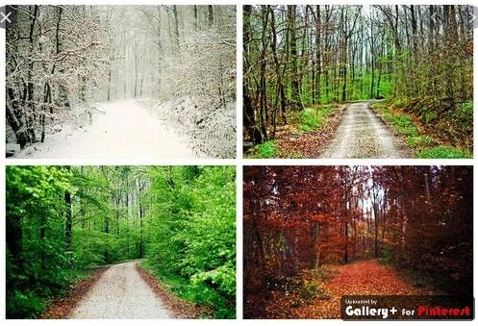
Writing
Can I describe the four seasons?
1
2
Can you explain what it is like in each season?

Slide 5

Task
Fold a piece of A4 paper into 4 sections. Label each box with the seasons: spring, summer, autumn, winter. Write 3 sentences in each box to explain what it is like in that season. What is the weather like? Is it warm or cold? Write about what happens to plants. Think about trees. What happens with animals and animal babies. Draw a picture which illustrates the season.
Write the name of the 4 seasons.
Spring
Summer
Draw a picture to illustrate to season.
Autumn
Winter
Draw lines to write on. This will keep your work smart.

Slide 6

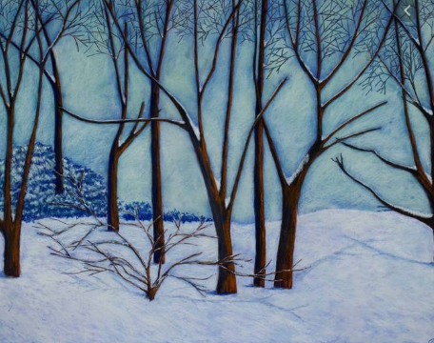
Winter
The weather is often cold and wet during the winter. The trees are bare and there are not very many colourful flowers growing. Animals hibernate because in winter time there is not much food to eat and it is very cold.

Slide 7

Mastery Keys
Plan or say out loud what is going to be written about
• Use punctuation correctly – full stops, capital letters
• Write expanded noun phrases to describe and specify
• Use subordination (because) and coordination (and)

Slide 8



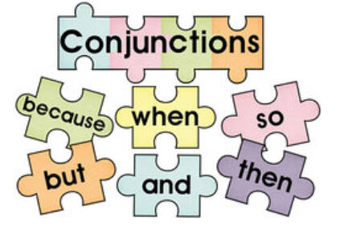
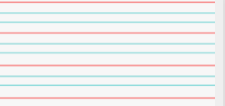
Can you re-read what you have written to check that it makes sense?
Joined handwriting
Adjectives
^

Slide 9


I wonder what will happen in our story today?
What was Jago pulling?
Why were the toads annoyed?
What were Alice and Jago both doing?
Which toad had the biggest and loudest voice?

Slide 10

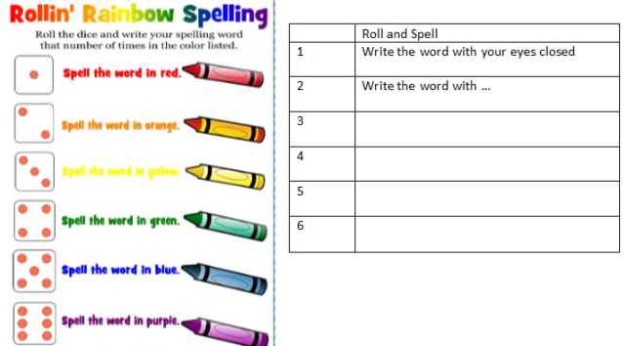
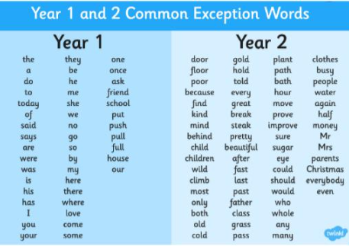
Spellings
Can you read and spell the words below?
fast last past father

