Slide 1




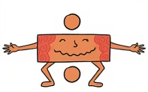


Maths
Year Two Swallows
Thursday 7th January 2021

Slide 2
4 A Day
50 + 22 = | 25 – 11 =
7 x 2 = | 40 ÷ 10 =

Slide 3
Answers
50 + 22 = 72 | 25 – 11 = 14
7 x 2 = 14 | 40 ÷ 10 = 4

Slide 4
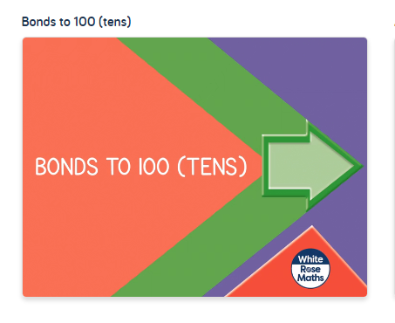
https://vimeo.com/463016488
Knkkkkkkkkkkkkkk kkVideo

Slide 5
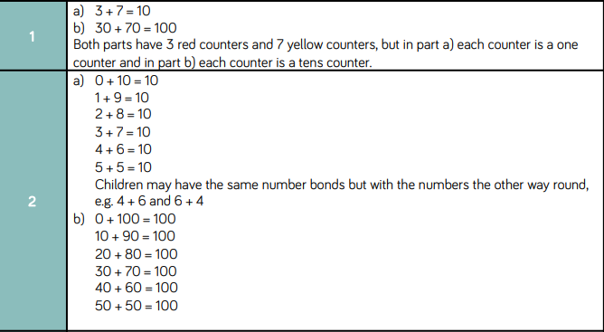
Answers

Slide 6
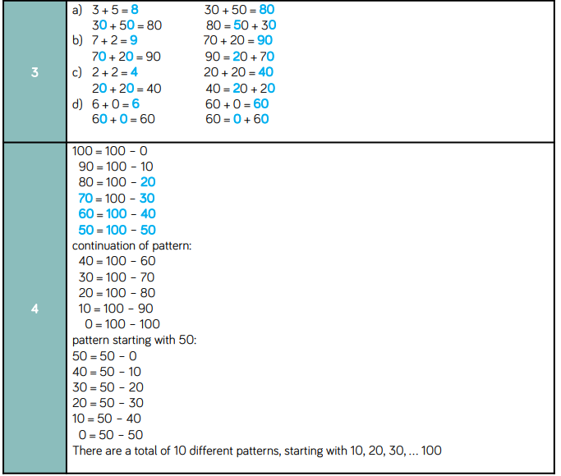
Answers

Slide 7
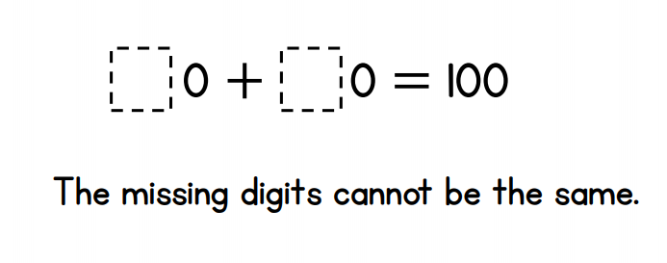
Challenge
True or False?

