Slide 1


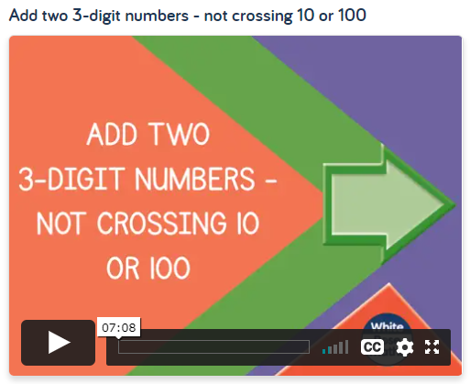
Thursday 7th January
Play this new times tables game I discovered yesterday. Focus on 6x and 9x tables
https://www.transum.org/software/Game/TablesConga.asp
Can I Add two 3-digit numbers not crossing 10 or 100?
https://whiterosemaths.com/homelearning/year-4/week-5/

Slide 2
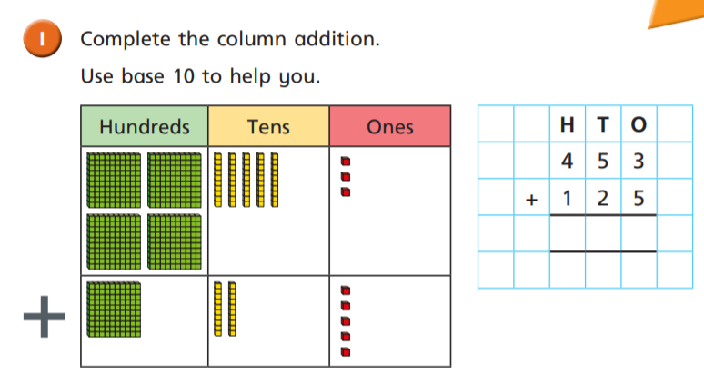

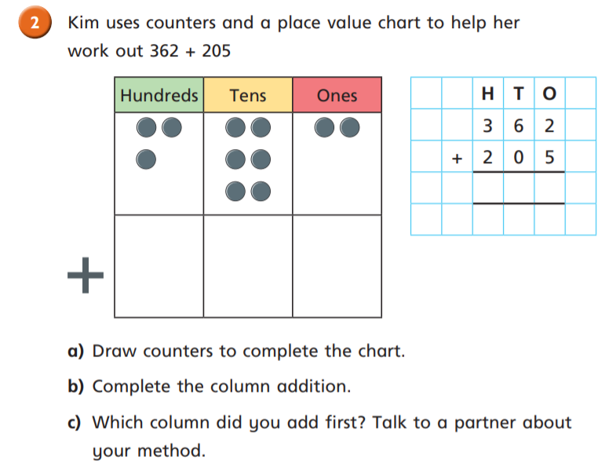

Slide 3
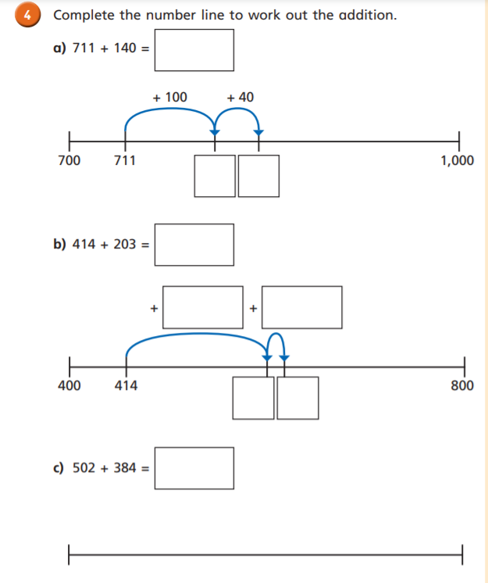

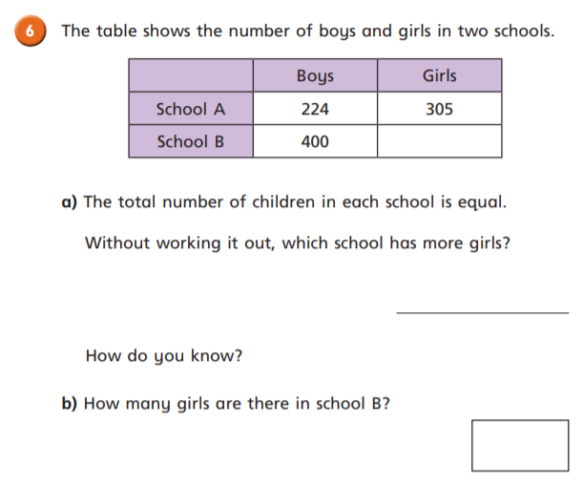

Slide 4
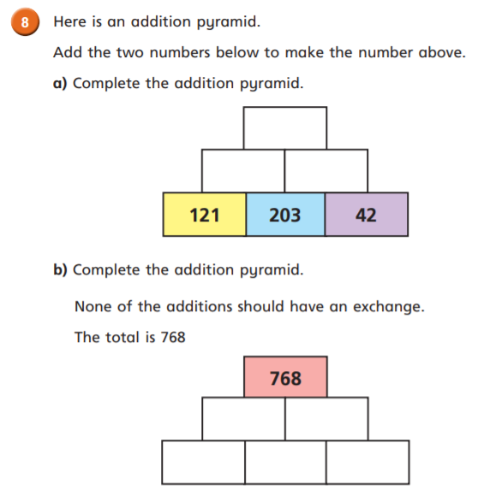
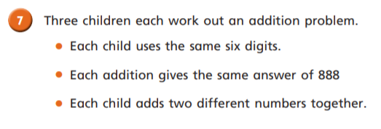
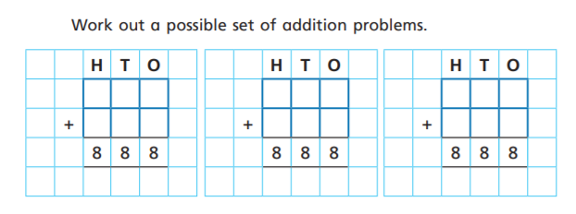
Challenge
Think first…. Which digits add together to make 8?
Jot this down first.

Slide 5
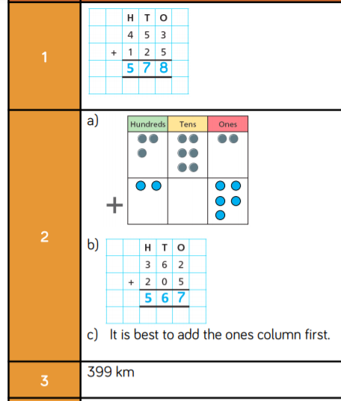
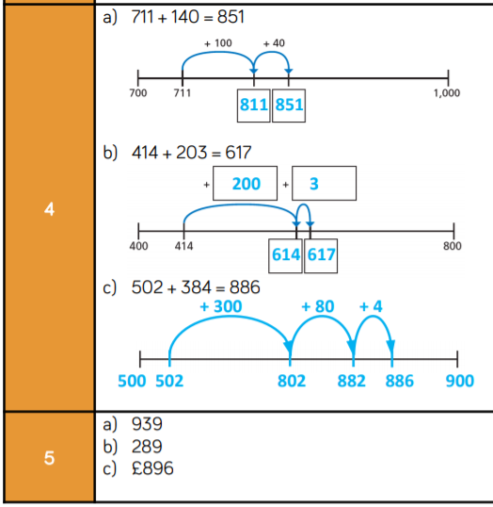
Answers

Slide 6
