Slide 1





English
Thursday 7th January 2021

Slide 2

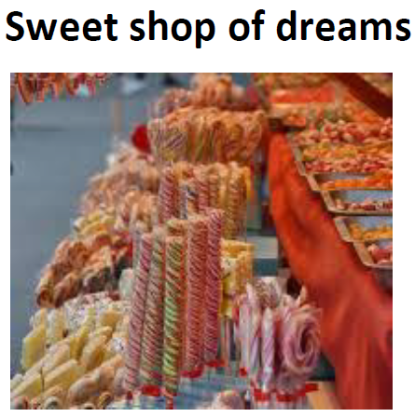
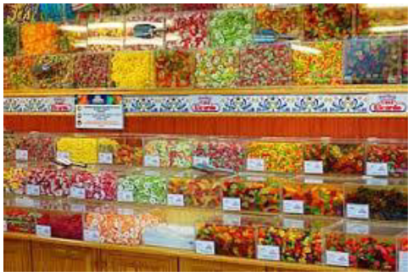
Imagine you have visited the most wonderful sweet and chocolate shop in the world. What would be on the shelves?
Design and draw 3 wonderful sweets or chocolates – consider shapes, sizes, colours and ingredients so that you have a variety.

Slide 3
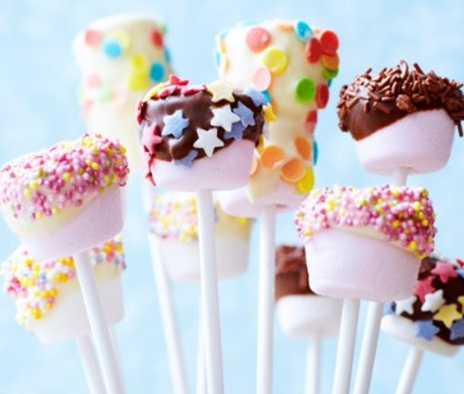
Once you have drawn 1 sweet/chocolate, label it with what is inside, what it is coated in, flavours, shape, size, ingredients. Can you think of a name for your sweet?
Then repeat for the other 2 sweets/chocolate.
Mallow pops
Brightly coloured discs of crispy puffed rice
Soft and creamy marshmallow
Crunchy star shaped sugar crystals
Thick, smooth chocolate coating
Popping candy

Slide 4
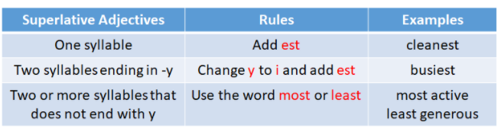
How to make your sweets sound like the best in the world!
Nice - nicest
Soft -softest
Hard -
Firm -
Smooth -
Tasty -tastiest
Creamy -creamiest
Crunchy -
Juicy -
Lovely -
Crispy -
Tangy -
Delicious – most delicious
Wonderful – most wonderful
Luxurious-
Delightful-
Exotic-
Gorgeous-
Complete each list of superlative adjectives.
Challenge: Can you think of 1 more superlative adjective for each list?

Slide 5
Create informative labels about the sweets explaining what is inside, what they are coated in, the flavours, the shape and size, the ingredients. Include the superlative adjectives.
Your job is to make people want to eat your sweets/chocolate.
Mrs Evans’ model:
With the softest creamy insides, Mallow Pops will melt in your mouth. These most delightful treats are coated in a range of the most luxurious dark, white and milk chocolate. Mallow Pops have the tastiest toppings including crispy puffed rice, the crunchiest star shaped sugar crystals and most explosively, a mouthful of popping candy.
Does my description make you want to eat my Mallow Pops?

