Slide 1

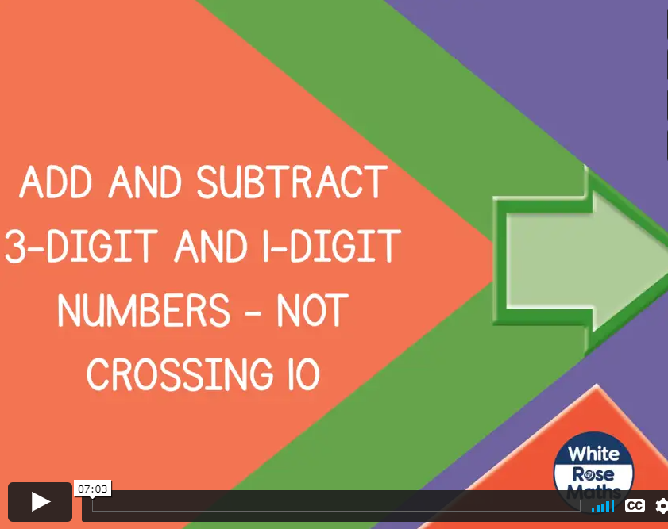
Thursday 7th January 2021
Today let’s look at how to add and subtract ones with 3 digit numbers.

Slide 2
Please watch this little video clip from lesson 3 that explains how we do this, then we can look at some further examples together.
We have covered this in class together so you will be able to show your families how to add 3 digit numbers!
Click on this link and I’ll talk to you again on the next slide after the video.
https://vimeo.com/459319169 (Y3 Autumn wk 4 lesson 3)

Slide 3
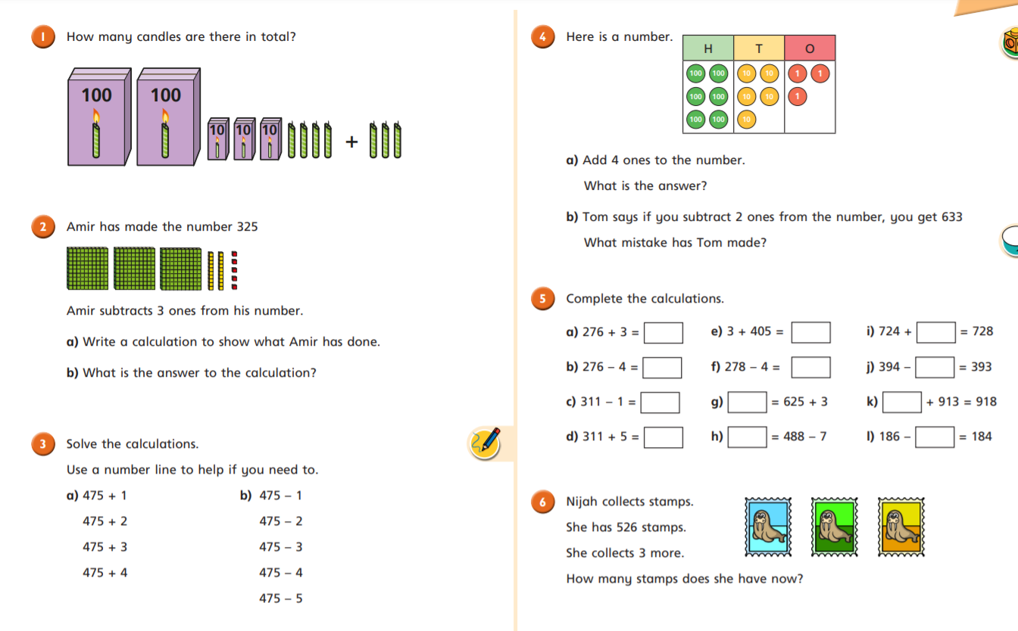

Slide 4
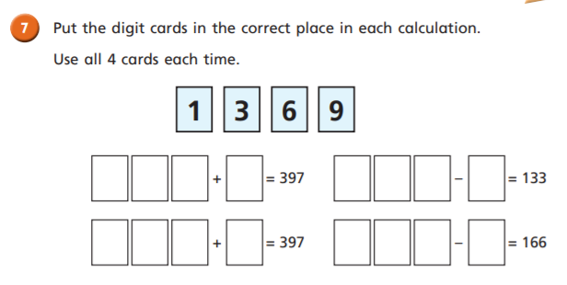
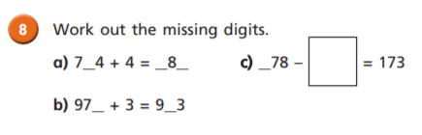
Challenge Time

Slide 5
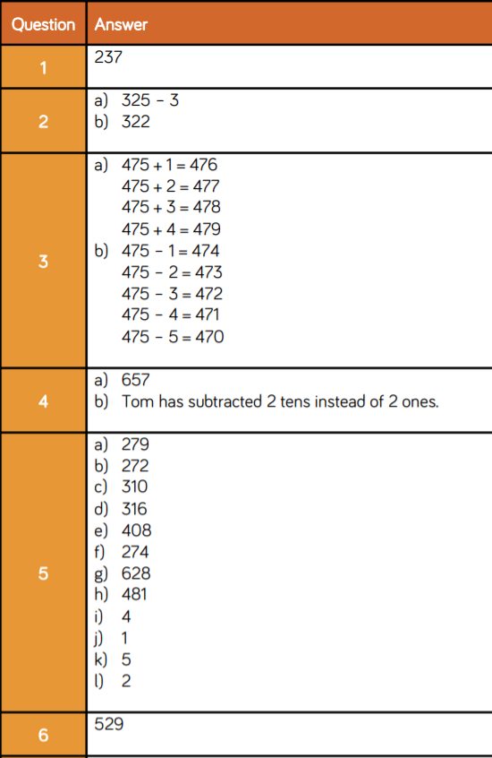
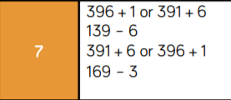
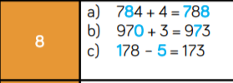
Here are the answers for you to check your work:

