Slide 1





Thursday 7th January 2021
Writing

Slide 2
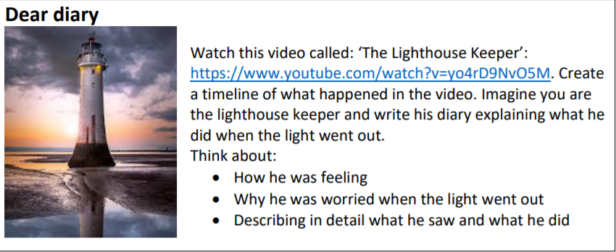
https://www.youtube.com/watch?v=yo4rD9NvO5M

Slide 3
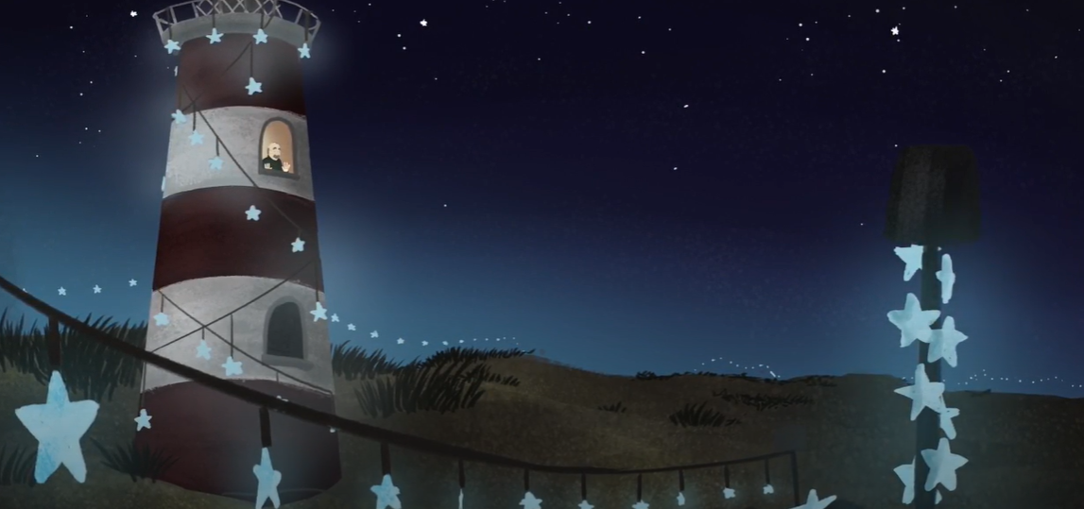
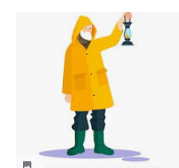
Vocabulary Mat
Anxious Relieved
Worried Busy
Nervous Determined
Confused Patient
Lonely Creative
Gloomy Intelligent
Hard working/ industrious
Perseverence

Slide 4
My Turn:
My heart sank with disappointment and fear when the light in my wonderful light house went out. How was I going to be able to keep the boats safe? I was anxious, worried and overwhelmed. Immediately, I went out into the darkness for a walk to think about how to solve this, walking always helps me to come up with a plan.
Moments later, as I was walking along the shore in the light of the moon with my lantern swinging in my hand, I noticed a beautiful blue star fish shimmering in the night’s sky. Carefully, I held it in my hand to take a closer look. It sparkled like one thousand stars. How pretty it was! This was the solution to my dilemma. Soon after, I was back in my shed, putting my plan into action. I worked tirelessly through the night, using my tools to make alternative lighting for the boats.

Slide 5
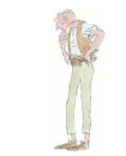


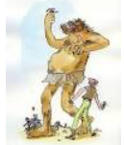
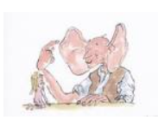
Story Time
The BFG by Roald Dahl

