Slide 1


Thursday 7th January
Writing

Slide 2
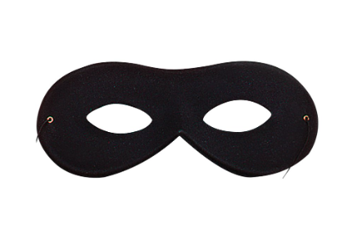
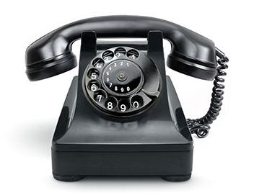
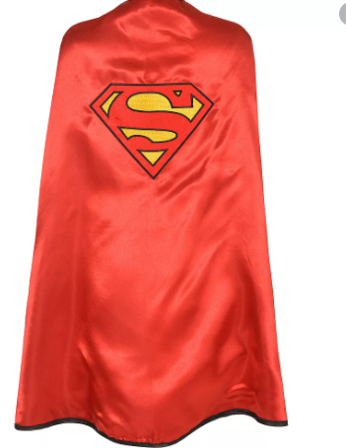

Who would use such items?
Why is there a mask?
Which superheroes do you know?

Slide 3
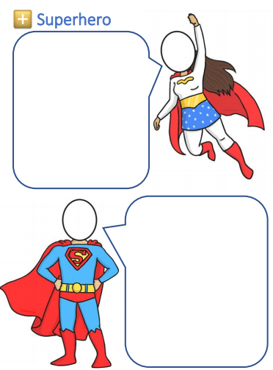
Think of a name….
Here are some words to help you
Captain…
The Mighty…
The amazing…
The incredible…
Super…
Introduce yourself…
Hi my name is The Amazing Mrs Campion.

Slide 4
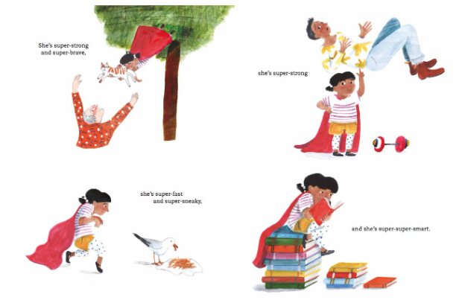
Questions to discuss
Who is Juniper Jupiter? How do you know?
What super powers does she have? How do you know?
Do you think that people know that Juniper Jupiter is a superhero? Why?
Have you got a favourite superhero? Why?

Slide 5
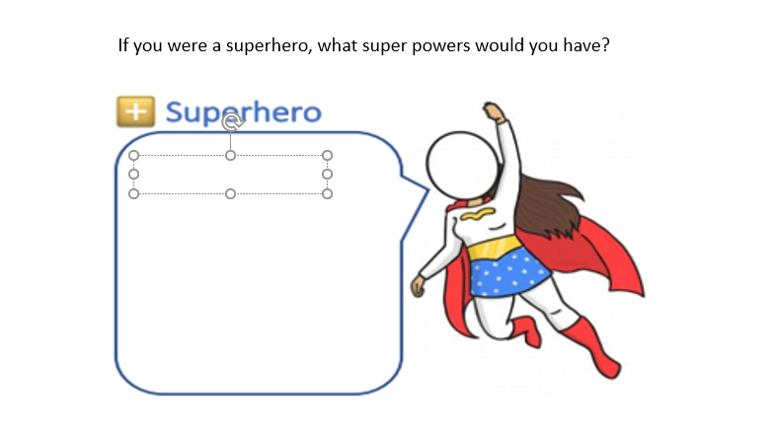
Notes:
Hi my name is The Amazing Mrs Campion. I am super strong, super kind and super helpful.

Slide 6
Now it is your turn to write!

