Slide 1

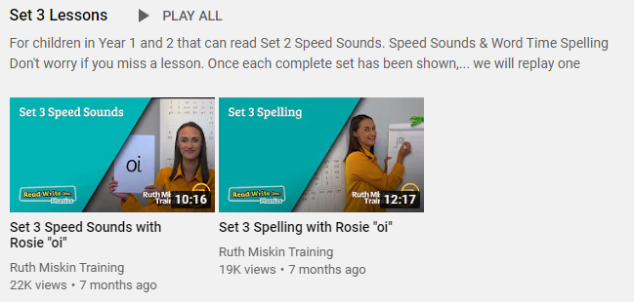
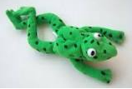

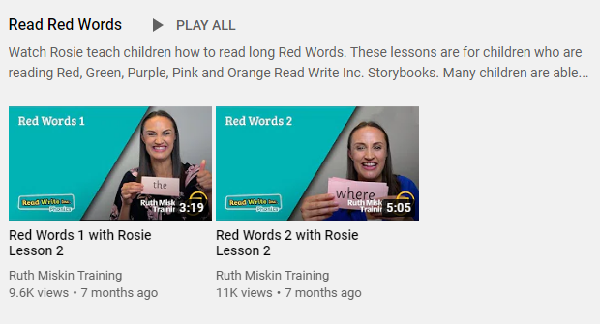
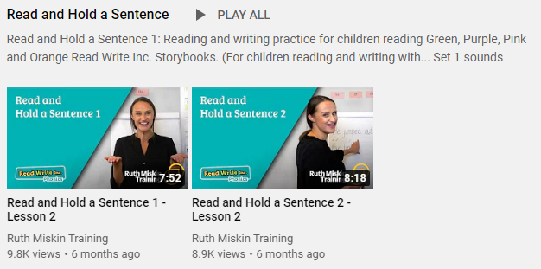

Set 3
If you are currently reading pink, orange, yellow, blue or grey books, please follow the links below to your Speed Sound lesson, red word focus lesson and hold a sentence activity for today. Each day you will need to click on the video’s shown in the screen shots below. Please remember that although the screen shot says /ee/, the sound will change each day but will be found in the same place. https://www.youtube.com/channel/UCo7fbLgY2oA_cFCIg9GdxtQ
Video 1: Please watch ‘Set 3 Speed sound’ lesson.
Video 2: Please watch ‘Set 3 Spelling’ lesson.
Video 3: Please watch ‘Red words 2’ lesson only.
Video 4: Please watch ‘Read and Hold a sentence 2’

