Slide 1


Starlings English Home Learning
Wednesday 6th January
Message for parents to accompany these slides:

Slide 2

For red, green and pink groups, click the link here to access the RWI videos of today’s new sound.
Reading
Spelling
For yellow and blue groups, click the link here to access the RWI videos of today’s new sound.
Reading
Spelling

Slide 3

For red, green and pink groups, click the link here to access the RWI video of today’s new sound.
Red Words
For yellow and blue groups, click the link here to access the RWI video of today’s new sound.
Red words

Slide 4

For red, green and pink groups, click the link here to access the RWI video of today’s new sound.
Hold a sentence
For yellow and blue groups, click the link here to access the RWI video of today’s new sound.
Hold A sentence

Slide 5


Today we are learning to retell the story of Little Red Riding Hood.
That means we will
Listen to the story of Little Red Riding Hood
Talk about what we like about the story, what our favourite parts of the story are and what characters we know from the story
Re-tell the story in our own words using pictures to help us.

Slide 6


Slide 7
Key questions
Did you like the story?
What happened in the story?
Who were the characters in the story?
What was your favourite part of the story?

Slide 8
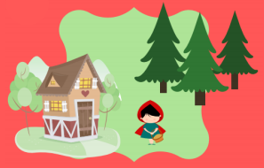
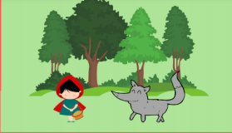
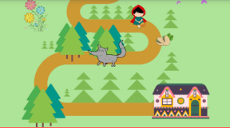

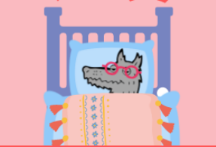

Slide 9
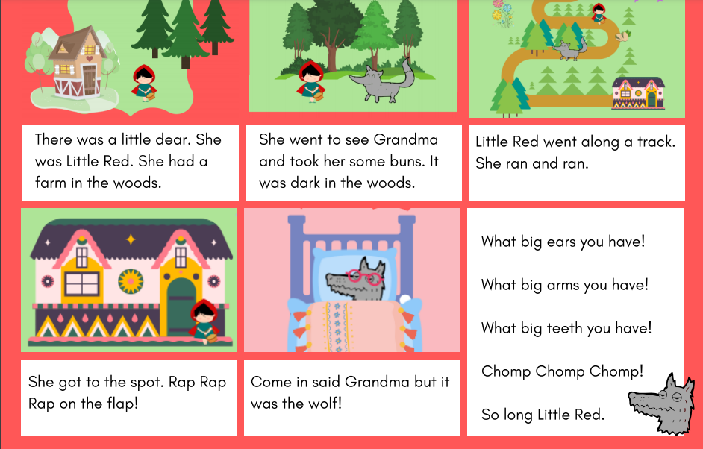

Slide 10

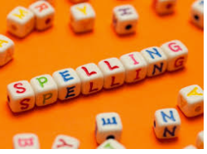



Words of the day!
his her our
Can you write the word his 10 times in your prettiest writing?
Can you write the word her 10 times with your eyes closed?
Can you write the word our 10 times using your other hand?

