Slide 1

Wednesday 6th January
Maths

Slide 2


Slide 3


Slide 4


Slide 5


Slide 6


Slide 7
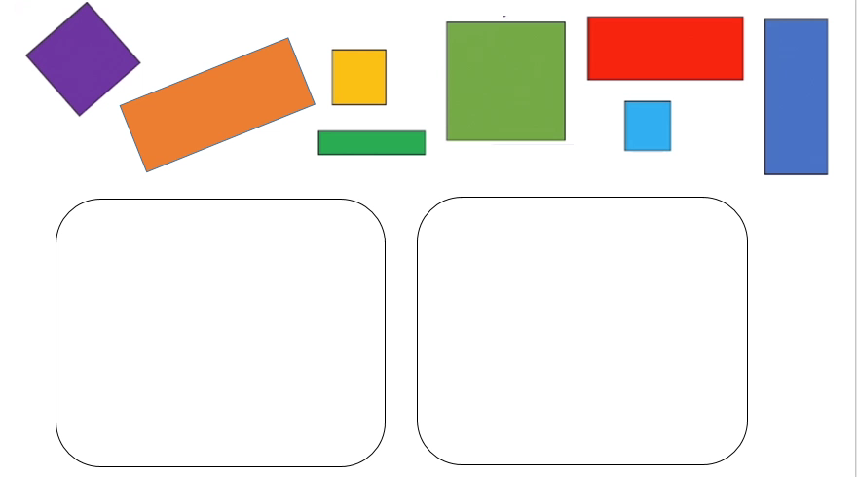








Slide 8




Slide 9

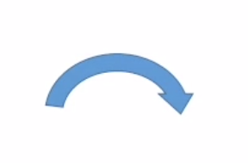


Slide 10
Now it is your turn…
Notes:
Collect shapes from around the house and have a go at sorting them.
Have a look at how many sides your shape has?
Do they have sides which are all the same length
Or are the sides different lengths.
See how many different ways you can sort
Enjoy exploring and sorting your shapes.

