Slide 1
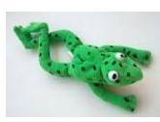



RWI Phonics
Set 1
If you are in Group 1B,1C and Red group for Phonics please use the following links for your RWI lessons.
Set 1 Phonics links:
Speed sounds: https://youtu.be/IwPebovohlo
Word time: https://youtu.be/GTsh3Masha4
Spelling: https://youtu.be/RNb8J97aBSM
Set 3
If you are in Blue group for Phonics please use the following links for our RWI lessons.
Set 3 Phonics links:
Speed sounds: https://youtu.be/oLLG-1JGNPQ
Spelling: https://youtu.be/J7aha_HAjoM
Hold a sentence: https://youtu.be/acQoGcwN9WM

