Slide 1


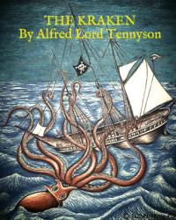


English
DATE
The Kraken
by Alfred Lord Tennyson

Slide 2

Practice reading the poem below. You can click here too to listen to me it reading it you!
The Kraken
Below the thunders of the upper deep,
Far, far beneath in the abysmal sea,
His ancient, dreamless, uninvaded sleep
The Kraken sleepeth: faintest sunlights flee
About his shadowy sides; above him swell
Huge sponges of millennial growth and height;
And far away into the sickly light,
From many a wondrous grot and secret cell
Unnumbered and enormous polypi
Winnow with giant arms the slumbering green.
There hath he lain for ages, and will lie
Battening upon huge sea worms in his sleep,
Until the latter fire shall heat the deep;
Then once by man and angels to be seen,
In roaring he shall rise and on the surface die.
by Alfred Lord Tennyson

Slide 3
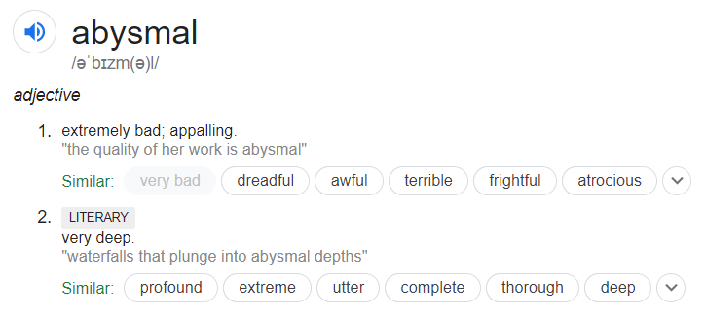

Activity 1
Highlight any words you don’t know. Use a dictionary to look them up or discuss them with an adult. Click here to access the online dictionary https://www.dictionary.com/
Draw an image to go alongside the new word that you have learned to help you remember the definition.

Slide 4
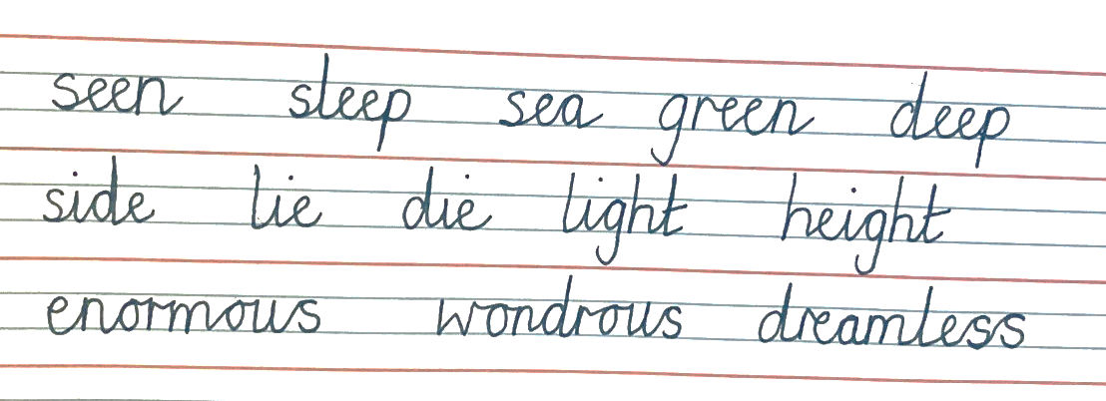
Activity 2
Practise your handwriting by copying out several lines of the poem as neatly as you can using a joined style. Try to choose a good pen and ensure you are sitting correctly at a table to do this. Warm up by practising with these joins:
Please share any examples of your handwriting with me on our class discussion page! ☺

Slide 5
War Poetry
Please enjoy listening to Mrs Whittingham read 'In Flanders Fields' by John McCrae

