Slide 1


English
Date: 06.01.21
‘Pleasant Sounds’ by John Clare
Lesson 1
Vocabulary – Dictionary Work

Slide 2

Read the poem below or click the sound button to hear it being read to you:
Pleasant Sounds
The rustling of leaves under the feet in woods and under hedges;
The crumpling of cat-ice and snow down wood-rides, narrow lanes, and every street causeway;
Rustling through a wood or rather rushing, while the wind halloos in the oak-top like thunder;
The rustle of birds’ wings startled from their nests or flying unseen into the bushes;
The whizzing of larger birds overhead in a wood, such as crows, puddocks, buzzards;
The trample of robins and woodlarks on the brown leaves, and the patter of squirrels on the green moss;
The fall of an acorn on the ground, the pattering of nuts on the hazel branches as they fall from ripeness;
The flirt of the ground lark's wing from the stubbles - how sweet such pictures on dewy mornings, when the dew flashes from its brown feathers.
by John Clare

Slide 3
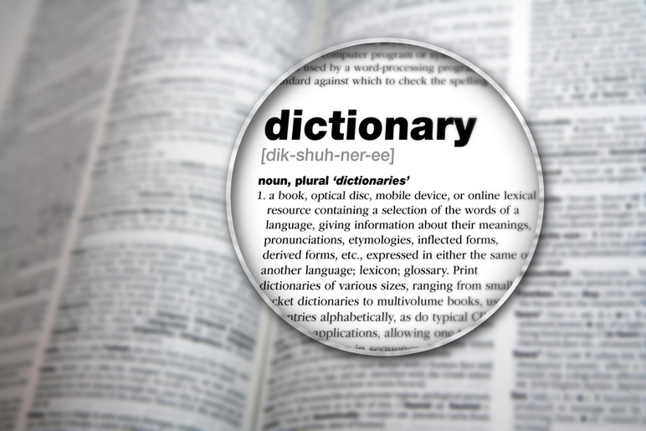
Activity 1
Read the poem again and make a list of any words you don’t know.
Then use a dictionary or the internet to look up the definitions.
Jot down these words and their definitions
Challenge: Can you use these words in a sentence?
Click on the sound button to hear activity 1 explained to you.

Slide 4
Activity 2
Can you remember what a synonym is?
Click on the sound button to hear activity 2 explained to you.
Synonyms are words that have similar meanings. For example, unhappy and sorrowful are synonyms for sad. These words all mean the same thing.
Can you think of any other synonyms for sad?
Task: Find synonyms for the following words.
startled | crumpling | trampling | patter
https://www.thesaurus.com/ - This is a great website you could use to help you.

Slide 5
Click on the sound button to hear the possible answers read to you.
Activity 2 – Possible Answers
There are lots of possible synonyms that you could have used. Here are just some examples:
startled | crumpling | trampling | patter
Scared | Crushing | Crushing | Tap
Shocked | Scrunching | Flattening | Clatter
Stunned | Creasing | Run over | Beat
Spooked | Crinkling | Squashing | Pitter-patter
Surprised | Collapsing | Stomping | Drum

Slide 6
