Slide 1





English

Slide 2

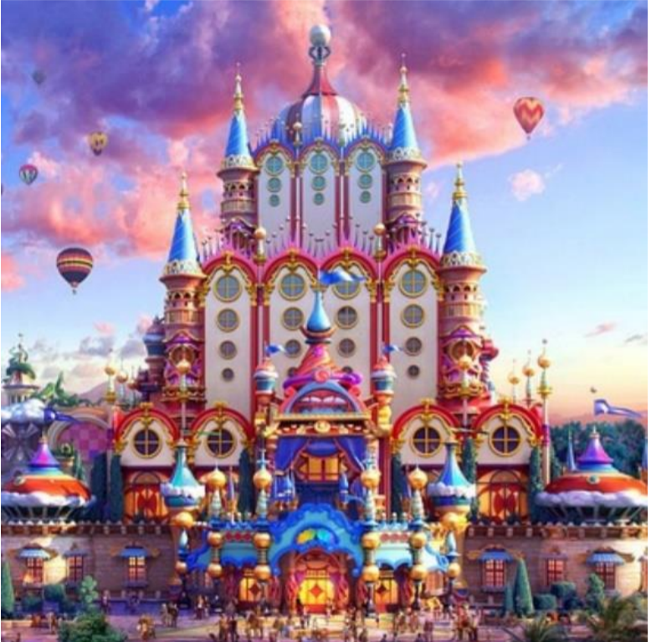
Wednesday 6th January
Thinking or talking task:
Look at the image. What do you think this place is?
A museum of delightful things, a factory, a hot-air balloon station or something else?
If you were approaching this building, what could you see?

Slide 3
Use your senses create your own noun phrases:
Creating ideas task
See
-brightly coloured balloons floating in the sky
-small, round windows set into the white walls
-
-
-
Hear
-excited crowds of people gathered in front of the building
-
-
-
You could use an online thesaurus to help https://www.collinsdictionary.com/dictionary/english-thesaurus

Slide 4
Use your senses create your own noun phrases:
Creating ideas task
See
-brightly coloured balloons floating in the sky
-small, round windows set into the white walls
- clouds like multi-coloured candyfloss sweeping across the sky
-a dome shaped roof high up in the unusually shaped building
-warm lights welcoming people inside
Hear
-excited crowds of people gathered in front of the building
-the distant whoosh of hot air inflating the balloons
-machinery clinking and clanging
-a low sounding drumming noise repeating over and over

Slide 5
Write a description that tells your reader about the approach, the sights and sounds, what is in front of you, above you, in the sky? Think about how you will divide the description into paragraphs.
Think carefully about vocabulary you can use and the ideas you have already had for your noun phrases.
Mrs Evans’ model
As I approached the unusually shaped building standing under the multi-coloured candyfloss clouds, I was mesmerised by the by the huge domes that reached up high into the sky.
All around me was the sound of excited chatter as people were drawn in by the warm welcoming lights that shone through the circular windows. It took me a few seconds to understand that the soft whooshing noise was coming from the brightly coloured balloons floating above my head.

