Slide 1
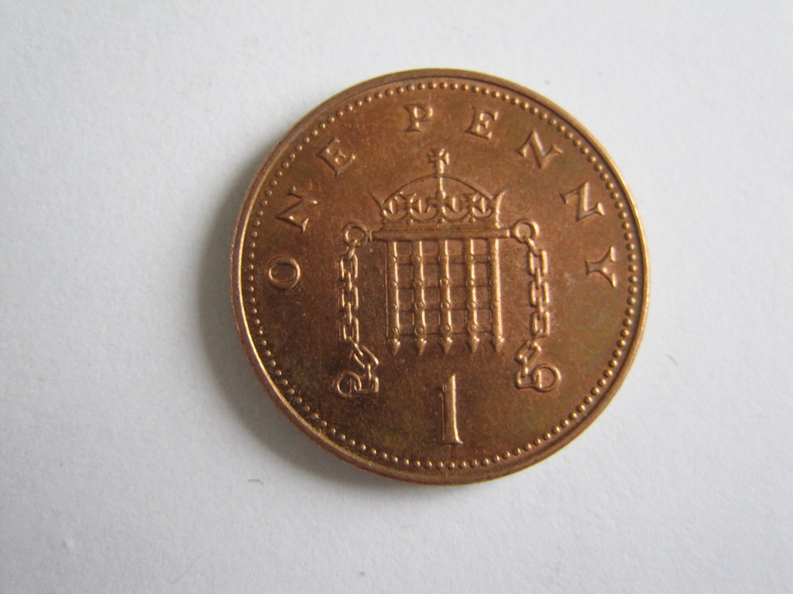
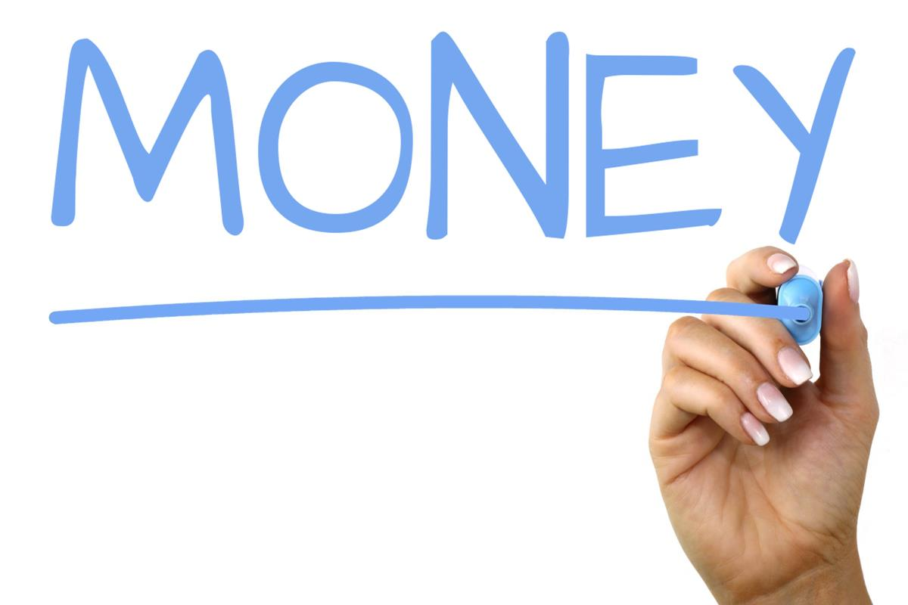
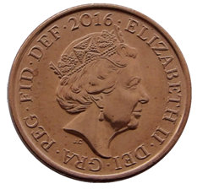


DAY ONE
Morning Starlings! Welcome to day one of our maths learning at home. Over the next week we are going to learn all about money! Today we are going to focus on 1ps so that we understand a single coin can be worth the same as several pennies.
You are going to have to ask your grown up (very kindly) if you can borrow some real coins.
You will need some 1p (pennies) coins.

Slide 2
Have a look at 1 pence (also called a penny – pence is the plural form) coin. This is the smallest unit of money used in the United Kingdom.
Look at a few 1p coins and see if you can spot things that are the same (size, picture of Queen, colour) and things that are different (pictures on the back, date). Did you know that although the coins may have different pictures they all have the same value of 1p?
We call the sides of the coins either ‘heads’ or ‘tails’. Why do you think this is? Can you play a guessing game with someone and toss the coin and see if it lands on ‘heads’ or ‘tails’?
Your next job is to pick up some 1ps together and lay them in front of you and count the value – keep on changing the amount of pennies.
Can you line up 5 x 1p coins (5p) and below 10 x 1p (10p) coins – what do you notice about the length of the lines?

Slide 3
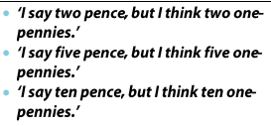
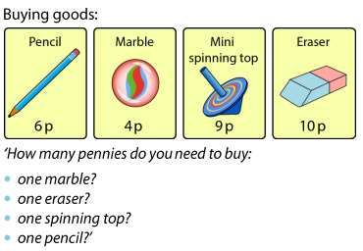
We are going to play a shopping game (only using 1p coins). I need you to understand that a single coin can worth the same as several pennies. So make sure you count your 1ps out when you buy your objects from the shop. It might help you to say this out loud:
How many pennies do you need to buy a pencil and an eraser?
Can you think of your own questions?

Slide 4
