Slide 1




Wednesday 6th January 2021
Writing

Slide 2
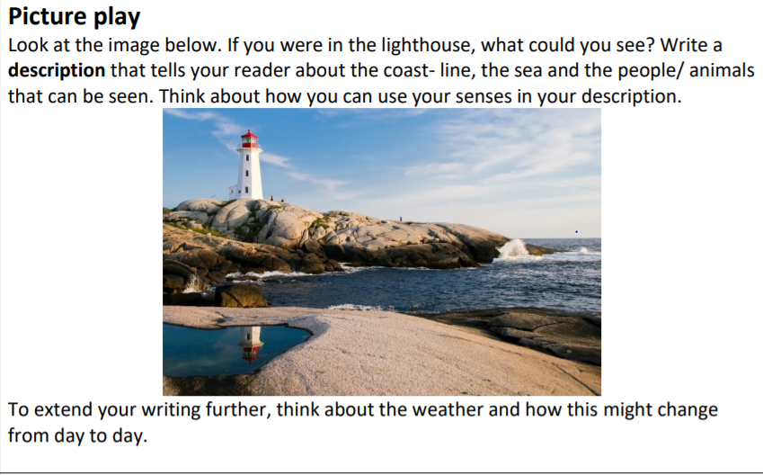

A Lighthouse Description

Slide 3
Think about our Mastery Keys
Noun phrases (describe a noun using adjectives eg the elegant, white lighthouse.)
Adverbs, these tell us how a verb is done and often end in ‘ly’.
Eg The waves rocked gently against the sharp, jagged rocks.
Adverbial phrases of time:
Eg A few moments later, immediately, soon after, as soon as I arrived…
Adverbial phrases of place:
Eg At the top of the cliff, against the shore, underneath the waves

Slide 4
My Turn
As I approached the window of the tall, white lighthouse that stood proudly at the top of the cliff, I noticed the wind was stirring the waves. Moments later, the sea was beginning to gather itself into mountainous waves. The white crests on the top of each wave, hit the sand powerfully, roaring as they did so. Suddenly, the noise of the rumbling ocean spraying against the windows of my lighthouse became deafening. The glass in front of me rocked as each wave exploded on it.
Below the surface of the water, a family of seals were enjoying the stormy waters. Together they twisted, corkscrewed and glided underneath the sea, staying close to each other for safety. Children were zipping their coats up as the ran along the sea front enjoying the wind buffeting them on their way.

Slide 5
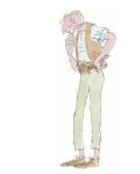
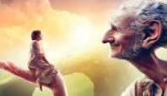

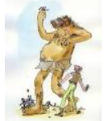
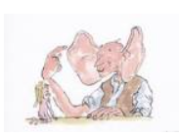
Story Time
The BFG by Roald Dahl
1
2

