Slide 1

Wednesday 6th January 2021
Today let’s look at how to add and subtract multiples of 100.

Slide 2

Please watch this little video clip from lesson 1 that explains how we do this, then we can look at some further examples together.
We have covered this in class together so you will be able to show your families how to add 3 digit numbers!
Click on this link and I’ll talk to you again on the next slide after the video.
https://whiterosemaths.com/homelearning/year-3/week-4/

Slide 3
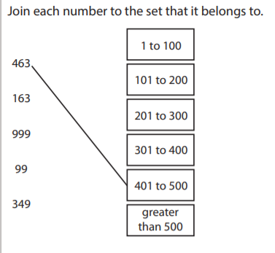
Now try these ones:
1. 500 + - - - = 1000
2. 1000 – 500 = - - -
3. - - - + 600 = 800
4. 1000 - ? = 100
5. 700 + --- = 900

Slide 4
Here are the answers:
1. 500
2. 500
3. 200
4. 900
5. 200

Slide 5
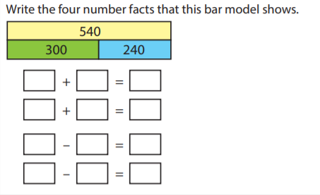
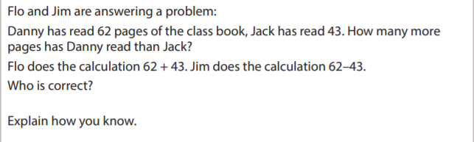
Challenge Time

Slide 6
Here are the answers, the bar model number sentences:
300 + 240 = 540
240 + 300 = 540
540 – 300 = 240
540 – 240 = 300
Jim is correct, you work this out by 62 – 43 as that will tell you the difference between these two numbers. Danny has read 19 more pages.

