Slide 1
‘Meet the Teacher’
Parent’s Evening
Reception / EYFS Class
2022-23

Slide 2
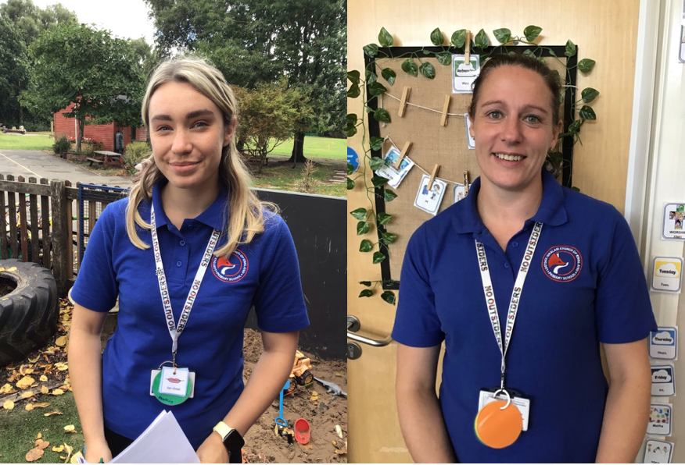
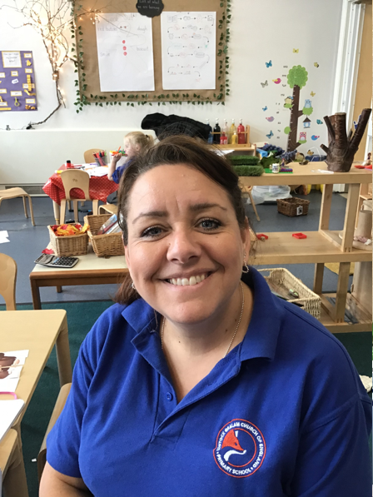
Who We Are – How to get in touch:
Who we are – Miss Dalby, Mrs Rathbone and Mrs Hoskins
Communication : Website or Weekly Blogs/ Newsletter
Communication from you:
In the morning, at the gate (if you have an urgent query) and in the afternoon, I am available for a longer chat.
Via email or call to the office who will alert myself throughout the day.
Class dojo for homework, direct messaging and sharing your lovely weekend adventures with us!
Reading diaries

Slide 3
General Organisation
School Uniform
• Dark grey skirt, pinafore dress, dark grey trousers
• Royal blue or white polo t-shirt (available with school logo) or plain white school blouse or shirt.
• Royal blue sweatshirt, jumper or cardigan (available with school logo).
• Plain, black, grey or white socks/tights
• Flat black shoes that the child can fasten or tie independently
• For the summer months - pale blue and white gingham style checked dress or dark grey school shorts/trousers
• Long hair to be tied back using plain black/blue hair bands
Snack – healthy snack for the morning, we have cereal, fruit and milk is provided free to children under 5.
Water bottle – everyone needs to bring a water bottle into school with water only.
Bags (School provided blue bookbags)
Forest School / EYFS Outdoor Learning
Wellies
Overalls/ Waterproof coats
Gloves (mittens preferably!)

Slide 4
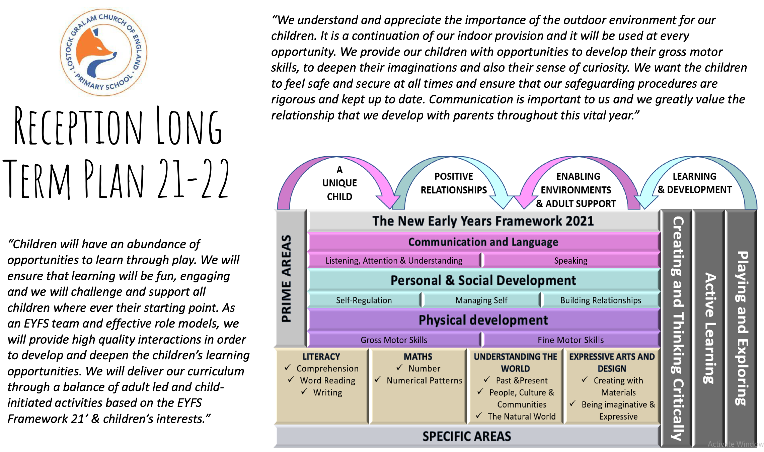
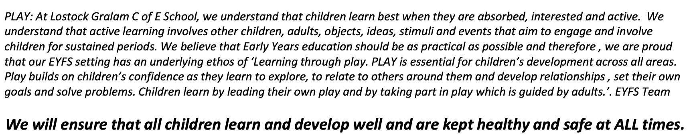
Overarching principles
22/23
Characteristics of Effective Learning

Slide 5
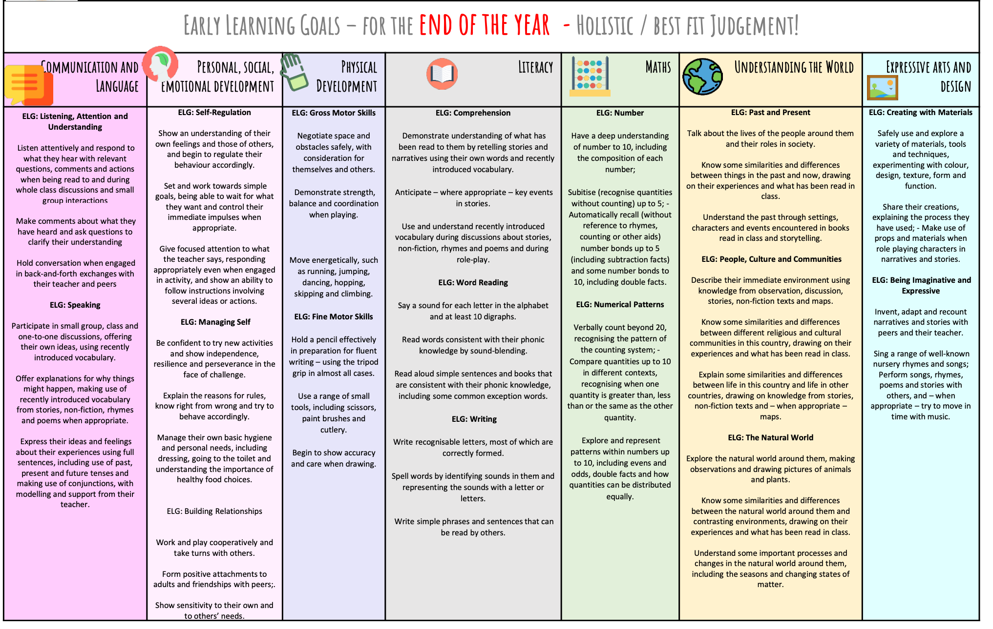
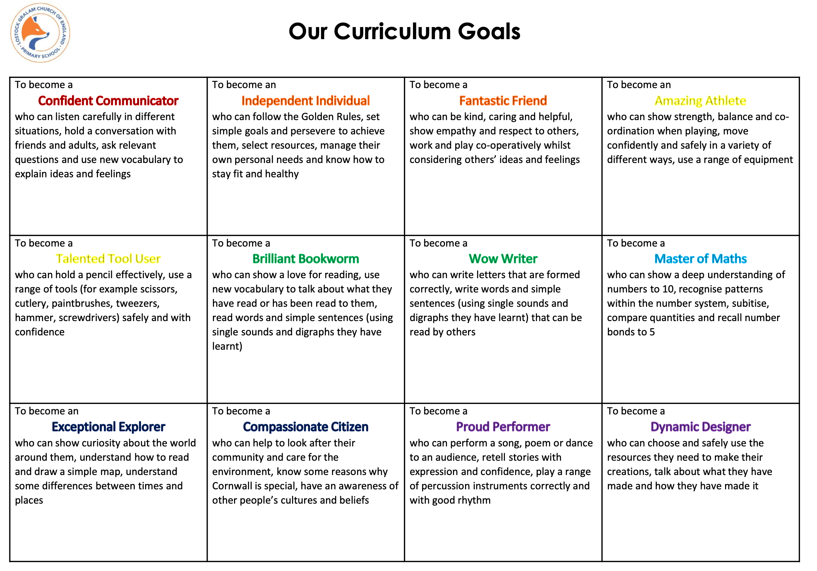

Slide 6
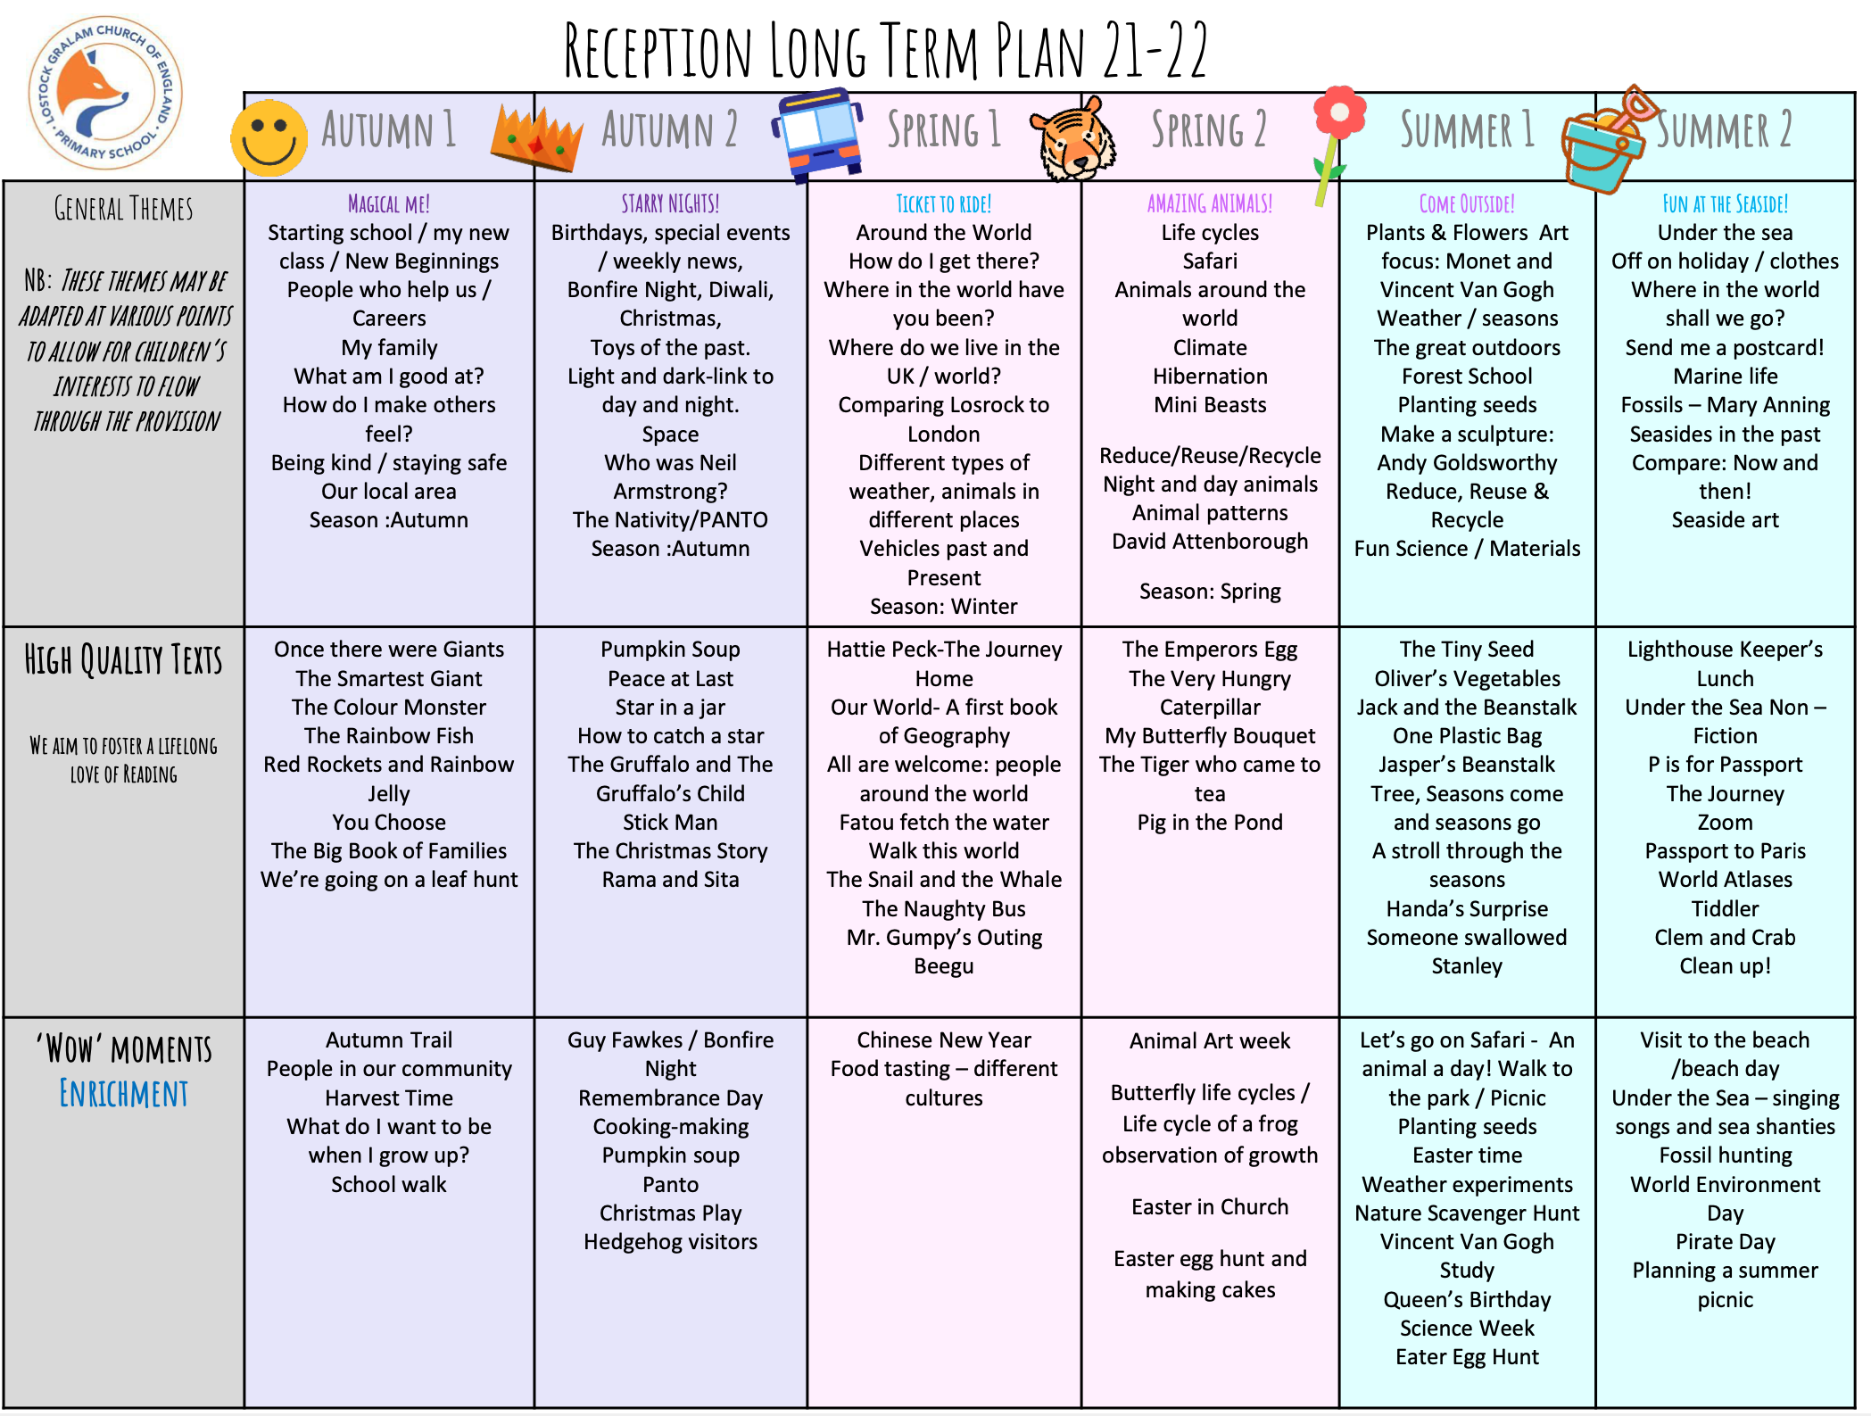
Reception Long Term Plan
Notes:
Put your theme for the year on this slide.

Slide 7
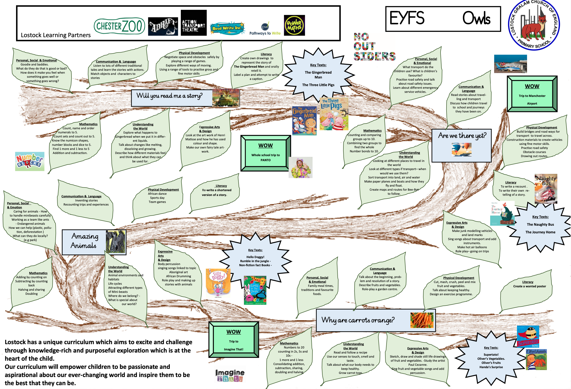
Notes:
Do I need this? Outdated?

Slide 8
Reception Visits & Experiences
Autumn term – Autumn Walk in Our Local Area, The Hedgehog Visit (October 2022) and Whole School Trip to the Pantomime (13th December)
Spring Term – Delamere Forest (February 2023) and Creepy Crawly Show (March 2023)
Summer Term – Imagine That - July 4th 2023
The above trips are provisional at this time due to the nature of Early Years, the trips may be subject to change according to the interests displayed by the children when exploring each topic. You will be updated closer to the time of any changes.

Slide 9
Reception Week Timetable
 | Monday | Tuesday | Wednesday | Thursday | Friday
8:45 - 9:00 | Rainbow challenge/ Register | Rainbow challenge/ Register | Rainbow challenge/ Register | Rainbow challenge/ Register | Rainbow challenge/ Register
9:00 - 9:30 | Phonics | Phonics | Phonics | Phonics | Phonics
9:30 - 10:00 | Literacy | Literacy / Busy time | Literacy / Busy time | Literacy / Busy time | Literacy / Busy time
10:00 - 11:10 | PE | Busy time / Lit Group 1 | Busy time / Lit Group 2 | Busy time / Lit Group 3 | Busy time / Lit Group 4
11:10 - 11:20 | Story / Disco Get ready for lunch | Story / Disco Get ready for lunch | Story / Disco Get ready for lunch | Story / Disco Get ready for lunch | Story / Disco Get ready for lunch
11:20 - 11:30 | Get ready for lunch | Get ready for lunch | Get ready for lunch | Get ready for lunch | Get ready for lunch
11:30 -12:45 | L U N C H | L U N C H | L U N C H | L U N C H | L U N C H
12:45 - 13:00 | Register / Zen zone | Register / Zen zone | Register / Zen zone | Register / Zen zone | Register / Zen zone
13:00 - 13:20 | Maths / Busy time Tidy up | Maths / Busy time | PE Tidy up | Maths / Busy time Tidy up | Maths / Busy time Tidy up
13:20 - 14:00 | Busy time / Maths Group 1 |  |  | Busy time / Maths Group 3 | Busy time / Maths Group 4
14:00 - 14:30 | Tidy up |  | Tidy up | Tidy up | Tidy up
14:10 - 14:30 | TOPIC - PSHE | TOPIC - ORACY | TOPIC - EAD | TOPIC - UTW | Buddy time
14:30 - 15:00 |  | Tidy up
15:00 - 15:10 | Get ready for hometime | Get ready for hometime | Get ready for hometime | Get ready for hometime | Get ready for hometime

Slide 10
Physical Education
PE days are: Monday and Wednesday
PE uniform
On your child’s designated PE day(s) they will come to school wearing their PE kit for the day. We have found that this enables the children to spend less time changing clothes and more time enjoying PE lessons.
• Black/navy PE skirt or shorts, black/navy leggings or joggers
• Plain white or school logo t-shirt plain blue/black hoodies or school logo hoodies
• Trainers can be worn
• Please remember children will need to remove earrings (or bring plasters to cover their earrings) They will also need to tie their long hair up for their PE lesson
This year we will be covering: ????
Notes:
Talk about PE lessons. Discuss appropriate PE kit. Earrings.

Slide 11
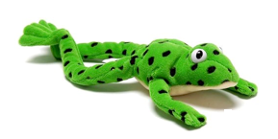

Phonics
Children are assessed and placed into appropriate groups every half term.
We have daily phonics lessons where children are taught sounds, they practice reading and spelling words containing those sounds and then they have decodable books containing the sounds they can read.
What can you do to help your child at home?
Use pure sounds not letter names
Use ‘Fred Talk’ to read and spell words
Listen to your child read their storybook everyday or as often as possible
Read stories TO your child
Notes:
Reception will receive them in due course. If your child does not have one please let me know and will replace it. Each week your child will have a slip in their diary stating which sounds they have focused on that week, the books they are bringing home and the focus for the reading that week.

Slide 12
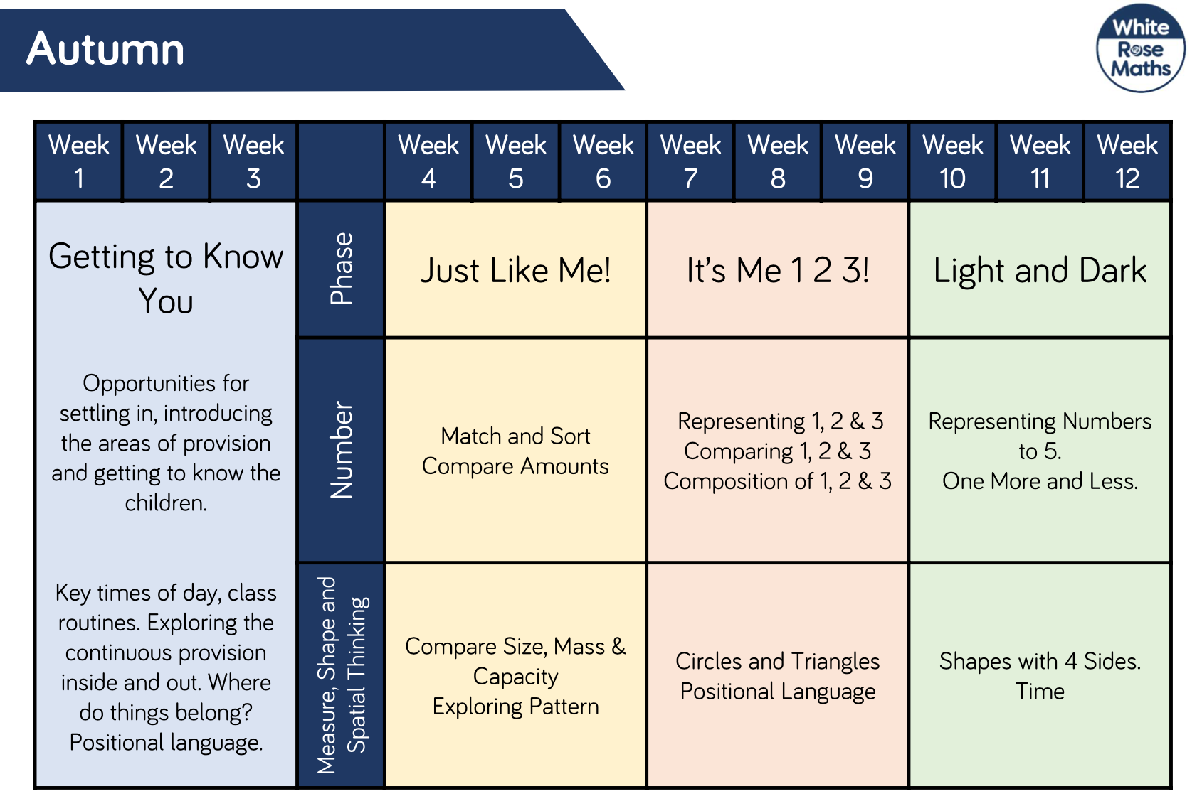
Mathematics
First4Maths
White Rose Maths

Slide 13
Homework
Reading
To help your child on their reading journey we suggest reading every night at least 10-20 minutes. Please make a note in your child’s reading diary as well so we can talk about the wonderful stories with your child!
Phonics in Reception
Phonics homework information for the following week will be provided every Thursday in your child’s reading diary alongside their new phonics reading material and a summery of the sounds covered in that week.
Maths Homework
Maths challenges will also be provided once a fortnight to Reception class in their reading diaries on Thursday alongside their new phonics reading material and their sounds review.

Slide 14
Behaviour
3 simple rules Ready Respectful and Safe
Supports our Christian ethos of living well together, kindness, dignity and respect
Positive reinforcements (Recognition Boards, Positive Notes Home, Christian Value stickers, Praise Book, Top Table)
Consistent in every classroom and with every adult
Praise in public and reprimand in private
Restorative conversations

Slide 15
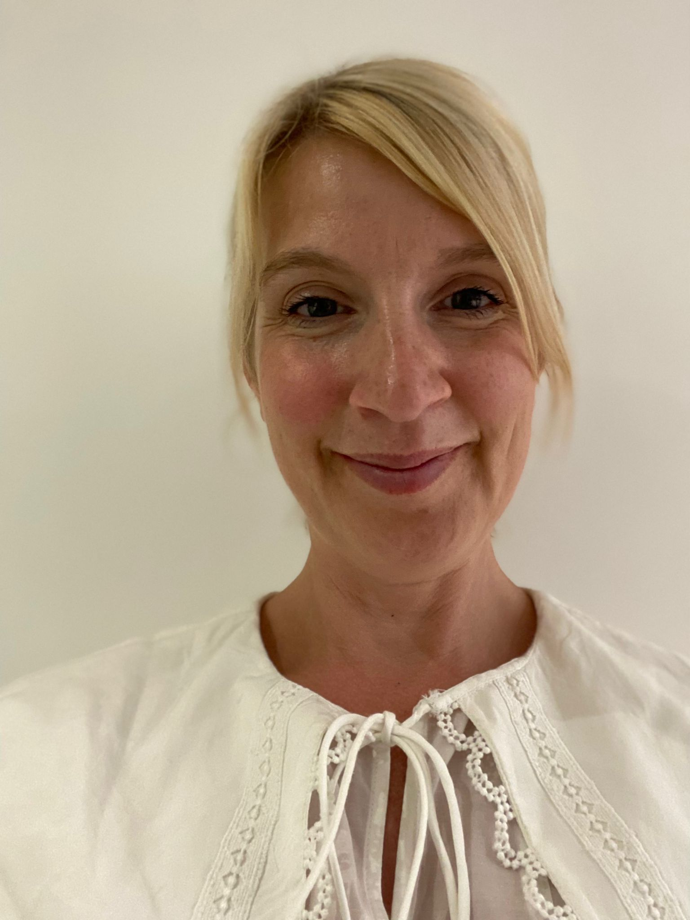
Laura Southall
My name is Laura and I’m the pastoral and inclusion lead here at Lostock, you can find me in school on Mondays, Wednesdays and Fridays!
My role is to support families in many different ways - whether it's some friendly, positive advice over the phone, referrals to foodbank or other local agencies or advice on housing, benefits, parenting and money management to name just a few.
If you feel like you need a little bit of extra support, please feel free to give me a call at school or catch me on the playground in the mornings.
I’m always happy to help and I look forward to speaking to you!!

Slide 16
Thank you for coming!

