Slide 1






English

Slide 2

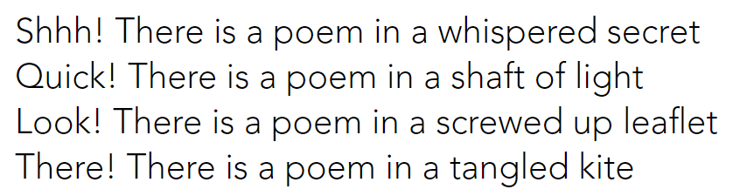
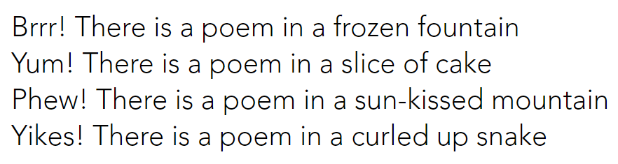
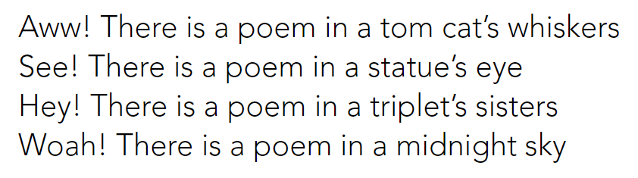
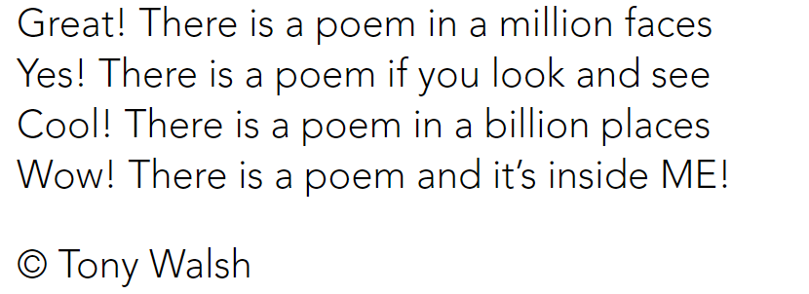

Slide 3
Think of the beginning words…
Have a think and jot down the exclamations we could use at the beginning of our poem…
Don’t forget the punctuation!
We are going to write our own version called: Wow! There is a story.
Yes!
Eeek!
Wow!
Hooray!
Super!

Slide 4
We are going to write our own version called: Wow! There is a story.
Choose the places where your story might be. Use Tony Walsh’s poem to give you ideas.
Just make a list at first….
Some of your ideas might begin to rhyme…
There is a story on the tip of my tongue
There is a story to make my hair stand up
There is a story squashed in the cushions on the chair
There is a story left on the top of my bunk
There is a story when I go outside and play
There is a story at the end of every day
There is a story that I can mould out of some clay
There is a story under the light of the moon
There is a story that I want to finish soon
There is a story in an elephant’s trunk
Mrs Evans’ ideas

Slide 5
We are going to write our own version called: Wow! There is a story.
Organise your ideas into verses. Have a look and see where the rhyming ones might go.
Add your exclamation words.
Wow! There is a story on the tip of my tongue
Help! There is a story to make my hair stand up
LOL! There is a story that is so much fun
Oooooh! There is a story in the leaves in my cup
Yuck! There is a story squashed in the cushions on the chair
Oops! There is a story left on the top of my bunk
Eeek! There is a story in a dragon’s lair
Honestly! There is a story in an elephant’s trunk
Hooray! There is a story when I go outside and play
Shhh! There is a story under the light of the moon
Yawn! There is a story at the end of every day
Hurry! There is a story that I want to finish soon
Mrs Evans

