Slide 1





English
The Brook
by Alfred Tennyson

Slide 2


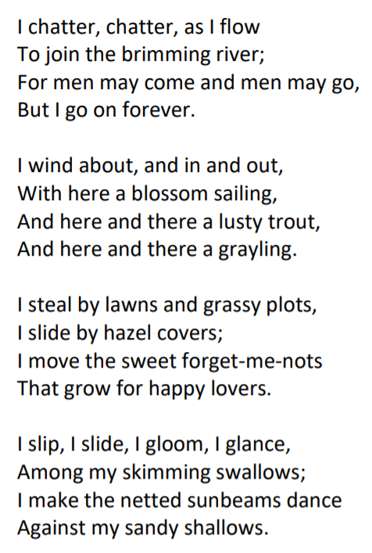
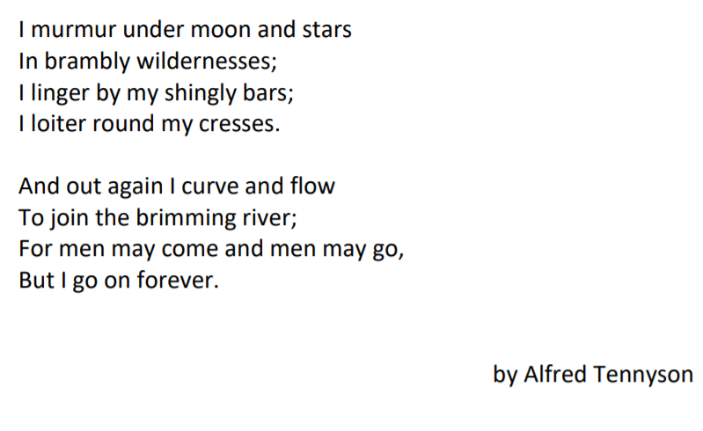

Slide 3
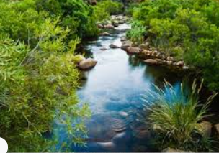
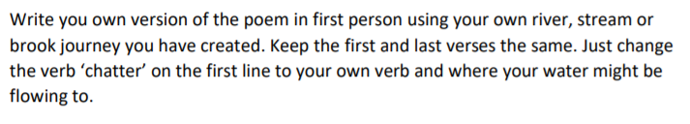
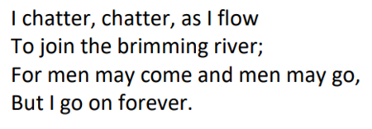
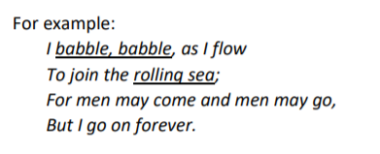
Tuesday 29th September
Can I write my own version of The Brook?
First and last verses
Look at all of your ideas from last week to remind yourself.
1) Choose a different verb to the verb ‘chatter.
2) Choose a different place for your water to flow to.
Alfred Tennyson
My ideas

Slide 4
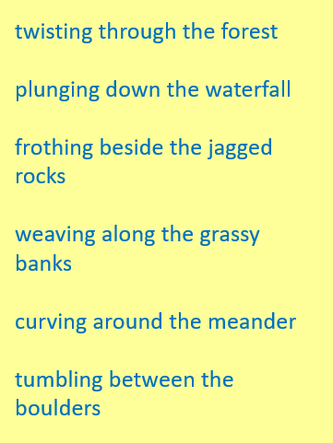
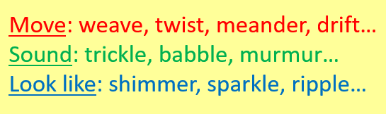
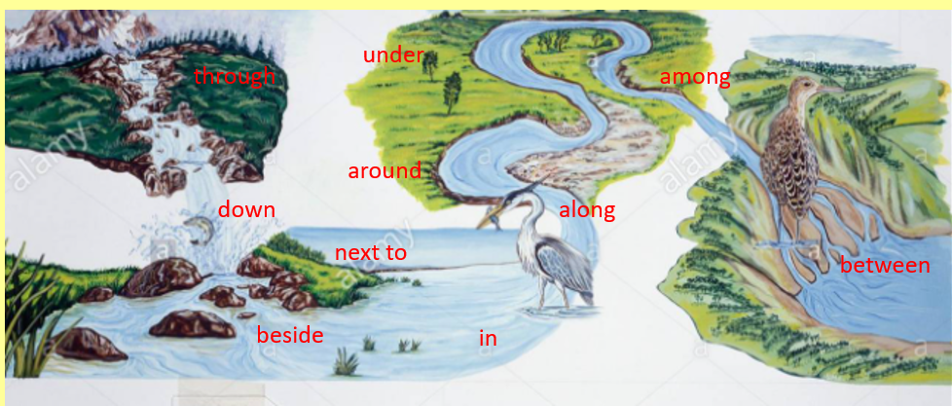

Slide 5
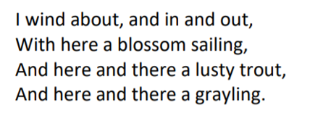
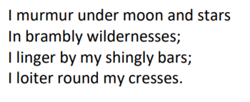
Alfred Tennyson
My ideas
2nd verse
Think about words to describe the movement your water makes and which creatures are in the water.
I twist and turn, and meander round the lawn,
With here a leaf surfing,
And here and there a pool of frogspawn,
And here and there a tadpole.
Alfred Tennyson
My ideas
Choose another verse you like and change some of the ideas- perhaps the sounds your water makes or the places and creatures it moves past.
I tumble between the boulders and rocks,
Plunging down the waterfall;
I babble at ducks huddled in flocks;
I drift where newts like to crawl.

