Slide 1


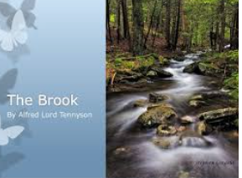


English
The Brook
by Alfred Tennyson

Slide 2


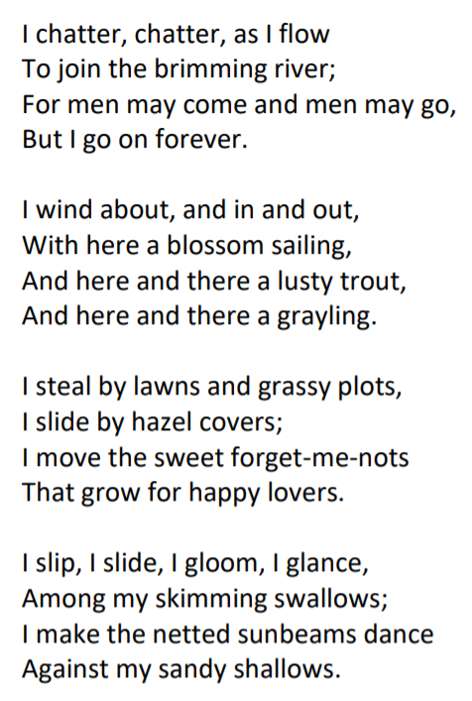
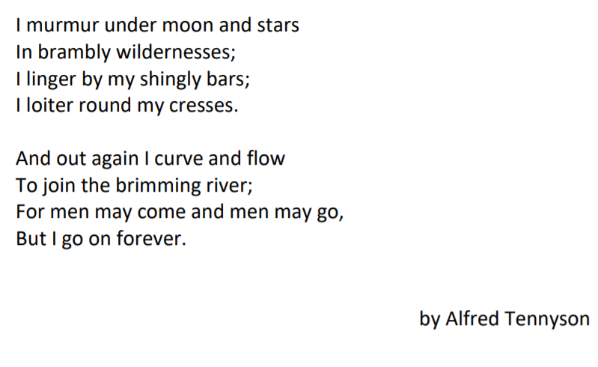

Slide 3
Can I use prepositions in adverbial phrases?
Prepositionsabout
by
among
against
under
round
in
out
Adverbial phrases (where, when, how)
under moon and stars- tells us where
After dark I shimmer- tells us when
I meander softly – tells us how
https://www.bbc.co.uk/bitesize/topics/zwwp8mn/articles/zw38srd

Slide 4
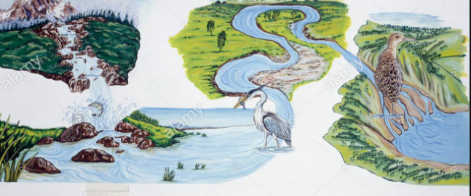
Can I write adverbial phrases ?
Think about the journey that you made up for your river, stream or brook and look at the sketch, map or drawing you made yesterday.
Write a list of prepositions around your map or drawing to label where (use my ideas on this picture to remind you)
Use your prepositions to write some descriptive adverbial phrases about your river/stream/brook.
twisting through the forest
plunging down the waterfall
frothing beside the jagged rocks
weaving along the grassy banks
curving around the meander
tumbling between the boulders
under
through
among
around
down
along
next to
between
beside
in
https://www.youtube.com/watch?v=HugvwuSdyFA

Slide 5

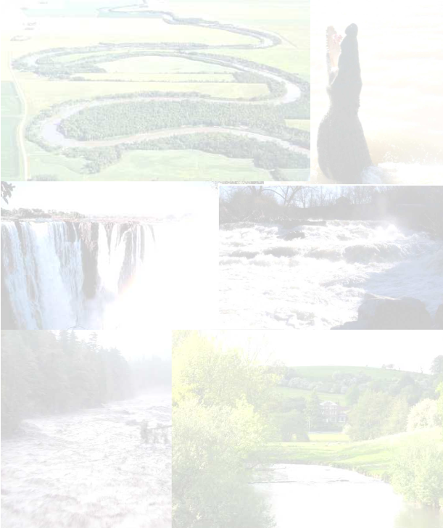


You might want to use one of these sheets from your pack to record your adverbial phrases on or you might want to write them around your picture/map.

Slide 6
Brook: noun. A small stream. The brook flowed into the river.
Brimming: verb. To be completely full. Full to the brim.
Lusty: adjective. To be healthy or full of life. The lusty trout swam in the brook.
Grayling: noun. A type of freshwater fish.
Forget-me-nots: noun. A type of plant with a light blue flower.
Sunbeams: noun. A beam or ray of sunlight.
Wildernesses: noun. A wild area of land where no one lives apart from wild animals.
Linger: verb. To stay in a place for longer than usual and not want to leave.
Shingly: adjective. An area covered in small pieces of stone and pebbles.
Loiter: verb. To stand or wait around without really doing anything.
Cresses: noun. Plant which can grow near water.

Slide 7
