Slide 1


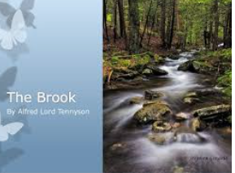


English
The Brook
by Alfred Tennyson

Slide 2


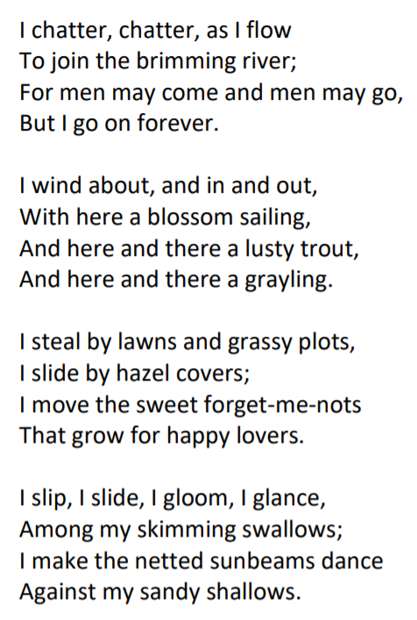
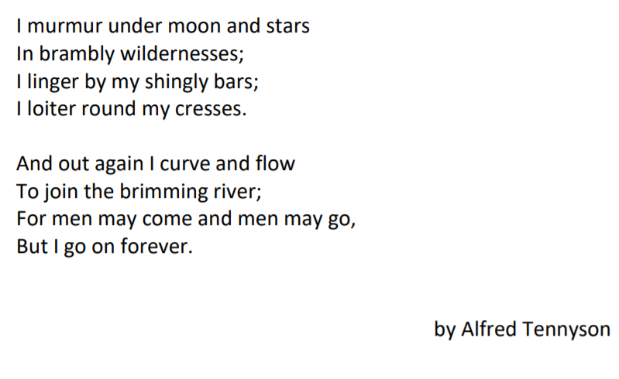

Slide 3
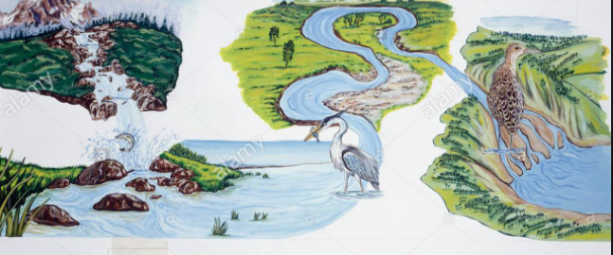
Lesson 4
Can I plan my own ideas for a poem?
1) Think about the journey that a river, stream or brook might take that is different to the one in the poem.
Make a list of all of the plants, creatures and landscapes that the brook or stream or river might see on its journey.
2) You might want to break this activity up into 2 parts and have a socially distanced walk to a nearby river or stream. Look at the plants, trees and wildlife that are nearby. You could even take some photos. Then, back at home you can sketch your river journey or map.
https://www.youtube.com/watch?v=HugvwuSdyFA
3) Add some verbs to describe how the river or stream you have chosen might move, sound or look. Choose some words from the poem to start you off:
Move: weave, twist, meander, drift…
Sound: trickle, babble, murmur…
Look like: shimmer, sparkle, ripple…

Slide 4

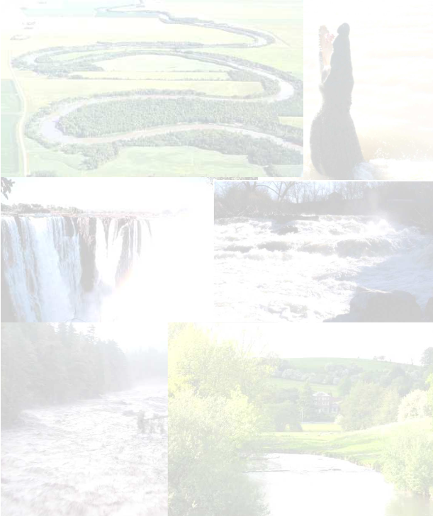


You might want to use one of these sheets from your pack to record your verbs on or you might want to write them around your picture/map.

Slide 5
Brook: noun. A small stream. The brook flowed into the river.
Brimming: verb. To be completely full. Full to the brim.
Lusty: adjective. To be healthy or full of life. The lusty trout swam in the brook.
Grayling: noun. A type of freshwater fish.
Forget-me-nots: noun. A type of plant with a light blue flower.
Sunbeams: noun. A beam or ray of sunlight.
Wildernesses: noun. A wild area of land where no one lives apart from wild animals.
Linger: verb. To stay in a place for longer than usual and not want to leave.
Shingly: adjective. An area covered in small pieces of stone and pebbles.
Loiter: verb. To stand or wait around without really doing anything.
Cresses: noun. Plant which can grow near water.

Slide 6
