Slide 1


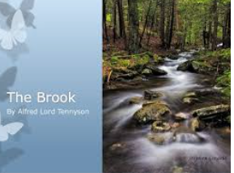


English
The Brook
by Alfred Tennyson

Slide 2


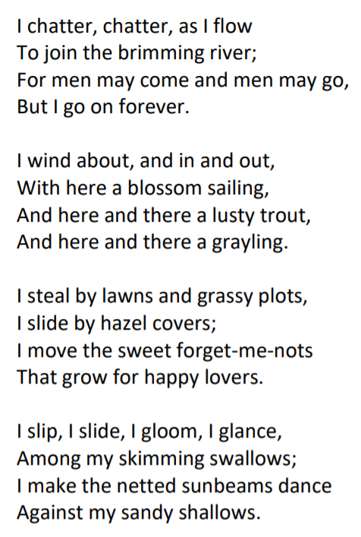
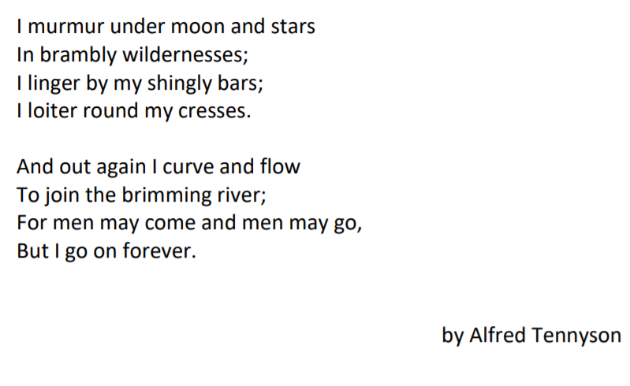

Slide 3
Questions about the poem.
What is the poem about?
2) Who is speaking in the poem?
3) List three animals that appear in the poem.
4) List three plants that appear in the poem.
5) What speed is the brook moving? How do you know? What clues are there?
Click to the next slide for a handwriting activity.

Slide 4
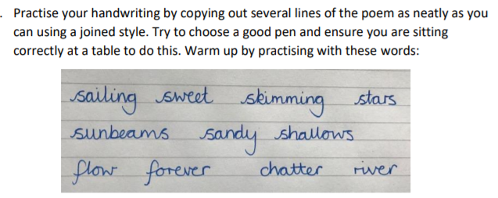
Handwriting practice

Slide 5
Brook: noun. A small stream. The brook flowed into the river.
Brimming: verb. To be completely full. Full to the brim.
Lusty: adjective. To be healthy or full of life. The lusty trout swam in the brook.
Grayling: noun. A type of freshwater fish.
Forget-me-nots: noun. A type of plant with a light blue flower.
Sunbeams: noun. A beam or ray of sunlight.
Wildernesses: noun. A wild area of land where no one lives apart from wild animals.
Linger: verb. To stay in a place for longer than usual and not want to leave.
Shingly: adjective. An area covered in small pieces of stone and pebbles.
Loiter: verb. To stand or wait around without really doing anything.
Cresses: noun. Plant which can grow near water.

Slide 6
