Slide 1


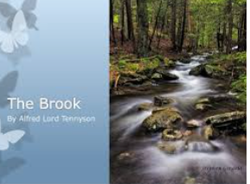


English
The Brook
by Alfred Tennyson

Slide 2


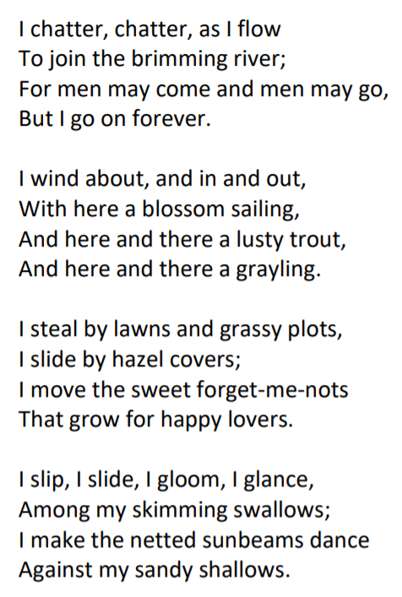
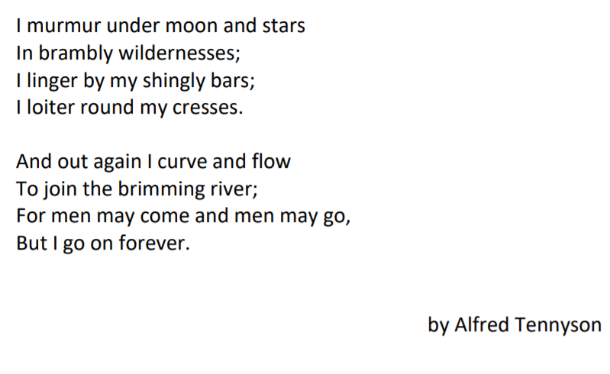

Slide 3
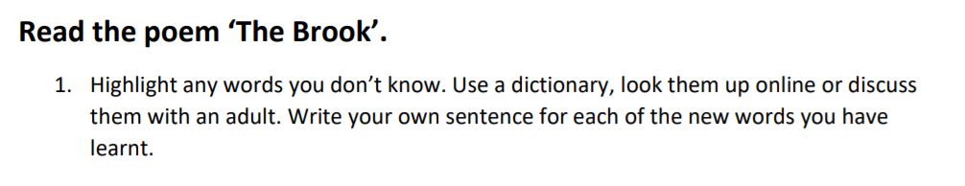
https://www.dictionary.com/
Brook: noun. A small stream. The brook flowed into the river.
Brimming: verb. To be completely full. Full to the brim.
Lusty: adjective. To be healthy or full of life. The lusty trout swam in the brook.
Grayling: noun. A type of freshwater fish.
Forget-me-nots: noun. A type of plant with a light blue flower.
Sunbeams: noun. A beam or ray of sunlight.
Wildernesses: noun. A wild area of land where no one lives apart from wild animals.
Linger: verb. To stay in a place for longer than usual and not want to leave.
Shingly: adjective. An area covered in small pieces of stone and pebbles.
Loiter: verb. To stand or wait around without really doing anything.
Cresses: noun. Plant which can grow near water.

Slide 4
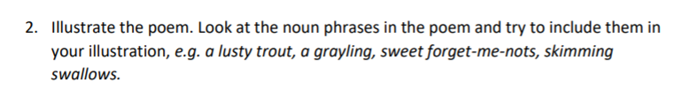
I chatter, chatter as I flow
To join the brimming river;
For men may come and men may go,
But I go on forever.
Have a look at the next slide for some ideas of illustrations.

Slide 5
