Slide 1


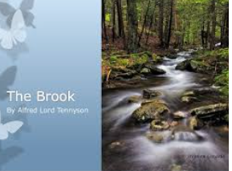


English
The Brook
by Alfred Tennyson

Slide 2


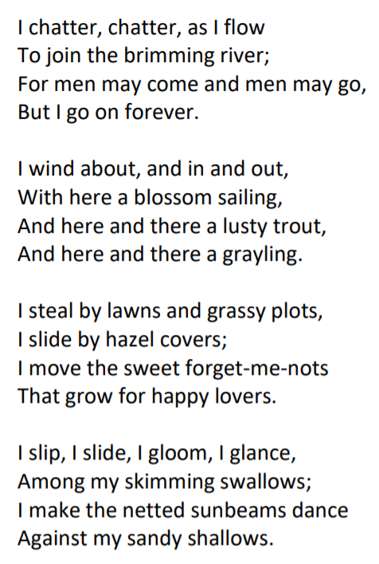
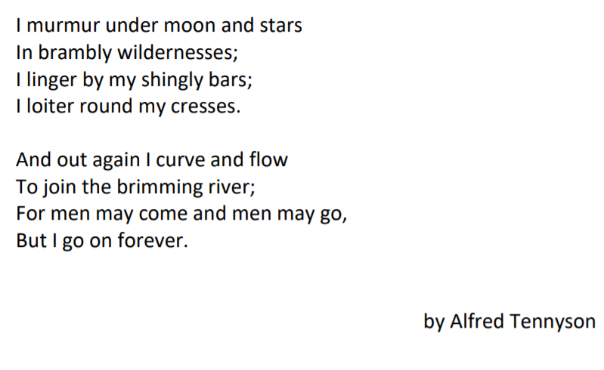

Slide 3
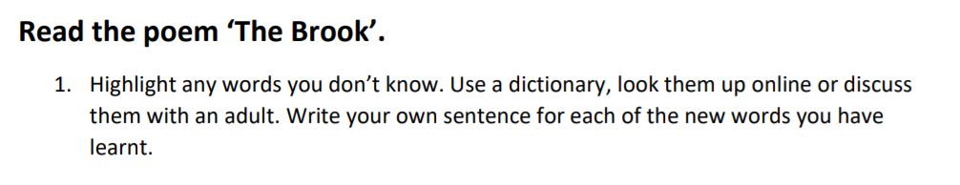
https://www.dictionary.com/
Brook:_noun a small stream
Brimming:_____________________________________________________
Lusty:_________________________________________________________
Grayling:_______________________________________________________
Forget-me-nots:_________________________________________________
Sunbeams:_____________________________________________________
Wildernesses:___________________________________________________
Linger:_________________________________________________________
Shingly:________________________________________________________
Loiter:_________________________________________________________
Cresses:________________________________________________________

