Slide 2
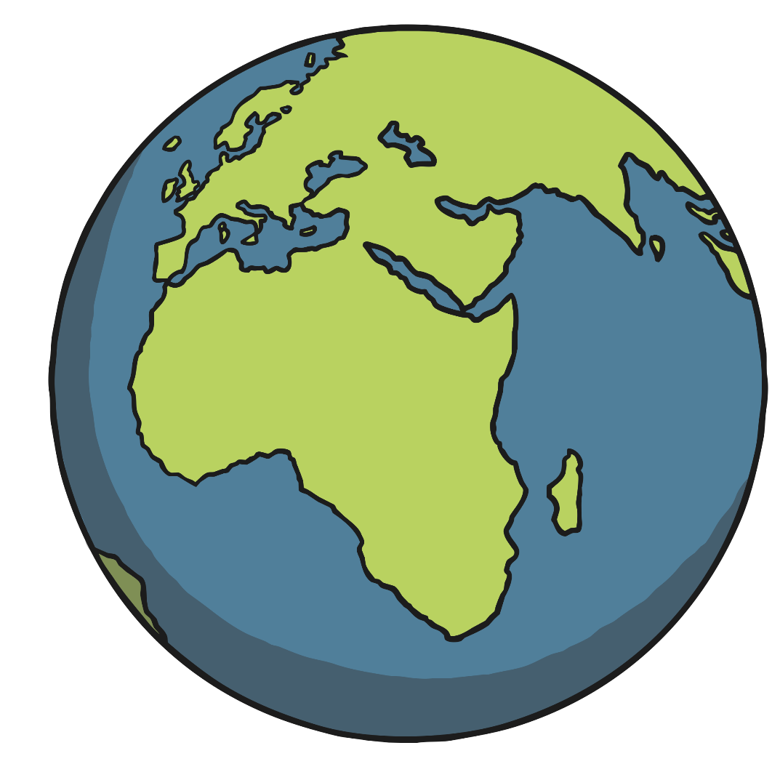
What Is an Ocean?
An ocean is a very large area of salt water. Most of the Earth is covered
in ocean.
There are five oceans in the world:
Pacific Ocean
Atlantic Ocean
Indian Ocean
Southern Ocean
Arctic Ocean

Slide 3
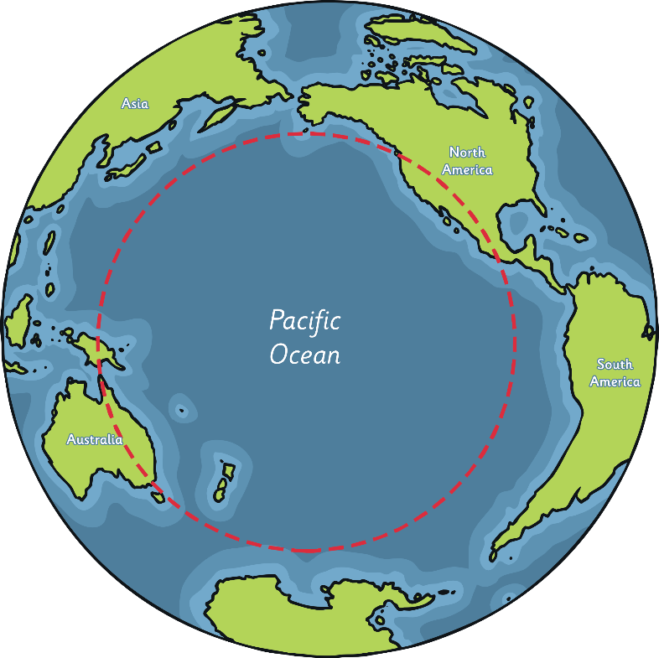
Pacific Ocean
The Pacific Ocean is the biggest ocean in
the world.
It reaches from North and South
America to Asia and Australia.
The Pacific Ocean is surrounded by a
line of volcanoes known as the Ring of Fire.
It is also home to the Great Barrier Reef,
which is the largest coral reef in the world.
Challenger Deep, the deepest point on Earth, is in the Pacific Ocean.
Did You Know…?
The word ‘Pacific’ means peaceful.

Slide 4
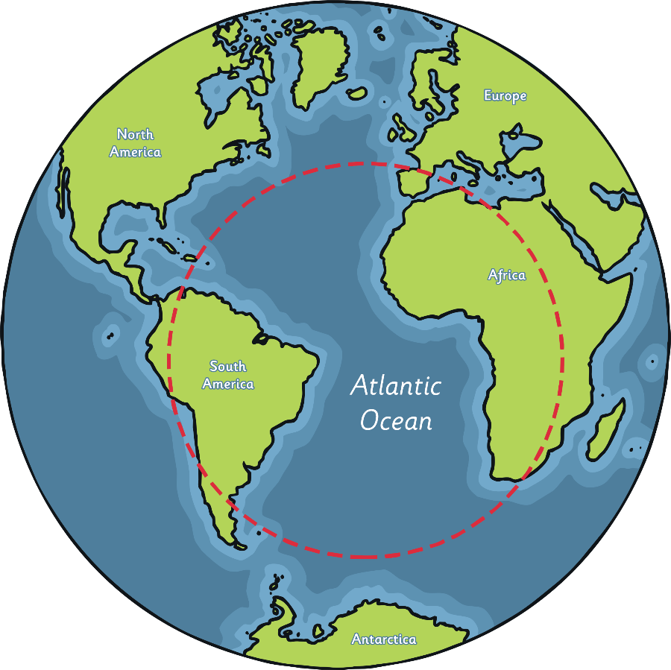
Atlantic Ocean
The Atlantic Ocean is the second biggest
ocean in the world.
It reaches from North and South
America to Europe and Africa.
The Atlantic Ocean is huge, but only
half the size of the Pacific Ocean.
The Mid-Atlantic Ridge, the longest
mountain range in the world, is
underwater in the Atlantic Ocean.
Did You Know…?
The first person to sail across the Atlantic Ocean from Europe to America was Leif Eriksson, a Viking, in the year 1000.

Slide 5
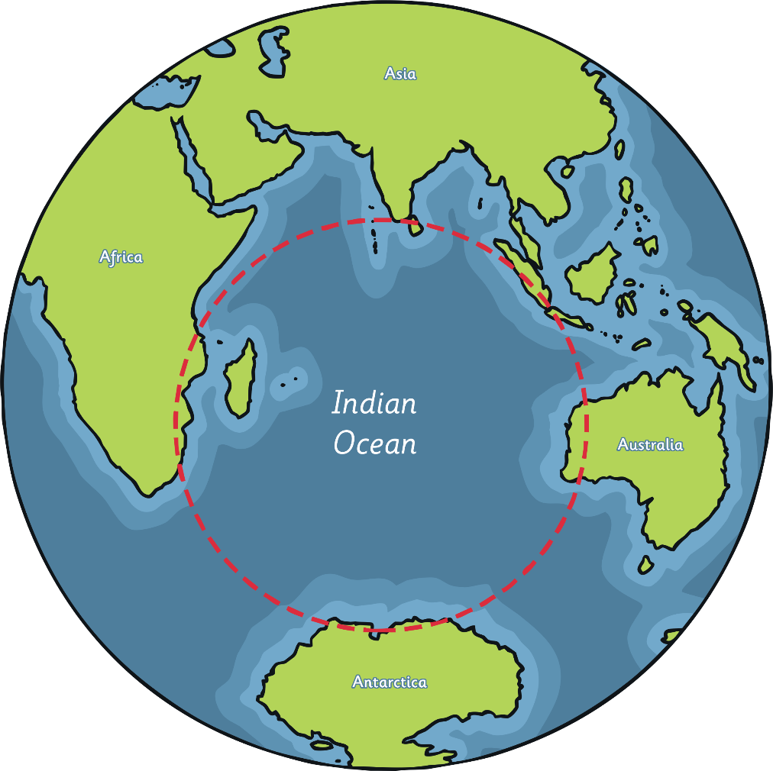
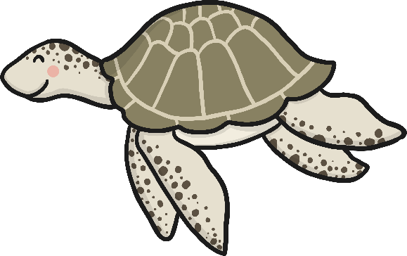

Indian Ocean
The Indian Ocean is the third biggest ocean in the world.
It is named after the country of India.
The Indian Ocean is home to many
endangered sea creatures, including
turtles, seals and dugongs (also
known as sea cows).

Slide 6
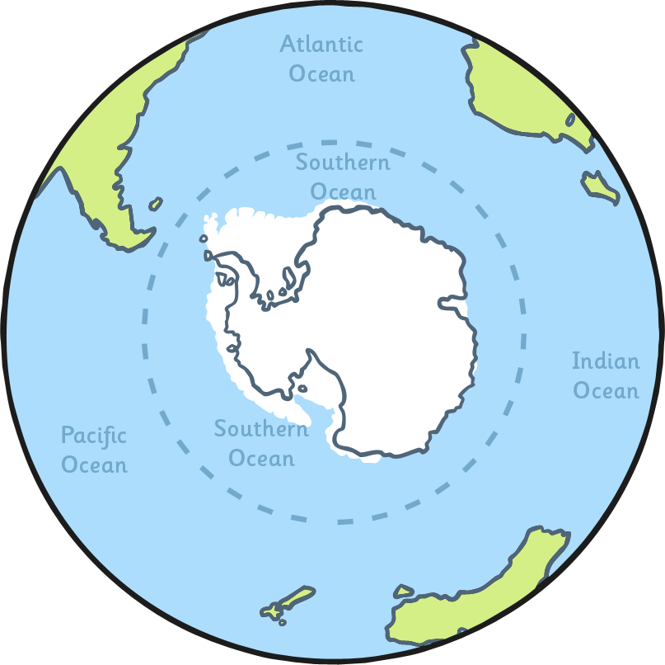
Southern Ocean
The Southern Ocean is the second smallest ocean in the world.
It is also known as the Antarctic
Ocean as it surrounds Antarctica.
It is the coldest and wildest
ocean in the world.
The Southern Ocean is home to
emperor penguins, blue whales,
elephant seals, giant squid and
the wandering albatross.

Slide 7
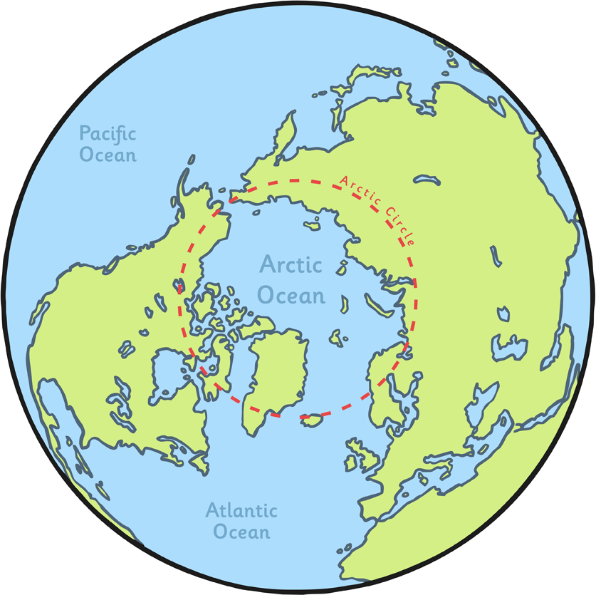
Arctic Ocean
The Arctic Ocean is the smallest ocean in
the world.
It surrounds the Arctic.
Often, the Arctic Ocean is completely
covered in ice.
Polar bears live on the ice that covers
the ocean and can swim in the water.
Did You Know…?
Because of climate change, the amount of ice covering the Arctic is getting smaller every year.

Slide 8
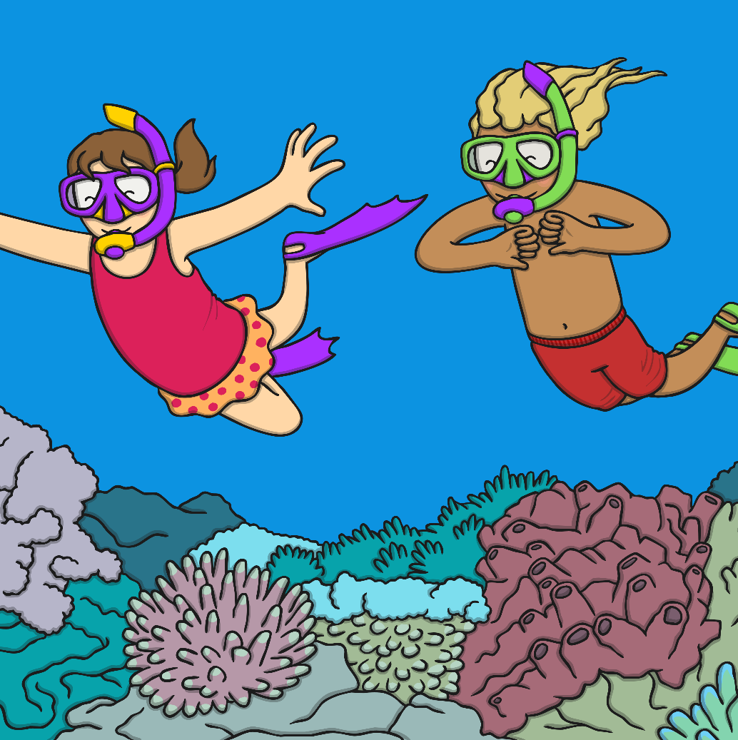
Why Are Oceans so Important?
Oceans make up over 70% of the Earth’s surface.
There are over 700,000 different species
of animal that live in the ocean. It is
important to protect the oceans to
make sure their habitats are safe.
The ocean is also full of tiny
plants which help to produce
oxygen, which we need
to breathe.
On top of this, oceans also provide
food for many creatures, including
humans!

