Slide 2
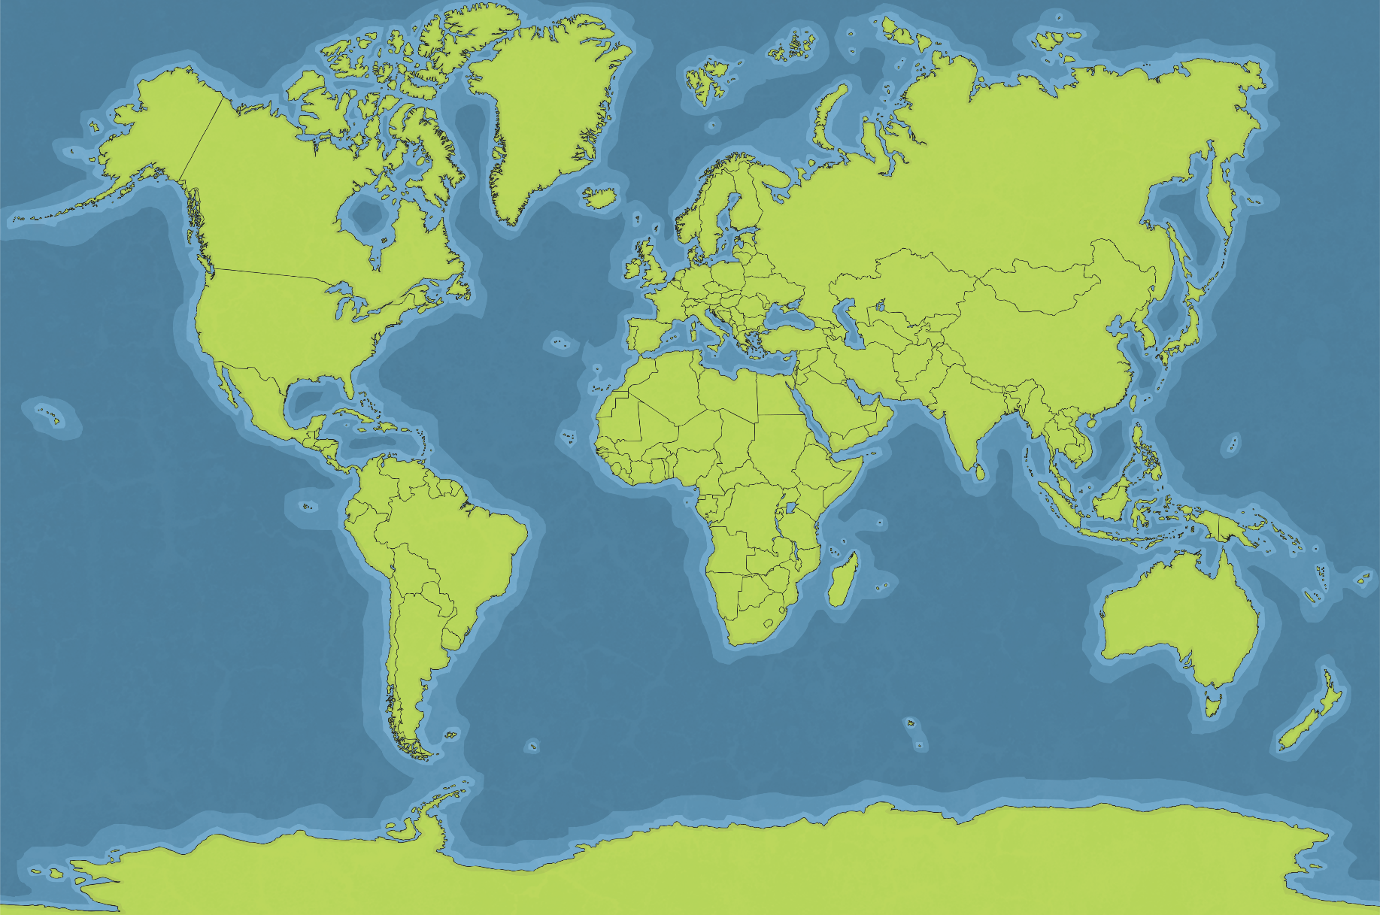
Oceans of the World
Arctic Ocean
Atlantic Ocean
Pacific Ocean
Pacific Ocean
Indian Ocean
Southern Ocean

Slide 3
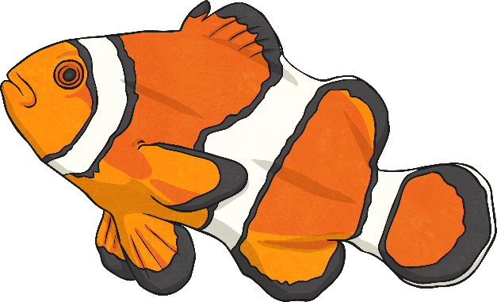
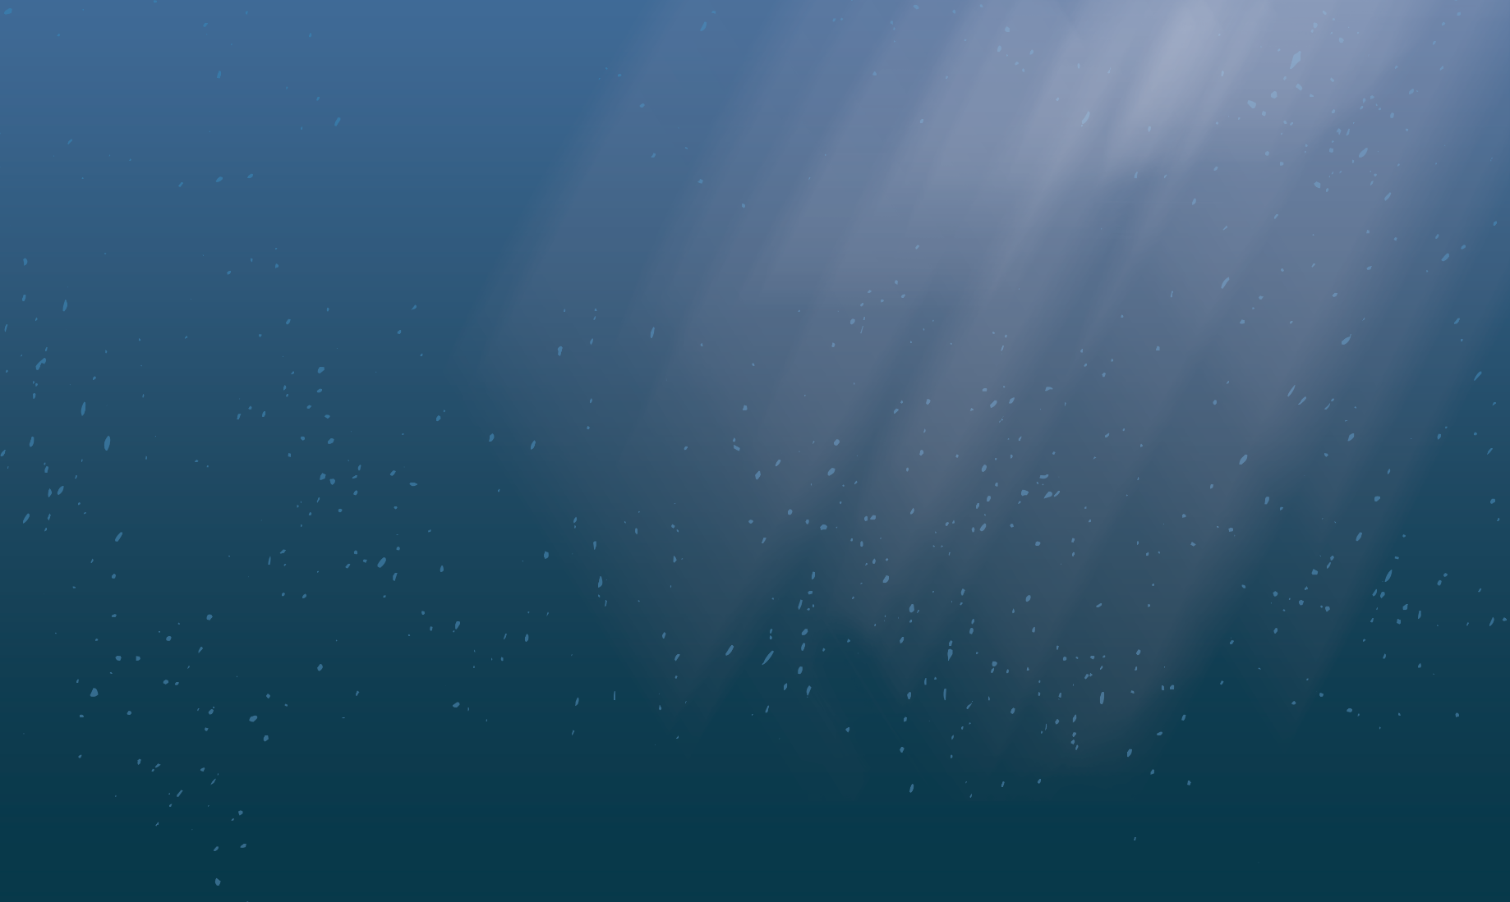
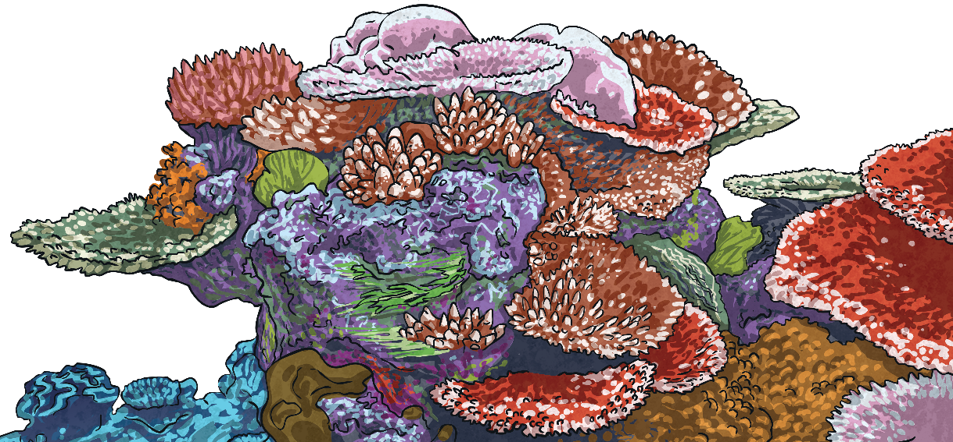
Ocean Habitats
There are massive variations in the different oceans’ temperatures and amounts of light. Because of this, they are home to a large number of different species.
Some creatures which live in oceans have gills so they can breathe underwater. Others are able to hold their breath for long periods of time and come to the surface to breathe once in a while.
Many plants that live in the ocean have adapted to survive with less sunlight than plants that live on land require.
Did you Know?
Oceans cover nearly 71% of the earth’s surface.

Slide 4
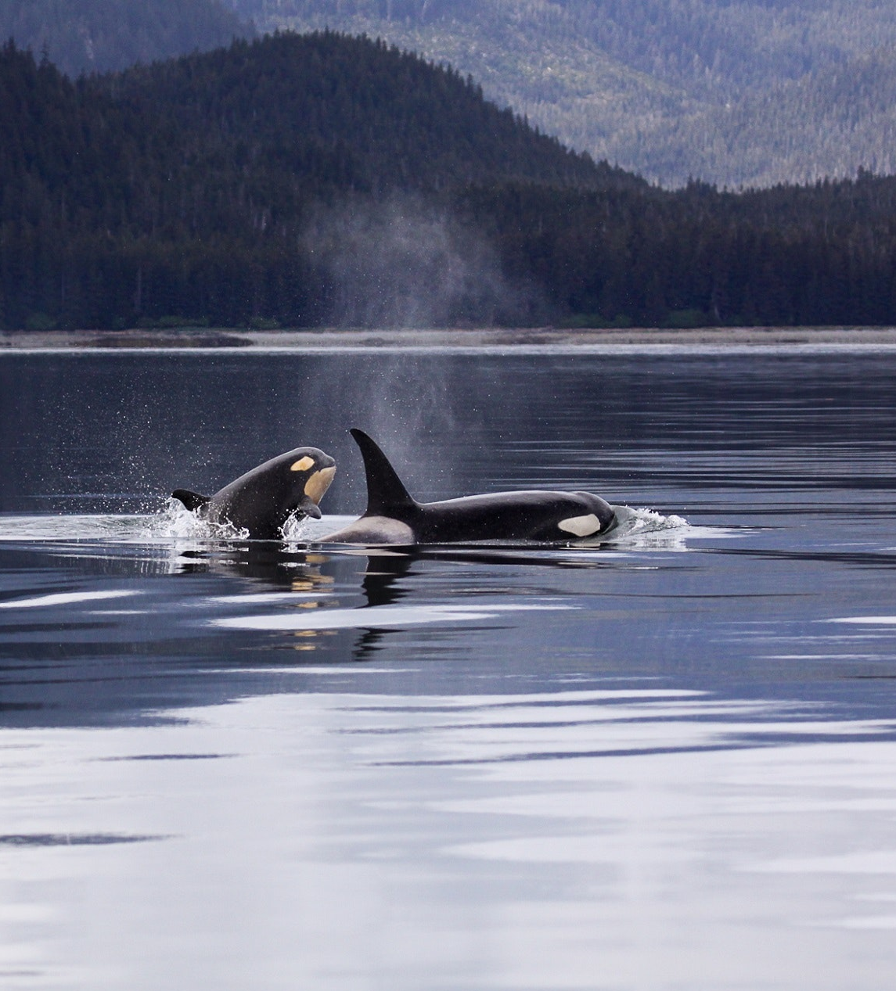
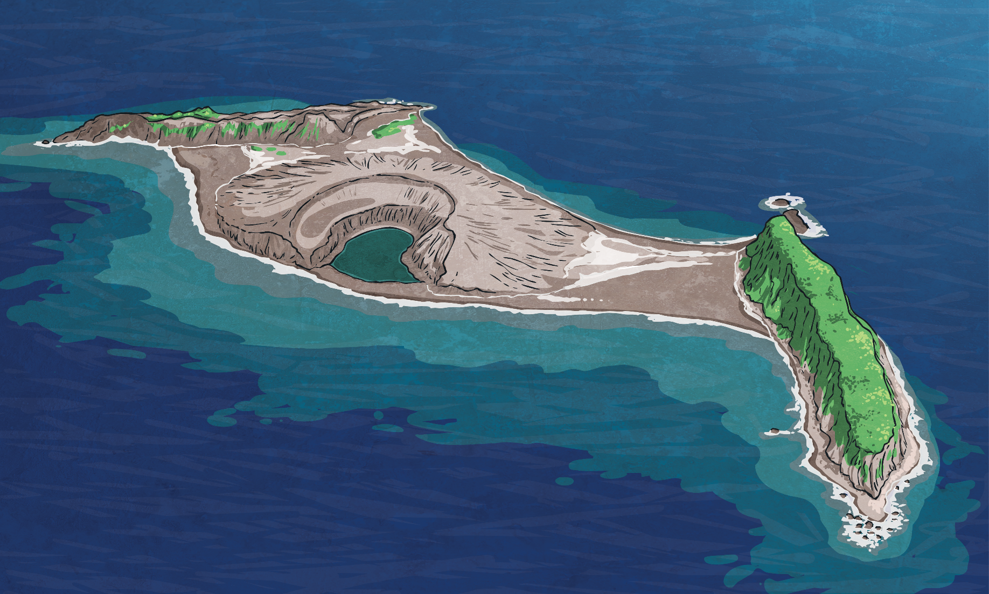
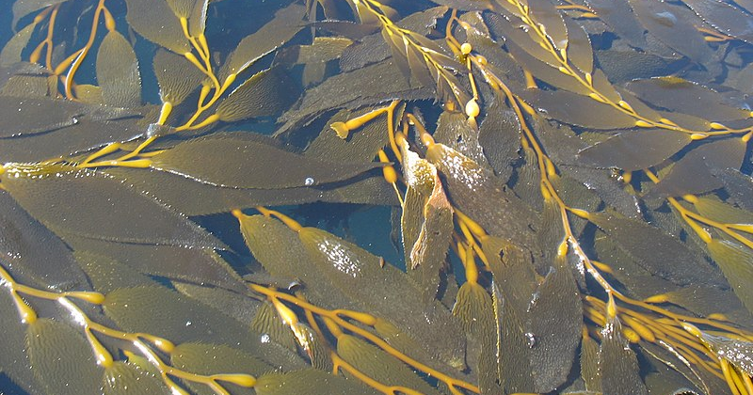
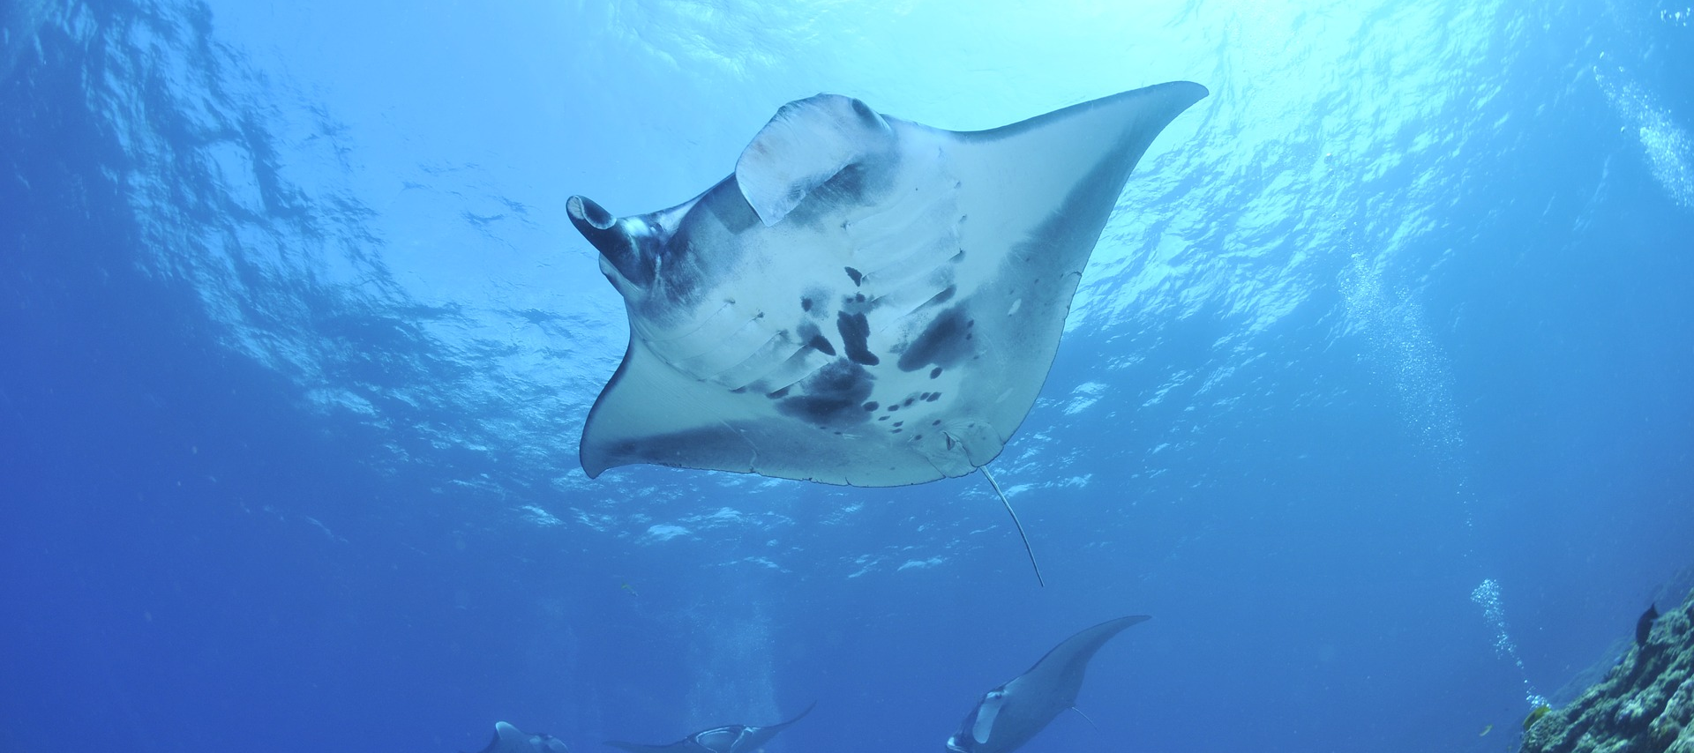
x
x
x
What Lives in the Pacific Ocean?
Kelp Forests
Orcas
Manta Ray
Manta rays are adapted to warm temperatures. The shape of their wings allows them to glide through the water.Manta rays are filter feeders which mean they suck in water (which contains plankton) and then push out the water through their gills, leaving only the plankton for them to eat.
Kelp forests are found in the ocean. They are ecosystems home to a large number of species.
?
Orcas, often known as killer whales, are apex predators of the Pacific Ocean. This means they are at the top of the food chain. Threats to orcas include lack of food due to disease, over farming of their prey and pollution.
?
?

Slide 5
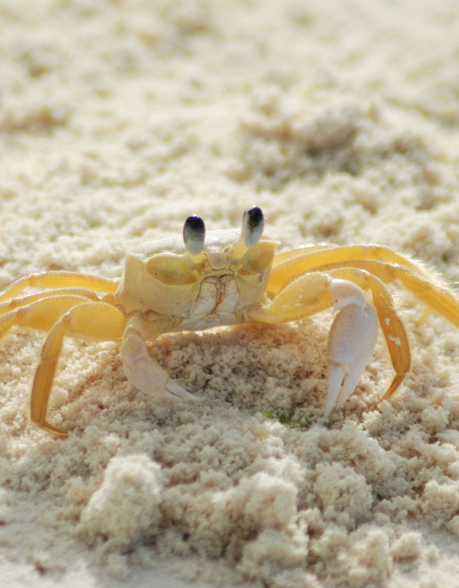
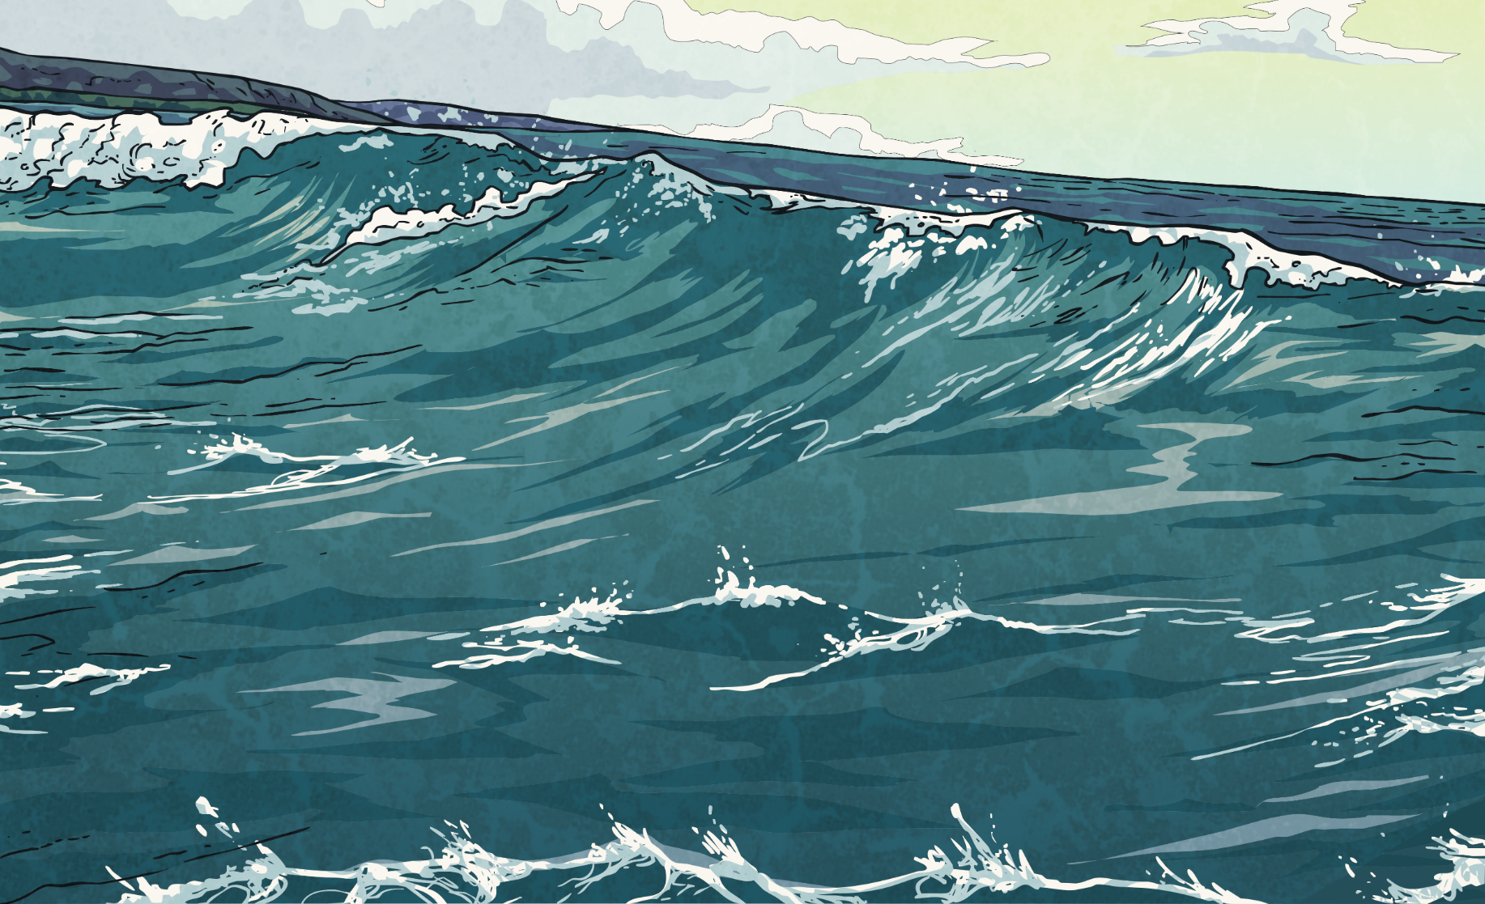
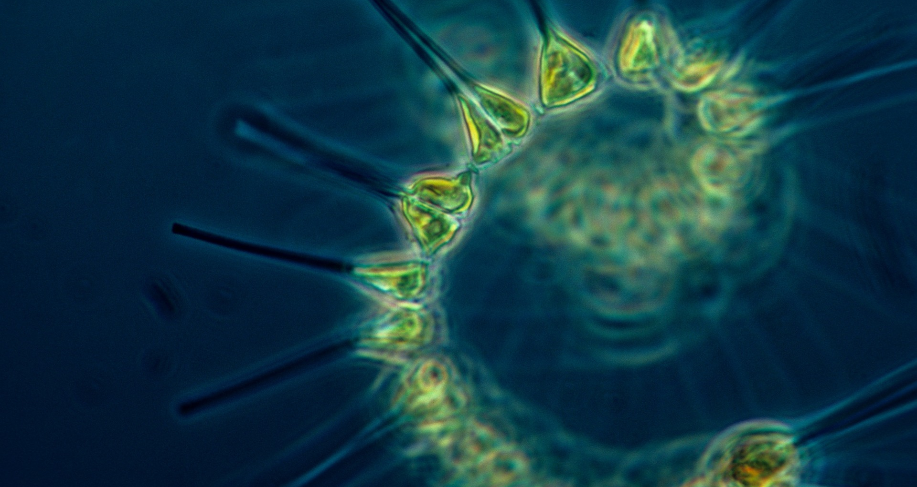
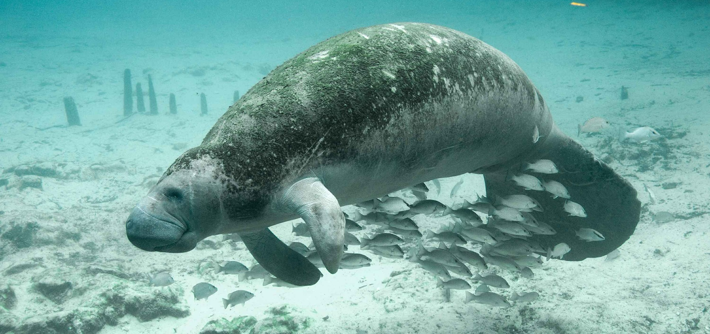
x
x
What Lives in the Atlantic Ocean?
Manatees
x
Phytoplankton
Atlantic Ghost Crab
Manatees glide through the oceans smoothly and have been known to swim at speeds of up to 24 km per hour. They can stay underwater for 20 minutes before having to come up to breathe. To help them conserve oxygen, they slow their heart rate while they are diving for food.
Phytoplankton are single celled plants that cannot be seen with the naked eye. They convert sunlight into energy using photosynthesis.
The Atlantic ghost crab’s colour allows it to camouflage itself against the sand to hide from predators. Atlantic ghost crabs burrow down into sand during the day and search for food at night.
?
?
?

Slide 6
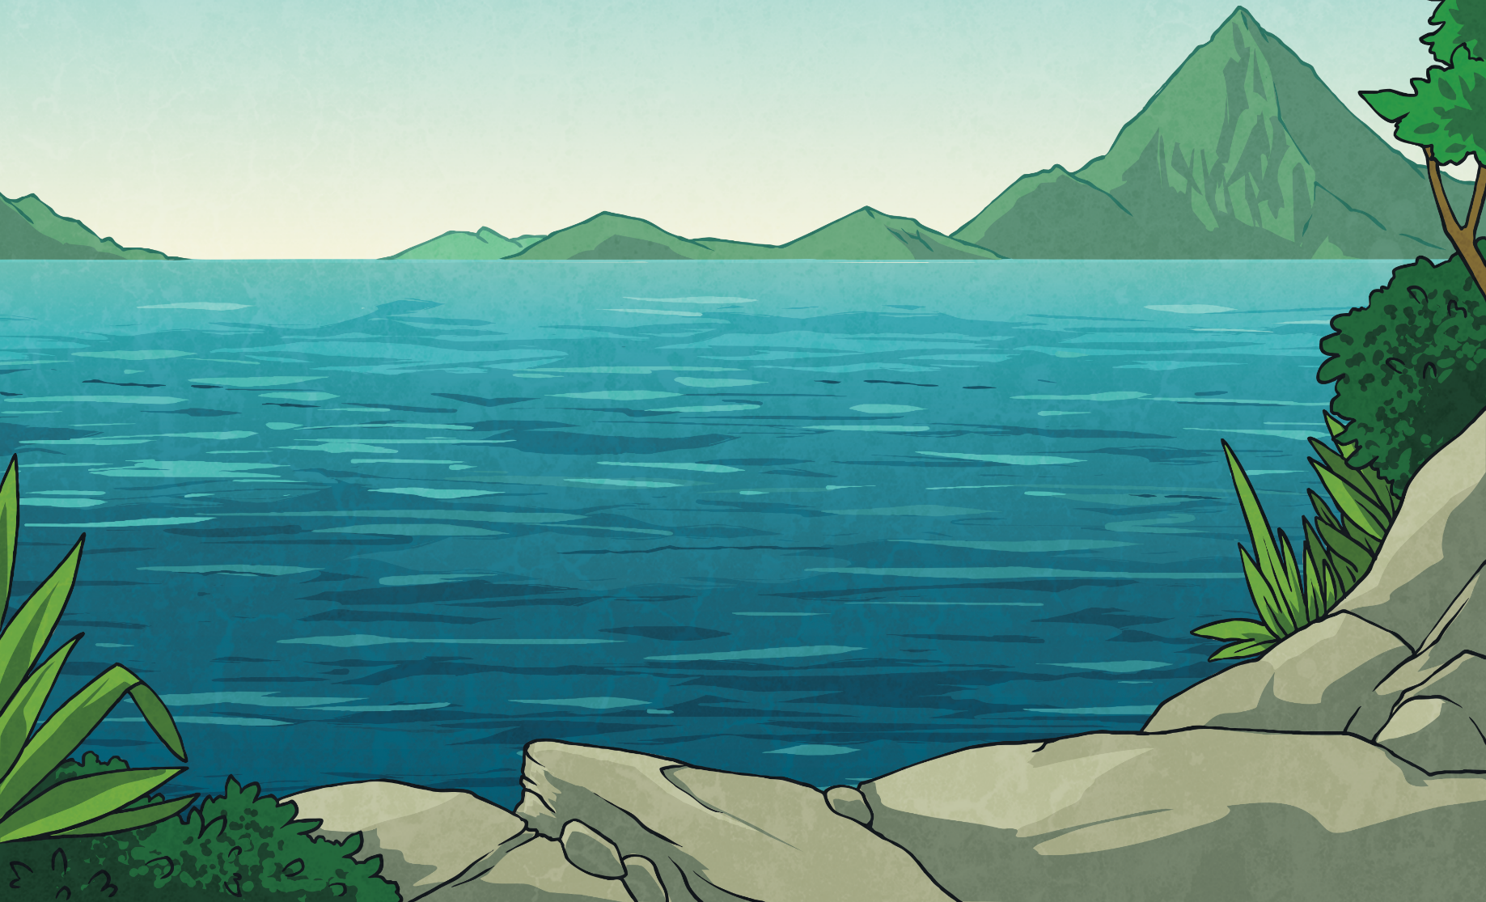
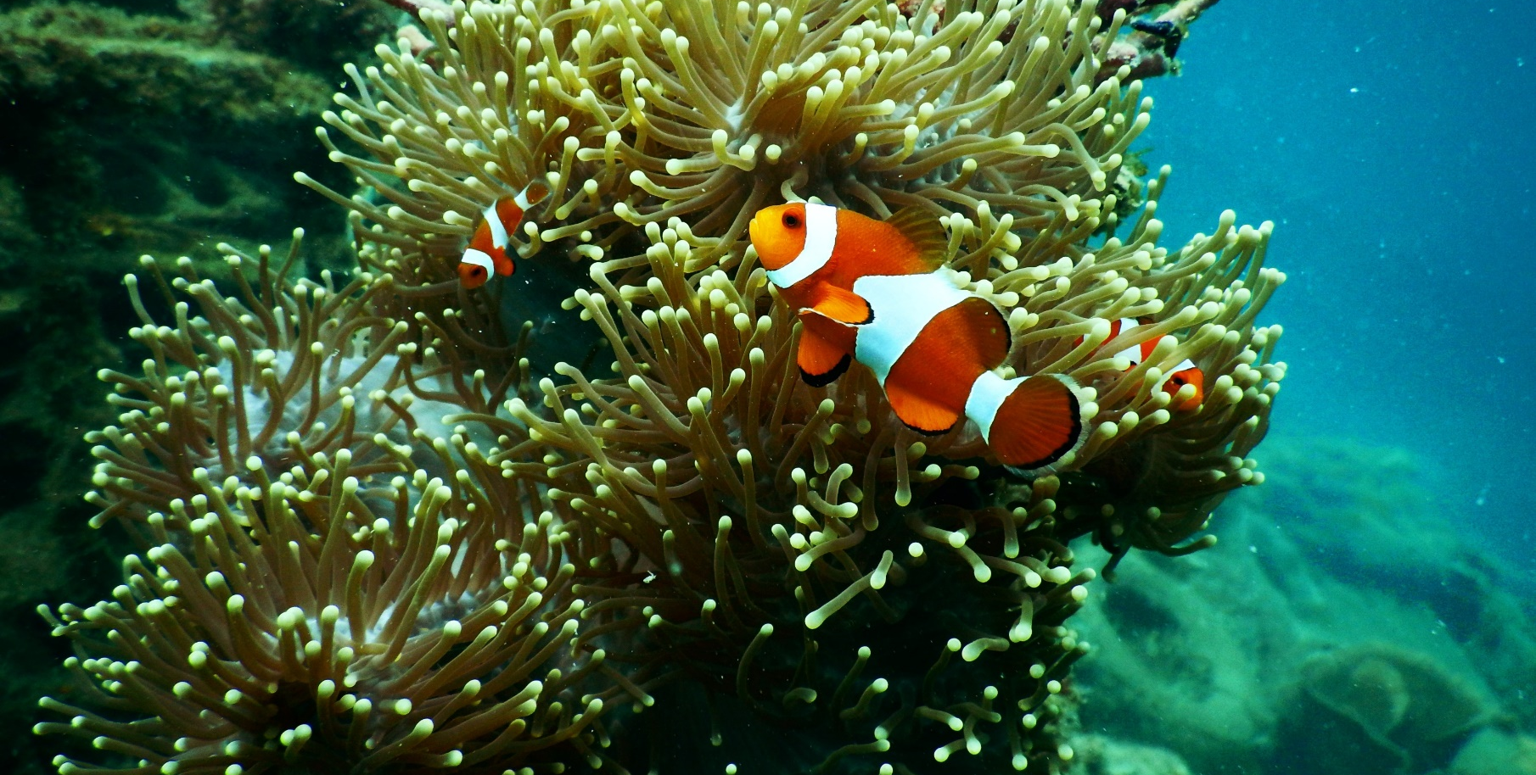
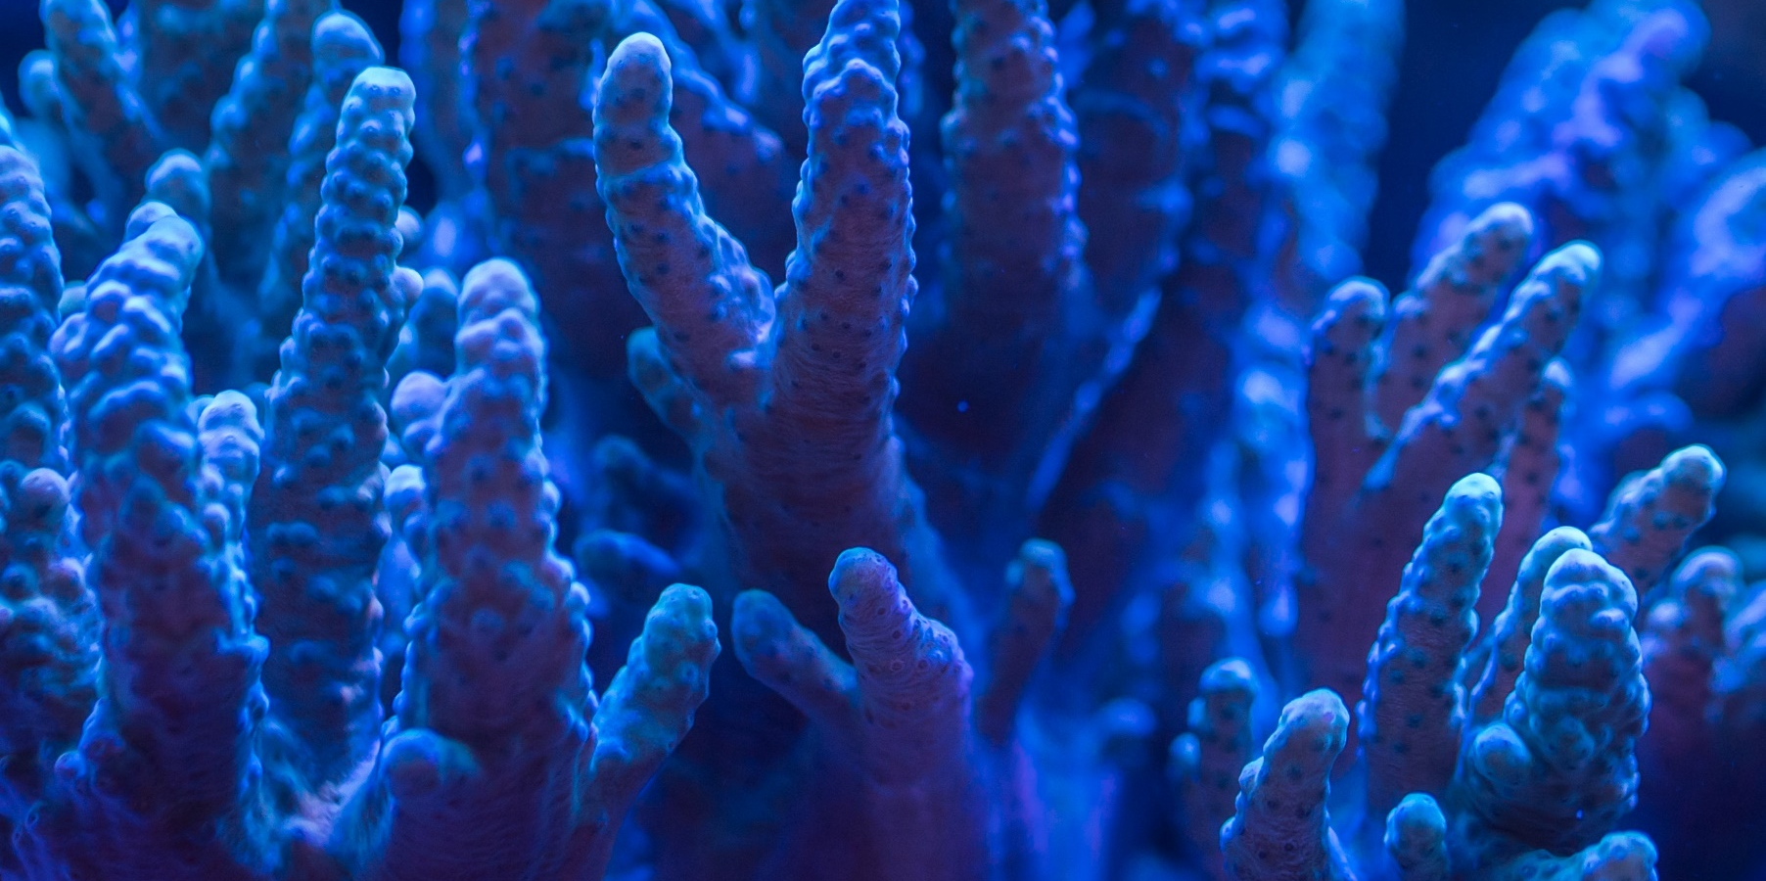
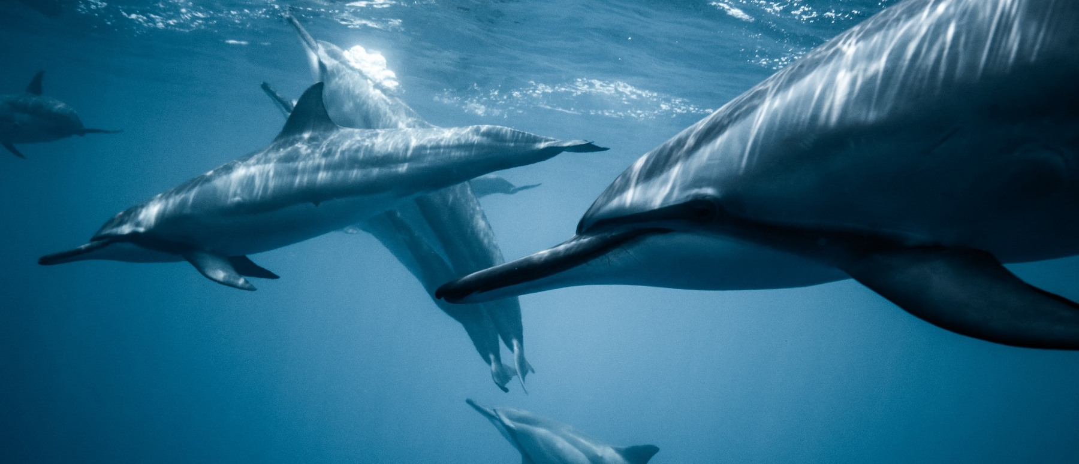
x
Bottlenose Dolphin
x
What Lives in the Indian Ocean?
x
Anemone Fish
Coral
Anemone fish, often known as clownfish, aren’t harmed by the sting of the sea anemone, which means they are protected from predators. They are omnivores, eating algae, plankton and molluscs.
Coral looks like plants but because they cannot make their own food, they are actually animals. Most coral structures are made up of tiny coral creatures called polyps.
Bottlenose dolphins swim so quickly that they sometimes rise out of the water. This helps them travel further while saving energy. They can hold their breath while diving for food for up to 12 minutes. Like other dolphins, bottlenose dolphins use echolocation (special clicking sounds) to help them find food.
?
?
?

Slide 7
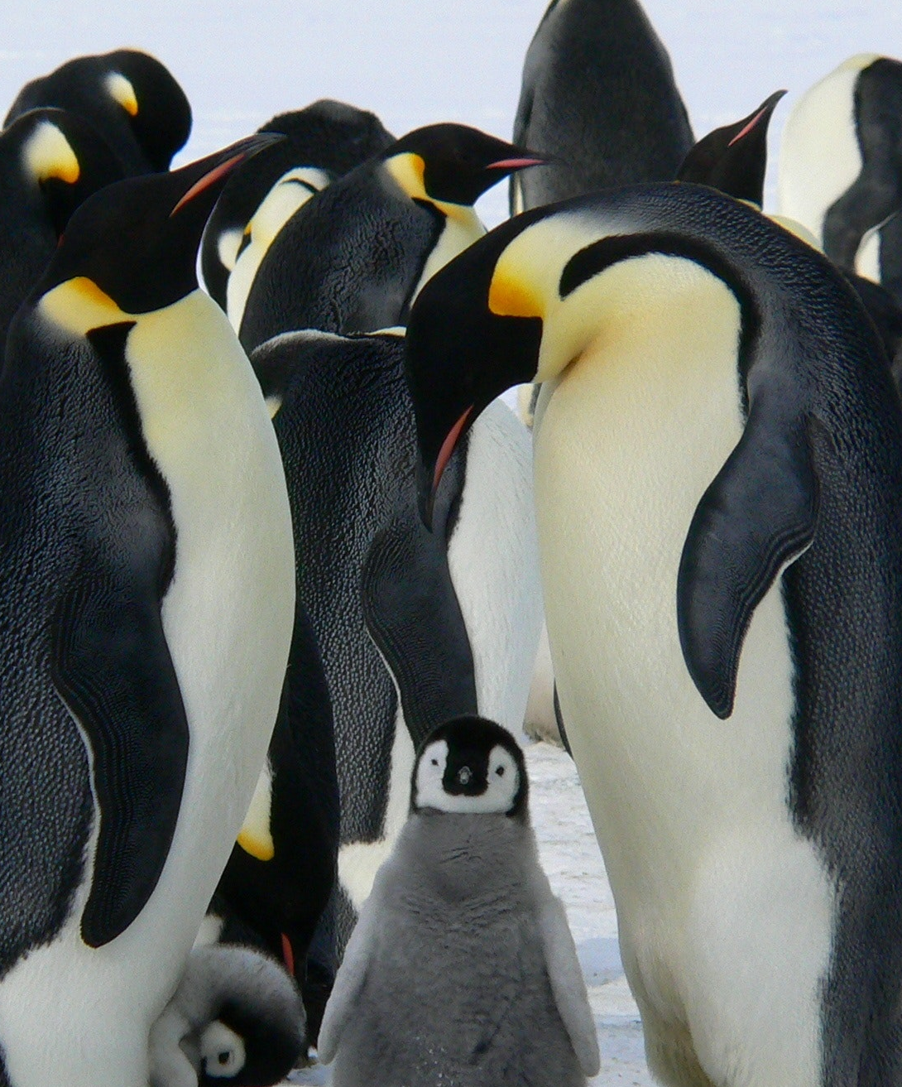
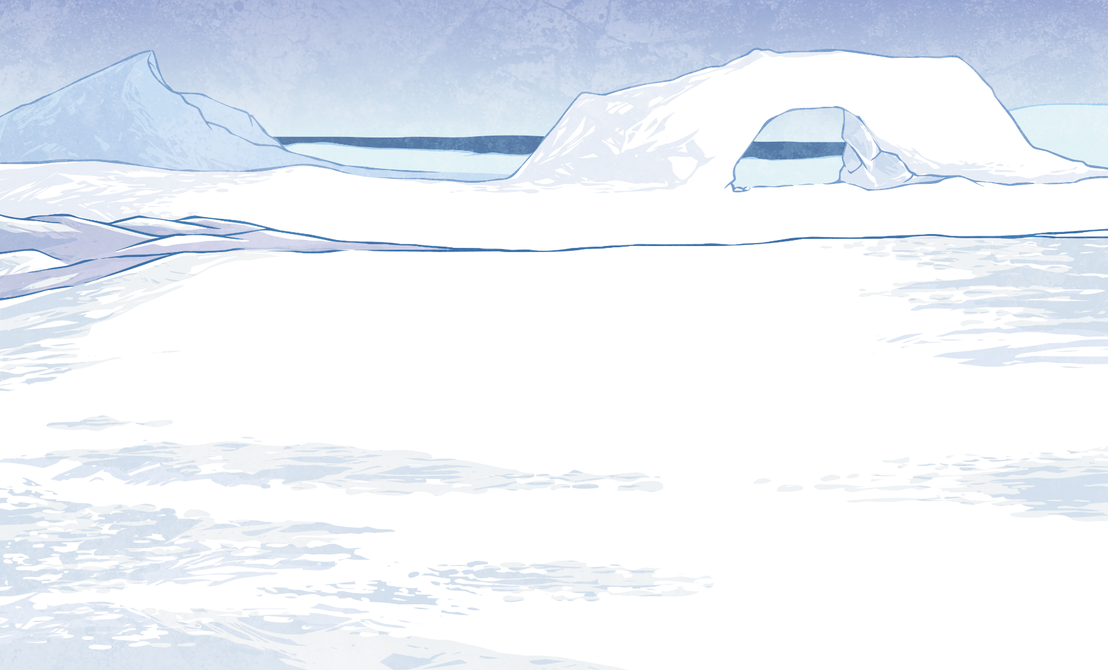
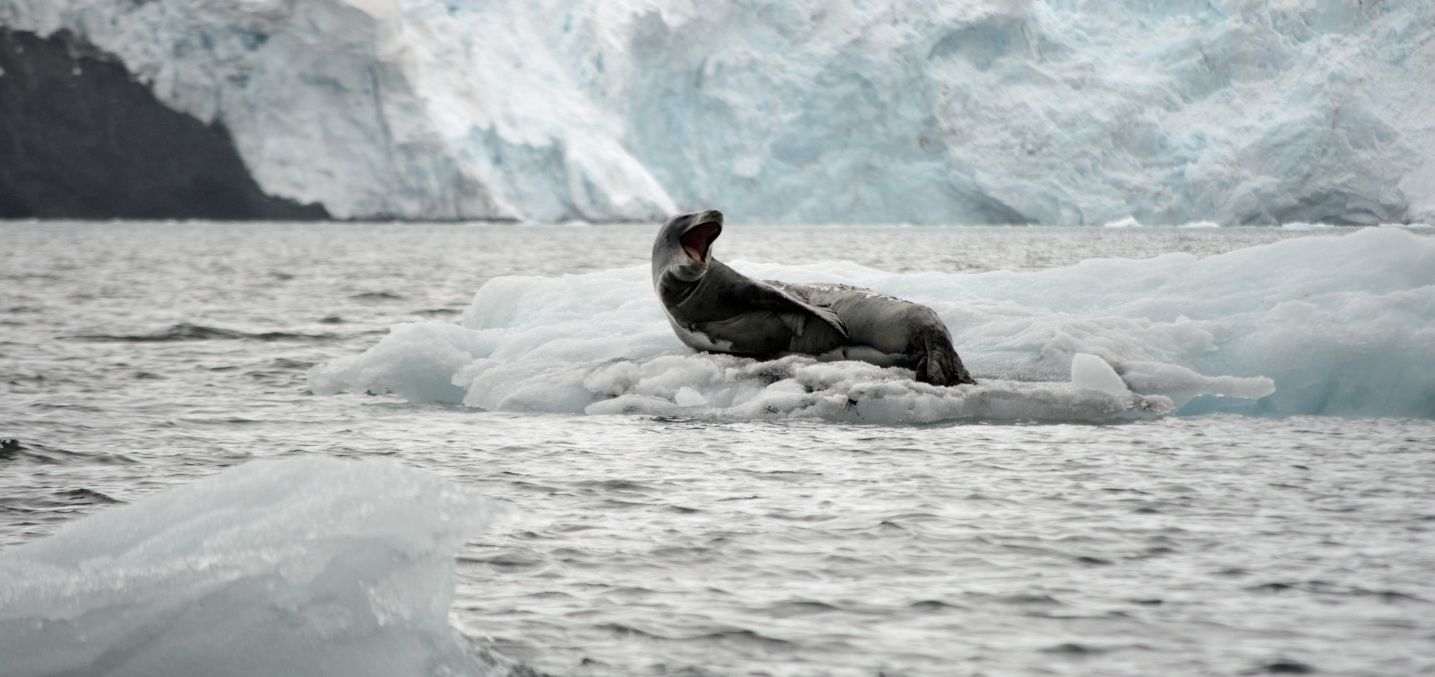
x
x
What Lives in the Southern Ocean?
Emperor Penguin
Leopard Seal
Leopard seals are both land and sea creatures. A leopard seal’s nostrils are slits that close when the seal is under water. Leopard seal’s eyes open wide while they are swimming to allow more light in and help the seal find food.
Emperor penguins have layers of fat and thick skin to protect them from cold temperatures. During extremely cold temperatures, emperor penguins huddle in groups of up to 1000 to help keep each other warm. Their bodies are streamlined to help them glide quickly in the water when catching prey.
?
?

Slide 8
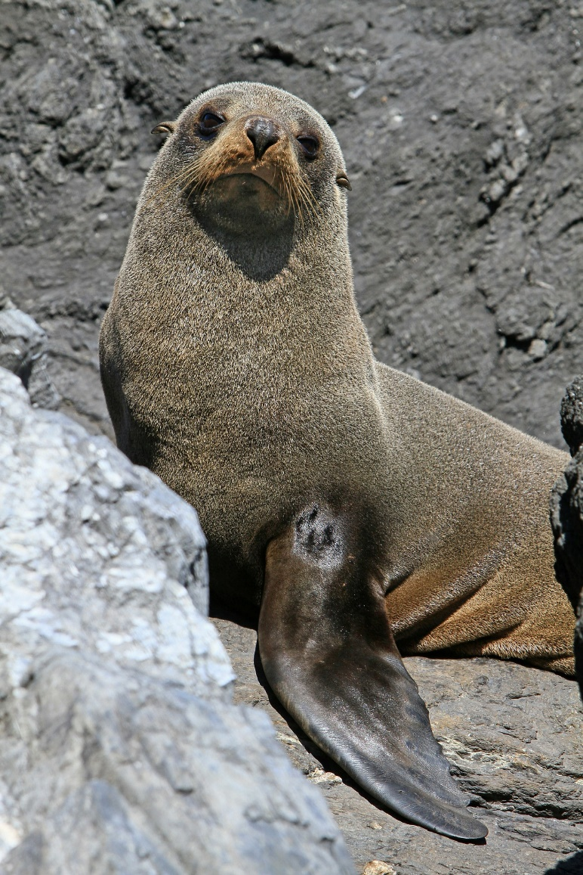
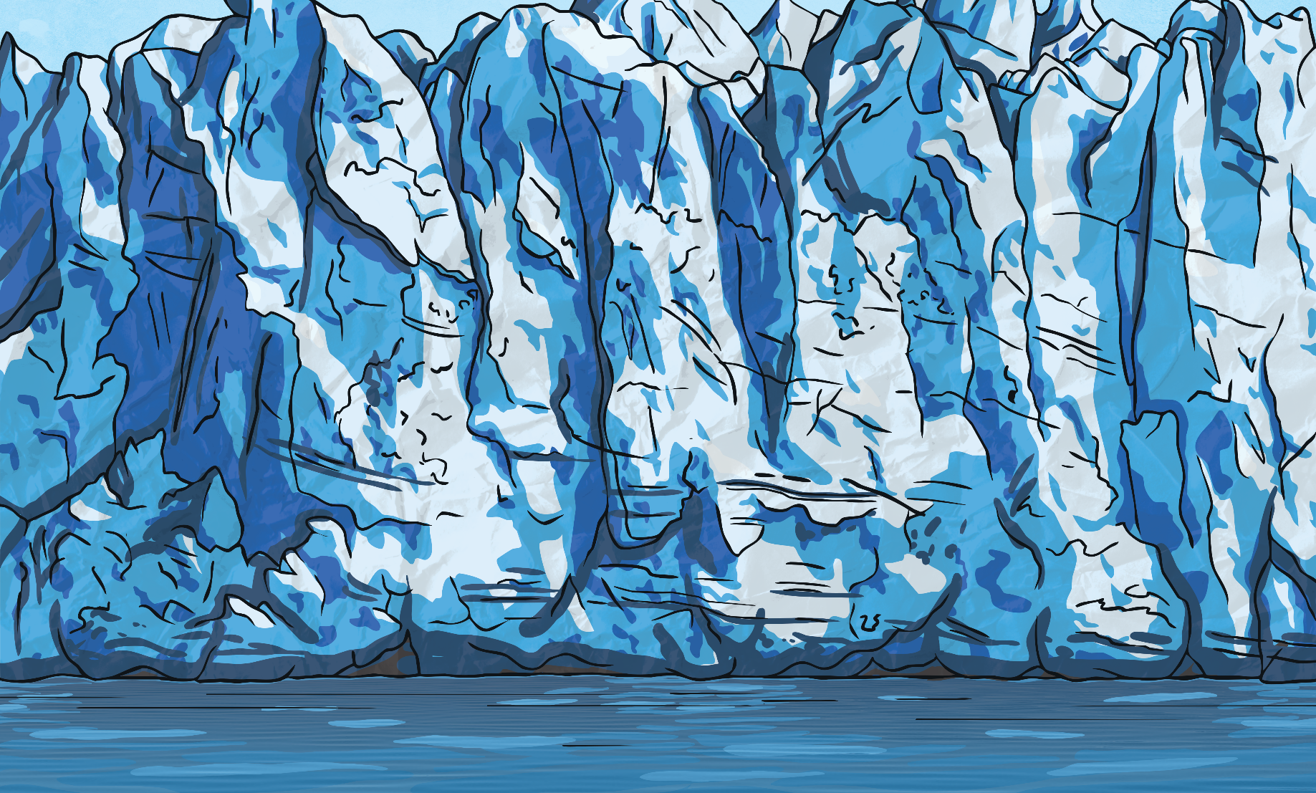
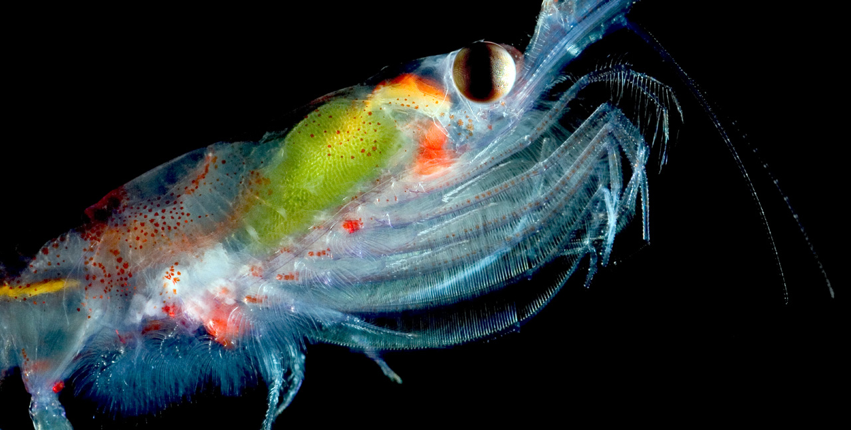
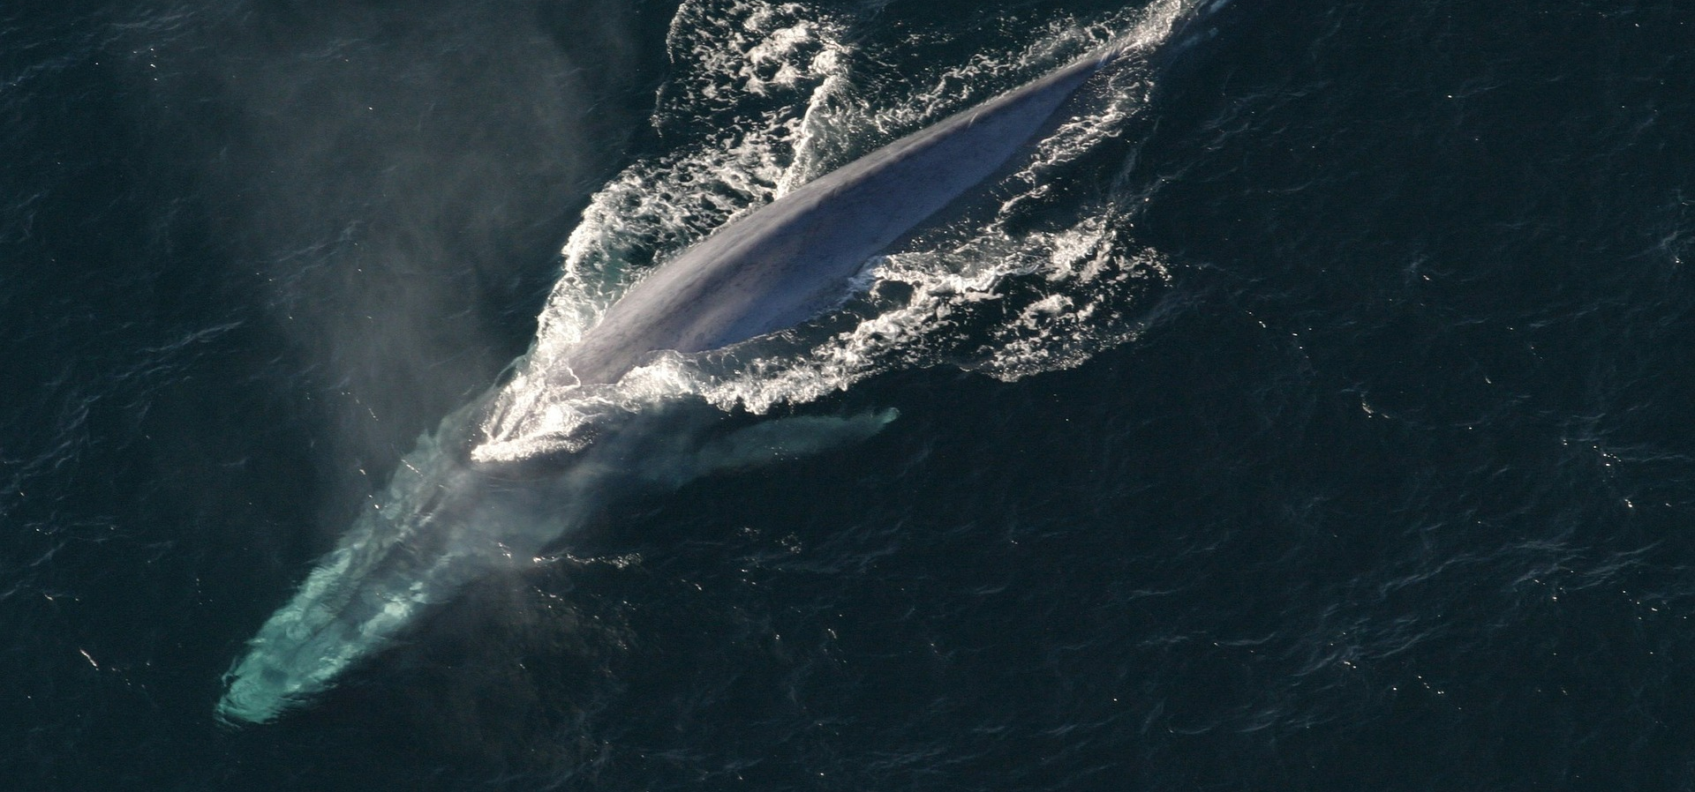
x
x
What Lives in the Arctic Ocean?
Northern Fur Seal
x
Krill
Blue Whale
Krill are towards the bottom of the food chain in many oceans. They are small crustaceans and are eaten by a range of creatures, including whales, seals, penguins and squid.
Blue whales are migratory. They live in the colder waters of the Arctic oceans and other oceans in the summer and then move to more tropical oceans in the winter. Blue whales have a thick layer of fat known as blubber which helps keep them warm.
Northern fur seals spend nearly all their time in the ocean, only coming to land to breed. They keep their front and rear flippers out of the water while bobbing on the surface, this is called ‘jughandling’.
?
?
?
Translucent krill by Maia Valenzuela is licensed under CC BY 2.0.

Slide 9
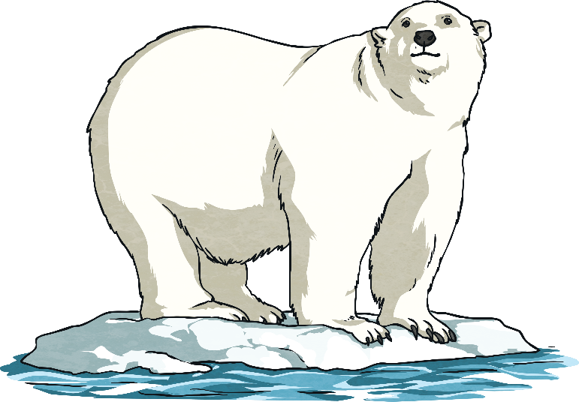
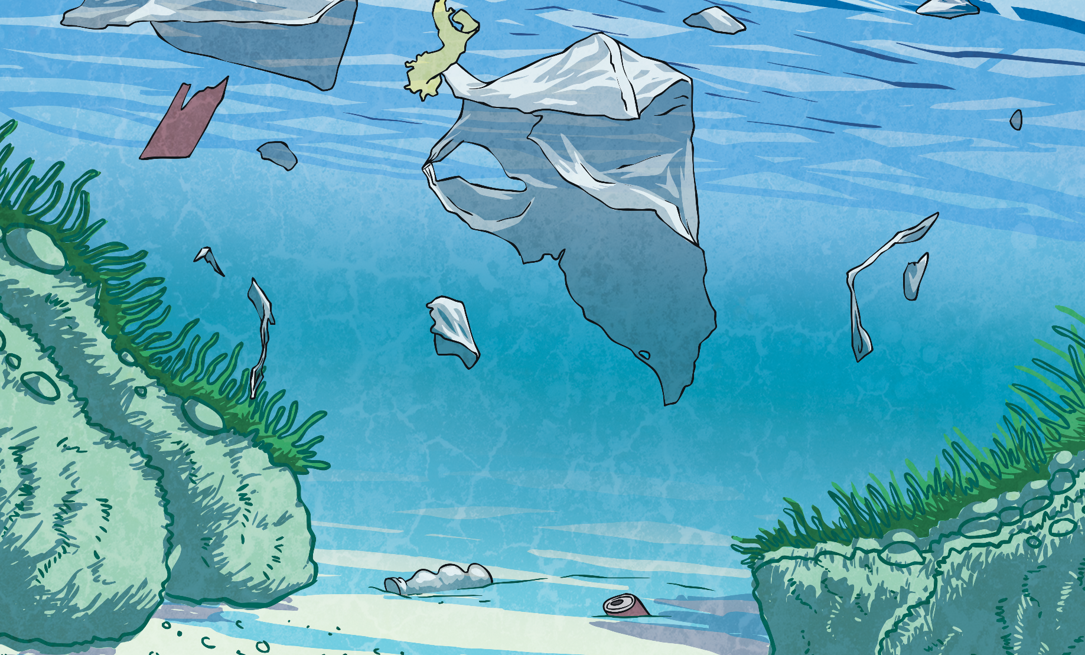
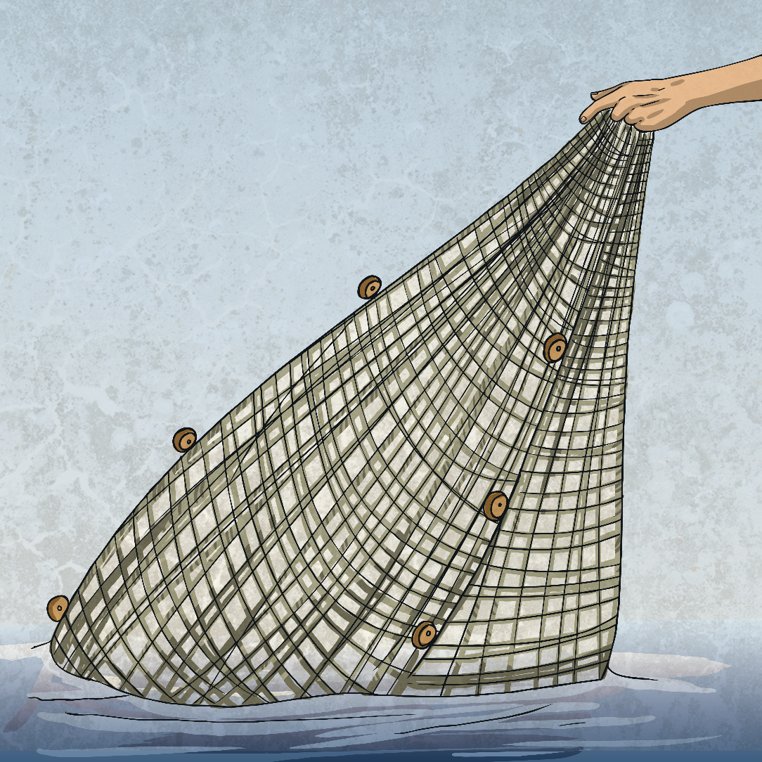
Threats to Ocean Habitats
Climate change is affecting the temperature of oceans, making some of them unsuitable for plants and animals that have adapted to different temperatures.
Climate change is causing the polar ice caps to melt, which means there is less land for creatures like the northern fur seal to breed on.
Over fishing causes problems in the ocean food chain, leading to a lack of food across many species.
Pollution is damaging ocean habitats. Oil spills damage the water-repellent fur and feathers of sea creatures. Scientists have found tiny pieces of plastic inside the bodies of fish.

