Slide 1

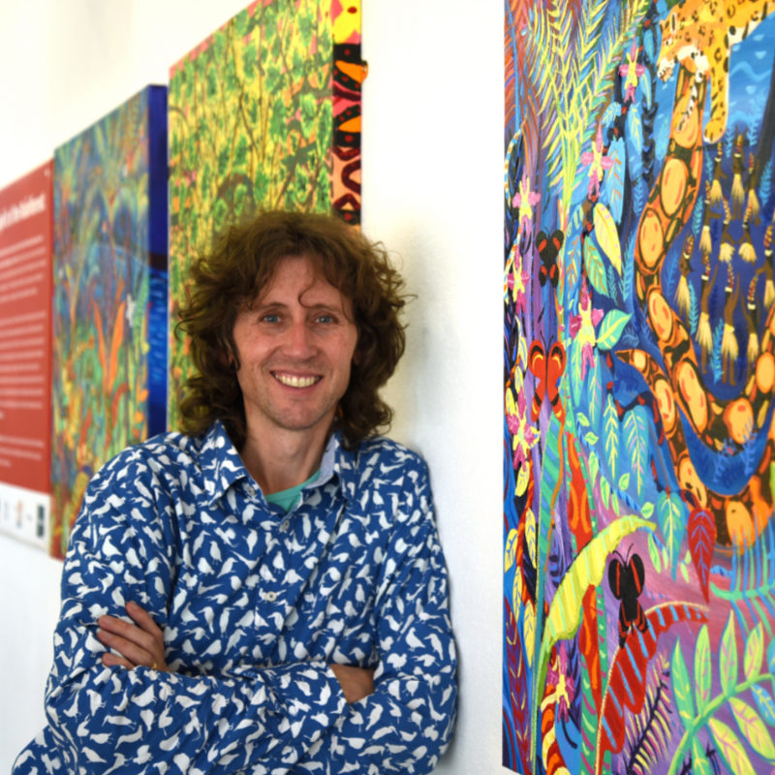
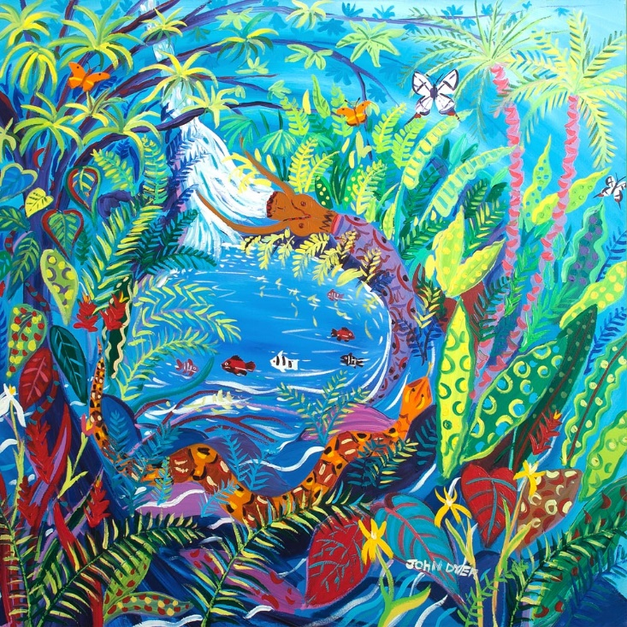



Chapter 1: Spirit of the Rainforest
Visit the Yawanawá tribe with artist John Dyer.
Develop your artistic skills whilst discovering the people, plants, animals and culture from one of the most diverse ecosystems in the world, the Amazon rainforest.
© John Dyer Gallery
© John Dyer

Slide 2
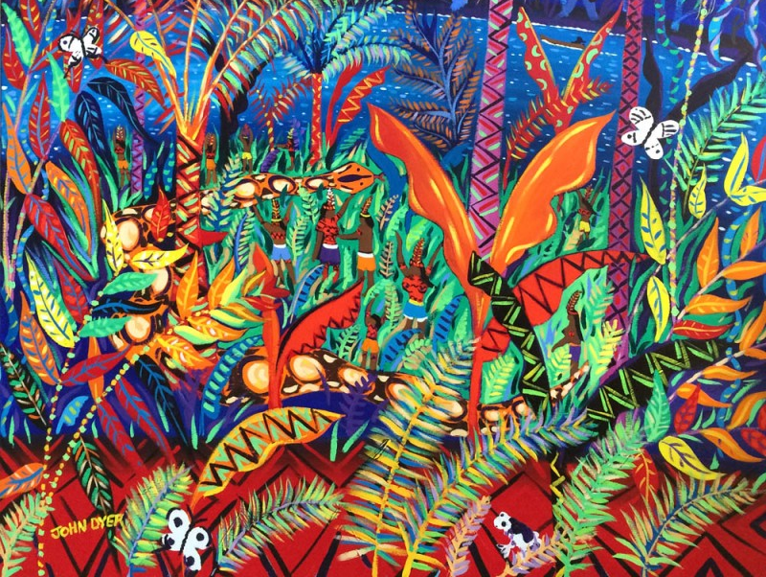


© John Dyer
Lesson 3. Rainforest wildlife
Learning objectives:
To describe the three main types of animal adaptations
To describe the adaptations of six animals found in the Amazon rainforest
To experiment with a range or art techniques.

Slide 3

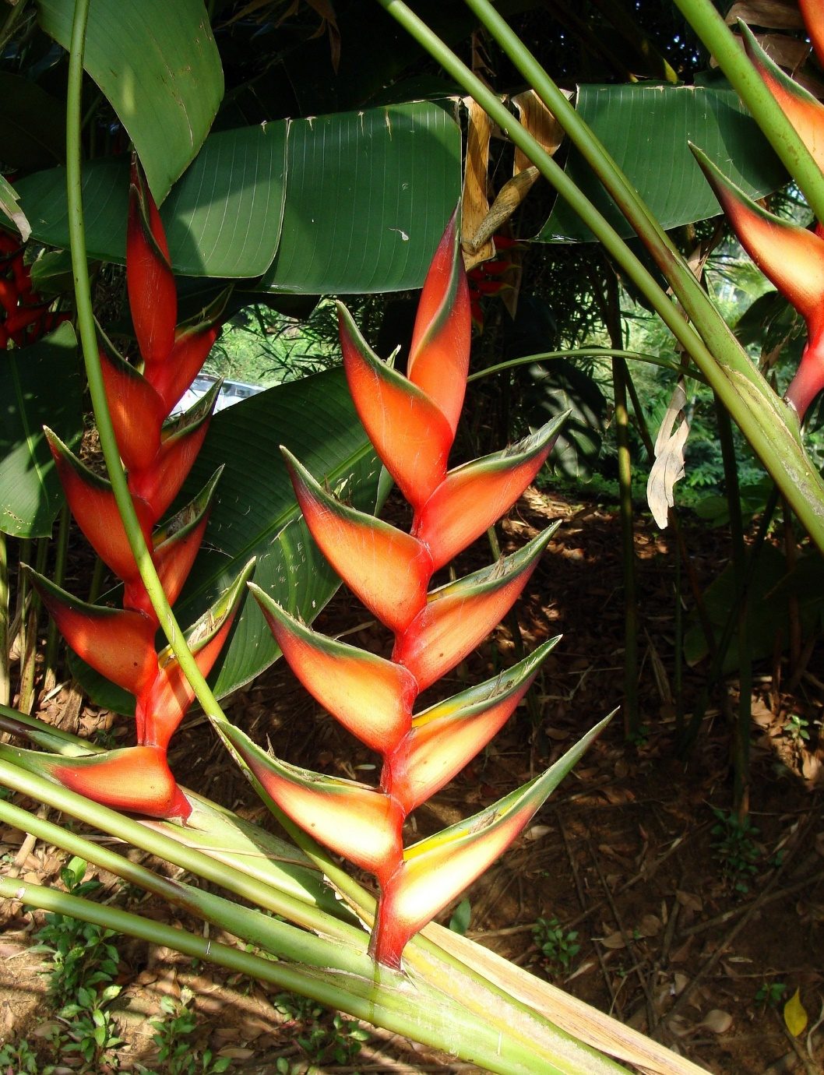
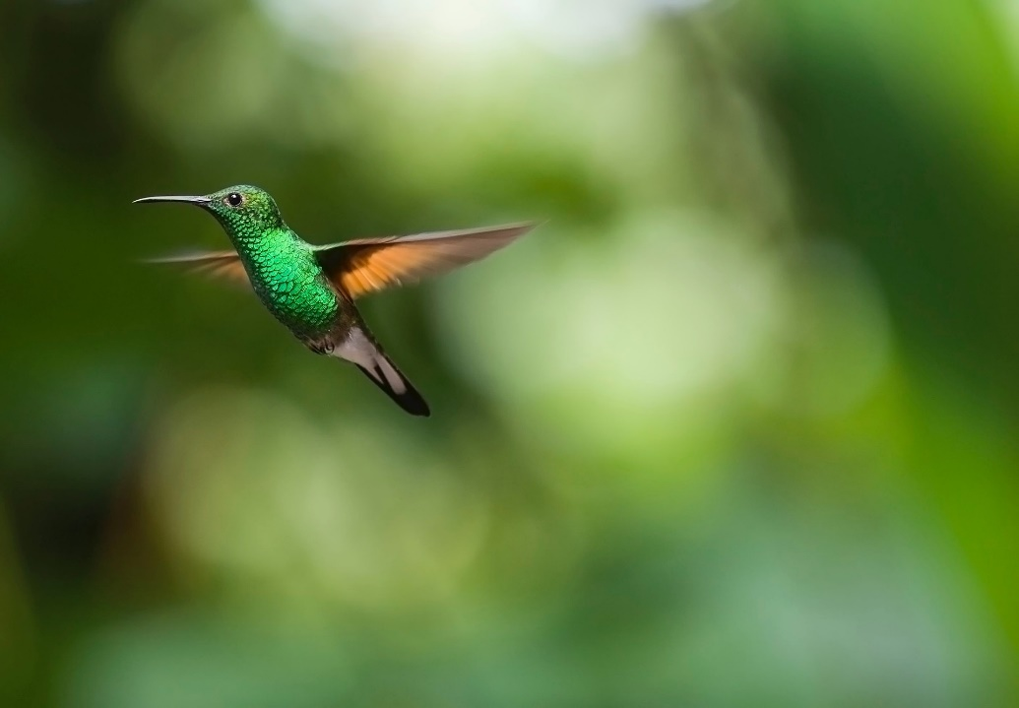
Camel
2
Lobster-claw
The nectar from the flowers is important food for hummingbirds and butterflies.
Pixaby.com
Pixaby.com

Slide 4

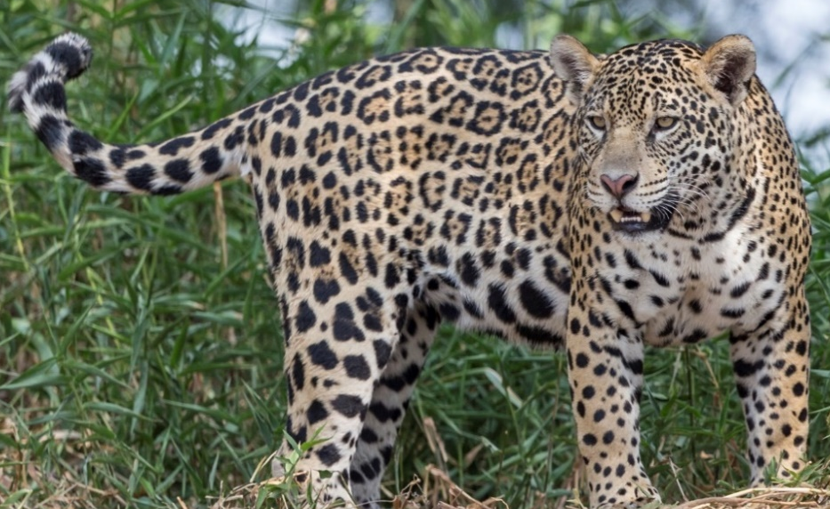
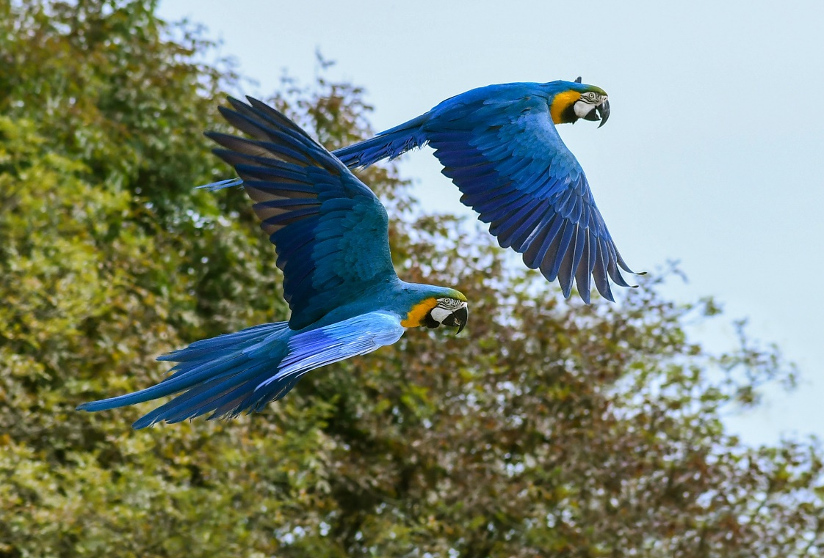
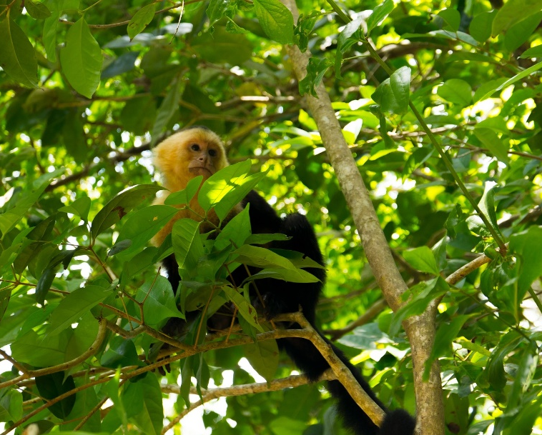
Camel
There are three main types of adaptations:
Physical
Social
Behavioural.
© www.tigersintheforest.com
Pixaby.com
Pixaby.com

Slide 5

Camel
2
Walk around the room and look at the different animal posters.
Make a list of the different adaptations.
Use the information on the posters to answer these questions:
What adaptation does a jaguar and a black caiman have in common?
Which is the shortest lived and which is the longest lived animal?
Which three animals lay eggs?
What adaptation does a jaguar and a macaw have in common?

Slide 6

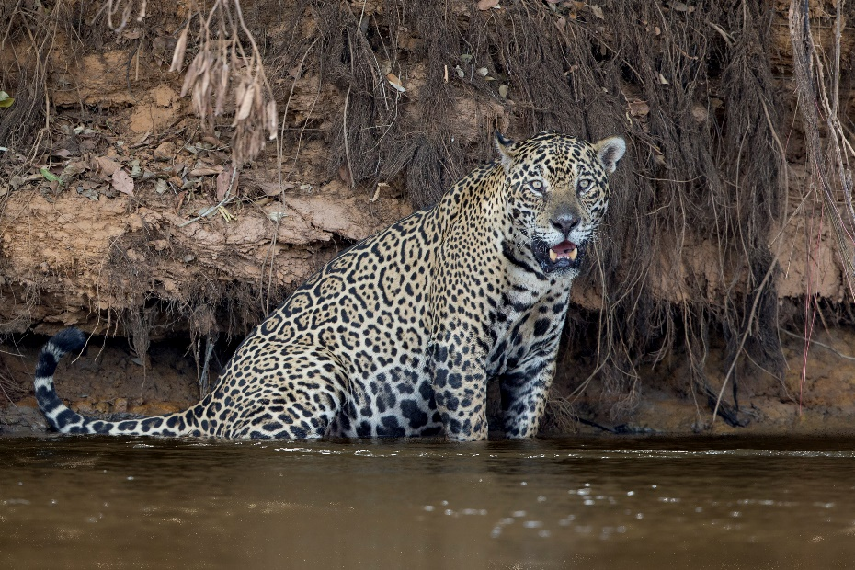
Interesting facts:
They are carnivores (they eat other animals).
There are only around 15,000 left in the wild.
They live for 12-15 years.
They are only found in Central and South America.
© www.tigersintheforest.com
Adaptations:
We have spots to help us blend in on the forest floor (camouflage)
We have big teeth to help us catch and eat our prey
We have good night vision to help us move around at night.

Slide 7

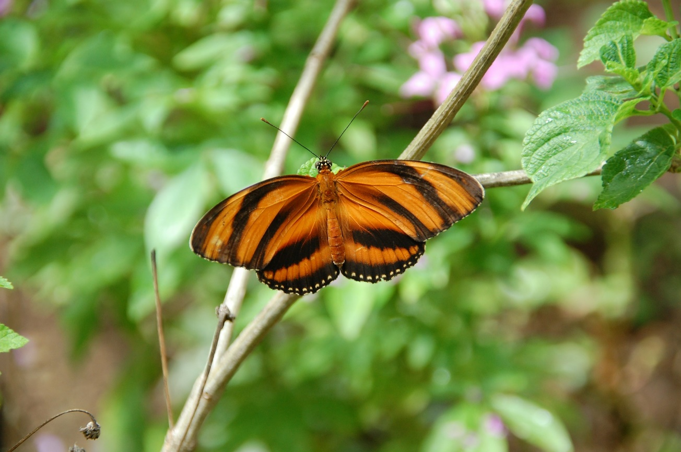
Camel
Interesting facts:
Most butterflies only live for 2-4 weeks.
They can be anything from around ½cm to 30cm in size.
There are about 24,000 difference species of butterfly in the world.
The species in the picture is called Dryadula phaetusa.
Pixaby.com
Adaptations:
We have wings so that we can fly
We come in lots of different colours to allow us to blend in with the rainforest or to make predators believe we are poisonous
We are diurnal (active during the day) to make the most of the sun’s warmth.

Slide 8

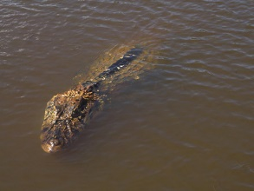
Camel
Interesting facts:
They live in slow-moving fresh water.
Males can be between 5.2 and 6 metres in length!
Females can lay 30 to 60 eggs at a time.
Today they are quite common in Brazil.
© Leonardo C. Fleck
Adaptations:
We have big teeth to help us catch and eat our prey
We have powerful tails and webbed feet to help us move through the water
We are one of the strongest animals in the rainforest.

Slide 9

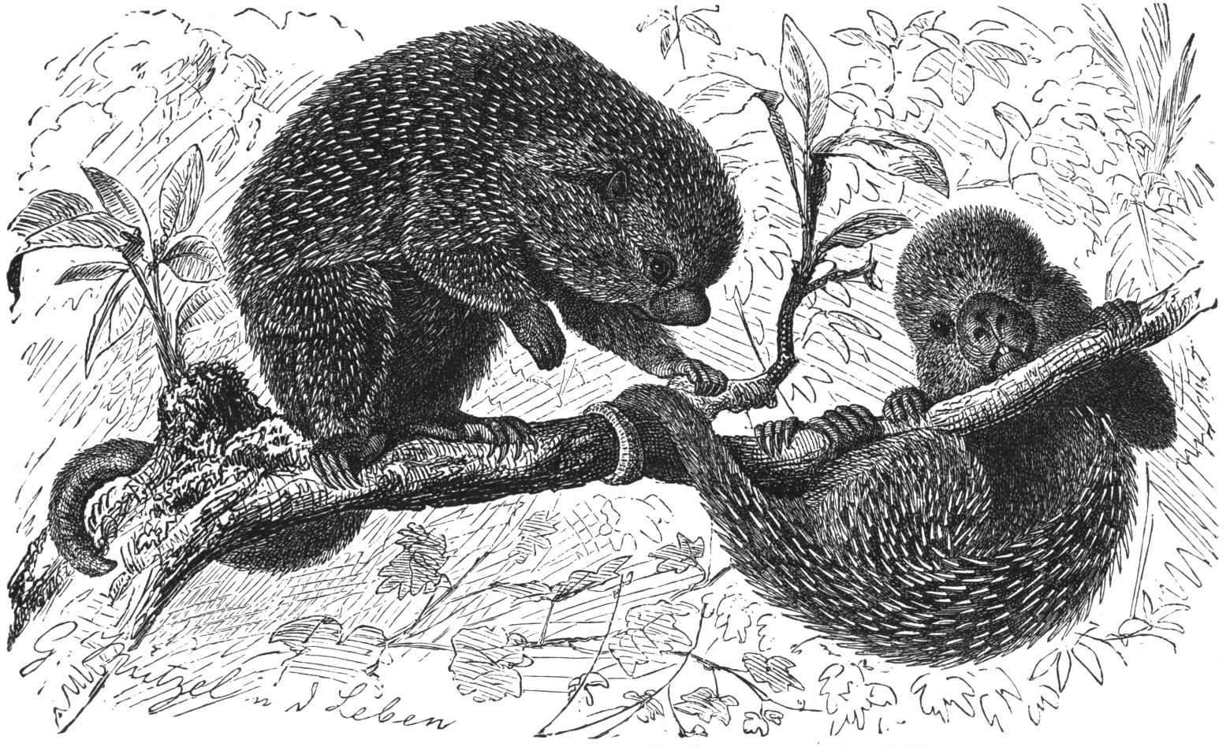
Camel
Interesting facts:
They live in trees, rarely coming down to the ground.
They eat leaves, fruit, and small fresh twigs and shoots.
They can grow up to 1m in length.
They stamp their back feet when they get excited.
Gustav Mützel, Brehms Tierleben, Small Edition 1927
Adaptations:
We are covered in short, thick spines to protect us from predators
We have prehensile tails that allow us to grip onto branches
We are nocturnal, moving around the forest at night.

Slide 10

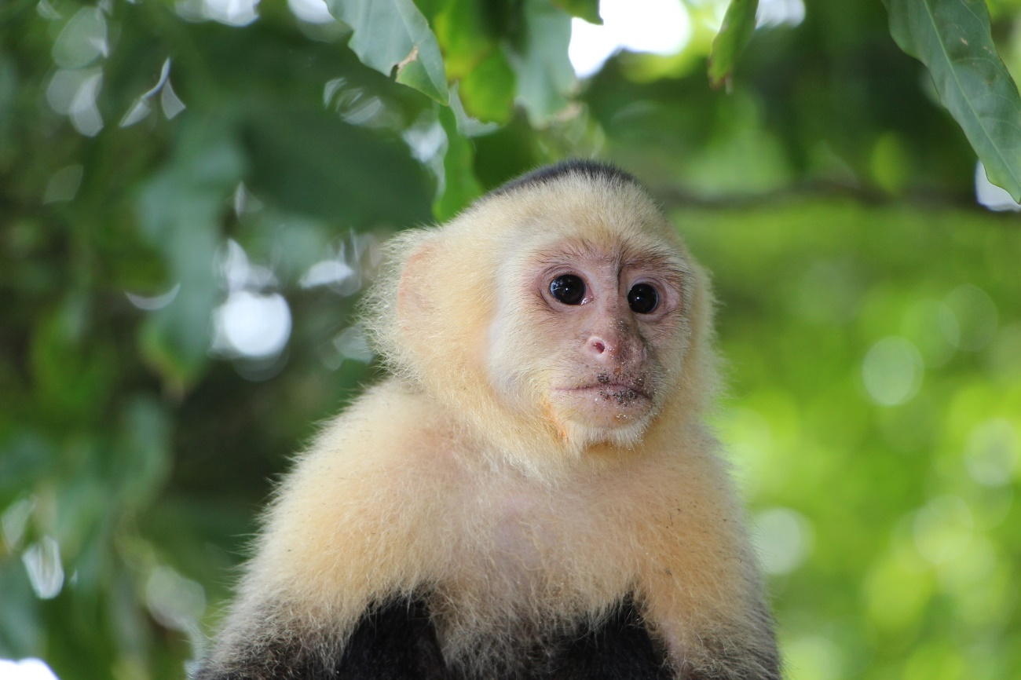
Interesting facts:
Capuchins are New World Monkeys.
They can live for 25 years.
They weigh around 900g when fully grown – that is less than a bag of sugar.
They are only found in Central and South America.
Pixaby.com
Adaptations:
We live in groups to help keep us safe from predators
We live in trees where we can find food
We have flexible tails to help us move around in the tree tops.

Slide 11

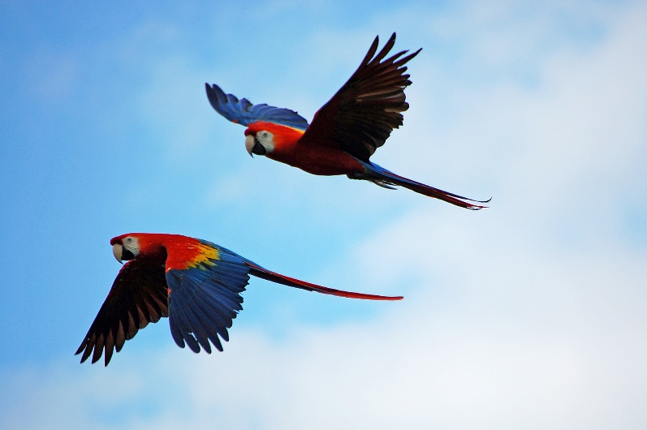
Interesting facts:
They can live for up to 60 years.
There live in flocks of 10-30 individuals.
There are 18 different species of macaw.
Six of these are now endangered.
Pixaby.com
Adaptations:
We have strong beaks to help us crack open nuts and seeds
We have wings so that we can fly
Our bright colours allow us to blend in amongst the fruits and flowers of the rainforest.

Slide 12


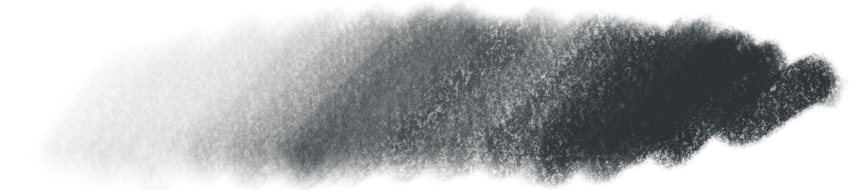

Recommended materials:
soft pencil
charcoal
Pastel.
Exploring tone
Using your material of choice explore the range of tones it can create. Use different amounts of pressure.
Mark marking
These all use different marks
Showing light and dark through mark making. The more marks there are in one area the darker it will look
You could use dots, lines, shapes, cross hatching or any combination of these to develop texture and tone.

Slide 13

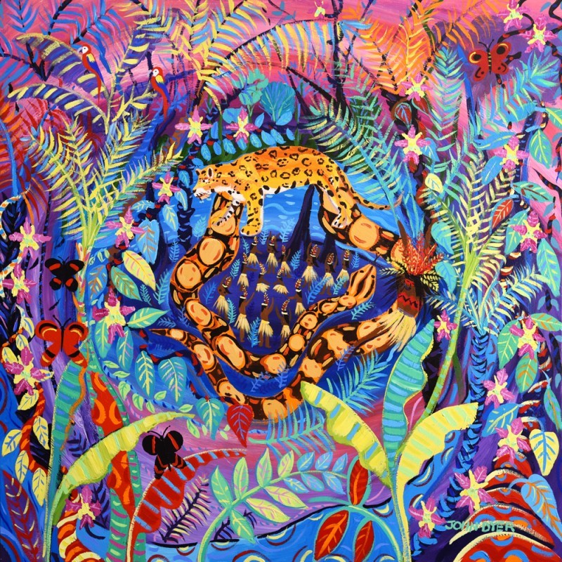

© John Dyer
Activity:
Try your hand at painting or drawing some of the animals you have learnt about today, in John’s style.
Top tips:
Feel free to rotate your page while you’re drawing or painting to make sure your hand isn’t at an awkward angle or smudging your work
You can use another piece of paper over your work as a mask to prevent smudging
Use a centre line and horizontal line for symmetry like in the ‘drawing people’ exercise in Lesson 1
Wait for the paint to dry slightly before adding other colours
Use at least two tones of your animals main colour e.g. red and a lighter red as this adds light and shade.

Slide 14
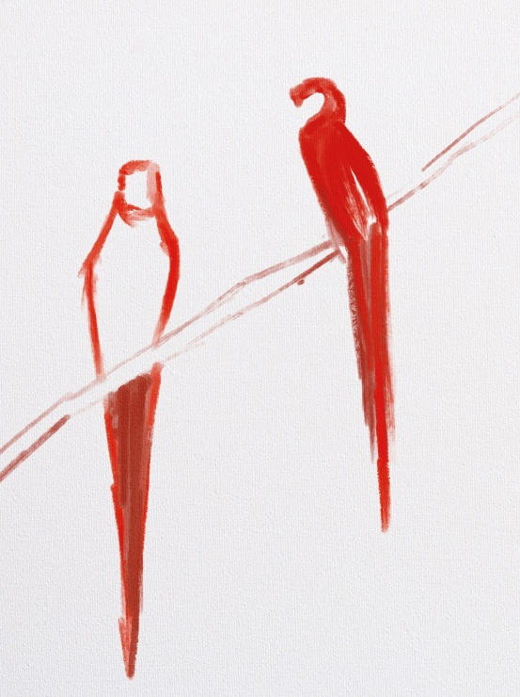
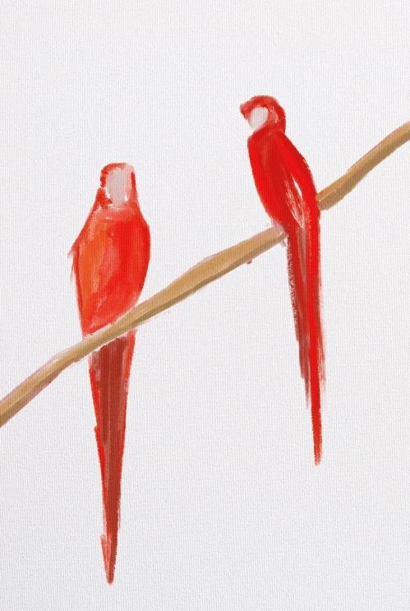
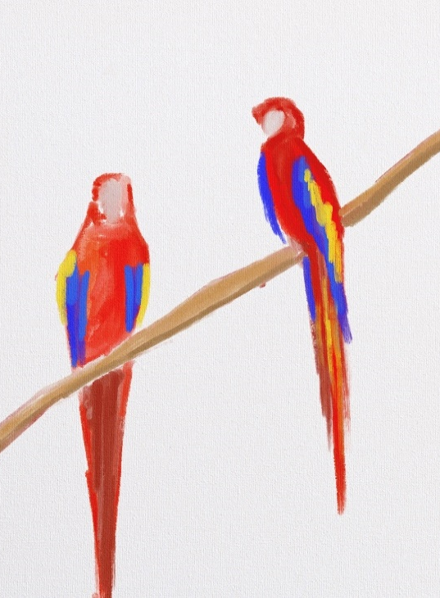
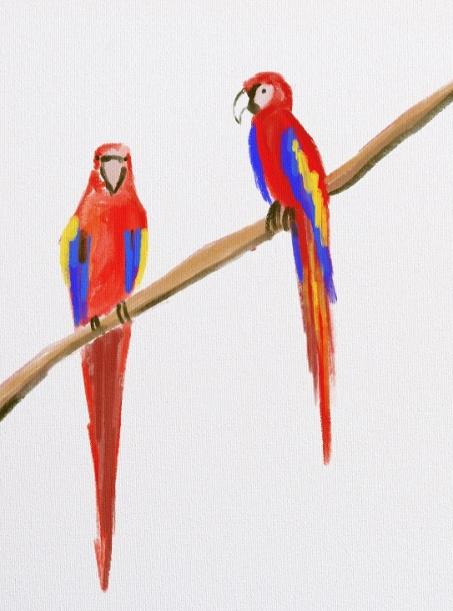
Step by step guide (painting a pair of macaws):
Step 1:
Look at an image of your animal
See the overall shape
Using a thin brush and pale paint, or a soft pencil establish the main shape of your animal.
Step 2:
Work with the main colour (varying tones) of your animal to fill in the shape
Use your outline as a rough guide but don’t worry if you go over it.
Step 3:
Using the other colours found on the animal start to add the details e.g. patterns or feathers.
Step 4:
Finish with details such as beaks, feet, eyes, noses etc. to bring your animal to life!

Slide 15

© John Dyer
Tell me…
…something you know now that you didn’t know an hour ago
…one adaptation shared by a Brazilian porcupine and a capuchin
…one top tip you need to remember when painting animals

