Slide 1

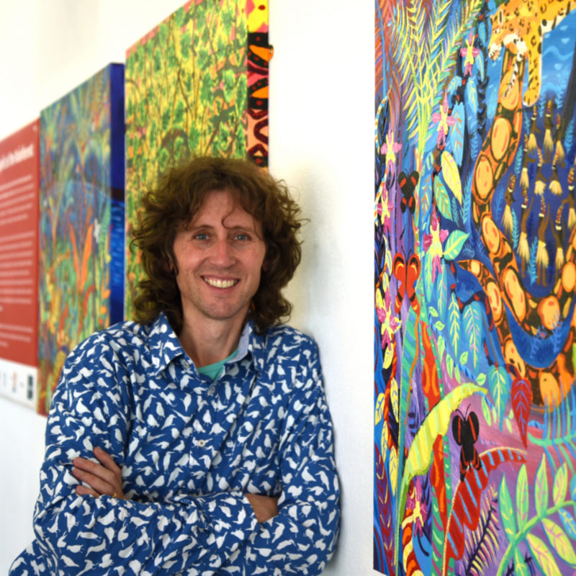
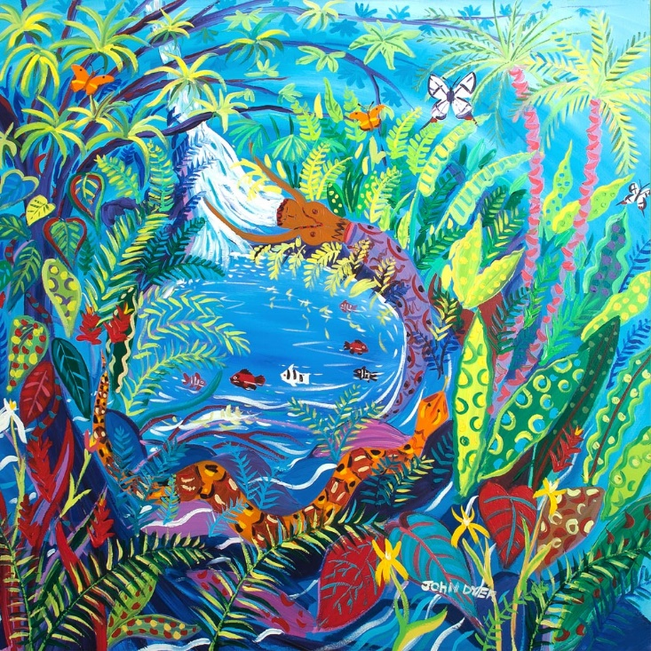



Chapter 1: Spirit of the Rainforest
Visit the Yawanawá tribe with artist John Dyer.
Develop your artistic skills whilst discovering the people, plants, animals and culture from one of the most diverse ecosystems in the world, the Amazon rainforest.
© John Dyer Gallery
© John Dyer

Slide 2
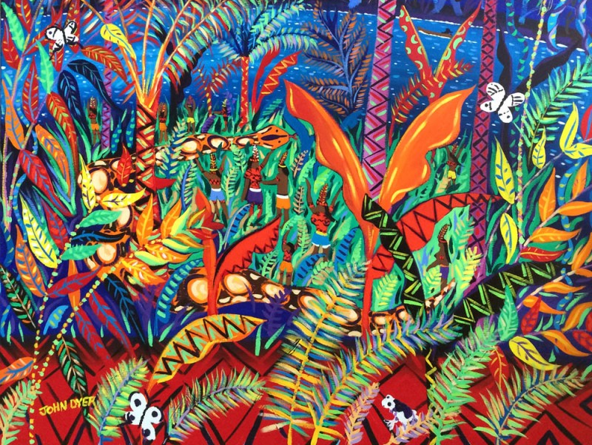


© John Dyer
Lesson 5. Art project
Learning objective:
To create your own rainforest inspired piece of modern art – using information and skills learnt during this course.

Slide 3

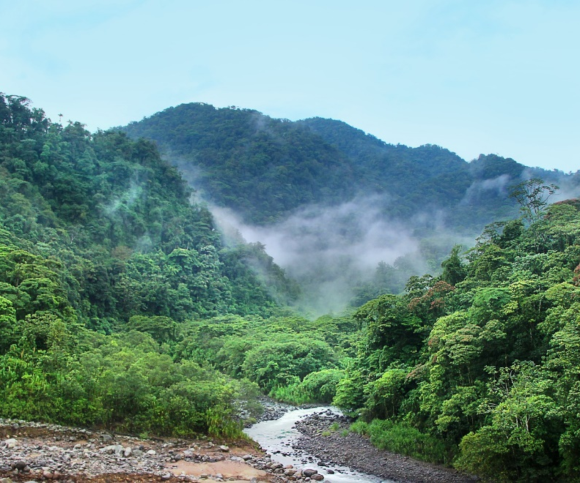
Use the techniques you have been practicing to create your own piece of rainforest inspired art.
Think about what you have learnt about the people, plants and animals of the rainforest.
Your art should aim to express your own connection with the rainforest.
Pixaby.com
© John Dyer

Slide 4


We have talked about individual elements like people, plants and animals as well as some techniques but how do you bring these together into a single piece of art?
https://vimeo.com/329404071
© John Dyer
Notes:
If the embedded video doesn’t play please use this link: https://vimeo.com/329404071

Slide 5


https://vimeo.com/330526438
This project was sponsored by
Procreate Pocket, iPhone app of the year 2018
Notes:
If the embedded video doesn’t play please use this link: https://vimeo.com/330526438

Slide 6

© John Dyer
Share your art with the world through
the online World Gallery
www.lastchancetopaint.com/submit-your-art/

