Slide 1

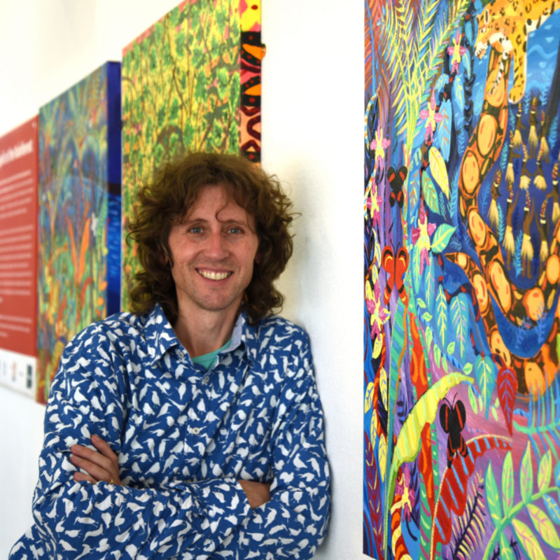
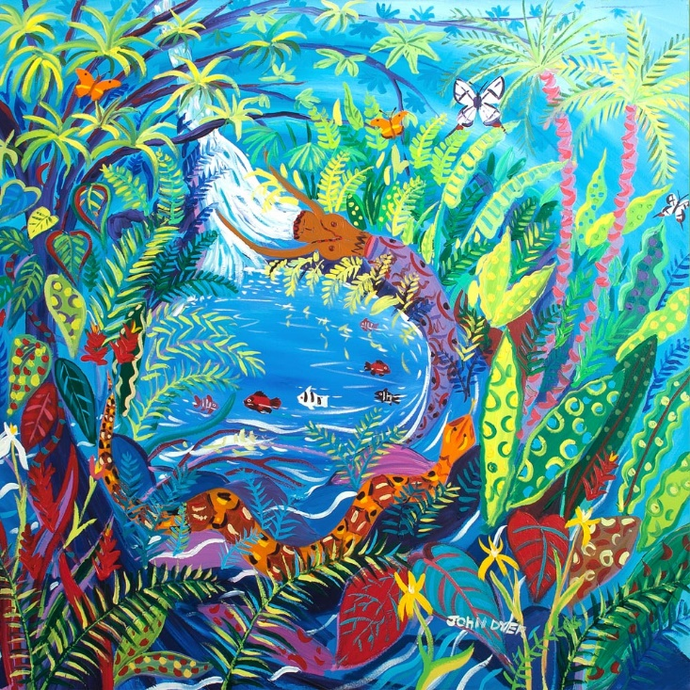



Chapter 1: Spirit of the Rainforest
Visit the Yawanawá tribe with artist John Dyer.
Develop your artistic skills whilst discovering the people, plants, animals and culture from one of the most diverse ecosystems in the world, the Amazon rainforest.
© John Dyer Gallery
© John Dyer

Slide 2
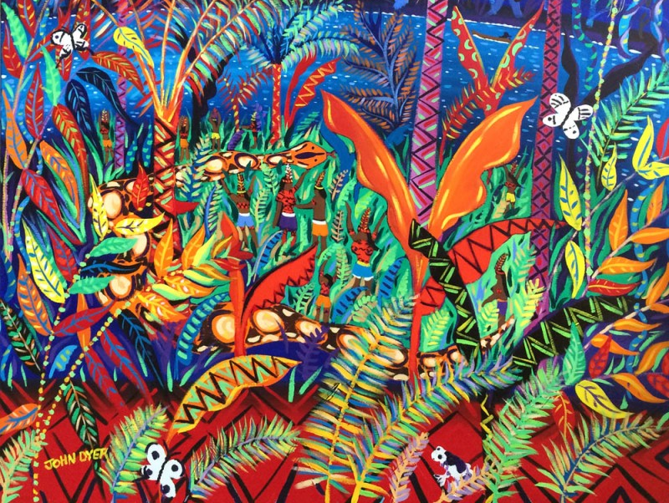


© John Dyer
Learning objectives:
To ask well thought out questions about a place, people and environment
To understand the importance of a balance between people, plants and animals in an ecosystem.

Slide 3

Camel
© John Dyer
John Dyer is a modern (contemporary) artist, born in 1968.
He focuses on colourful landscapes, architecture, gardens and notable events.
John started his career as a photographer and his first assignment was in the Amazon rainforest.
John travelled with his daughter, Martha-Lilly (a musician) and explorer Robin Hanbury-Tenison.
© John Dyer Gallery
© John Dyer

Slide 4

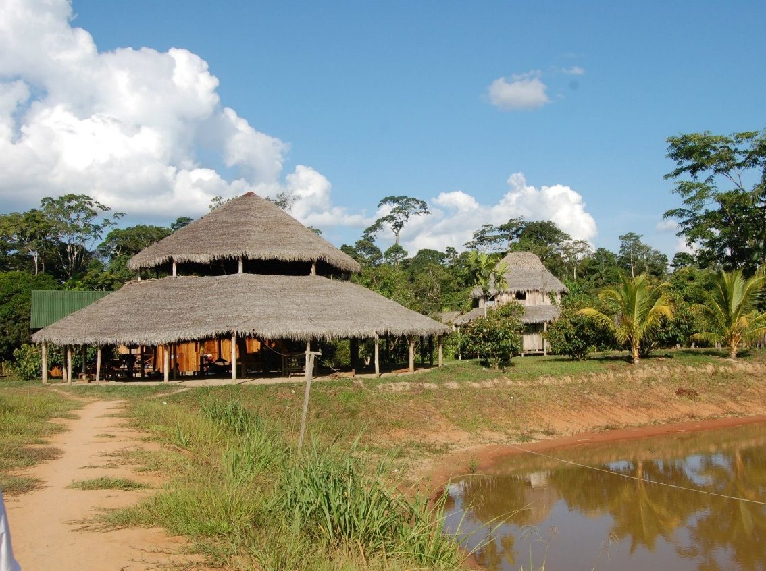
In Mutum, John painted alongside Amazon Indian artist Nixiwaka Yawanawá and several other members of the tribe.
Together they explored the deep connection between the tribe and the spirits of the rainforest, through art.
© Nixiwaka Yawanawá

Slide 5

Camel
Start with a question word:
Where, What, How, Why, When….
2. Consider your subject:
Are you talking to an individual or group directly?
You
Are you talking to someone about someone else?
[Name], He, She, They
Are you talking to someone about an object?
It, They
3. Add a verb:
Work, Think, Make, Protect, Get…..
Examples:
  What does Nixiwaka think about deforestation?
  How did you get your painting equipment to the village?
  What does it smell like in the rainforest?
© John Dyer

Slide 6

Camel
You can also add other phrases to make your sentence more complex:
• Although . . .
• As . . .
• Despite the fact that . . .
• Even though . . .
• If . . .
• In general . . .
• I would like to . . .
• Given that . . .
Examples:
  As a member of the Yawanawá tribe what does Nixiwaka think about deforestation?
  Given that you are using modern art materials how did you get them to the village?
  In general what does it smell like in the rainforest?
© John Dyer

Slide 7

Camel
What are the top 10 questions your class would like to ask?
1.
2.
3.
4.
5.
6.
7.
8.
9.
10.
© John Dyer

Slide 8

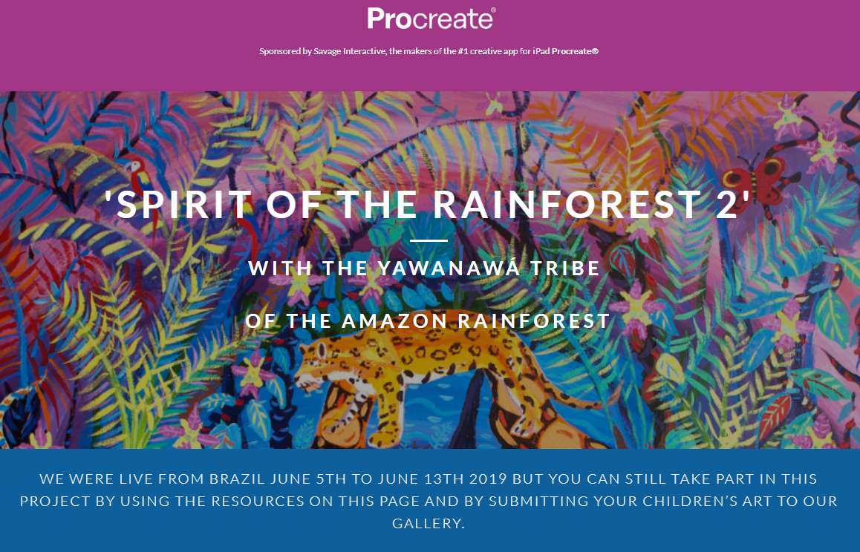
Join the Last Chance to Paint team in the rainforest by watching their video blogs, reading about their adventures, viewing some amazing artistic creations, and submitting your questions.
Don’t forget to join
the Facebook group for more information about future chapters.
© John Dyer

Slide 9
© John Dyer
Tell me…
…something you know now that you didn’t know an hour ago
…three questions and answers you found particularly interesting

Slide 10
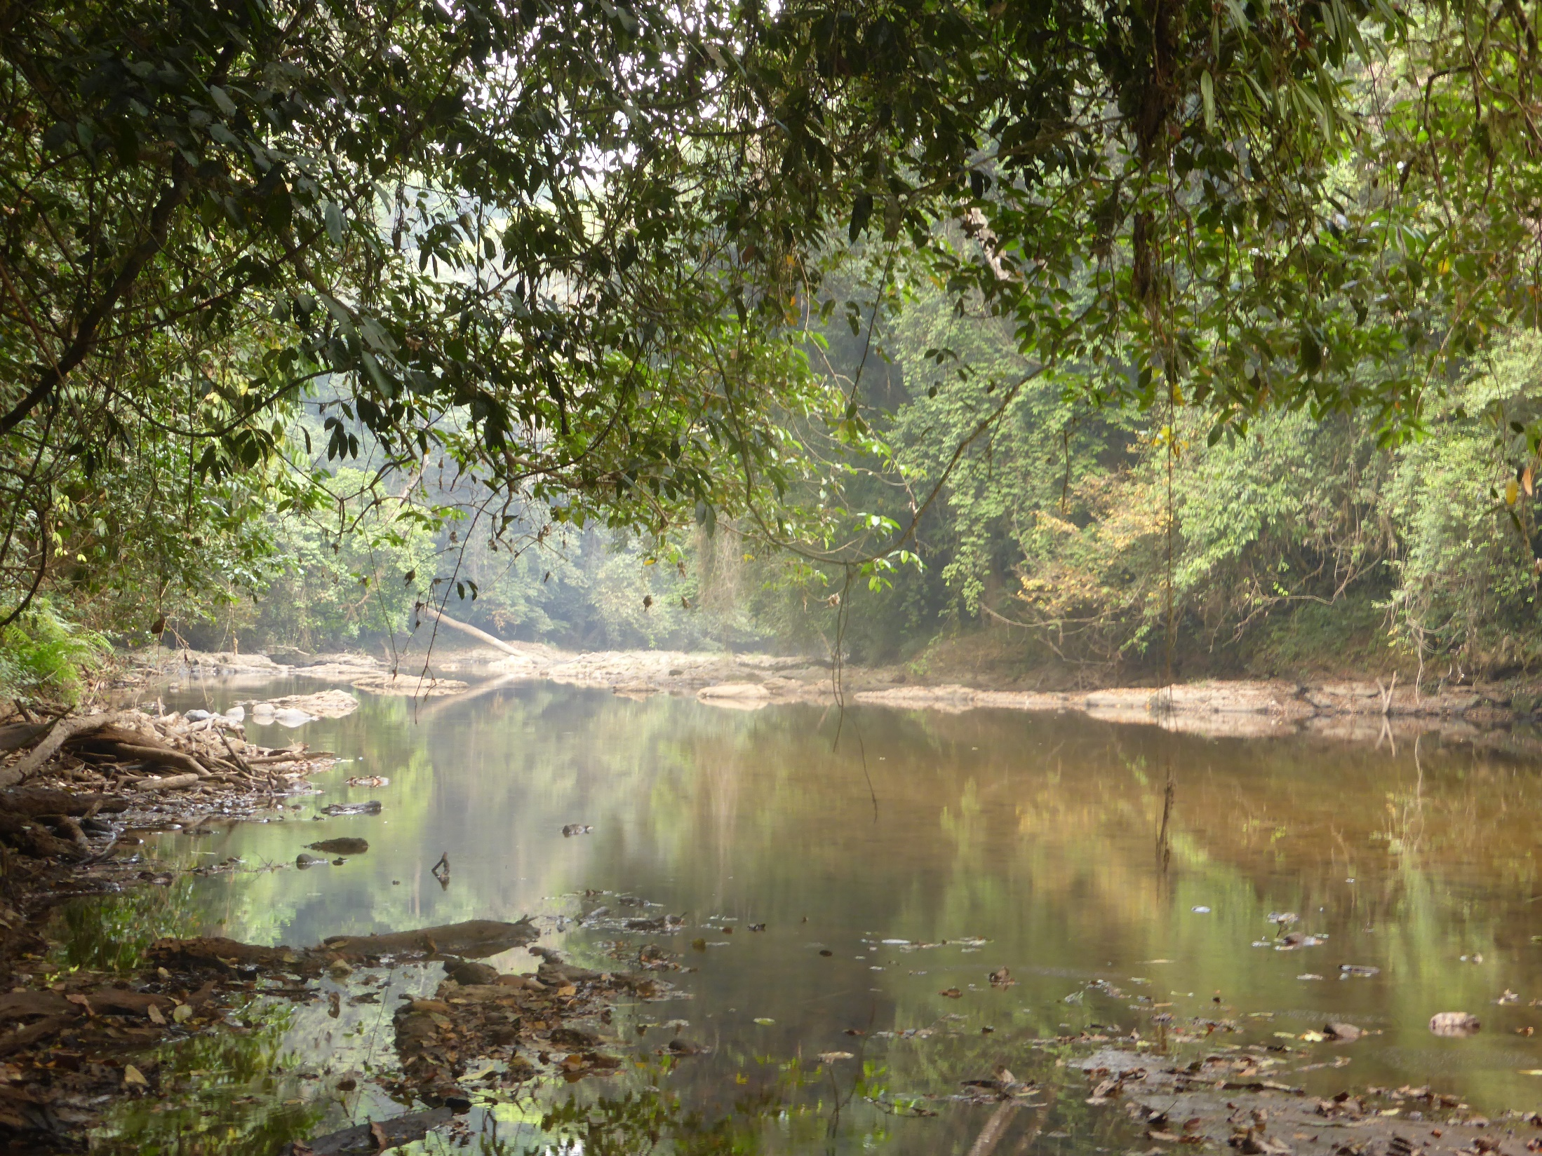
What would happen if we took all the resources we wanted from the world with no thought for tomorrow?
© BFF

Slide 11

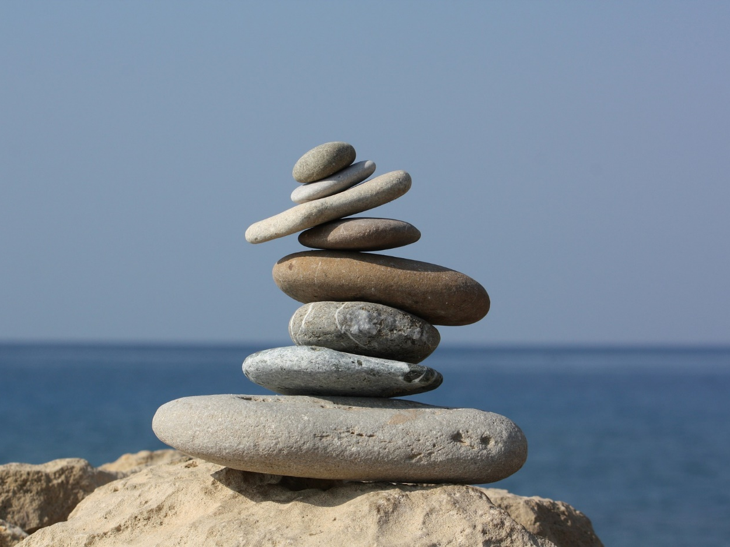
An ecosystem is an area where biological elements (e.g. plants and animals) interact with non-biological elements (e.g. soil and water).
An ecosystem can be as small as a single tree or as big as a forest.
Ecosystems must have balance if they are to work properly and be sustainable.
If even one change takes place to a component, this can have a knock on effect for the rest of the ecosystem.
© John Dyer
Pixaby.com

Slide 12
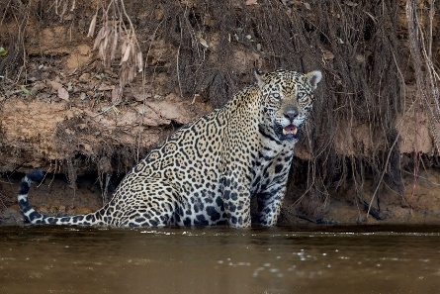
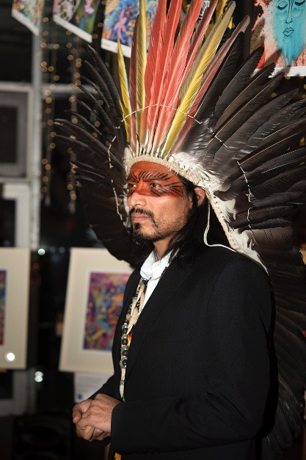
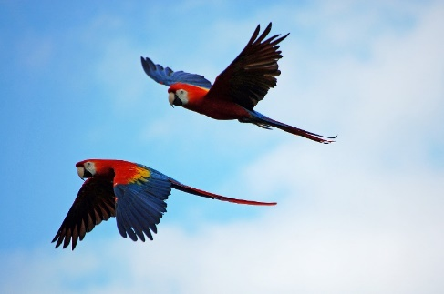
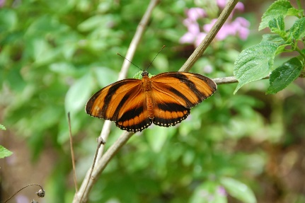
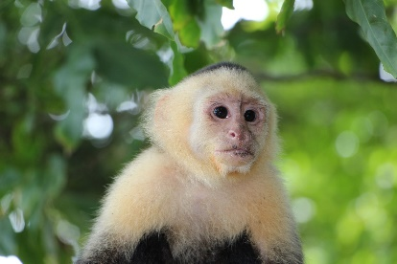
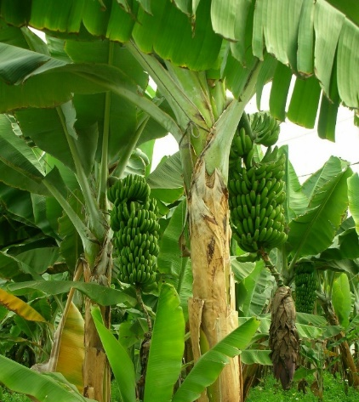
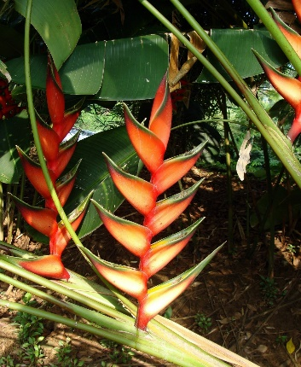
Jaguar (carnivore/ secondary consumer)
Human (omnivore – eating both plants and animals)
Macaw (herbivore/ primary consumer)
© www.tigersintheforest.com
Butterfly (pollinator/ primary consumer)
Pixaby.com
© Emily Whitfield-Wicks/Eden
Pixaby.com
Pixaby.com
Banana
(producer)
Capuchin (herbivore/ primary consumer)
Lobster-claw
(producer)
Pixaby.com
Pixaby.com
Decomposers and detritivores
© BFF

Slide 13
© John Dyer
Tell me…
…why balance is important in the rainforest

