Slide 1

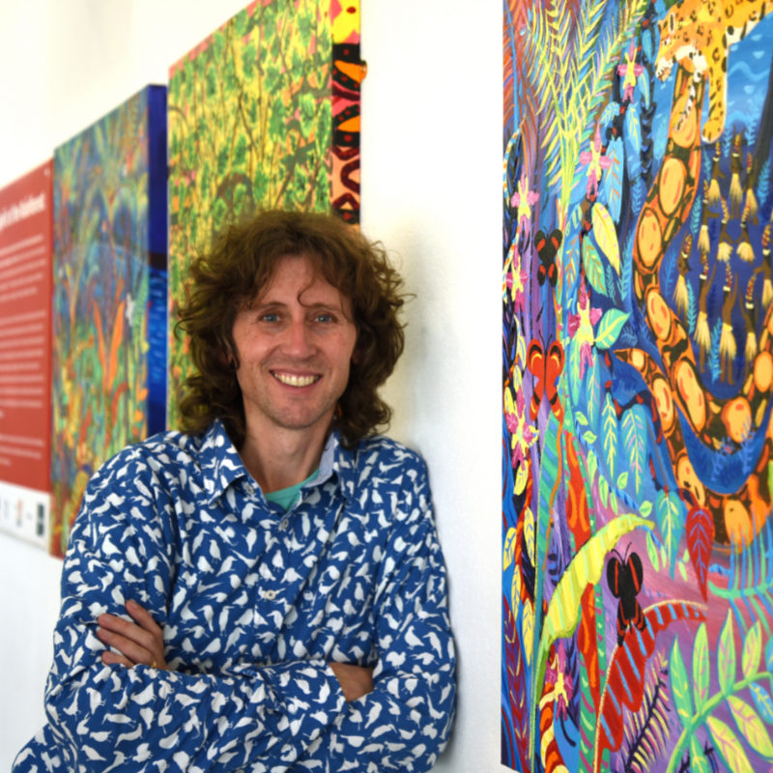
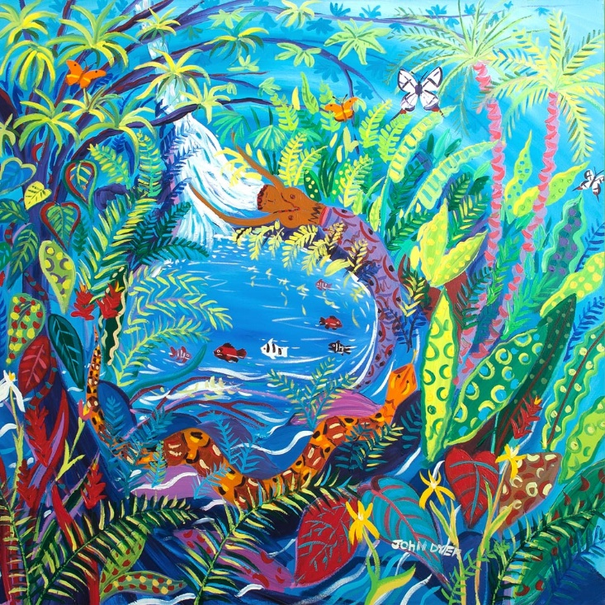



Chapter 1: Spirit of the Rainforest
Visit the Yawanawá tribe with artist John Dyer.
Develop your artistic skills whilst discovering the people, plants, animals and culture from one of the most diverse ecosystems in the world, the Amazon rainforest.
© John Dyer Gallery
© John Dyer

Slide 2
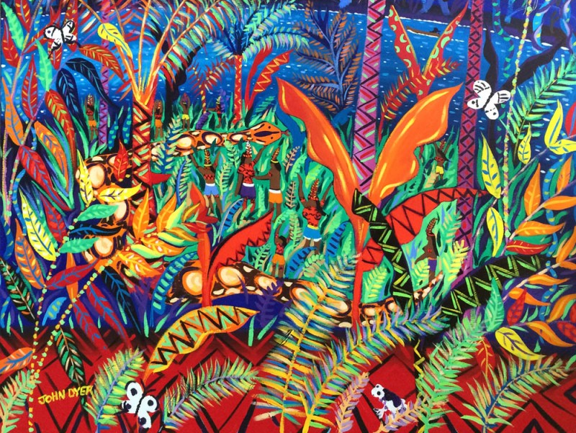


© John Dyer
Learning objectives:
To describe the characteristics of the rainforest
To describe six different plants found in the Amazon rainforest
To experiment with a range or art techniques, including different colours.

Slide 3

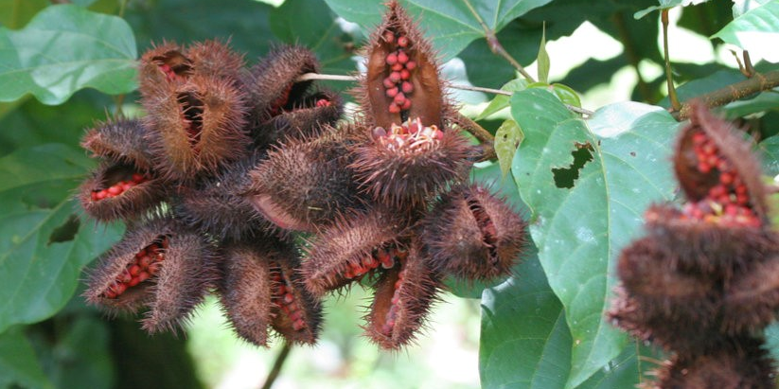
Camel
2
These are annatto seeds from the achiote plant. They are used by the Yawanawá tribe to make red paint.
But, do you know what we might use them for here in the UK?
Dye from the seeds can be used as an orange food colouring in cheese, cakes, and popcorn for example.

Slide 4

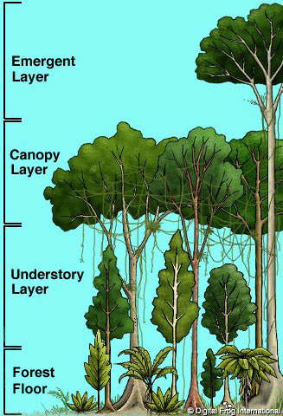

Rainforests are mainly situated around the Earth’s ____________
They have four main vegetation layers: emergent, ____________, understory and forest floor
And they are warm and ________.
Only around 5% of Earth’s land surface is rainforest – but about half of all animal and plant species live there.
The ____________ rainforest is the largest rainforest in the world.
© John Dyer

Slide 5
Rainforests are mainly situated around the Earth’s equator
They have four main vegetation layers: emergent, canopy, understory and forest floor
And they are warm and wet.
Only around 5% of Earth’s land surface is rainforest – but about half of all animal and plant species live there.
The Amazon rainforest is the largest rainforest in the world.
© John Dyer

Slide 6

Camel
2
Walk around the room and look at the different plant posters.
Use the information on the posters to answer these questions:
Which plant has fruit that can take a year to ripen?
Which plant is used to make chocolate?
Which plant is important for hummingbirds and butterflies?
Which plant does the Yawanawá tribe use to help build their houses?
Which plant family contains nearly 30,000 different species?
Which plant is a herb?

Slide 7

Camel
2
On each of the posters there is a letter.
Can you put them into the right order to make a word related to the lesson?
O
S
R
T
E
F
FOREST
© John Dyer

Slide 8

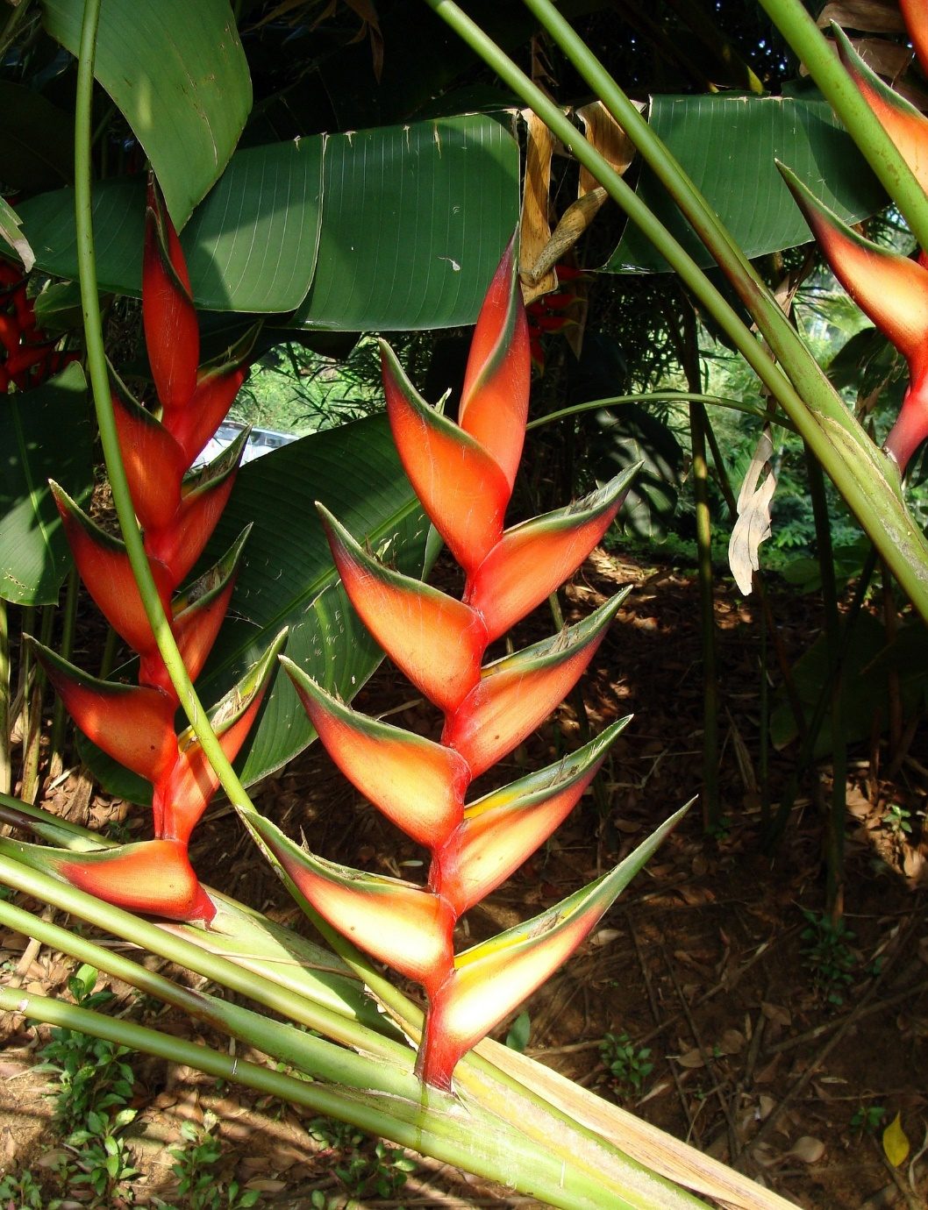
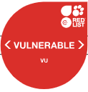
Camel
2
Why do you think this plant is called a lobster-claw?
The red clawlike leaves are protecting the plant’s tiny flowers.
The nectar from the flowers is important food for hummingbirds and butterflies.
They come in many colours, including purple, red, yellow, pink and green.
R
Pixaby.com

Slide 9

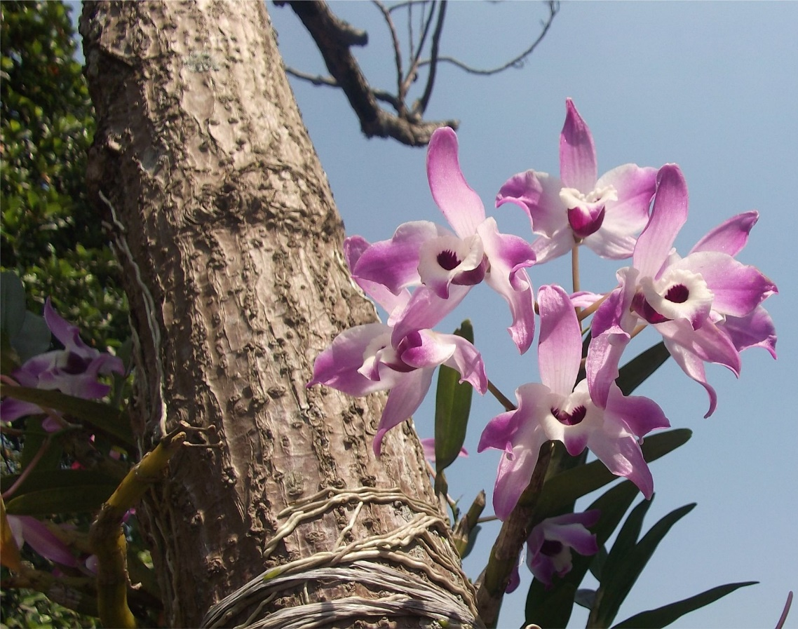
Camel
2
Do you recognise this flower?
The orchid family is the largest plant family on earth – there are nearly 30,000 different orchids!
Orchids in the rainforest can get their water from the air, rain or moisture – this means that they can live on tree trunks above the forest floor.
Their flowers are usually pollinated by birds or bees.
Pixaby.com
T
Notes:
Additional information: There are 25,000 - 30,000 different species of orchid, at least 10,000 of which can be found in the tropics (Rainforest Alliance).

Slide 10

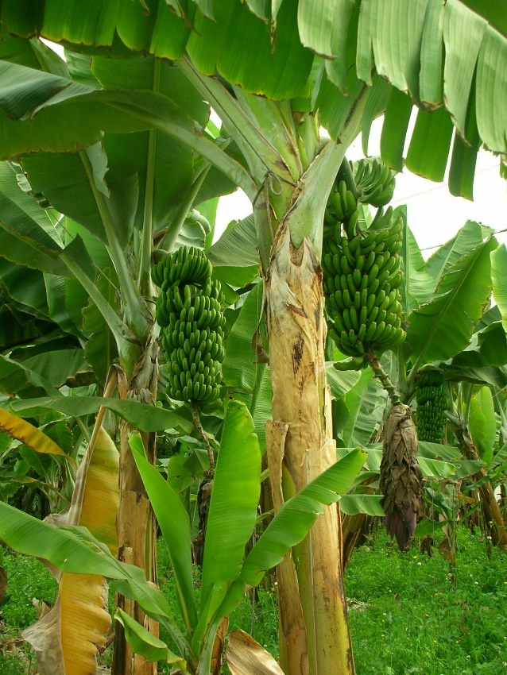
Camel
2
Banana plants – are they a ‘palm tree’ or a herb?
They are in fact a herb!
Their trunks are not made of wood like a tree but are made of lots of sheets of overlapping leaves.
Banana fruit are popular around the world but their leaves are also very useful.
O
Pixaby.com

Slide 11

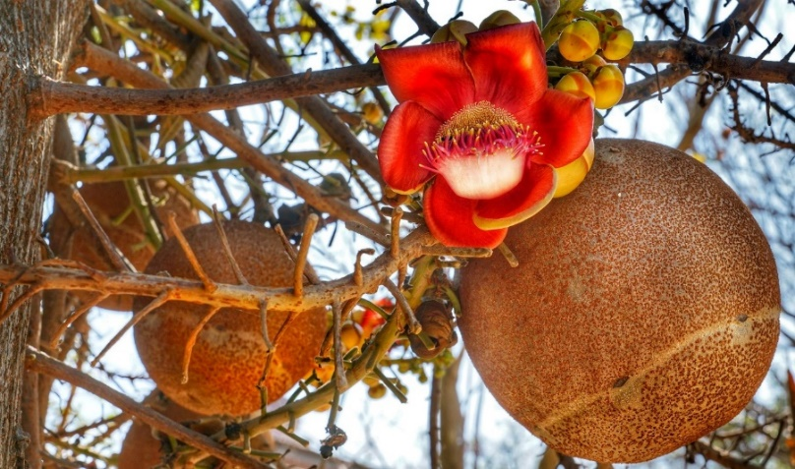
Camel
Pixaby.com
2
Why do you think it is called the cannonball tree?
The round, brown fruit grow into large round balls.
These fruit can take more than a year to ripen!
E

Slide 12

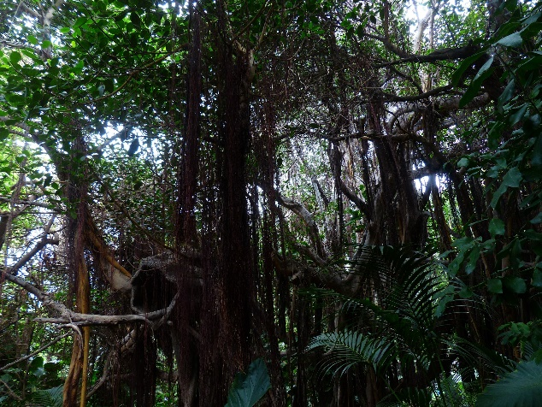
Camel
2
Do I hang from the branches or grow from the ground?
Lianas grow from the ground up, climbing and wrapping around other plants.
They are only found in tropical forests.
Pixaby.com
How does the Yawanawá tribe use them?
The roof of tribal houses (pêshê) are thatched with palm leaves which are tied into place with liana vines.
S
Notes:
Additional info: “Lianas belong to several different plant families”. (Rainforest Alliance)

Slide 13

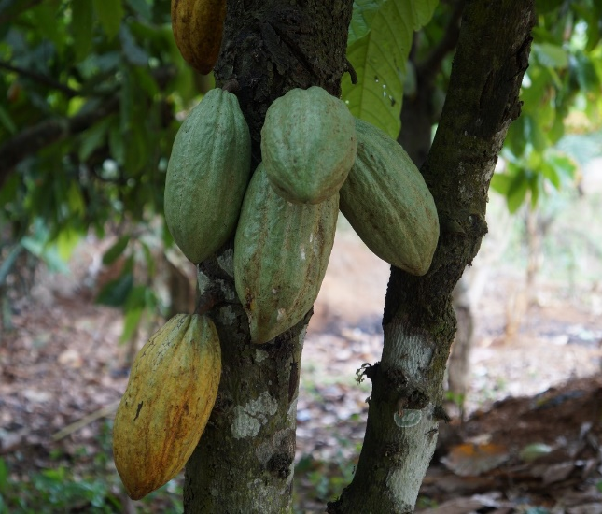
Camel
2
What yummy treat is made from cacoa seeds?
Chocolate!
These trees grow very well in areas with lots of rainfall.
The green seed pods grow out of the trunk, instead of from the branches.
Sadly, because chocolate is so popular, people sometimes even cut down the rainforest to grow it!
Pixaby.com
F

Slide 14

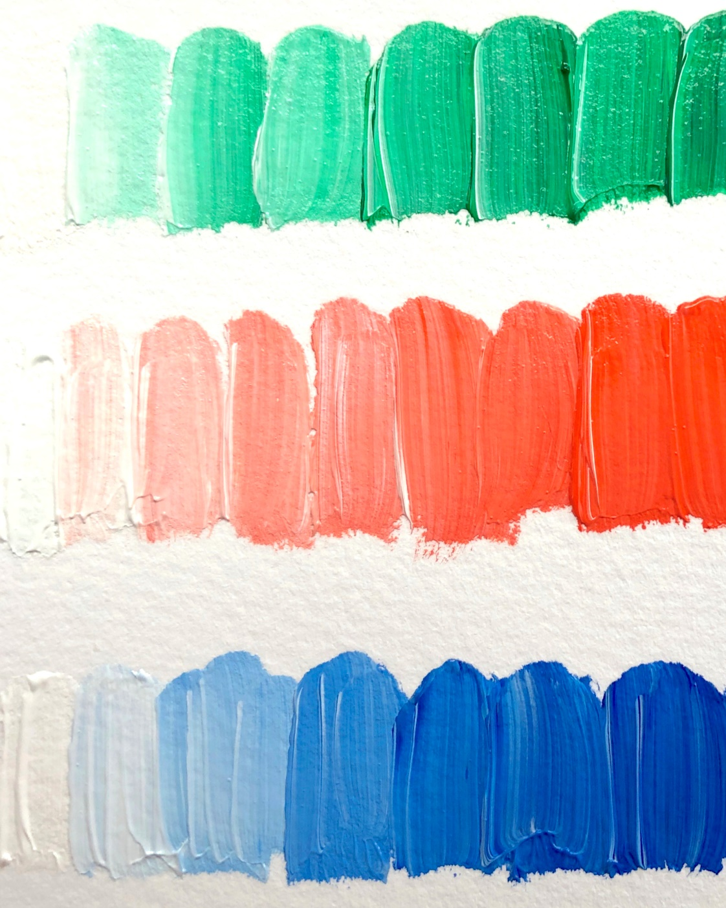

Creating gradients with paint.
Choose any colour paint and white paint
Start with a blob of white paint on your palette
Paint a strip of white on your paper
Add a small amount of the other colour to the white
Paint another strip
Continue in this manner until the full range of the colour is shown on your page.
© John Dyer

Slide 15
Hints and tips for colour mixing:
Make sure your water is clean – regularly change the water.
Check that your brush is clean before you mix colours
Shocking pink, turquoise blue and lemon yellow provide a wider colour mix than the classic primary colours, red, blue and yellow.
Always mix the colour into the white never add white to the colour.
© John Dyer

Slide 16


Camel
© John Dyer
Activity:
Try your hand at painting or drawing some of the plants you have learnt about today, in John’s style.
Top tips:
Look carefully at the shape and colours of the plant you are going to paint
Green is a good starting colour
Use yellow paint for highlights
Use blue paint to add some shadow
Don’t worry too much about details.
Pixaby.com

Slide 17
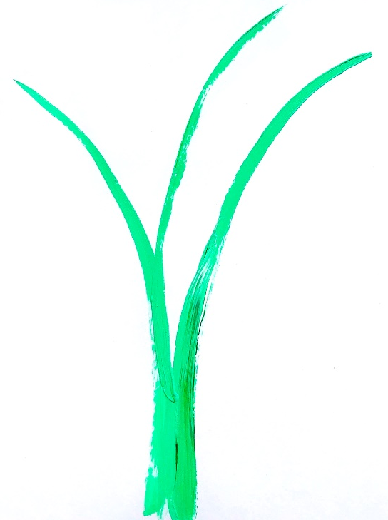
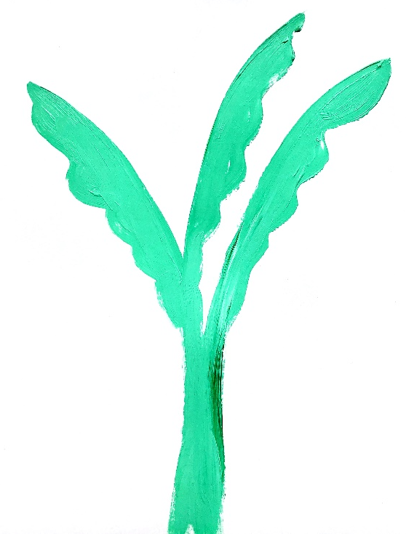
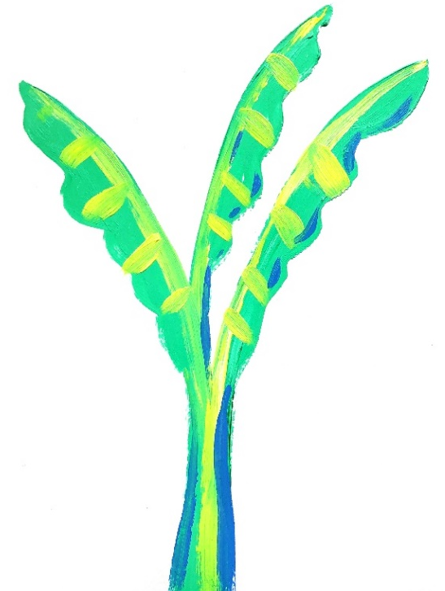
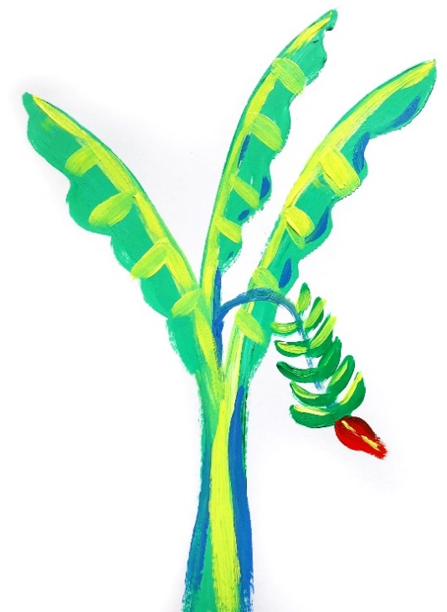
Step by step guide (painting a banana plant):
Step 1:
Look at the basic shape of your plant
Paint it in a similar colour to what you can see in the image.
Step 2:
Start adding shape detail e.g. leaves
Block this in colour.
Step 3:
Think about the sun shining on the plant
Add some highlights and shadows (optional).
Step 4:
Add any fruits or flowers to your plant if they have them.
Extra:
If your paint has dried, go over any highlighted sections to bring out the colour.

Slide 18
© John Dyer
Tell me…
…something you know now that you didn’t know an hour ago
…the name of three rainforest plants
…one top tip you need to remember when painting plants

