Slide 1

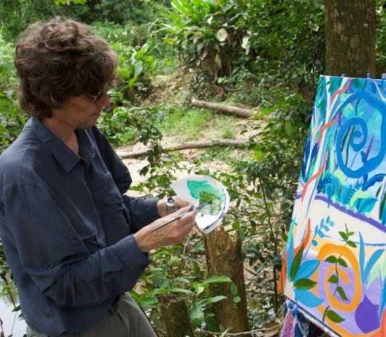
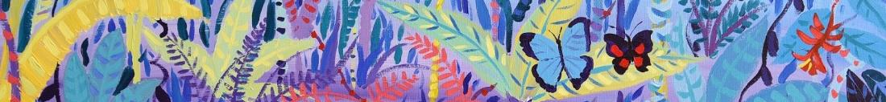




© John Dyer
Chapter 2: Person of the Forest
Visit the Penan tribe with artist John Dyer.
Develop your artistic skills whilst discovering the people, plants, animals and culture from one of the most diverse ecosystems in the world, the Borneo rainforest.
© John Dyer
© John Dyer

Slide 2
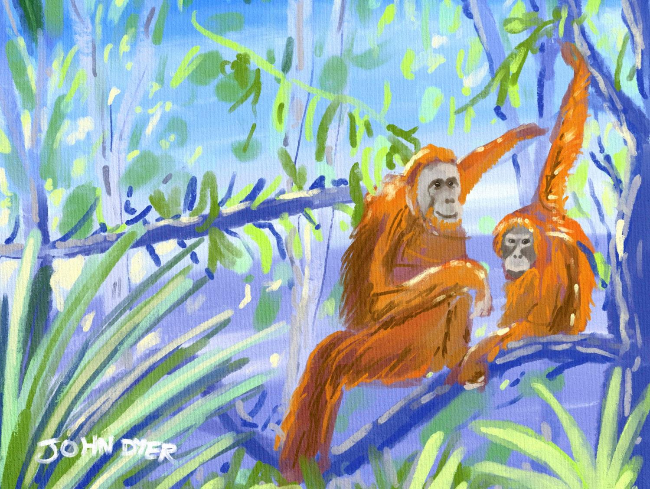


© John Dyer
Learning objectives:
To ask well thought out questions about a place, people and environment
To create your own rainforest inspired piece of modern art – using information and skills learnt during this course.

Slide 3

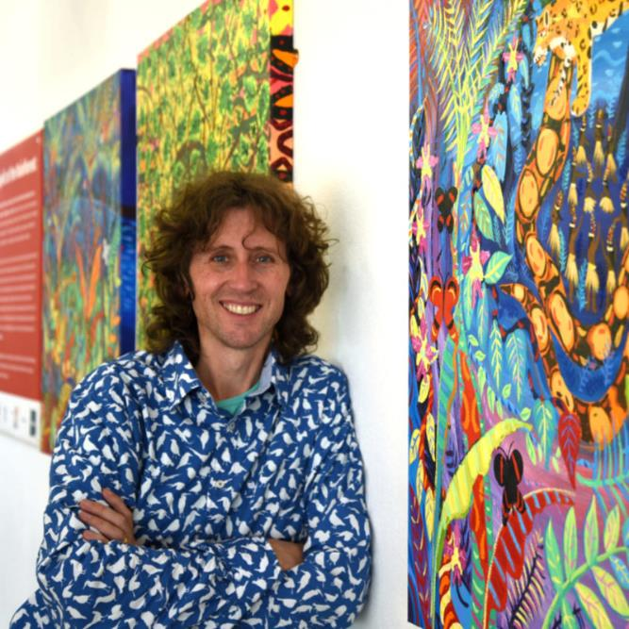
Camel
© John Dyer
John Dyer is a modern (contemporary) artist, born in 1968.
He focuses on colourful landscapes, architecture, gardens and notable events.
John started his career as a photographer and his first assignment was in the Amazon rainforest.
John is traveling with his daughter, Martha-Lilly (a musician) and explorer Robin Hanbury-Tenison.
© John Dyer Gallery
© John Dyer
© John Dyer

Slide 4

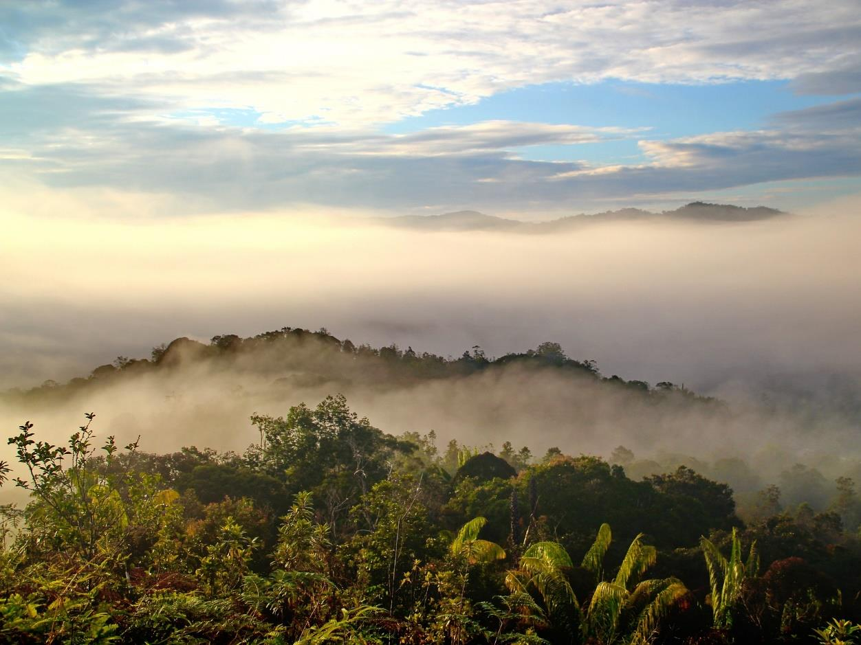
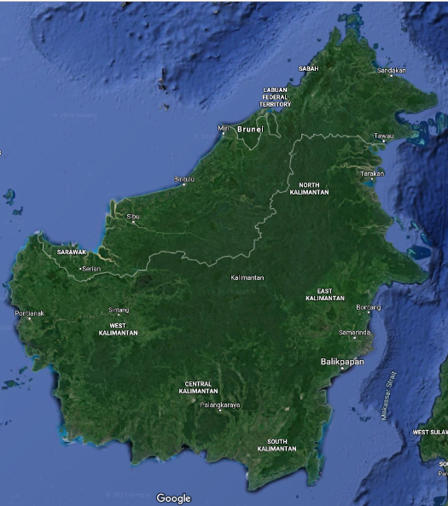
Pixabay.com
In Sarawak, John is painting alongside members of the Penan community, learning about their culture and connection to the forest.
John is then travelling down to Indonesian Borneo to visit the Orangutan Foundation in Lamandau Wildlife Reserve to paint Asia’s only great ape – the orangutan.

Slide 5


Camel
Start with a question word:
Where, What, How, Why, When….
2. Consider your subject:
Are you talking to an individual or group directly?
You
Are you talking to someone about someone else?
[Name], He, She, They
Are you talking to someone about an object?
It, they
3. Add a verb:
Work, Think, Make, Protect, Get…..
Examples:
  What do the Penan think about deforestation?
  How did you get your painting equipment to the rainforest?
  What does it smell like in the rainforest?
© John Dyer

Slide 6
Challenge:
Thinking about the last four lessons, in your books write down four questions you would like to ask John, one based on each subject:
About the Penan
About the plants of the rainforest
About the animals that live there
About the threats to the future of the rainforest.
As a class, vote on the top four questions and send John a message via the Last Chance to Paint blog.
© John Dyer
Notes:
How you can get involved
1: Subscribe to the blog posts & send us questions - https://www.lastchancetopaint.com/news/
2: Watch our daily video diary on YouTube - https://www.youtube.com/channel/UCLKKZyhgbHCFeHHcmRb7m5Q?view_as=subscriber%3Fsub_confirmation%3D1 (a great way to look back on previsou chapters as well).
3: Follow & watch us on Facebook - https://www.facebook.com/lastchancetopaint/
4: Sign up for our email updates - https://www.lastchancetopaint.com/pledge-your-support/

Slide 7

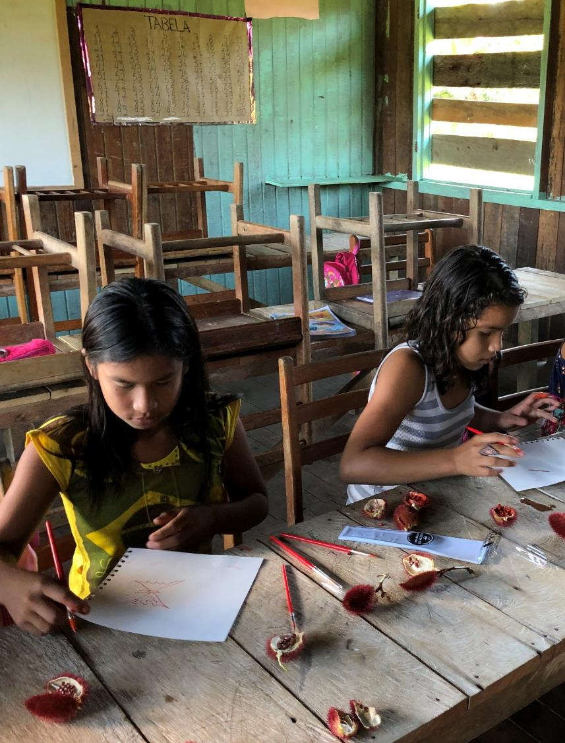
Use the techniques you have been practicing to create your own piece of rainforest inspired art.
Think about what you have learnt about the people, plants and animals of the rainforest as well as the threats they face.
Your art should aim to express your own connection with the rainforest.
© John Dyer
© John Dyer

Slide 8


We have talked about individual elements of a painting as well as some techniques, but how do you bring these together into a single piece of art?
© John Dyer

Slide 9


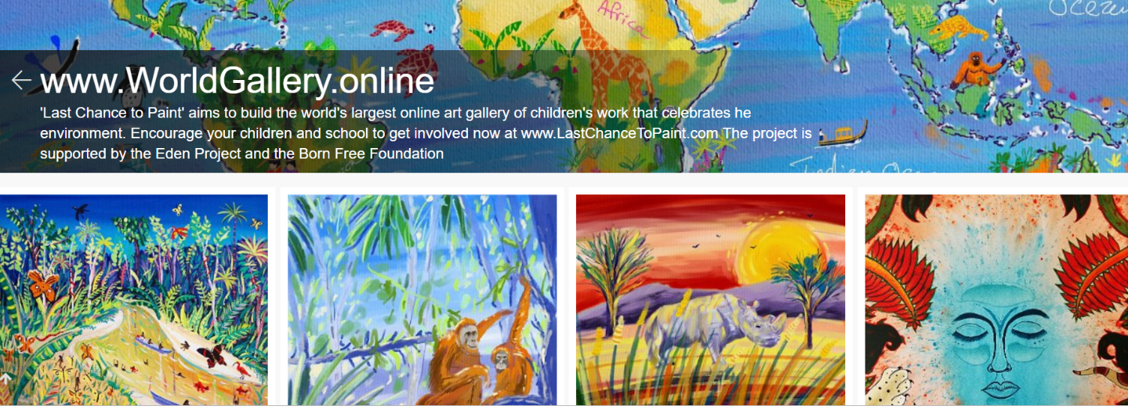
Share your art with the world through the online World Gallery
www.lastchancetopaint.com/submit-your-art/
There is no deadline for submission but for your artwork to be in with a chance of receiving a
send it to us by 22nd November 2019.

Slide 10
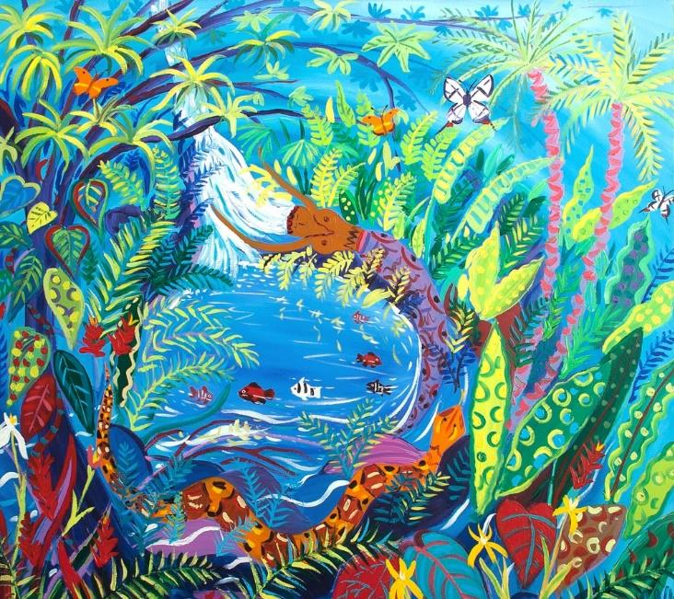
© John Dyer
Tell me…
…something you know now that you didn’t know an hour ago
…two questions and answers you found particularly interesting.

