Slide 1

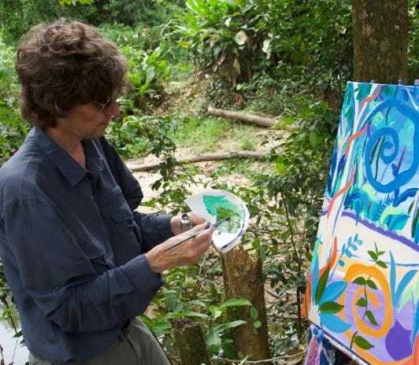
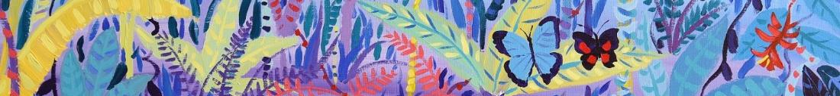
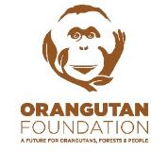



© John Dyer
Chapter 2: Person of the Forest, Borneo
Visit the Penan with artist John Dyer.
Develop your artistic skills whilst discovering the people, plants, animals and culture from one of the most diverse ecosystems in the world, the Borneo rainforest.
© John Dyer
© John Dyer

Slide 2
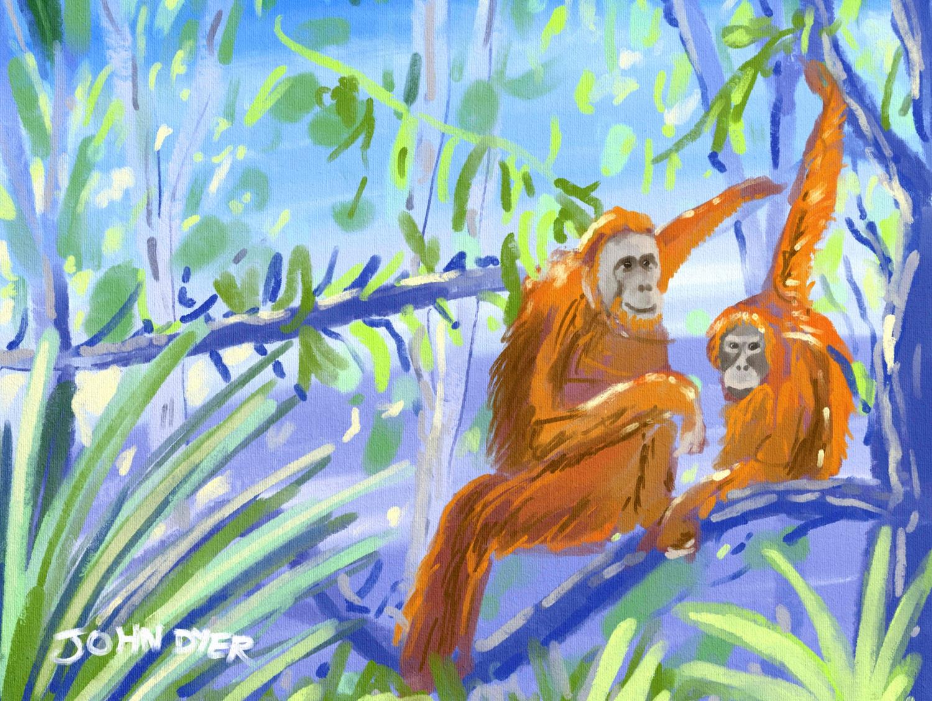


© John Dyer
Learning objectives:
To list the key threats to the Bornean rainforest
To understand the importance of a balance between people, plants and animals in an ecosystem.

Slide 3
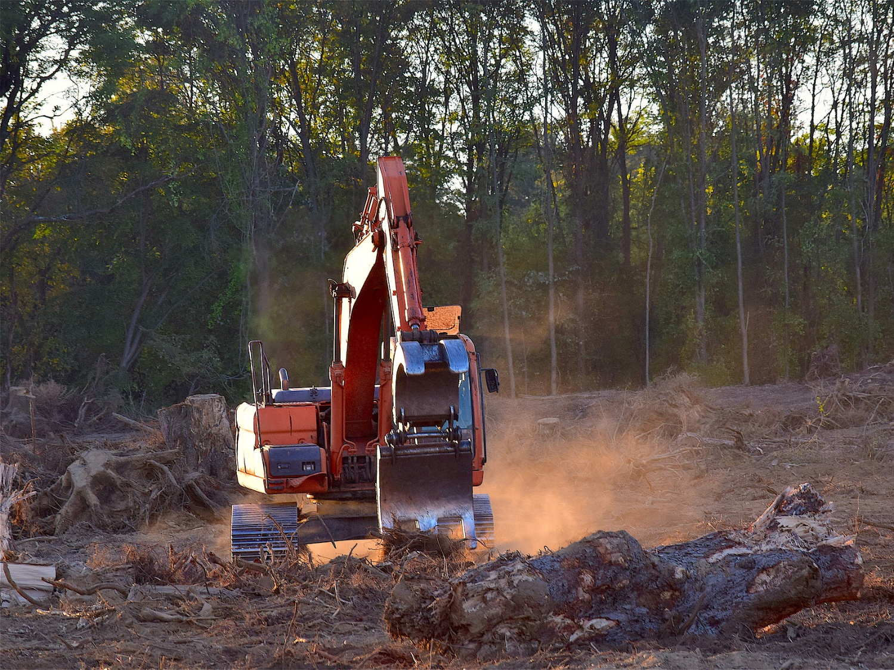

Human impacts are the changes that humans have made to the natural world. These can be positive or negative.
Examples of negative impacts include habitat loss, pollution and climate change.
Pixaby.com

Slide 4
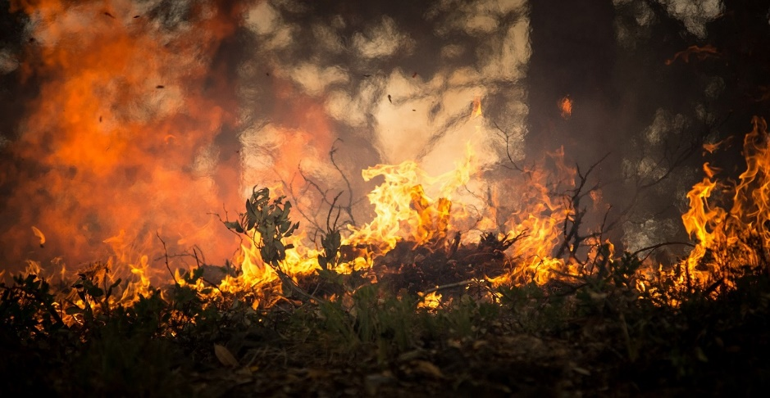
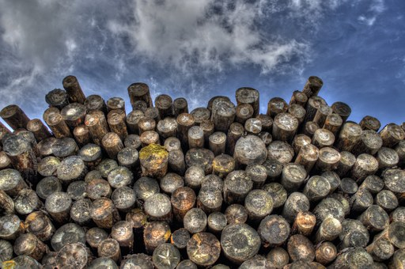
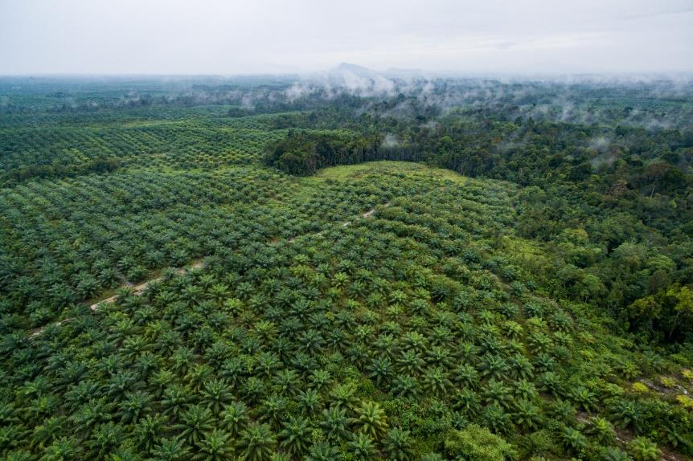
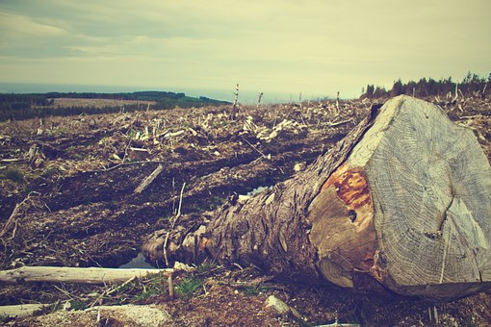
Deforestation
Illegal logging
Mining
Wild fires
Climate change
Palm oil
Local farming.
Borneo’s rainforest is believed to be the oldest rainforest in the world!
Images from Pixaby.com
© CIFOR
Notes:
Plantation image sourced through flickr.com
https://www.flickr.com/photos/cifor/
https://creativecommons.org/licenses/by-nc-nd/2.0/

Slide 5
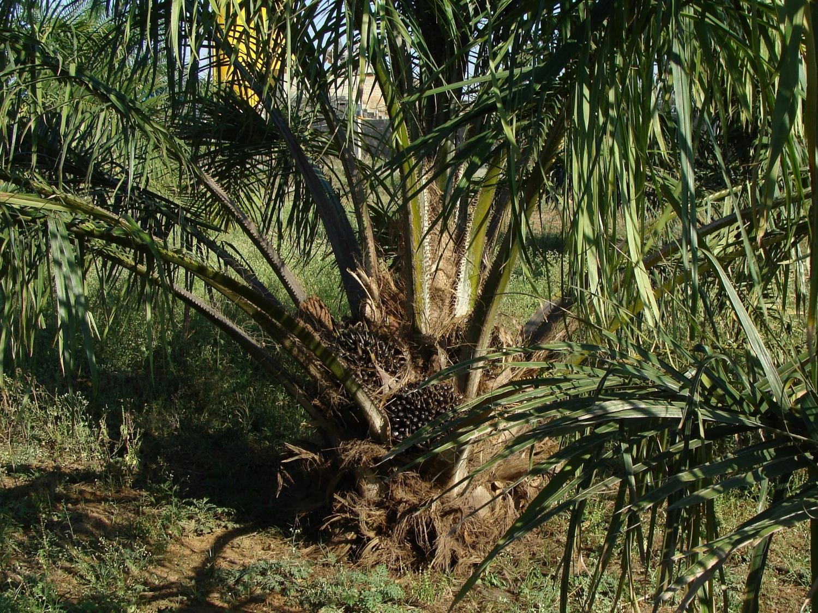

Pixaby.com
Palm oil is a type of vegetable oil made from the seeds of the oil-palm plant
The plants are often grown in large plantations or monocultures
Guess which of these products palm oil is found in: shampoo, soap, toothpaste, chocolate, biscuits, nail varnish, lipstick, ice cream, bread
All of them!
Because it is so useful, people cut down large areas of rainforest in order to make room for plantations.

Slide 6

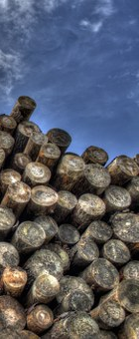
Pixaby.com
How do these threats impact on…
The Penan
The plants of the forest
Orangutans?
Each member of your group will be given an information sheet for which they will need to become the ‘expert’.
The ‘experts’ then leave their group to form a ‘super group’ of experts about the same subject.
Challenge:
Are there any other impacts that might affect your subject other than those listed on your sheet?
You will need to remember what you have learnt in previous lessons.
Here, you will need to question one another and combine your ideas and knowledge.
Then each ‘expert’ returns to their ‘home’ group to share their findings.

Slide 7
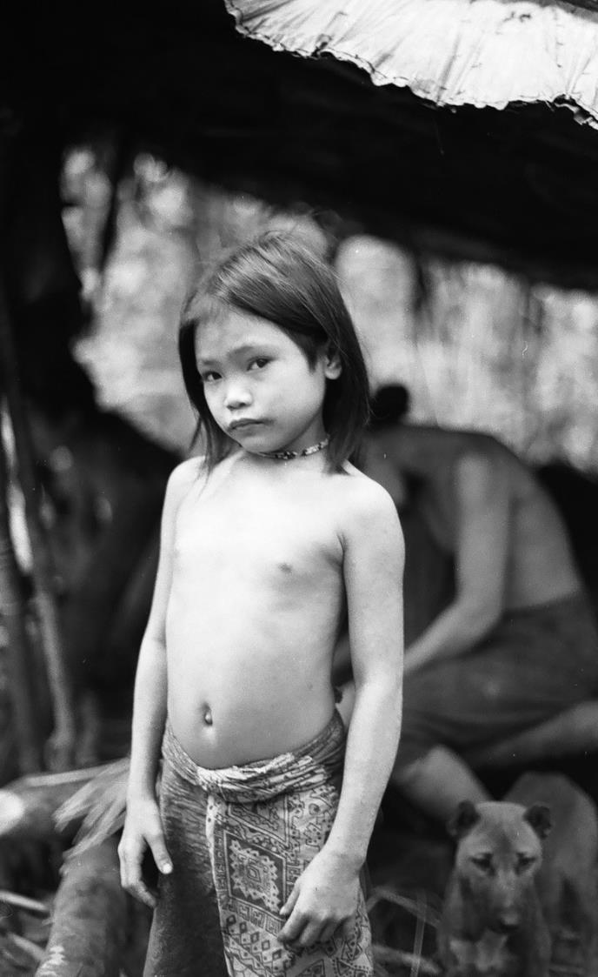

Logging doesn’t just remove trees:
It releases soil into rivers, killing fish
It removes habitats used by wildlife – on which the Penan depend.
What happens next?
When the forest starts to grow back, it is with thick scrub which is hard to navigate
Sometimes the cleared land is then used to plant oil-palm plantations, leaving nothing for the Penan who have relied on the forests for generations.
© Robin Hanbury-Tenison
© John Dyer

Slide 8

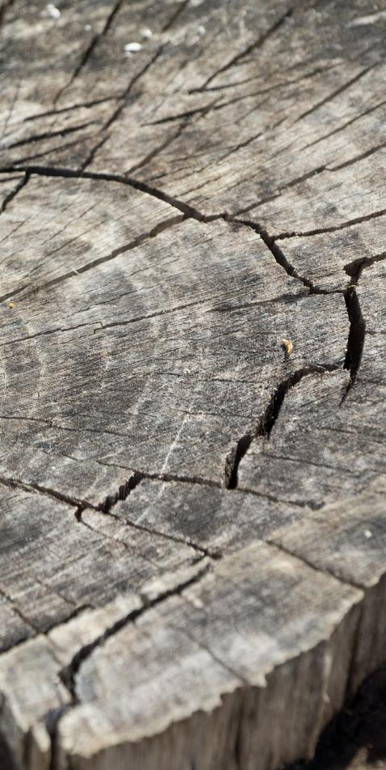
Pixaby.com
Logging the largest trees causes more light to reach the lower levels resulting in rapid growth, increasing competition.
Selective logging and increased competition alters the balance of water, light and space available to species, impacting on biodiversity.
  Biodiversity is the variety of all living things, including plants, animals and micro-organisms.
Forests are cleared to make way for farming, plantations and mining, causing a decline in many species endemic to Borneo – which could result in them becoming extinct.
© John Dyer

Slide 9

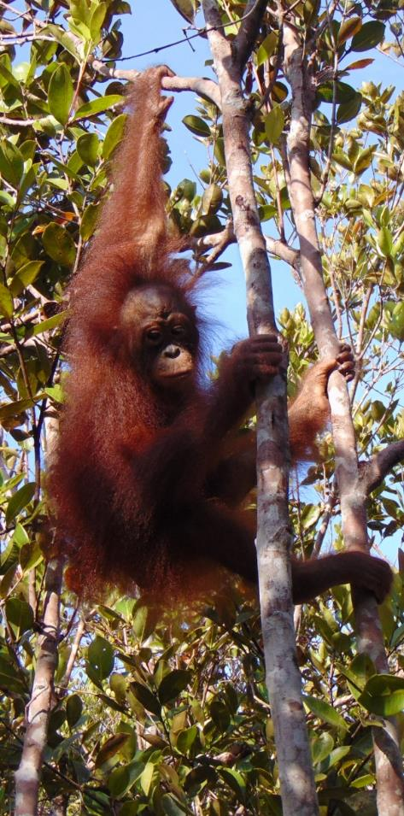
© Orangutan Foundation
Habitat loss:
Loss of habitat, mostly due to oil-palm plantations, is leaving orangutans with less space and less food
Fires are sometimes set deliberately to clear areas of forest quickly, this can be fatal to any wild animal caught in its path
Orangutans live most of their lives in trees – when these are cut down they lose their homes.
Contact with people:
Orangutans are often seen as pests by local farmers as they eat crops, resulting in conflict
Sometimes people even take baby orangutans from the forest to sell them as pets.
© John Dyer

Slide 10
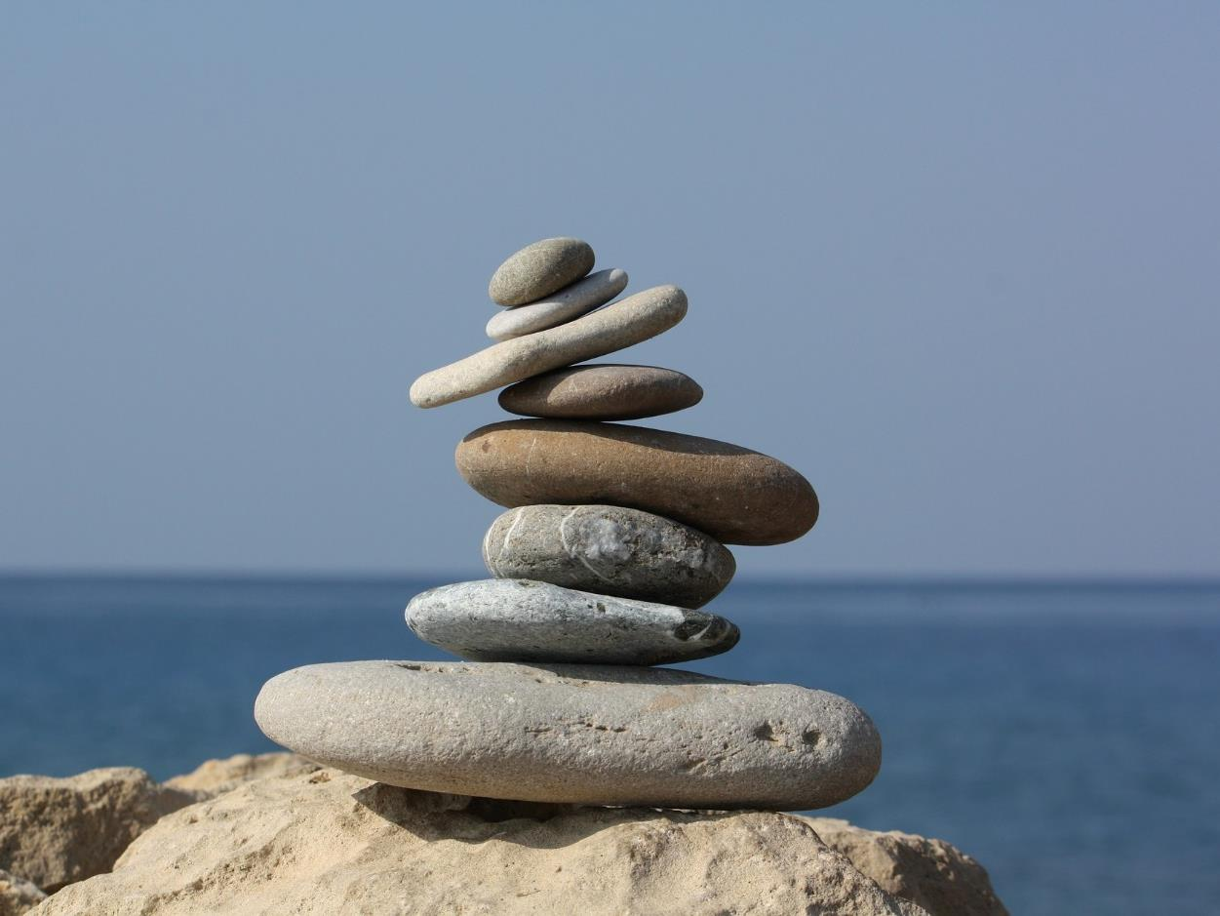

Ecosystems must have balance if they are to work properly and be sustainable.
If even one change takes place to a component, this can have a knock-on effect for the rest of the ecosystem.
An ecosystem is an area where biological elements (eg plants and animals) interact with non-biological elements (eg soil and water).
An ecosystem can be as small as a single tree or as big as a forest.
Pixaby.com
Pixaby.com

Slide 11
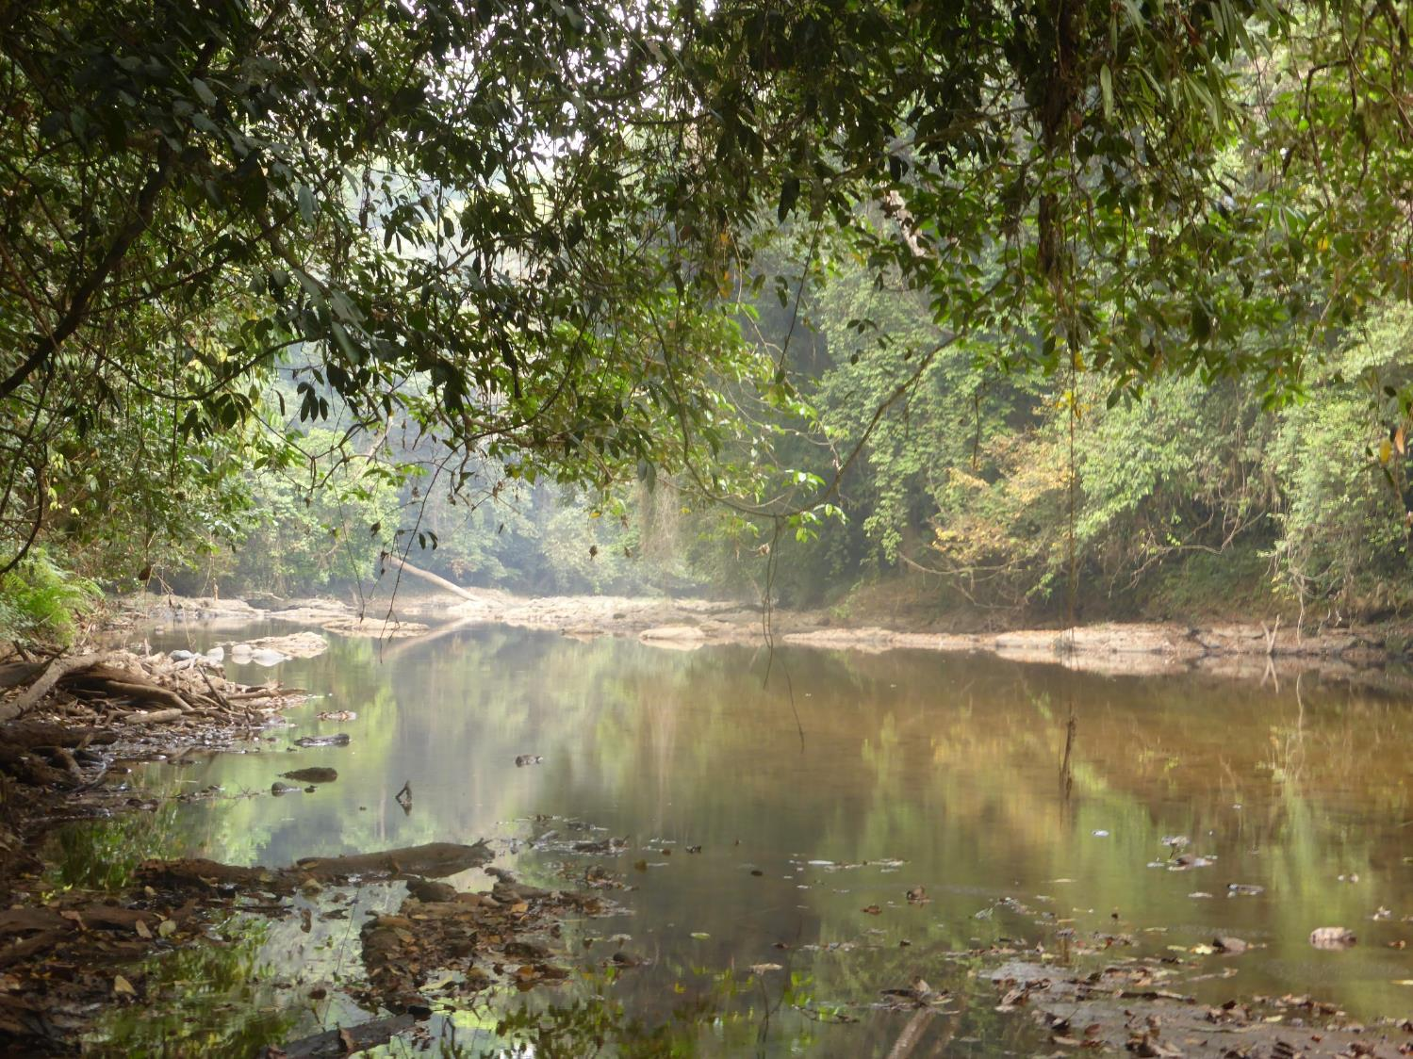
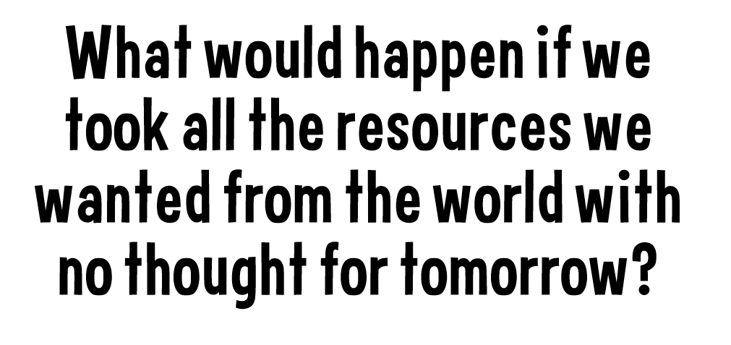
© Liz Greengrass, BFF

Slide 12
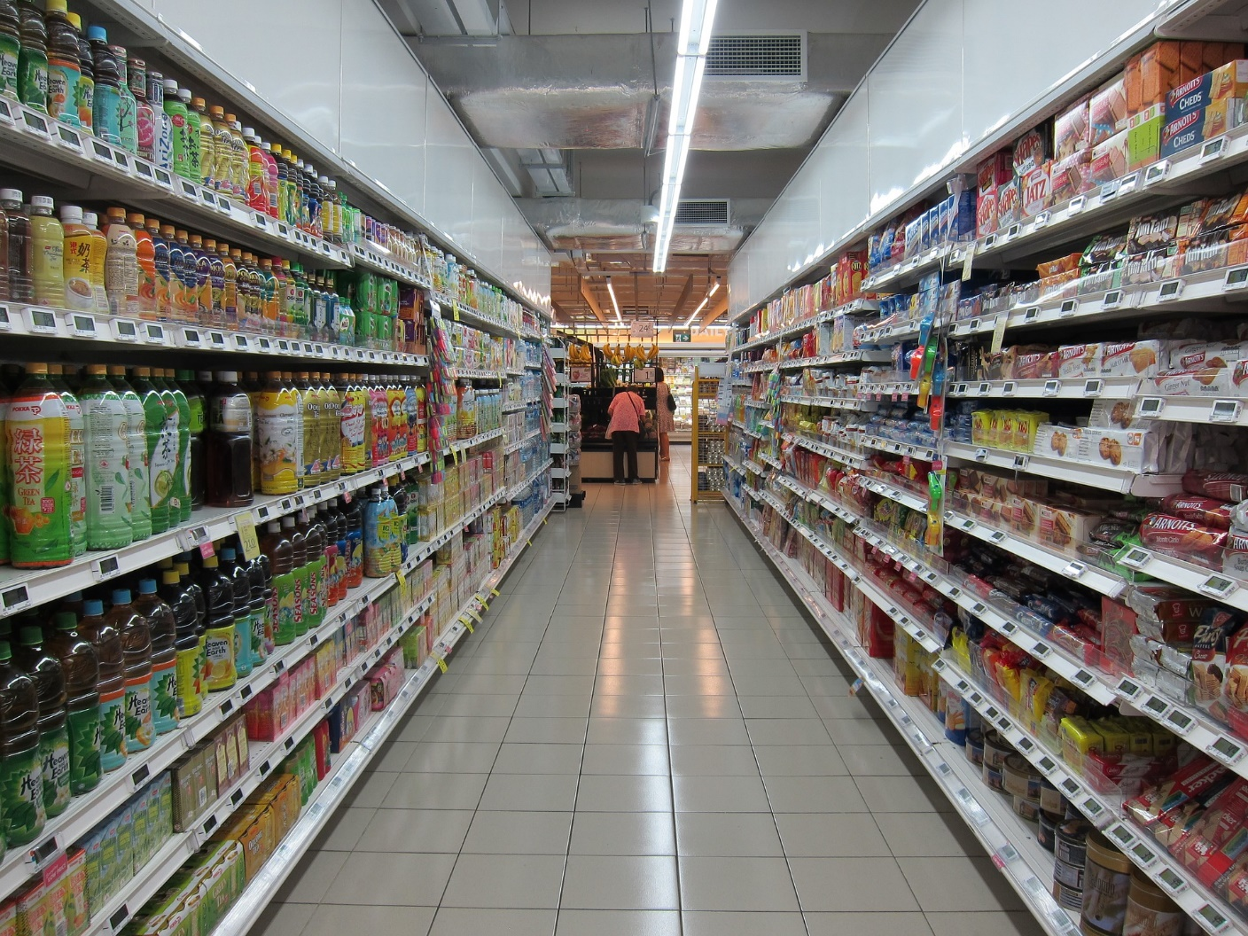

Three easy actions:
Buy products and food that don’t contain palm oil
Buy recycled paper to reduce the number of trees we use
Teach others about these issues and help them to make the right choices.
Challenge:
Pledge to change one thing to help save the rainforest.
This could be eating only rainforest alliance chocolate or buying one less product containing palm oil.

Slide 13

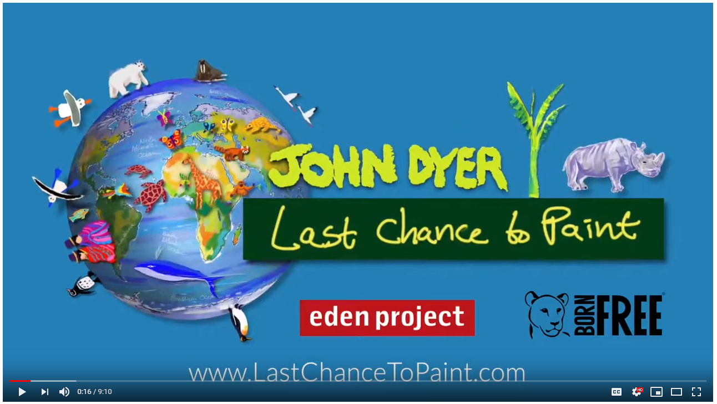
Camel
Annatto seeds
Traditional song
© John Dyer
Notes:
https://www.youtube.com/channel/UCLKKZyhgbHCFeHHcmRb7m5Q?view_as=subscriber%3Fsub_confirmation%3D1

Slide 14
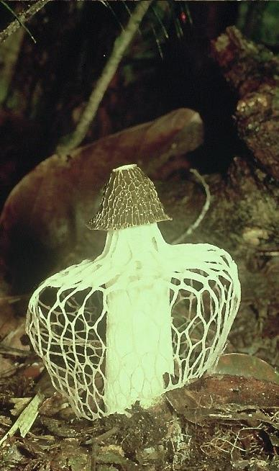
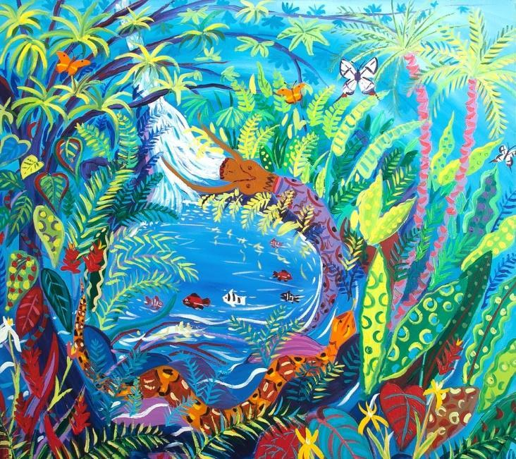
© John Dyer
A forest fungus
Did you know that fungi, moulds and mushrooms are not plants… but have a kingdom all of
their own.
Tell me…
…something you know now that you didn’t know an hour ago
…why balance is important in the rainforest
…one thing we can do to reduce our negative human impact.
© Robin Hanbury-Tenison

