Slide 1

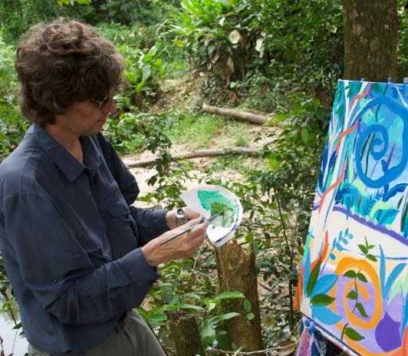
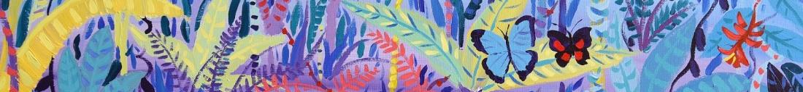




© John Dyer
Chapter 2: Person of the Forest
Visit the Penan tribe with artist John Dyer.
Develop your artistic skills whilst discovering the people, plants, animals and culture from one of the most diverse ecosystems in the world, the Borneo rainforest.
© John Dyer
© John Dyer

Slide 2
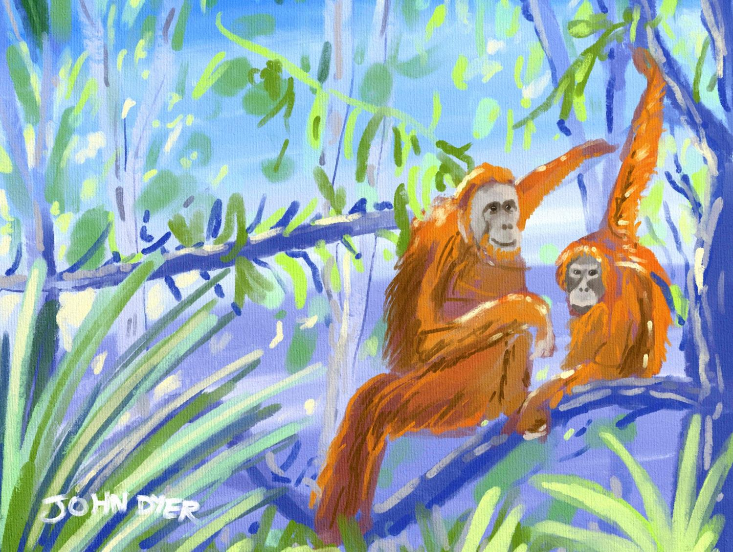


© John Dyer
Learning objectives:
To learn about the diversity of animals in Borneo's rainforest
To experiment with a range or art techniques.

Slide 3

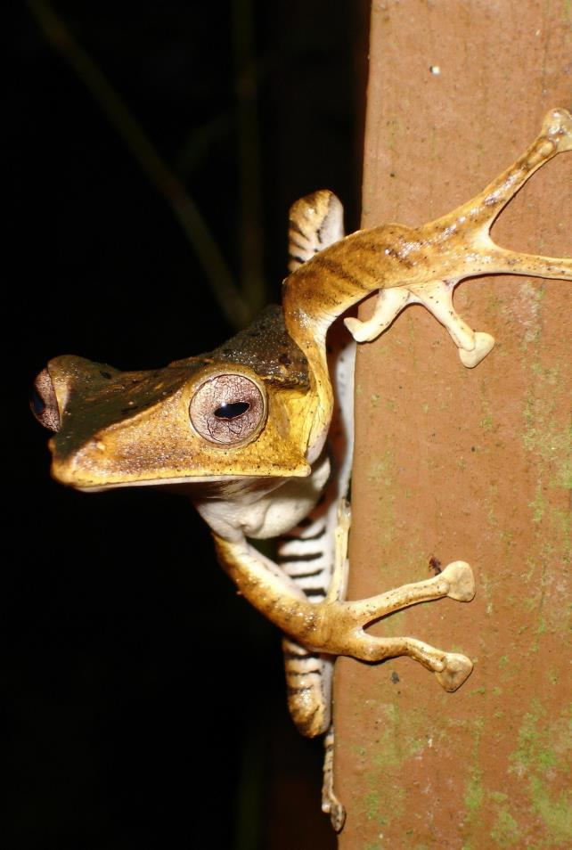
Camel
2
Borneo is home to a wide range of species, including around:
  222 mammals (of which 44 are endemic)
  420 birds
  149 amphibians and
  254 reptiles.
Do you remember what endemic means?
Endemic means that these species are only be found on Borneo.
Pixabay.com
Pixaby.com
© John Dyer
Notes:
Source: http://borneoproject.org/borneo/biodiversity-conservation

Slide 4
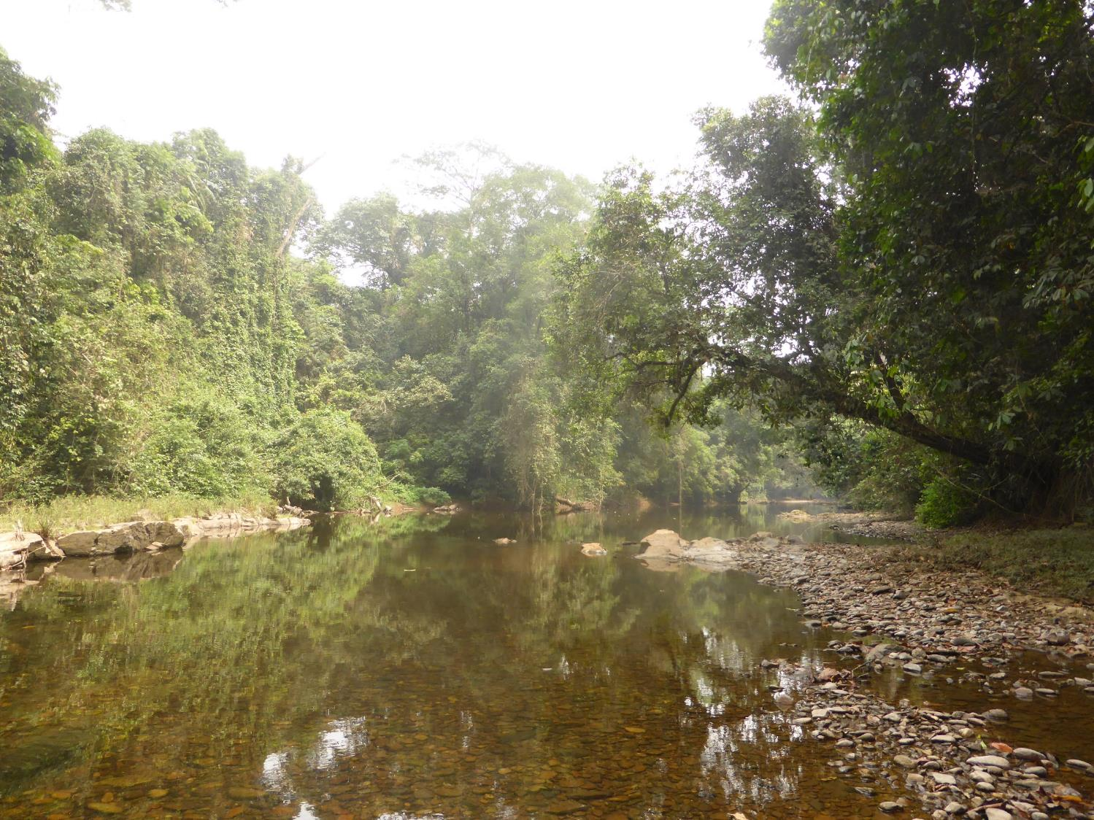
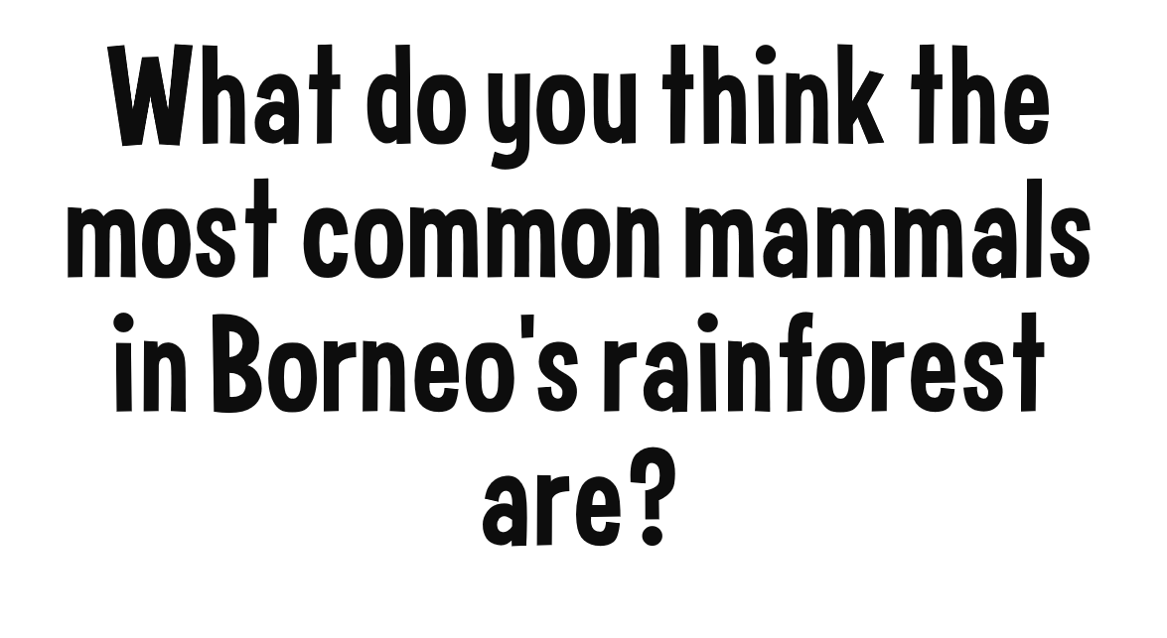
© Liz Greengrass, Born Free

Slide 5
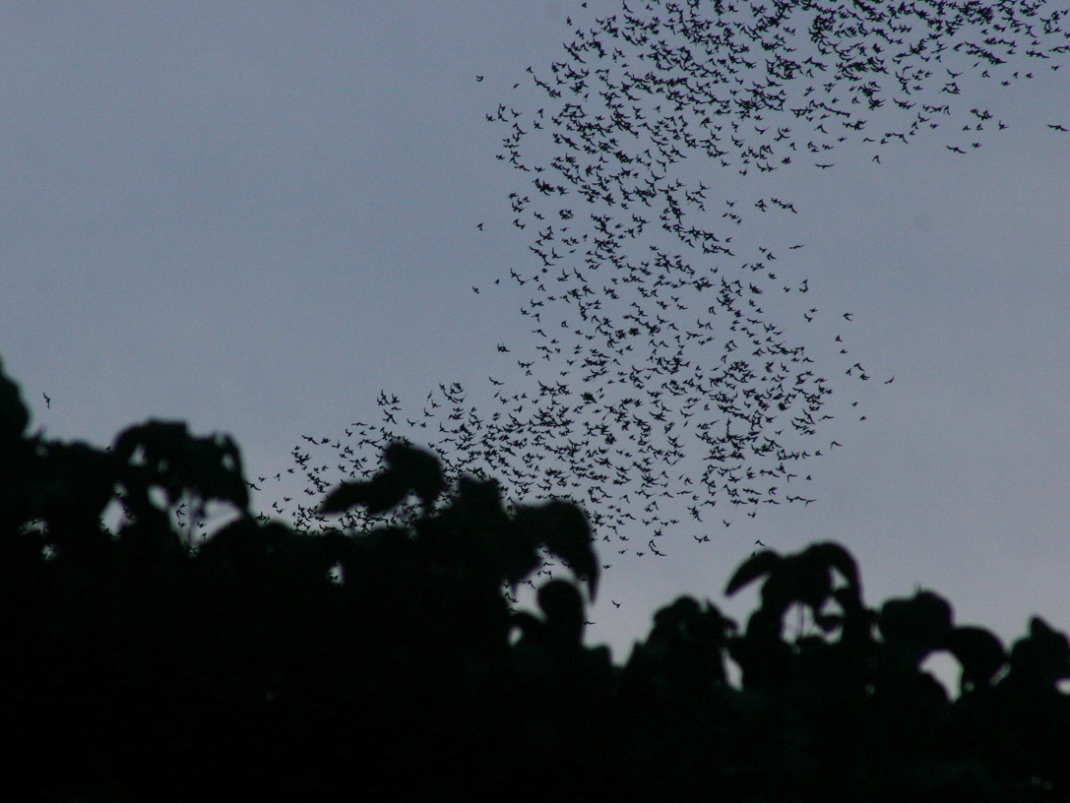
The most common mammals are bats:
In fact, around 90 different species can be found on the island
They play a vital role in the ecosystem, including pollination and seed dispersal.
© chem7
Notes:
Image sourced through flickr.com
https://www.flickr.com/photos/88087720@N00/
https://creativecommons.org/licenses/by/2.0/

Slide 6


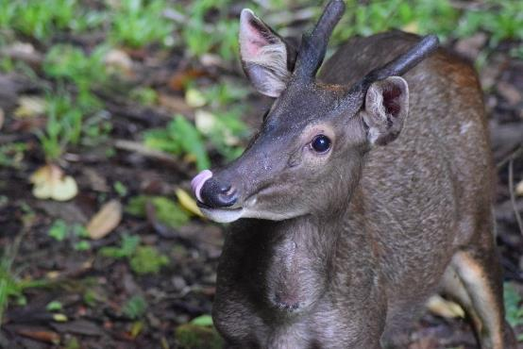
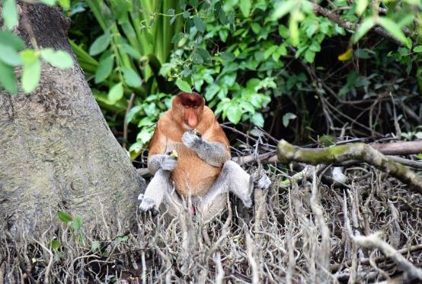


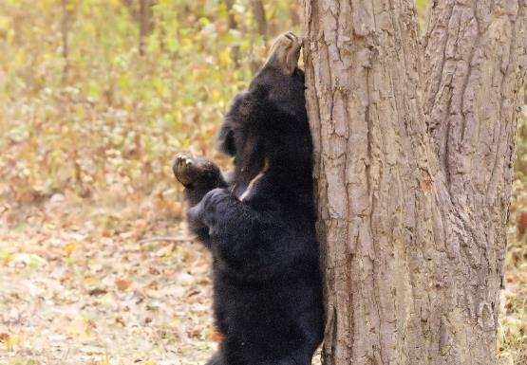
The sambar is listed as Vulnerable
on the IUCN Red List. Hunting, along with other threats, caused their numbers to decline.
Proboscis monkeys are endemic to Borneo and are easily recognisable by their large noses and pot bellies.
Sun bears are the smallest member of the bear family – measuring just 1.2m – 1.5m in length.
All images Pixabay.com

Slide 7

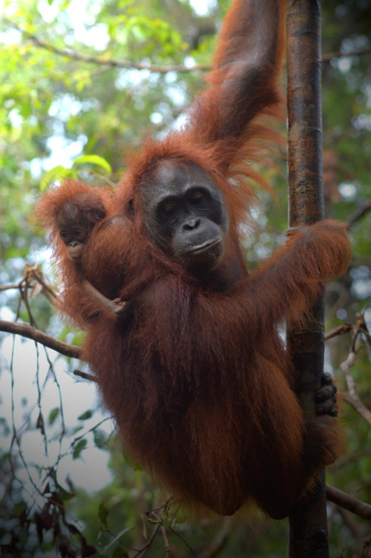

© Orangutan Foundation
The name orangutan comes from the Malay and Indonesian words orang, meaning person, and hutan, meaning forest – person of the forest.
Where are they found?
They only live in the rainforests of Borneo and Sumatra.
There are three species of orangutan:
Sumatran, Bornean and Tapanuli
All three are listed as Critically Endangered on the IUCN Red List
© John Dyer

Slide 8

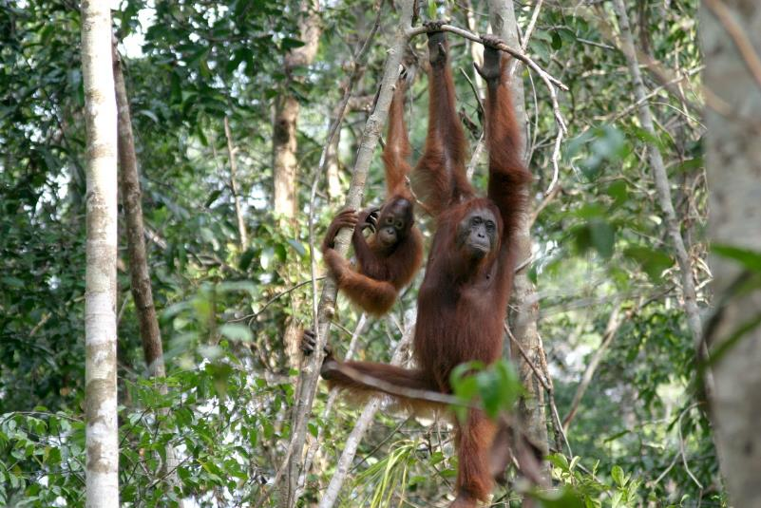
© Orangutan Foundation
Notes:
Student worksheet

Slide 9
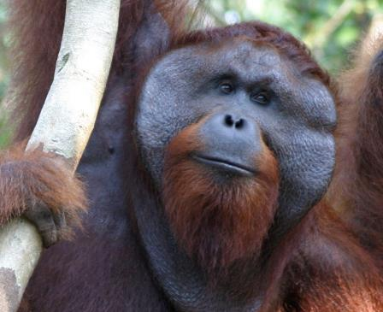
Their hair is red in colour.
Female Bornean orangutans weigh between 48kg and 55kg while males weight between 93kg and 130kg.
Orangutans can live for up to 45 years but only have a baby once every seven to eight years.
They mostly eat fruit but will also feed on flowers, honey, bark, leaves and insects.
Orangutans are the largest arborial (tree living) animal in the world and Asia’s only great ape.
© Orangutan Foundation
They have an arm span of 2.5m (nearly twice their height).
Dominant males have enlarged cheeks called flanges.
© Orangutan Foundation

Slide 10

The indigenous people of Borneo have a legend that says that the orangutan was originally a human who pretended not to be able to speak and climbed up into the trees to escape having to work.
Orangutans use leafy branches to shelter themselves from rain.
In prehistoric times, orangutans lived all throughout Asia – roaming as far north as China.
Male orangutans produce calls to warn off other males and these calls can be heard for up to two miles.
© Orangutan Foundation
They are important to the forest because they help to spread seeds – larger animals can spread larger seeds.
Humans share around 97% of their DNA with orangutans – they are one of our closest relatives.

Slide 11

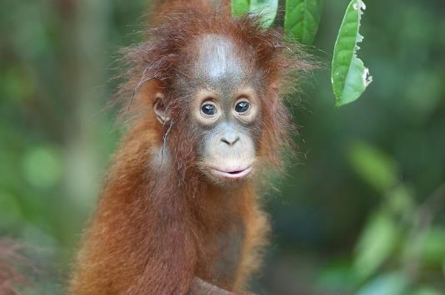
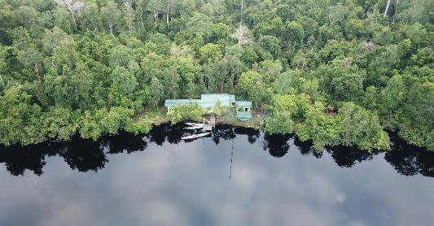
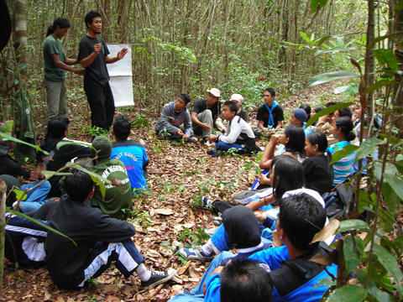
The Orangutan Foundation
Orangutans:
We rescue orphaned, homeless and injured orangutans, and when they’re ready, release them back into the wild.
Forest:
Our guard posts help protect large areas of rainforest from being cut down and destroyed by illegal activities (such as logging and fires) – whilst also planting new trees.
People:
We work with local schools and communities to help raise awareness of orangutans and demonstrate why their forest homes are so important.
All pictures © Orangutan Foundation

Slide 12

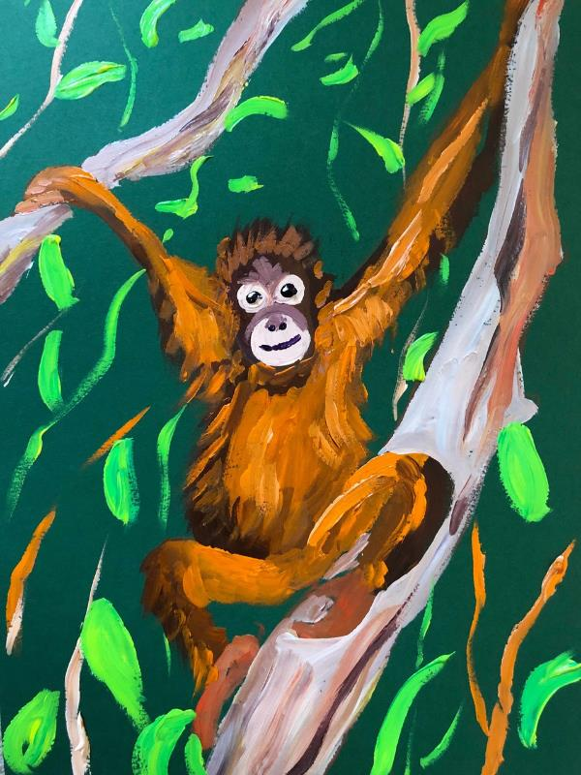
Camel
© John Dyer
Activity:
Painting an orangutan in its natural habitat.
Top tips:
You will be painting over the drawing so feel free to make many marks to slowly mould your outline to the shape you want.
Use a good brush and of the right size so you can control your marks and create hair and texture.
Possible materials:
Coloured piece of card (John used green, A4)
Drawing materials such as:
  Soft pastel
  Soft pencil
  Coloured paints
Mixing pot or pallet
Good paint brush.
© John Dyer

Slide 13
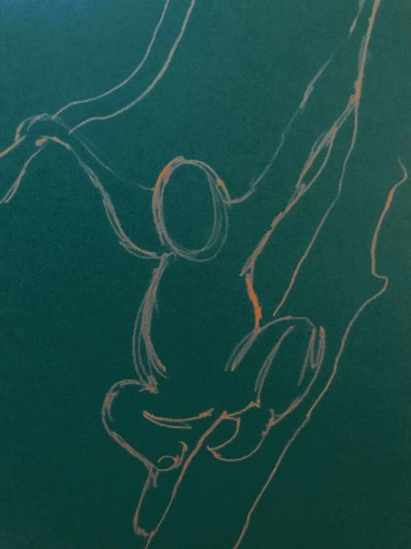
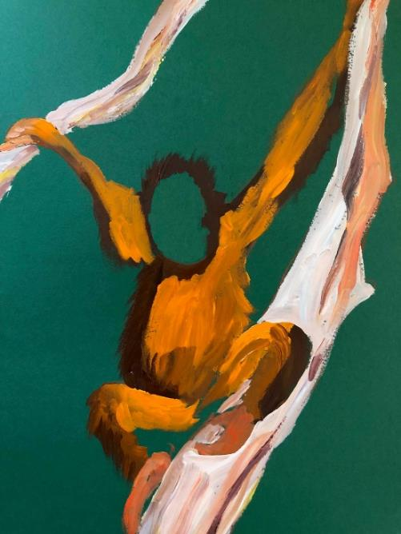
Step by step guide:
Step 1:
Using a pencil or pastel draw the outline of the orangutan and the two trees, the one it is sitting on and the one it is holding
You can use photographs of orangutans you have searched for to base this exercise on if you prefer
When drawing the body gently sketch out the head, add the round body and then work on the arms and legs.
Step 2:
Once you are happy with your sketch drawing, mix a deep brown paint for shade and a bright orange for light and start to paint on the areas of light and shade
You can mix an orange from yellow and then add a small quantity of red. To create a brown you can mix yellow with a small amount of red and then add a small quantity of blue
Allow your brush to become slightly dry and then add some dry brush strokes to add the hair of the orangutan.

Slide 14
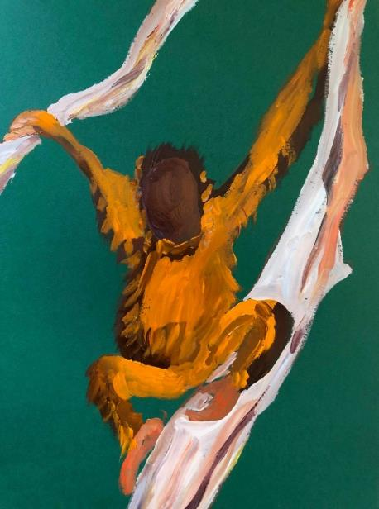
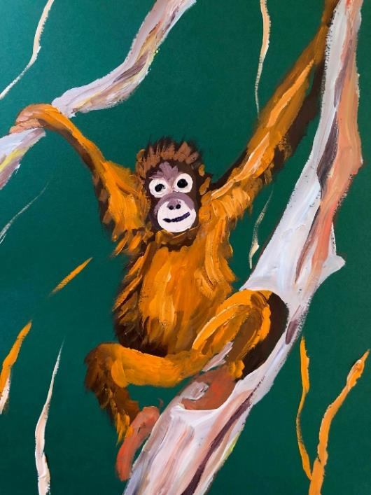
Step by step guide:
Step 3:
Paint the orangutan’s face a deep brown
You might want to let it dry at this stage or using wet on wet paint use a very pale cream/white colour to add the two eyes and nose/mouth area as circular shapes.
Step 4:
In the larger circle, the nose can be added and the mouth
Add the dark pupils to the orangutan and with a tiny touch of white you can add a reflection to the eyes to add life
Finally, if you have time, add some forest leaves in the background and make sure your trees have been painted in a pale white colour.
How do you feel about orangutans now you have painted one?

Slide 15


Camel
Annatto seeds
Traditional song
© John Dyer
Notes:
https://www.youtube.com/channel/UCLKKZyhgbHCFeHHcmRb7m5Q?view_as=subscriber%3Fsub_confirmation%3D1

Slide 16
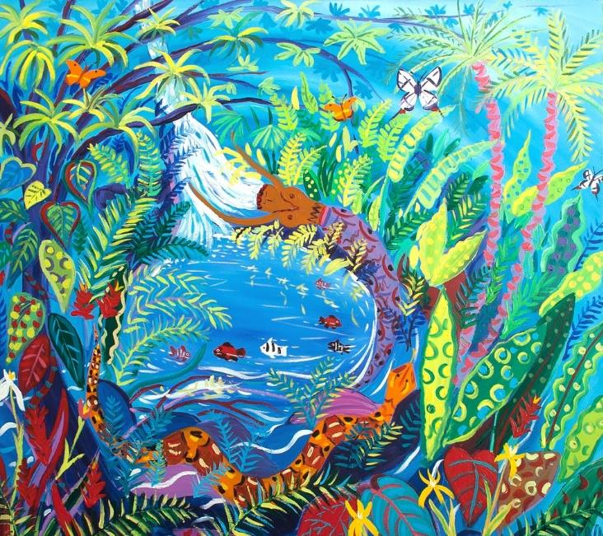

© John Dyer
Tell me…
…something you know now that you didn’t know an hour ago
…two facts about orangutans
…one top tip you need to remember when painting orangutans.

