Slide 1

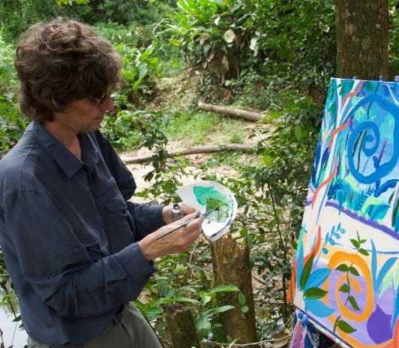
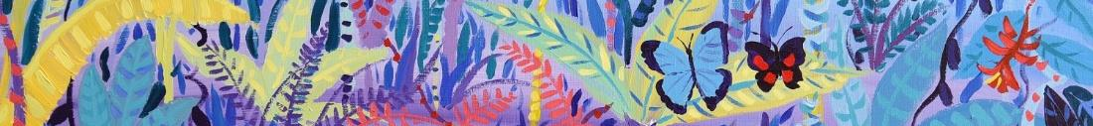




© John Dyer
Chapter 2: Person of the Forest, Borneo
Visit the Penan with artist John Dyer.
Develop your artistic skills whilst discovering the people, plants, animals and culture from one of the most diverse ecosystems in the world, the Borneo rainforest.
© John Dyer
© John Dyer

Slide 2
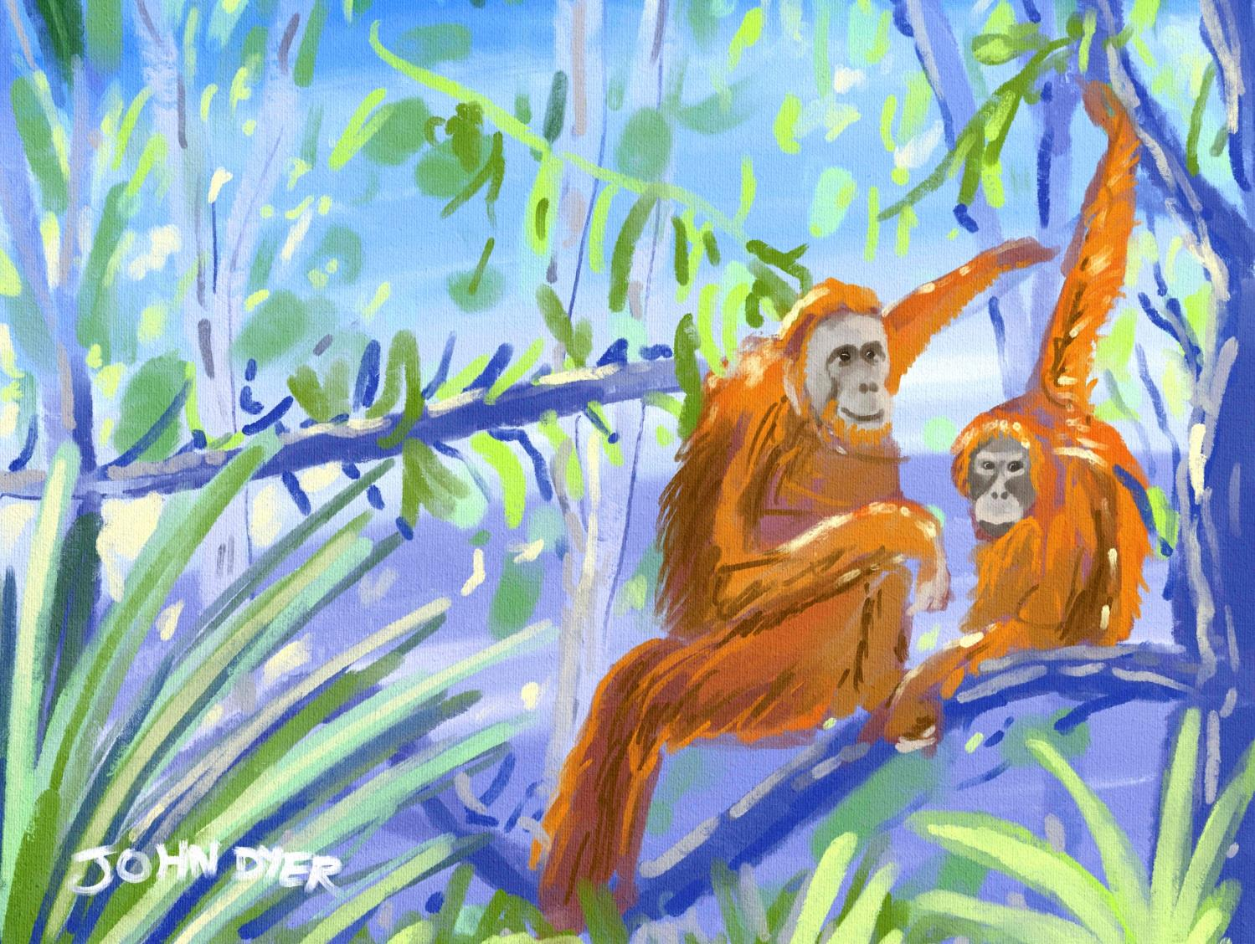


© John Dyer
Learning objectives:
To describe the characteristics of the rainforest
To describe five different plants found in the Borneo rainforest.

Slide 3

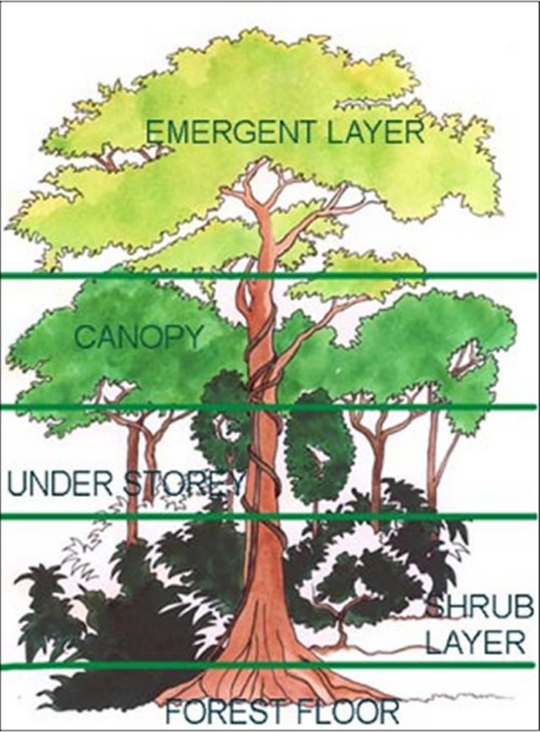

2
Rainforests are mainly situated around the Earth’s ____________
They have four main vegetation layers: emergent, ____________, understory and forest floor
They are warm and ________.
The ________ contains 70-90% of all life in the forest due to the abundance of food
Only ___% of the light reaches through the leaves and it can take ____ minutes for rain to reach the forest floor due to the dense vegetation above.
© John Dyer
Notes:
FilI the blanks

Slide 4
2
Rainforests are mainly situated around the Earth’s ____________
They have four main vegetation layers: emergent, ____________, understory and forest floor
They are warm and ________.
The ________ contains 70-90% of all life in the forest due to the abundance of food
Only ___% of the light reaches through the leaves and it can take ____ minutes for rain to reach the forest floor due to the dense vegetation above.
Use these words and numbers to fill in the gaps:
10 canopy equator
canopy wet 2%
Notes:
FilI the blanks

Slide 5
2
Rainforests are mainly situated around the Earth’s equator
They have four main vegetation layers: emergent, canopy, understory and forest floor
They are warm and wet.
The canopy contains 70-90% of all life in the forest due to the abundance of food
Only 2% of the light reaches through the leaves and it can take 10 minutes for rain to reach the forest floor due to the dense vegetation above.
© John Dyer
Notes:
FilI the blanks

Slide 6
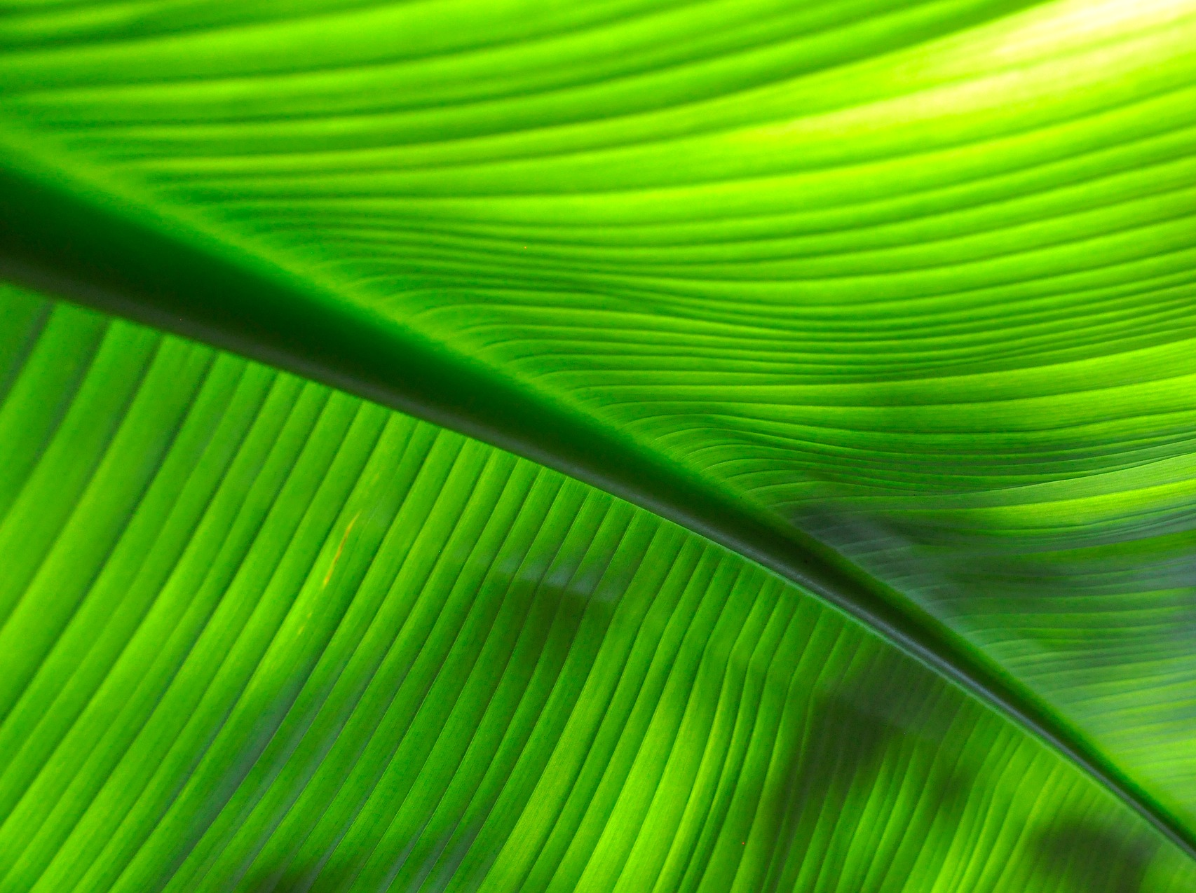

Medicine
People
Oxygen
Biodiversity
Water
Notes:
Only around 6% of Earth’s land surface is rainforest – but about half of all animal and plant species.
A quarter of ingredients in modern medicines come from rainforest plants.ve there!
More than 20 percent of the world oxygen is produced in the Amazon Rainforest.
Indigenous peoples account for 6% of the total. Around a sixth of them depend on the forests for their livelihoods. These tribes have unique cultures, ways of relating to the environment and have retained unique social and cultural practices.
Others include water, global warming
https://www.bbc.com/bitesize/guides/zwy7sg8/revision/3

Slide 7

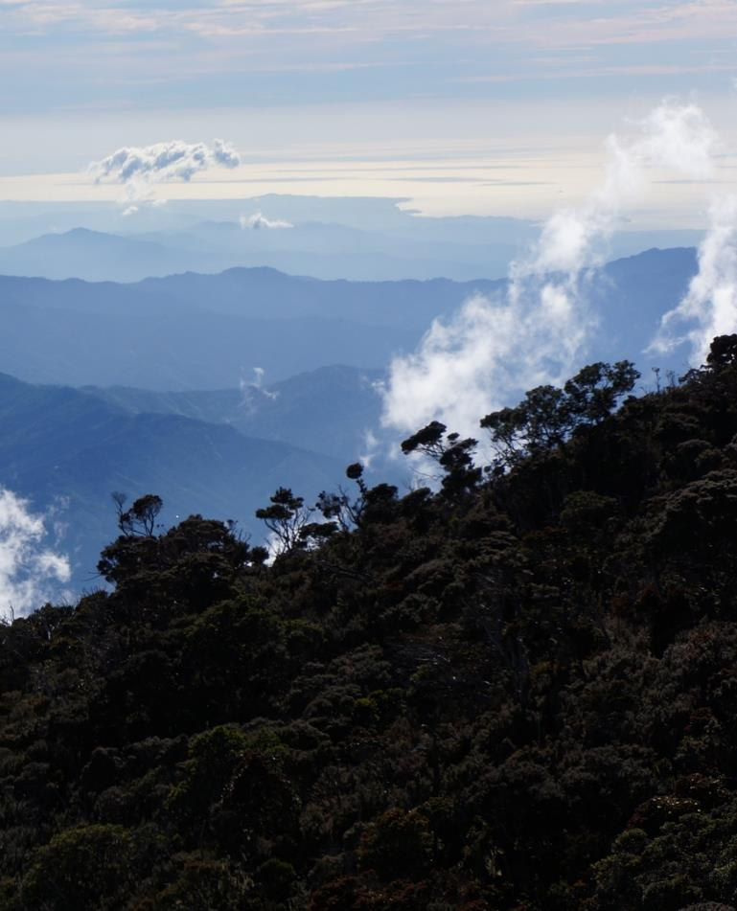
Borneo has around 15,000 species of flowering plants and 3,000 different species of trees
Many plants that grow and live in Borneo’s rainforests are endemic – this means they are only found only on the island
  About 40% of all plants found on Borneo only exist here.
Pixaby.com
© John Dyer
© John Dyer

Slide 8

Walk around the room and look at the different plant posters.
Use the examples to design (draw and annotate) your own plant. Thinking about:
What you would look like if you were a plant
What you would smell like and why
Where and how you would get your nutrients (food)?
Where you would grow and how big you would get
What people might use you for.
© John Dyer

Slide 9


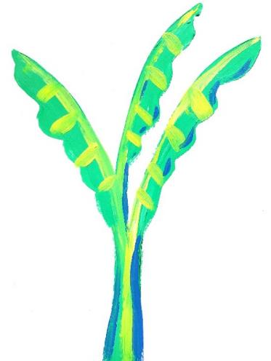
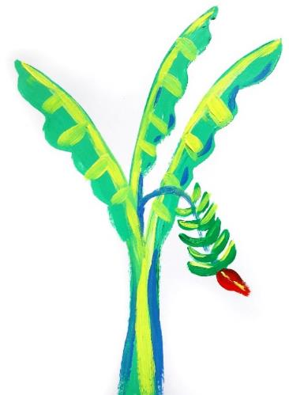
Step 1:
Choose your colour or colours
Start adding shape detail eg leaves.
Top tips:
Think carefully about the shape and colours of the plant you are going to draw
Green is a good starting colour if your plant has leaves
  Use a lighter colour for highlights
  Use a darker colour to add some shadow.
Step 2:
Think about the highlights and shadows.
Step 3:
Add any fruits or flowers to your plant if it will have them.
Step 4:
Annotate your drawing with notes about:
  Smell
  How you would get your food
  Where you would grow
  Size
  Use etc.

Slide 10

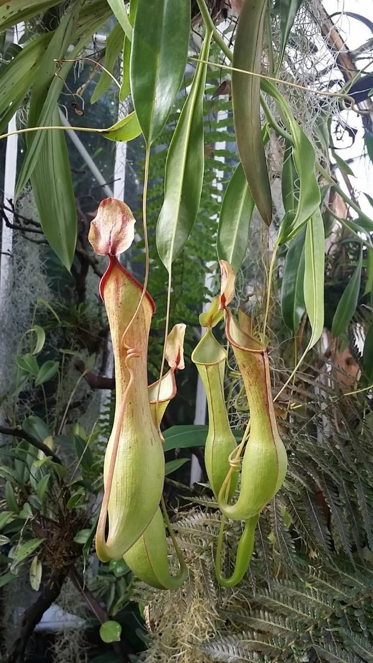
Camel
Facts:
They get their name from their shape – which allows them to trap insects
They can grow in very poor soil as they get their nutrients from their prey.
One species of pitcher plant found in Borneo has become known as the ‘shrew toilet’. It uses nectar to attract tree shrews and birds – their droppings fall into its pitcher and provide most of the plants’ nitrogen requirements.
2
Pixaby.com

Slide 11

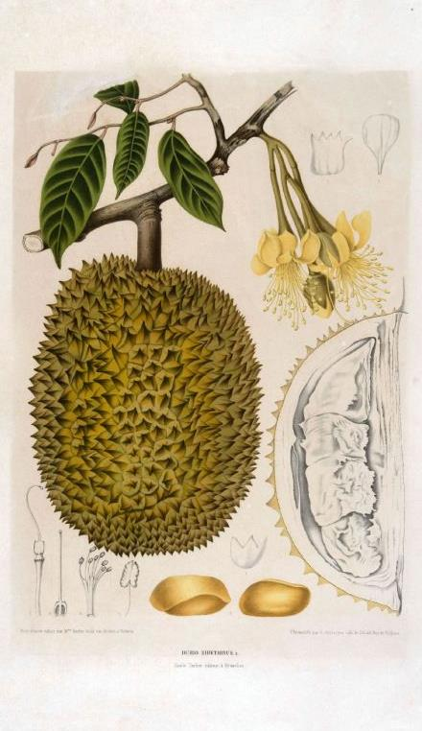
Camel
Facts:
This tree produces an edible fruit that has a custard like texture
These large fruits can be 15cm to 20cm across
The yellow flowers shed their pollen in the evening attracting bats which help to pollinate the plant.
The sometimes overpowering, sickly sweet smell of the fruit means that it is banned from some hotels and public transportation in south east Asia.
2
© Tropenmuseum, part of the National Museum of World Cultures
Notes:
Image sourced from: Wiki commons
https://commons.wikimedia.org/wiki/File:COLLECTIE_TROPENMUSEUM_De_vrucht_de_bloemen_en_het_blad_van_de_Durio_zibethinus_L._TMnr_3401-1688.jpg

Slide 12

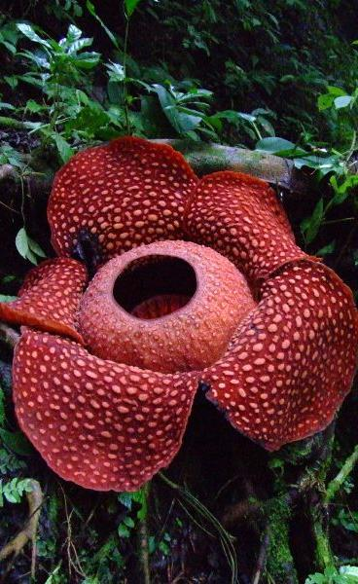
Camel
Facts:
These are parasitic plants that live inside vines (absorbing their nutrients) with only their flowers showing
They emit the smell of rotten meat to attract pollinators such as insects
There are 28 different species found across south east Asia.
A species of corpse flower (Rafflesia arnoldii) has the world’s largest flower, weighing up to 10kg each and measuring 100cm across.
2
© Tamara van Molken
Notes:
Image sourced through flickr.com
https://www.flickr.com/photos/tamaar/
https://creativecommons.org/licenses/by-nc-nd/2.0/

Slide 13

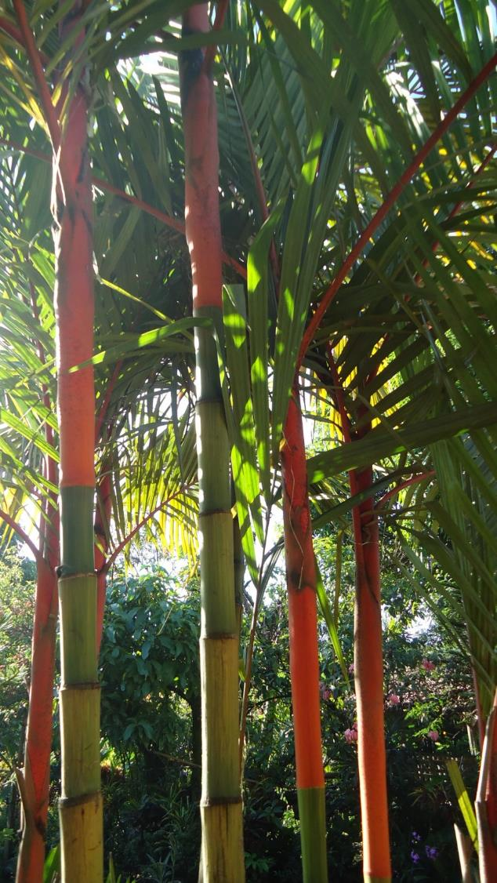

Camel
Facts:
Around 2,600 species of palm can be found around the world
Palm leaves can be enormous, for example, one oil-palm leaf can be 10m long
The lipstick palm has distinctive red leaf shafts (stems).
In 1999, the government of Indonesia brought in a new law to protected it from being harvested as it was becoming threated.
2
Pixaby.com
Wikicommons.com
Notes:
Image sourced through Flikr

Slide 14

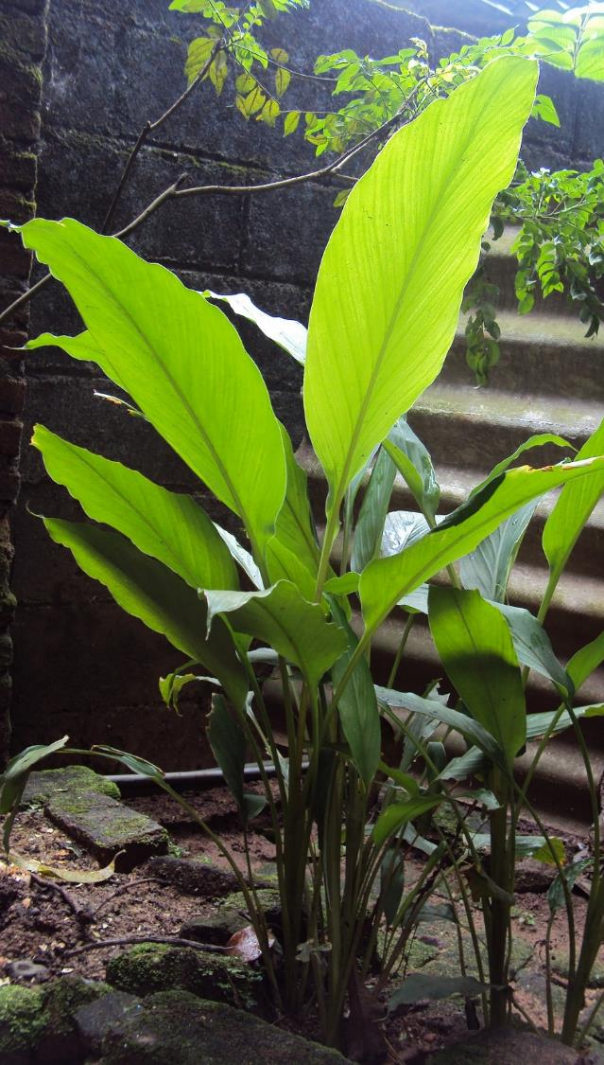
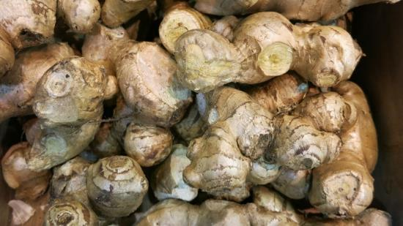
Camel
Facts:
The part of the ginger plant that is commonly used as a spice actually grows below ground – like a potato
Ginger is a herb – this means that its stem is not made of wood like a tree but of lots of sheets of overlapping leaves.
Ginger root has been in use
since ancient times and
eating it has many reported
health benefits.
2
Pixaby.com
Pixaby.com

Slide 15


Camel
Annatto seeds
Traditional song
© John Dyer
Notes:
https://www.youtube.com/channel/UCLKKZyhgbHCFeHHcmRb7m5Q?view_as=subscriber%3Fsub_confirmation%3D1

Slide 16
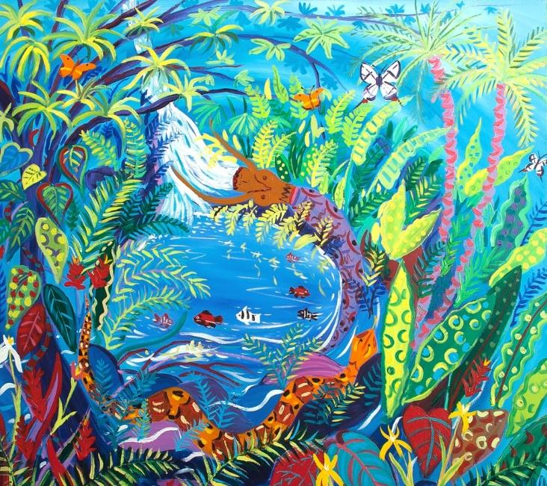
© John Dyer
Tell me…
…something you know now that you didn’t know an hour ago
…the name of three rainforest plants found in Borneo

