Slide 1

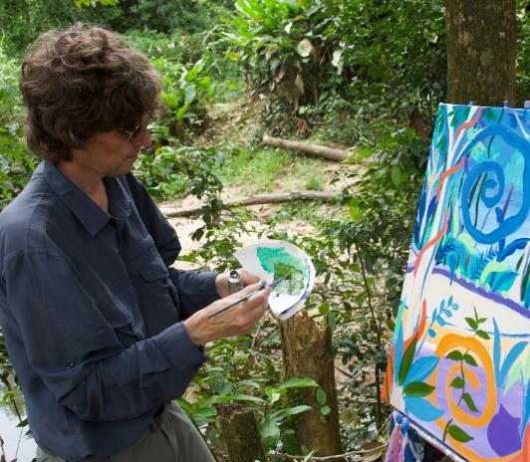
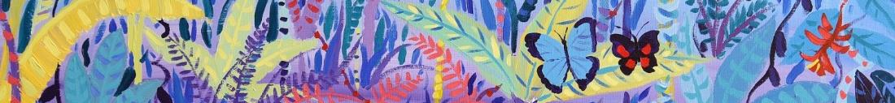




© John Dyer
Chapter 2: Person of the Forest, Borneo
Visit the Penan with artist John Dyer.
Develop your artistic skills whilst discovering the people, plants, animals and culture from one of the most diverse ecosystems in the world, the Borneo rainforest.
© John Dyer
© John Dyer

Slide 2
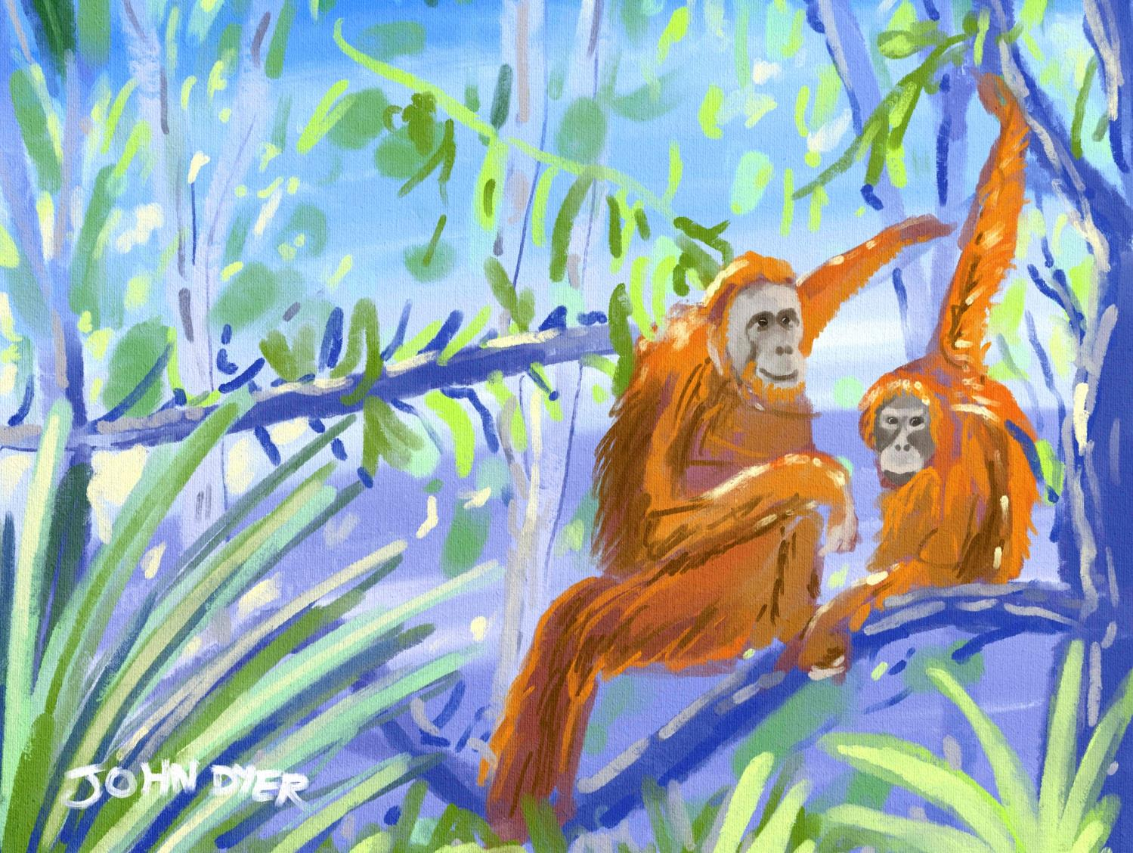


Learning objectives:
To describe the location of Borneo
To compare the culture and customs of the Penan and your own
To experiment with tonal drawings.

Slide 3
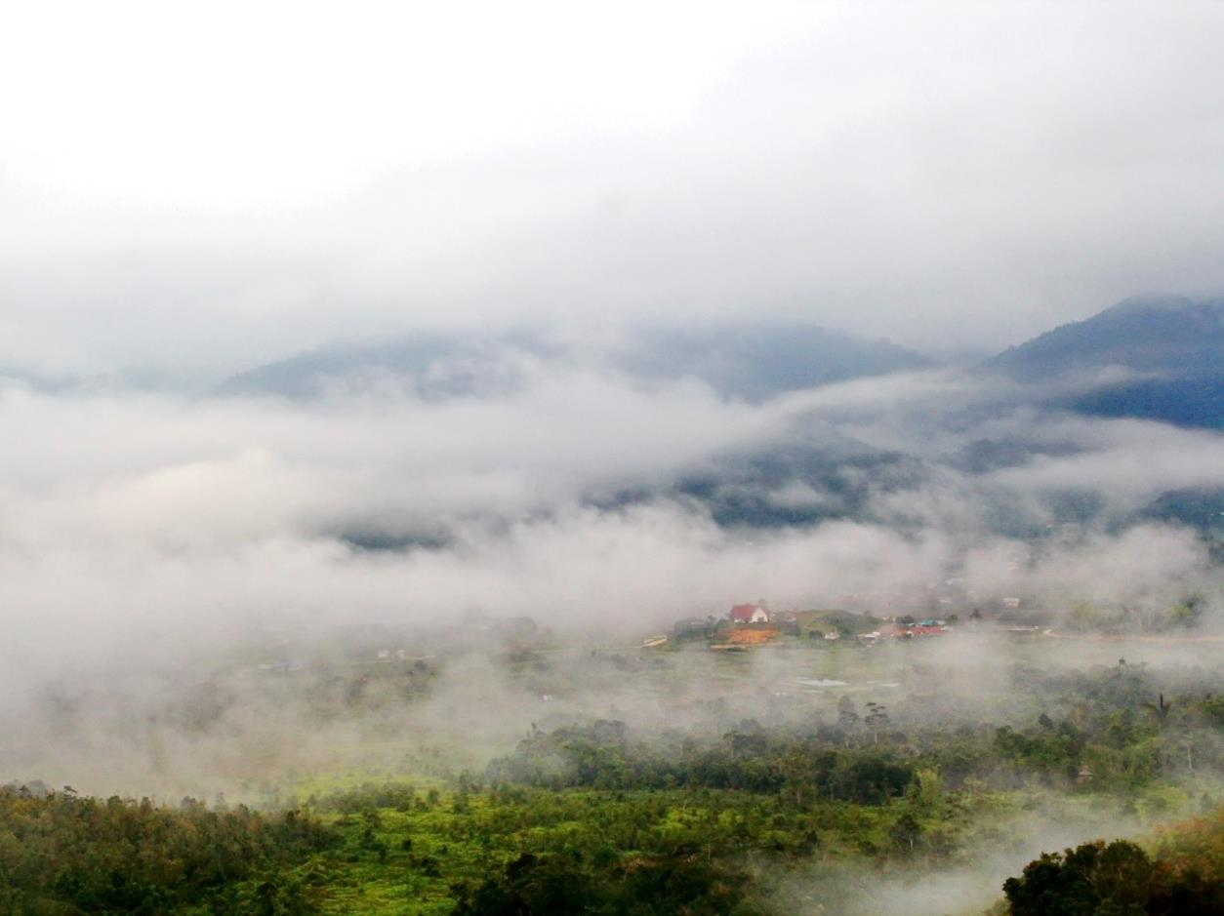

Write down three geographical questions that you would like to ask about this image.
Pixaby.com
Notes:
E.g. Who lives here? What is the climate like? What is the land being used for? What animals live here?
These questions can be collected – see if they are all answered by the end of the project.

Slide 4

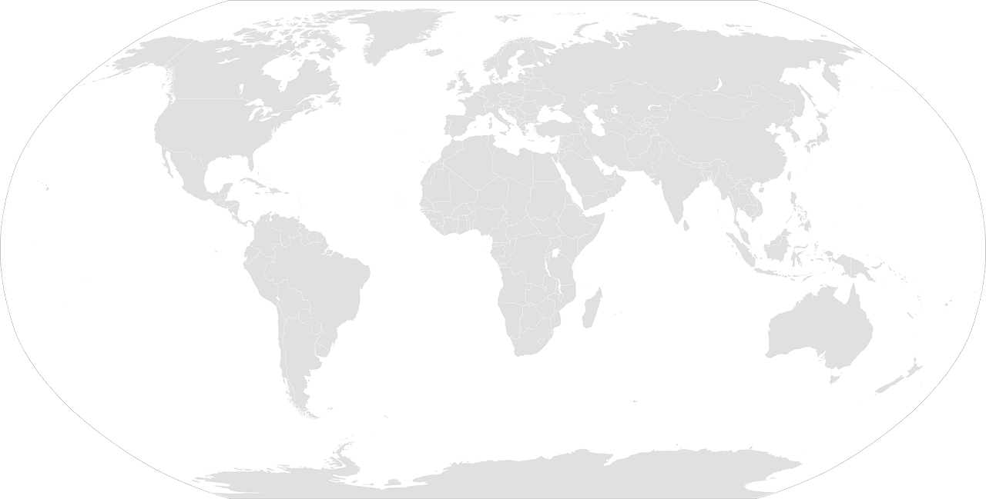
Use the map to locate Borneo
Pixaby.com
© John Dyer
© John Dyer

Slide 5
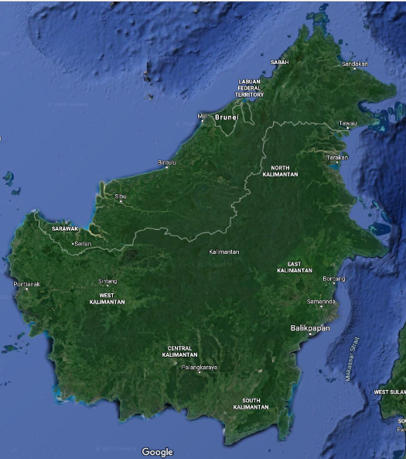
Did you find it?
The island of Borneo is divided amongst the countries of Malaysia, Brunei and Indonesia.
Borneo is the third largest island in the world and is 748,168 km².
Pixaby.com
© John Dyer
© John Dyer

Slide 6
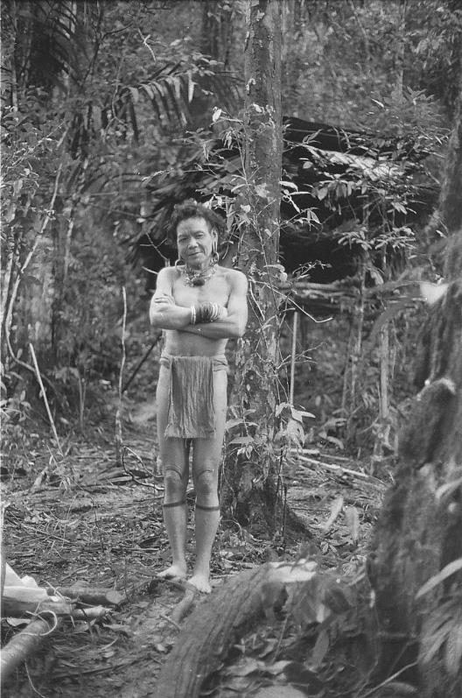
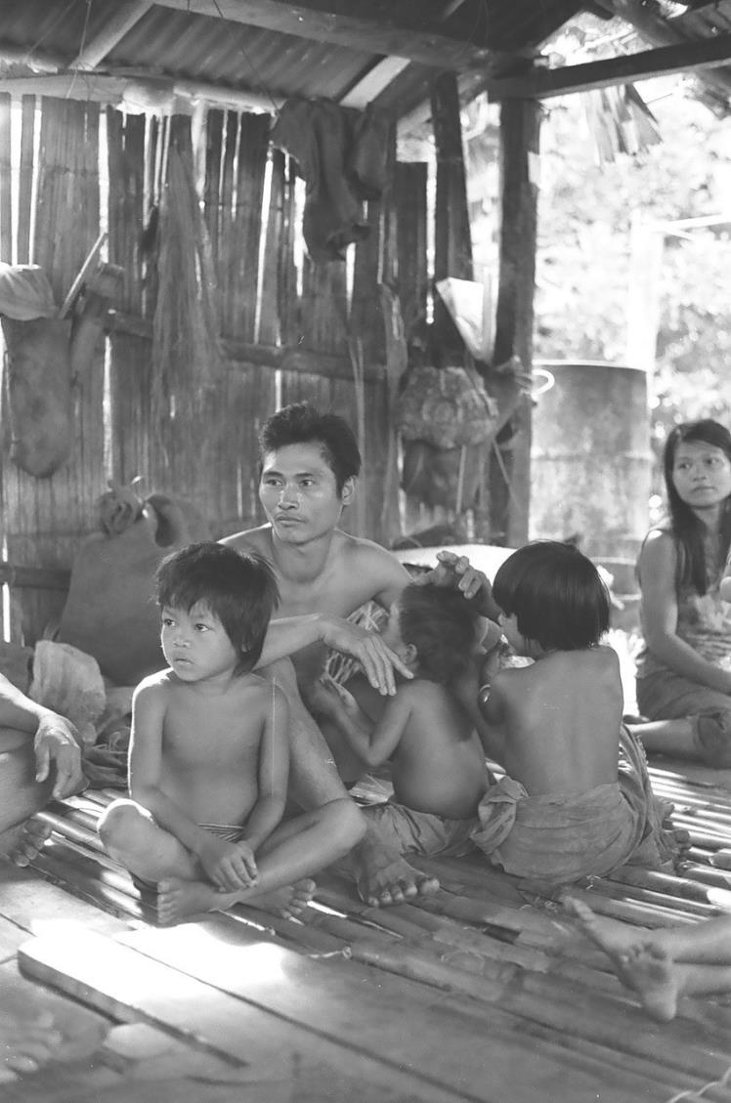

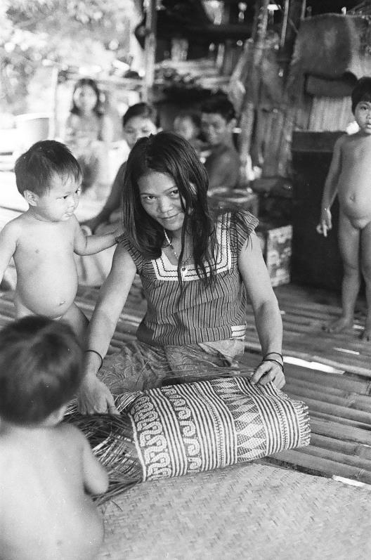
© Robin Hanbury-Tenison
© Robin Hanbury-Tenison
© Robin Hanbury-Tenison
© John Dyer

Slide 7

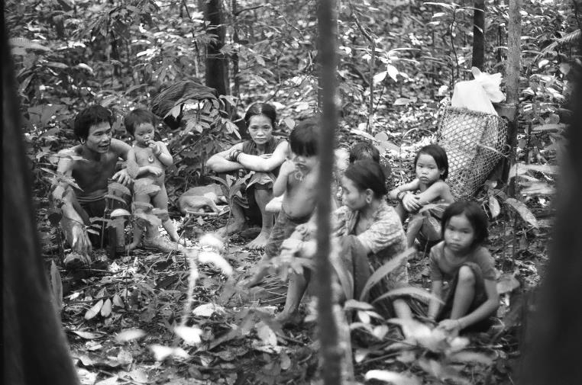
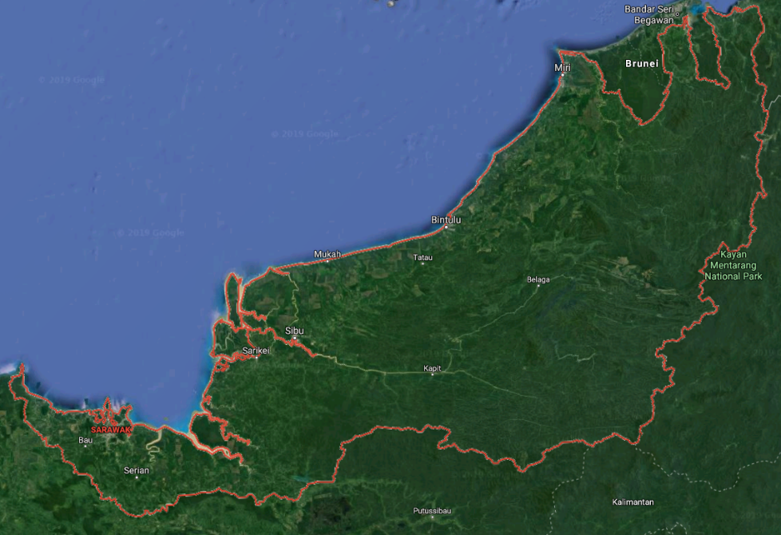

Camel
The Penan are a hunter-gatherer, nomadic people from Sarawak, a state in Malaysian Borneo.
There are around 10,000 – 12,000 Penan living in communities of between 15 and 50 people throughout the state.
© Robin Hanbury-Tenison
© John Dyer
Notes:
http://www.bbc.co.uk/tribe/tribes/penan/index.shtml
https://www.survivalinternational.org/tribes/penan

Slide 8

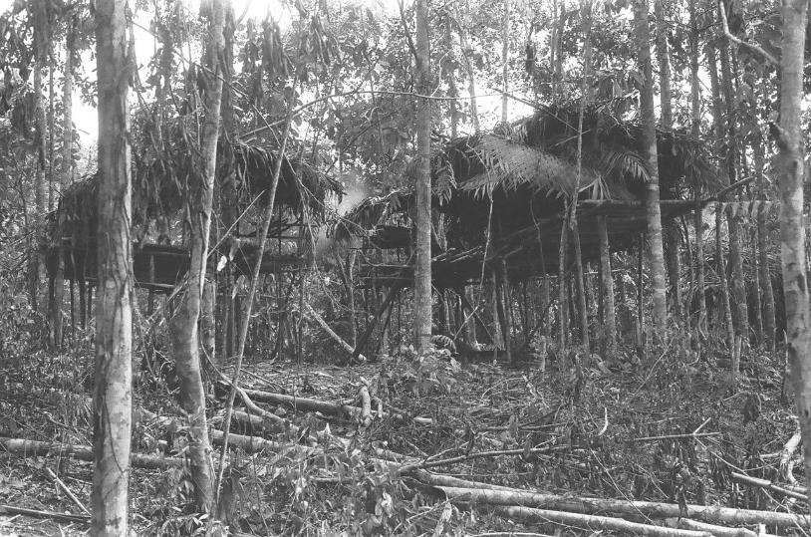
© Robin Hanbury-Tenison
The Penan don’t stay in the same place long, moving every month or so
They make simple huts called selaps, leaving these behind each time they move to a new patch of forest
They have few possessions, carrying what they do have in backpacks made of palm leaf (rattan)
However, most communities have now started to settle more permanently, leaving behind their nomadic life but remaining reliant on the forest.
If you could only take three items with you when you moved from place to place, what would they be?
What would be the benefit of having possessions that lasted a long time and could be fixed if they break?
© John Dyer
© John Dyer
Notes:
http://www.bbc.co.uk/tribe/tribes/penan/index.shtml
https://www.survivalinternational.org/tribes/penan

Slide 9

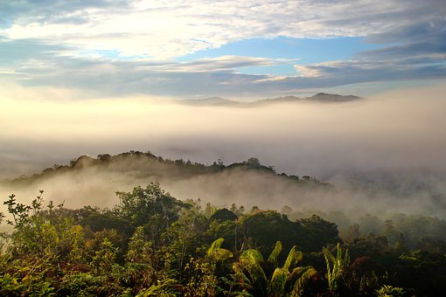
Camel
Create your own ‘stick’ language drawing the shapes you create next to these phrases:
We went this way
We found food
We need help
Another phrase of your own invention.
Annatto seeds
The Penan traditionally live in dense forest, so how do they find their way from place to place?
The Penan have ancient paths used since the time of their ancestors which they follow through the forest
They also have a special way of communicating with each other using sticks. They lay these in the pathways to indicate which way they have gone, to let other’s know they have found something or as a warning.
Traditional song
Pixaby.com
© John Dyer
© John Dyer
Notes:
http://www.bbc.co.uk/tribe/tribes/penan/index.shtml
https://www.survivalinternational.org/tribes/penan

Slide 10

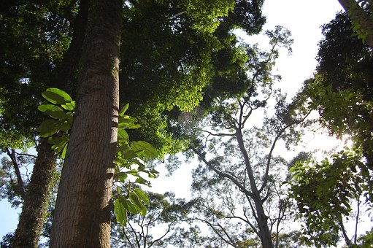
“We’re not like the people in the towns, who have money and can buy things. If we lose all the things the forest gives us, we will die.”
PENAN MAN, BA LAI
Why is the forest important to the Penan?
It provides the materials to build their homes
It holds the ancient paths of their ancestors
It is where they find their food and water.
However, the rainforest is disappearing – the island lost 12% of its forest cover between 2000 and 2010 alone.
There will soon be nothing left for the Penan or the wildlife that lives there.
Pixaby.com
© John Dyer
© www.tigersintheforest.com
Notes:
http://www.bbc.co.uk/tribe/tribes/penan/index.shtml
https://www.survivalinternational.org/tribes/penan
http://www.borneofutures.org/deforestation.html

Slide 11
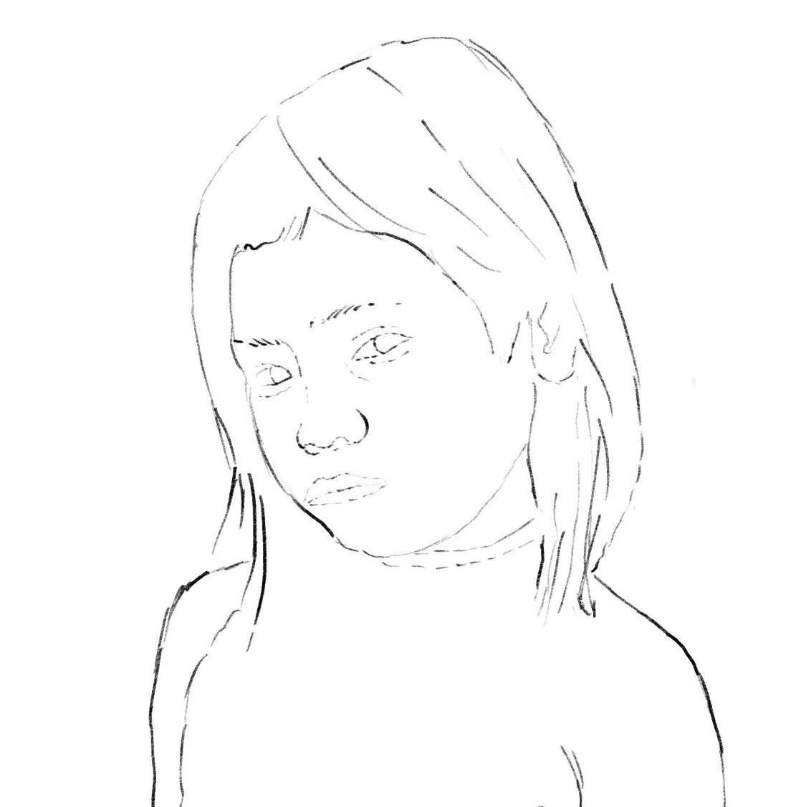
© John Dyer

Slide 12

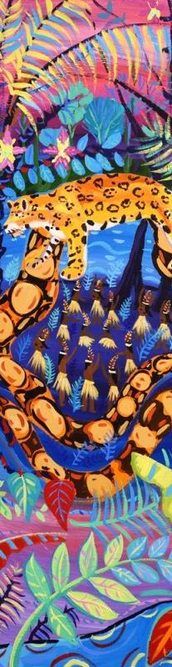
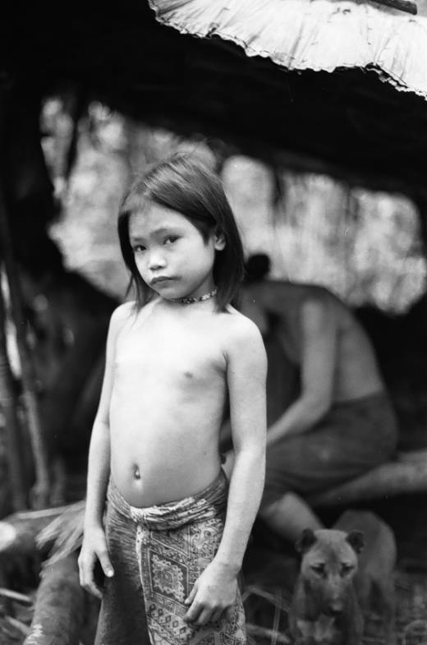
What is a tonal drawing:
Using light and shade to create a shape or image.
Activity:
Making the best of limited resources – what can you do with just two materials?
Using the provided line drawing of the Penan girl to work on top of, establish the areas of tone.
Possible materials:
Worksheet or blank paper
Drawing materials such as:
  Soft pencil (4B or above)
  Black drawing pencil
  Charcoal
  Compressed charcoal
  Graphite stick
  Soft pastel
  Black watercolour paint.
© Robin Hanbury-Tenison

Slide 13
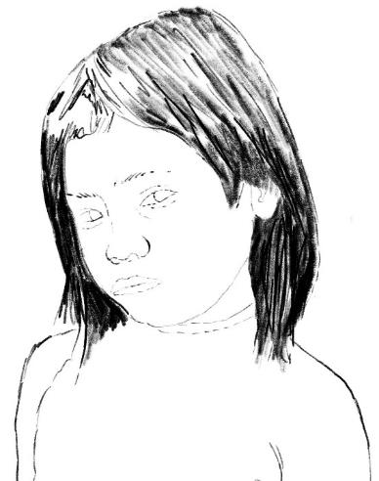
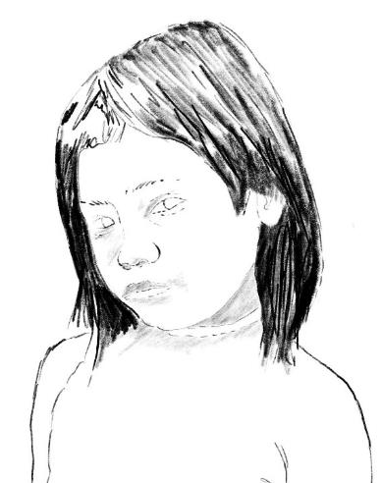
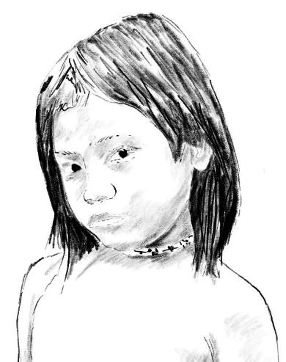
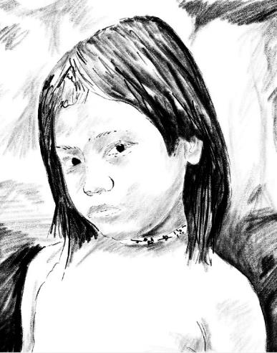
Step by step guide:
Step 1:
Very dark marks can be used for the hair of the Penan girl
Leave areas of paper white to create the shine in her hair and develop texture with your mark making or brush strokes.
Step 2:
Look carefully at the range of very subtle tones on the girl's face and gently shade those areas.
Step 3:
The area on her neck is slightly darker than her face which adds depth.
Add her dark eyes.
Step 4:
Deep textures and tones in the background give the feeling of the light and dark of the rainforest
Notice how by adding the dark background she leaps off the page and creates a very strong image.
Do you feel a connection to her?

Slide 14


Camel
Annatto seeds
Traditional song
© John Dyer
Notes:
https://www.youtube.com/channel/UCLKKZyhgbHCFeHHcmRb7m5Q?view_as=subscriber%3Fsub_confirmation%3D1

Slide 15
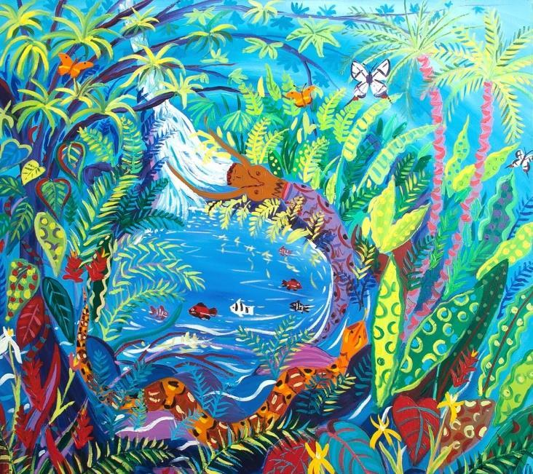
© John Dyer
Tell me…
…something you know now that you didn’t know an hour ago
…three differences between the culture and customs of the Penan and your own
…one top tip you need to remember when making tonal drawings.

