Slide 1

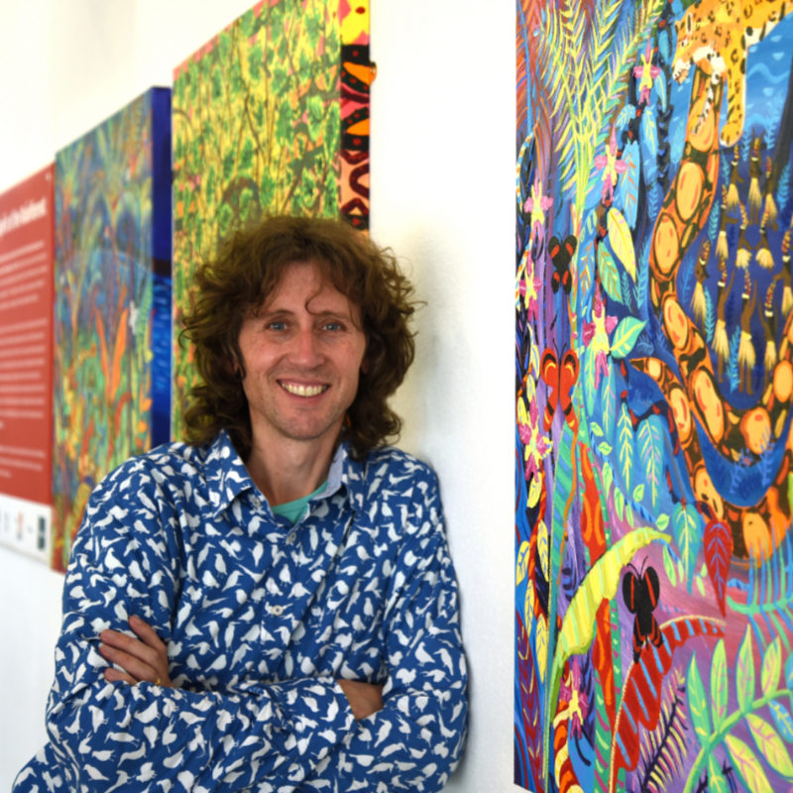
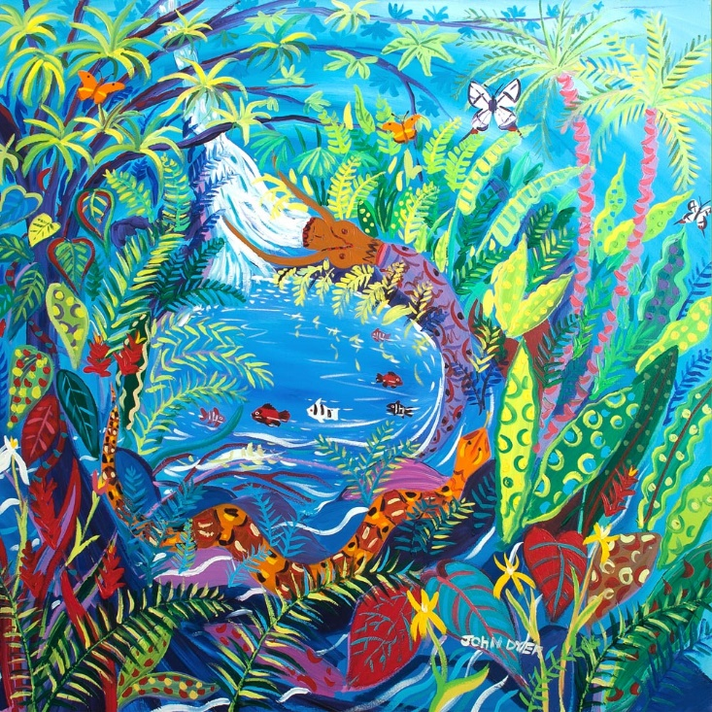



Chapter 1: Spirit of the Rainforest
Visit the Yawanawá tribe with artist John Dyer.
Develop your artistic skills whilst discovering the people, plants, animals and culture from one of the most diverse ecosystems in the world, the Amazon rainforest.
© John Dyer Gallery
© John Dyer

Slide 2
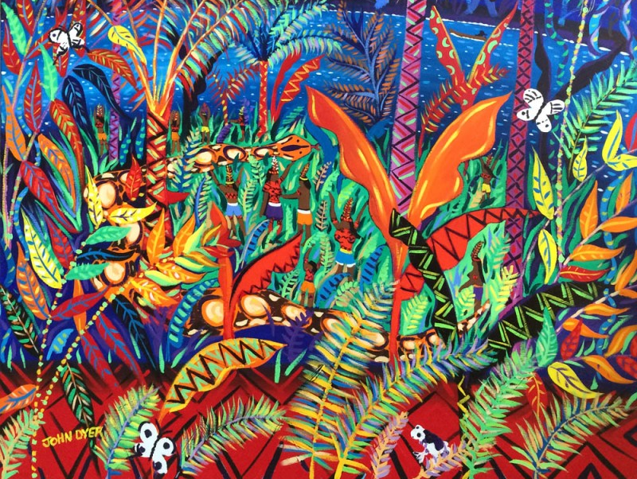


© John Dyer
Learning objectives:
To describe the location of Brazil
To explain the difference between the culture and customs of the Yawanawá tribe and your own
To experiment with a range or art materials and techniques.

Slide 3


Use the map to locate South America and Brazil
Pixaby.com
© John Dyer

Slide 4
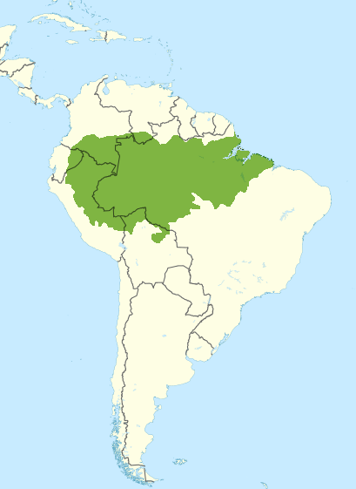
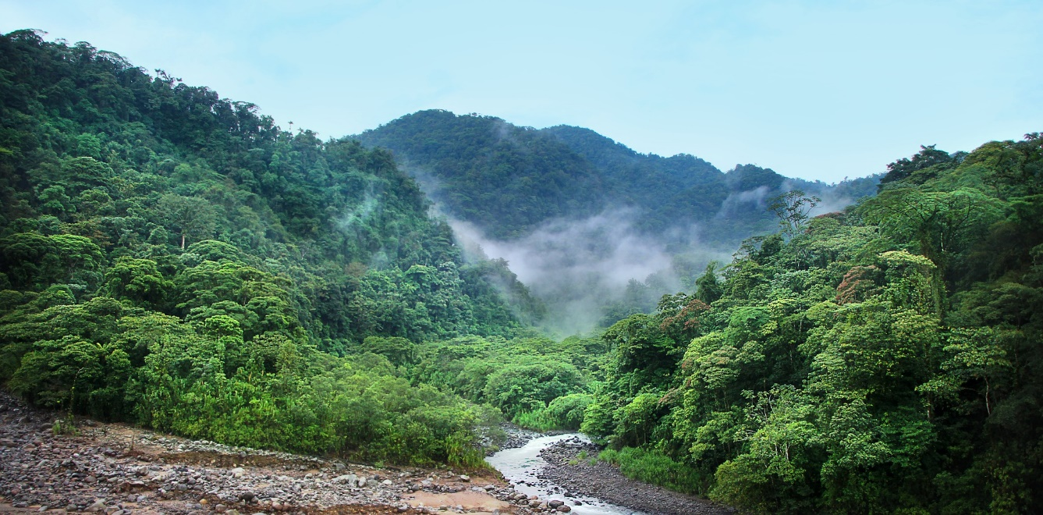
Camel
The Yawanawá tribe lives deep in the Brazilian Amazon in eight tribal villages.
The Amazon rainforest spans nine countries in South America and holds a huge variety of different plants and animals.
Guyana
Venezuela
Suriname
Colombia
French Guiana
Ecuador
Brazil
Peru
Bolivia
Pixaby.com
Wiki commons
Pixaby.com
© John Dyer
Notes:
Additional information: 60% of the Amazon rainforest is found in Brazil.

Slide 5
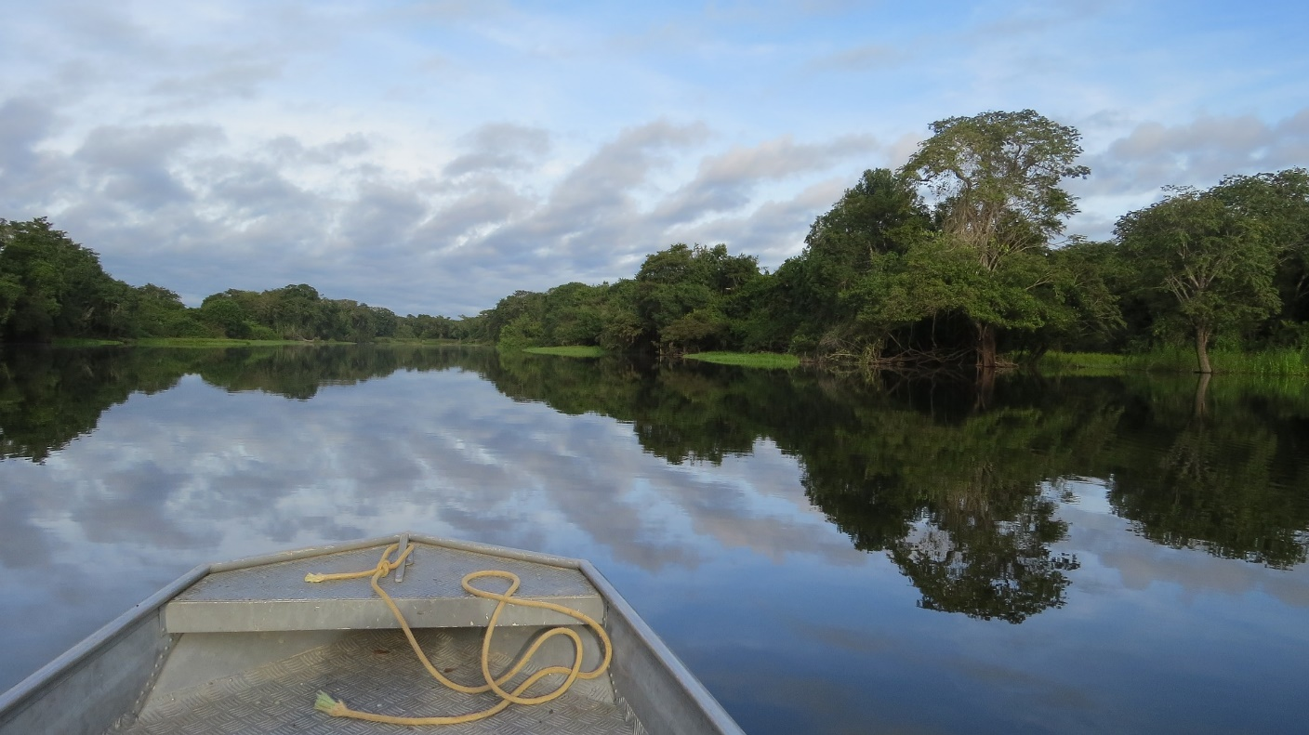
Camel
John met his guide and headed south on the Rio Gregório for many hours to reach the village of Mutum.
Rio Gregório
State of Acre
Pixaby.com
© John Dyer

Slide 6

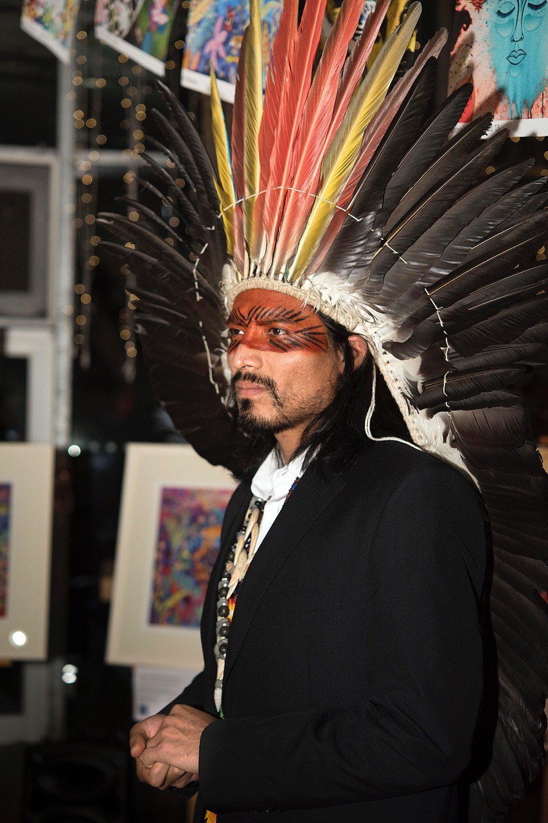
…and let me tell you about my tribe.
“There are over 900 Yawanawá.
The name Yawanawá translates as ‘The People of the Wild Boar’.
All food is shared amongst our village so no one goes hungry.
Generosity and sharing is essential to our way of life.”
© Emily Whitfield-Wicks/Eden
Information sourced from Survival International.org
© John Dyer

Slide 7

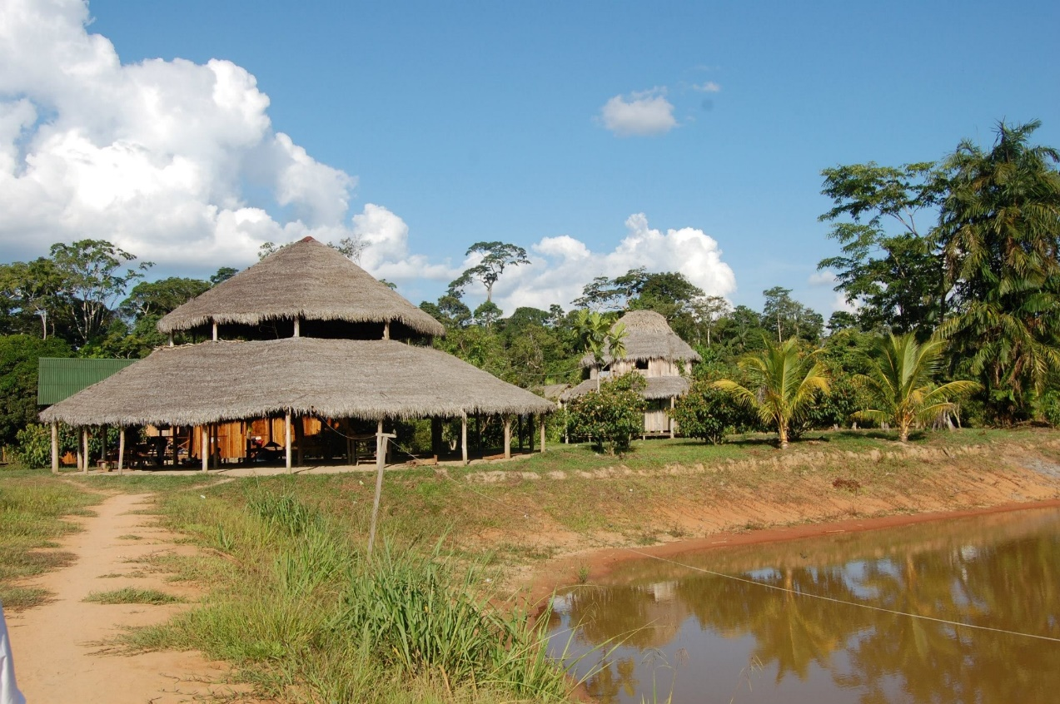
“Living in the forest, we have a deep connection with it.
We get our food, housing and virtually everything we need from our rainforests.
In the rainforest you are surrounded by the constant sounds of animals, insects, frogs and water.
We have a lot of respect for our land, and we have a responsibility to look after it.”
© Nixiwaka Yawanawá
Information sourced from Survival International.org
© John Dyer
Notes:
Additional info: “Our way of life is developed from our ancestors. We live close to nature.” Nixiwaka Yawanawá

Slide 8
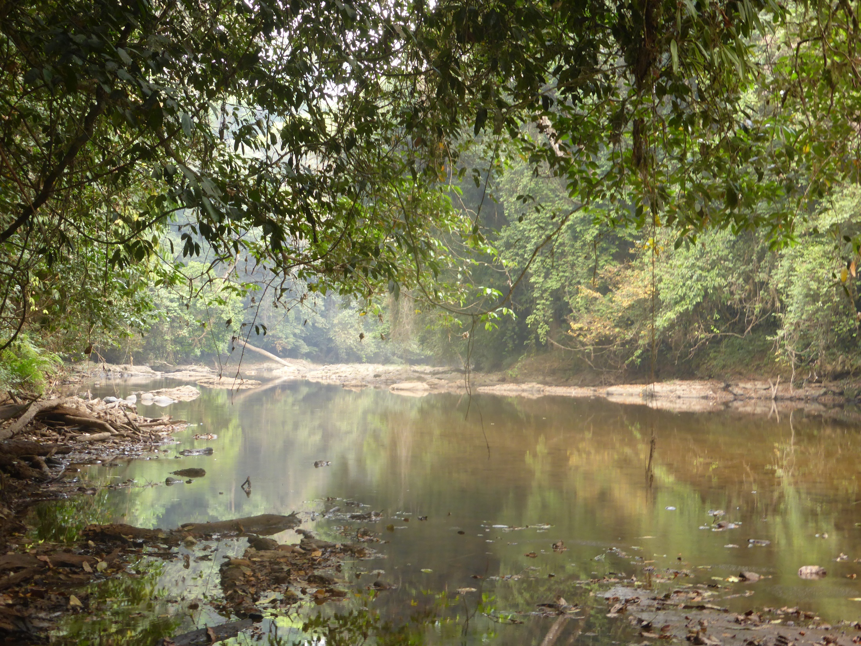
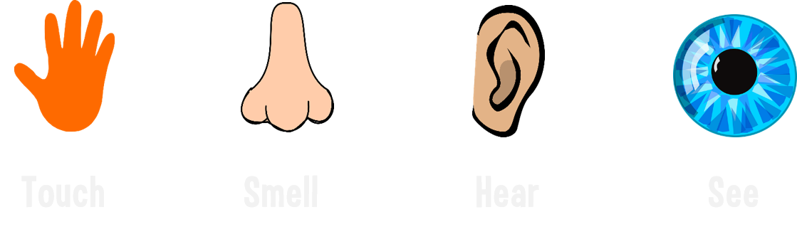
© BFF

Slide 9

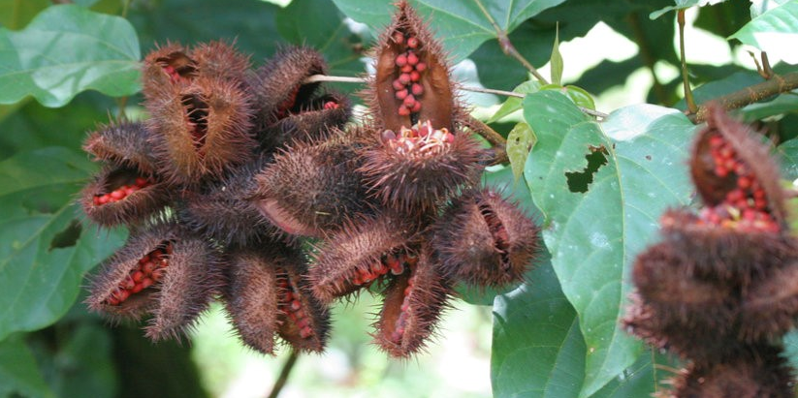

Camel
Annatto seeds
“We make paint out of annatto seeds and the jenipapo plant.
These make red and black paints that we use to paint our faces and our bodies… it can stay on for three weeks. The patterns we paint are inspired by animals.
Our songs are old and reflect our lives within nature.
Our necklaces are made from seeds and feathers and we make headdresses called ’maiti’.”
Traditional song
Information sourced from Survival International.org
© John Dyer
Notes:
Additional information:
“We only wear our ‘maiti’ on very special occasions or ceremonies where we are connected to the spiritual world.” Nixiwaka Yawanawá
They believe that the body painting (Kênê) brings them closer to nature, gives them power, and protects them. The patterns often reflect the patterns found on the animals in the rainforest such as the jaguar and boa constrictor (Survival International.org).
If the embedded video doesn’t play please use this link: https://vimeo.com/311861733

Slide 10

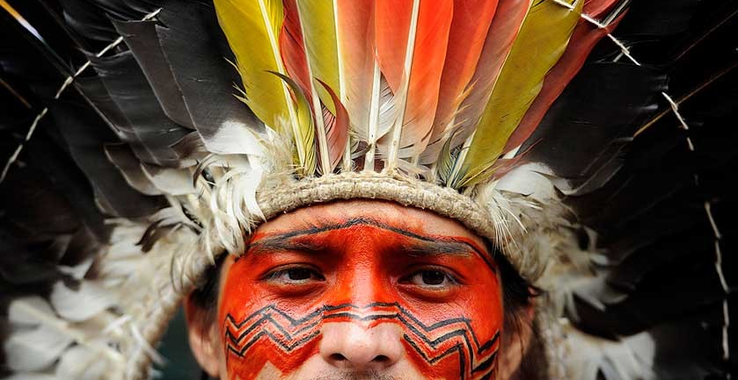

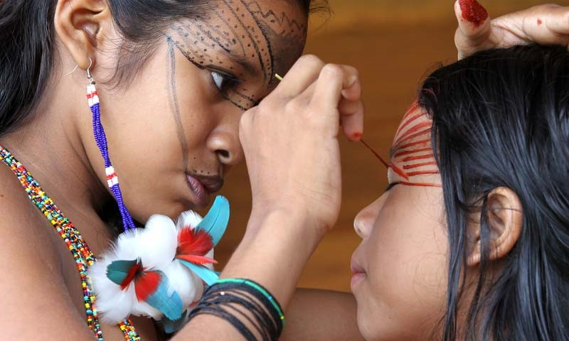
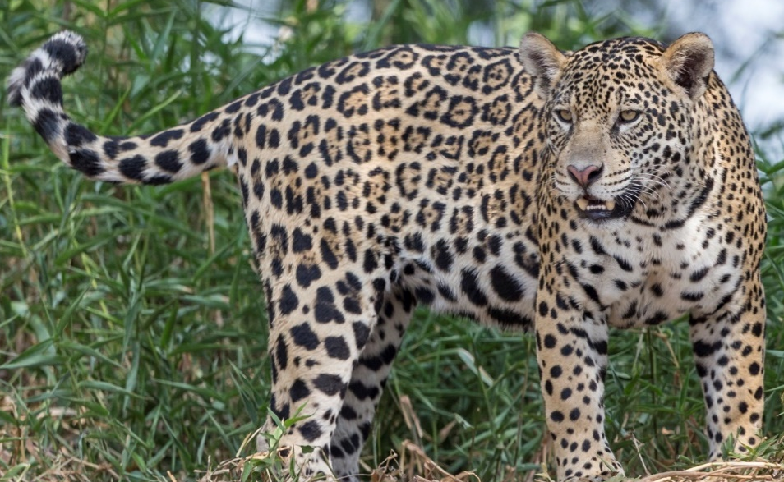
© epa b.v. / Alamy
Activity:
Use your worksheet to experiment with face painting designs (Kênê) using black and red.
Materials:
Worksheet
Extra paper
Drawing or painting materials such as:
  Felt-tip pens
  colouring pencils
  crayons
  pastels
  watercolours
  fine paint brushes.
© www.tigersintheforest.com

Slide 11
© John Dyer

Slide 12
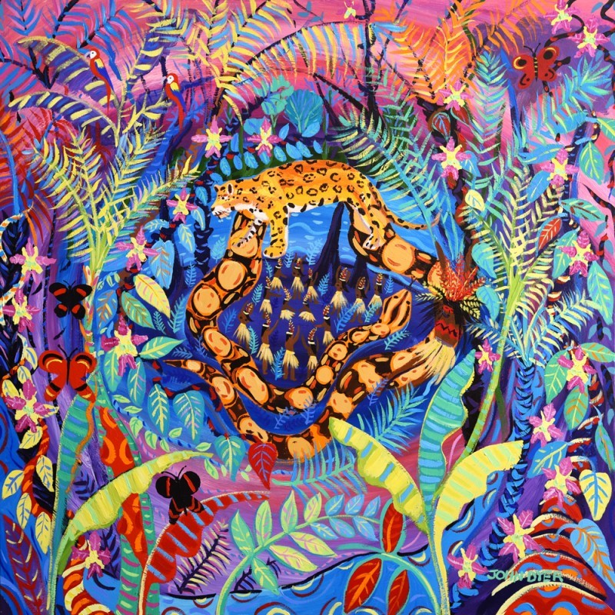

Camel
© John Dyer
Activity:
Try your hand at painting or drawing people in John’s style.
Top tips:
Use a soft pencil: 4B – 6B
Use your body, or a friends, to see where the main joints are e.g. elbows and knees
  This will help construct your body and make it more realistic and in proportion
For the extra features e.g. hair and clothing, art materials such as paint, coloured pencils or pastels can be used
  The Yawanawá often have long, dark hair.

Slide 13
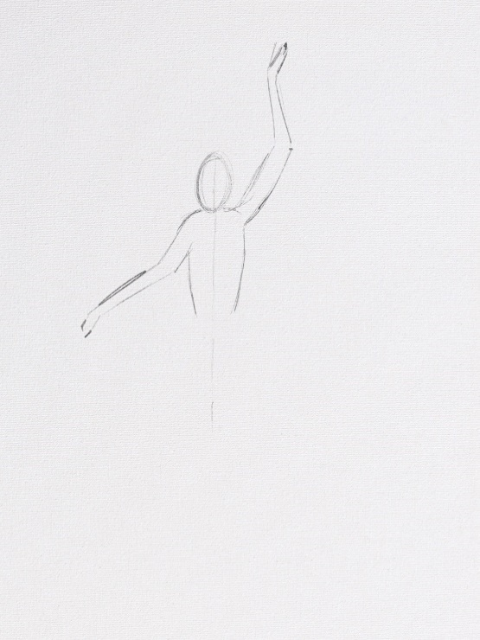
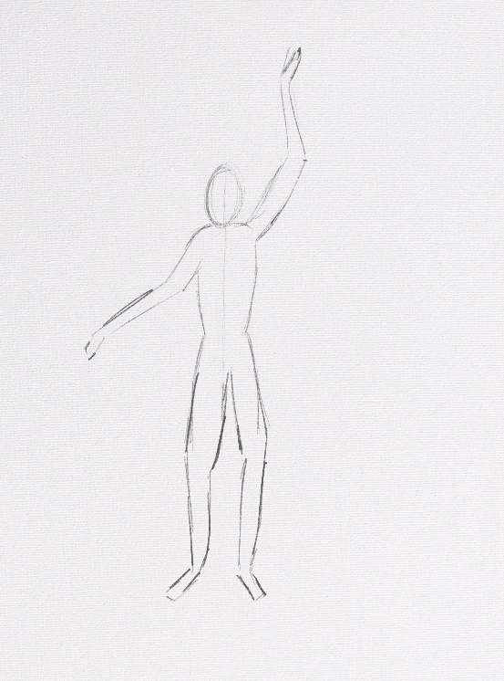
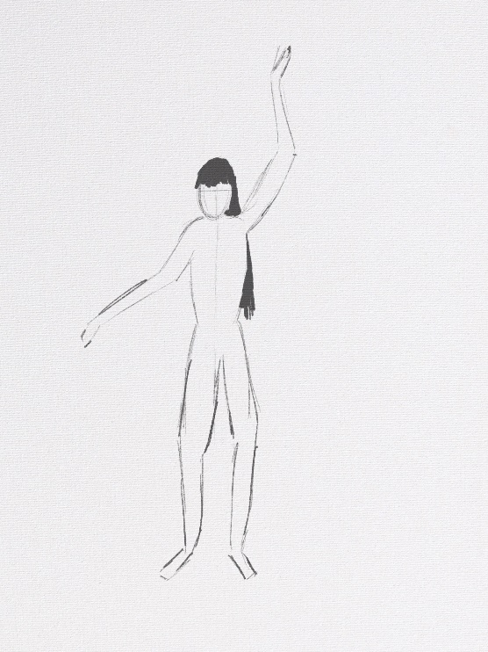
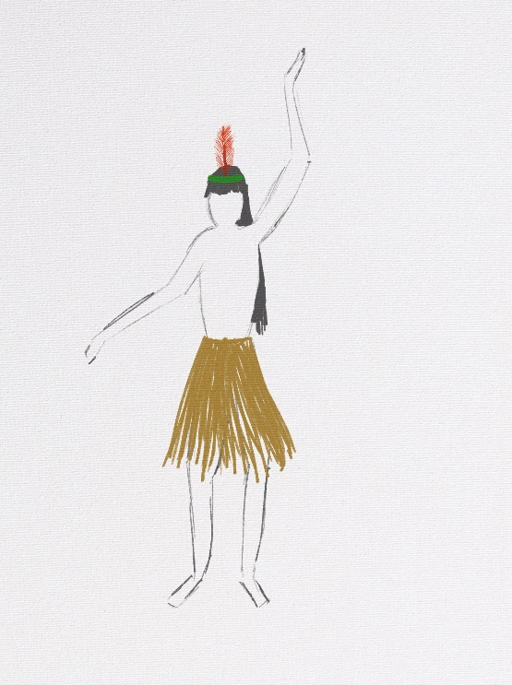
Step by step guide:
Step 1:
Decide on body position: standing, sitting, waving etc.
Draw the head as an oval
Draw a vertical line of symmetry through the head and through where the body will be. Use a ruler as required
Draw the shoulders, arms and upper body. See top tips!
Step 2:
Add the legs
Bend the legs slightly at the knees.
Step 3:
Add the hair style of your choice.
Step 4:
Add a ceremonial grass skirt, or coloured shorts and a t-shirt
Add a head dress of your design and choosing
Remove any extra pencil markings such as the central line.
Extra
Add a body colour or body paint markings.

Slide 14
© John Dyer
Tell me…
…something you know now that you didn’t know an hour ago
…three differences between the culture and customs of the Yawanawá tribe and your own
…one top tip you need to remember when painting people.

