Slide 1


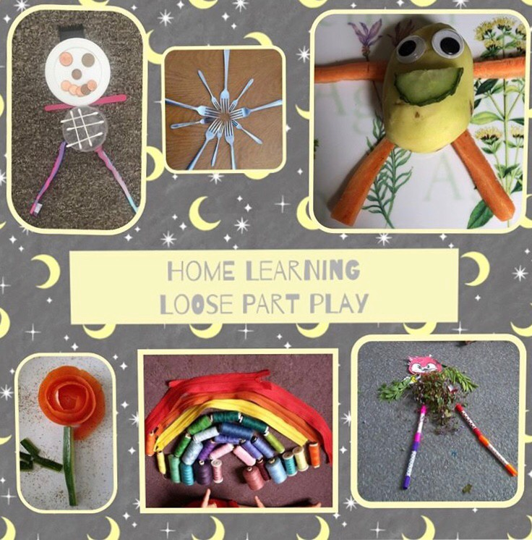
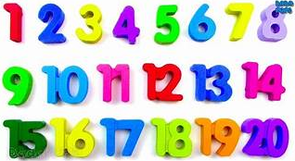


Add your photos and videos onto Tapestry.
We love seeing all the exciting things you are doing!
My Home Learning Journey Grid: Week beginning: 18th May
Phonics
Daily Speed Sound Lesson using RWI facebook/Youtube videos.
See Tapestry for uploaded activities for your child’s RWI group including RWI Get Writing Book.
Special Family Task
Maths
This week we will be looking at one more and one less of a number and combinations of numbers up to 20. https://www.thenational.academy/online-classroom/reception/maths#subjects
Loose Parts Play!
Time to be creative and use loose parts to create your own pictures and models.
Let’s get physical!
Use the Youth Sport Trust Website to take part in 60 second activity challenges. https://www.youthsporttrust.org/60-second-physical-activity-challenges
You can even download a challenge activity tracking sheet!
Reflection Time
Find somewhere quiet and think about all the things that make you smile.
Think of something that you find tricky or that you always need help with.(tying shoelaces, dressing, eating, doing your hair.)Video yourself doing it and then practise everyday for 2 minutes. And then video yourself again. I bet you have improved. We would love to see your before an after videos

