Slide 1


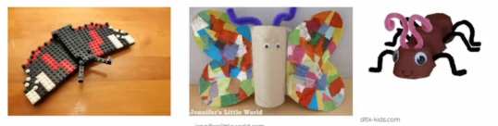

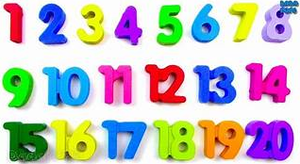

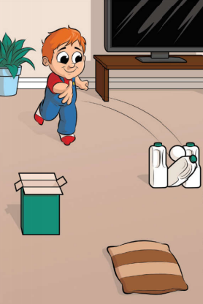

Add your photos and videos onto Tapestry.
We love seeing all the exciting things you are doing!
My Home Learning Journey Grid: Week beginning: 11th May
Phonics
Daily Speed Sound Lesson using RWI facebook/Youtube videos.
See Tapestry for uploaded activities for your child’s RWI group including RWI Get Writing Book.
Special Family Task
Maths
This week we will continue to consolidate our numbers up to 20.
Use https://www.thenational.academy/online-classroom/reception/maths#subjects for daily Maths lessons.
Construct a mini beast.
Using whatever resources you have available in your house can you construct a mini beast.
You could use paper, Lego toilet roll tubes, loose parts etc.
Let’s get physical!
Can you use objects to create your own target game?
Can you record your score?
Do something kind for someone who lives with you. It could be something to help them or something that will make them smile.
Time to help out by pegging out the washing. How quickly can you peg the washing out?

