Slide 1


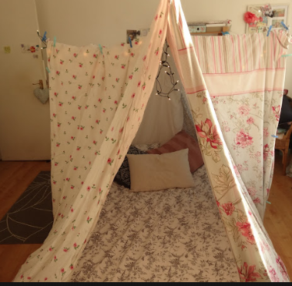
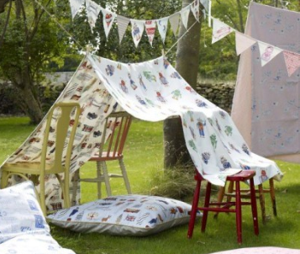



Add your photos and videos onto Tapestry.
We love seeing all the exciting things you are doing!
My Home Learning Journey Grid: Week beginning: 4th May
Phonics
Daily Speed Sound Lesson using RWI facebook/Youtube videos.
See Tapestry for uploaded activities for your child’s RWI group including RWI Get Writing Book.
Special Family Task
Maths
This week in Maths we will learning about the calendar and time.
Please use the link to access this weeks lessons https://www.thenational.academy/online-classroom/reception/maths#subjects
Build a den.
You could build a den inside or outside. You could use cardboard boxes, blankets and cushions. You could make a cave by outing a sheet over the table. I wonder what it’s like inside? Can you take a picture?
Can you learn some days of the week songs?
https://www.youtube.com/watch?time_continue=106&v=TVmprQ_RlvE&feature=emb_title
https://www.youtube.com/watch?v=mXMofxtDPUQ
Let’s get physical!
Take part in the 30 day fitness challenge each day. I will remind you what it is each day on the blog!!
Can you help with the washing up after lunch or dinner?

