Slide 1



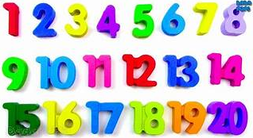



Add your photos and videos onto Tapestry.
We love seeing all the exciting things you are doing!
My Home Learning Journey Grid: Week beginning: 27th April
Phonics
Daily Speed Sound and Spelling lesson using RWI facebook/Youtube videos.
See Tapestry for uploaded activities for your child’s RWI group including RWI Get Writing Book.
Special Family Task
Maths
This week in Maths we will be consolidating numbers to 20.’Please use the maths challenge grid to help with some ideas to do at home to help.
Fold some paper and make a plane . Draw some windows and decorate it. Have a competition to see whose plane travels the furthest.
Karaoke!
Play your favourite music and sing along!
Let’s get physical!
Why not try the GoNoodle workouts. There are so many to choose from! Here is a link to our favourite Trolls one.
https://www.youtube.com/watch?v=KhfkYzUwYFk
Can you learn how to make your own bed each morning?

