Slide 1
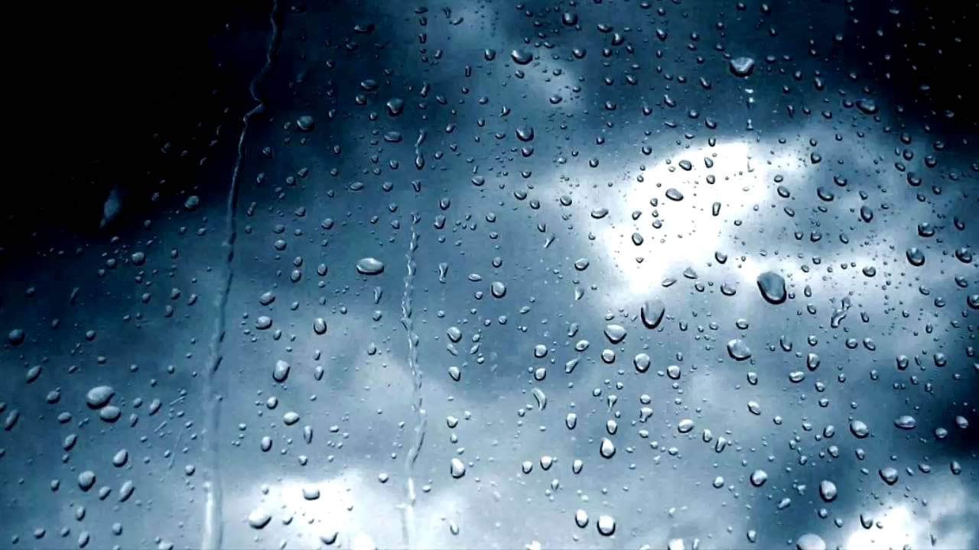
The Water Cycle
L/O: To identify the main stages of the water cycle

Slide 2
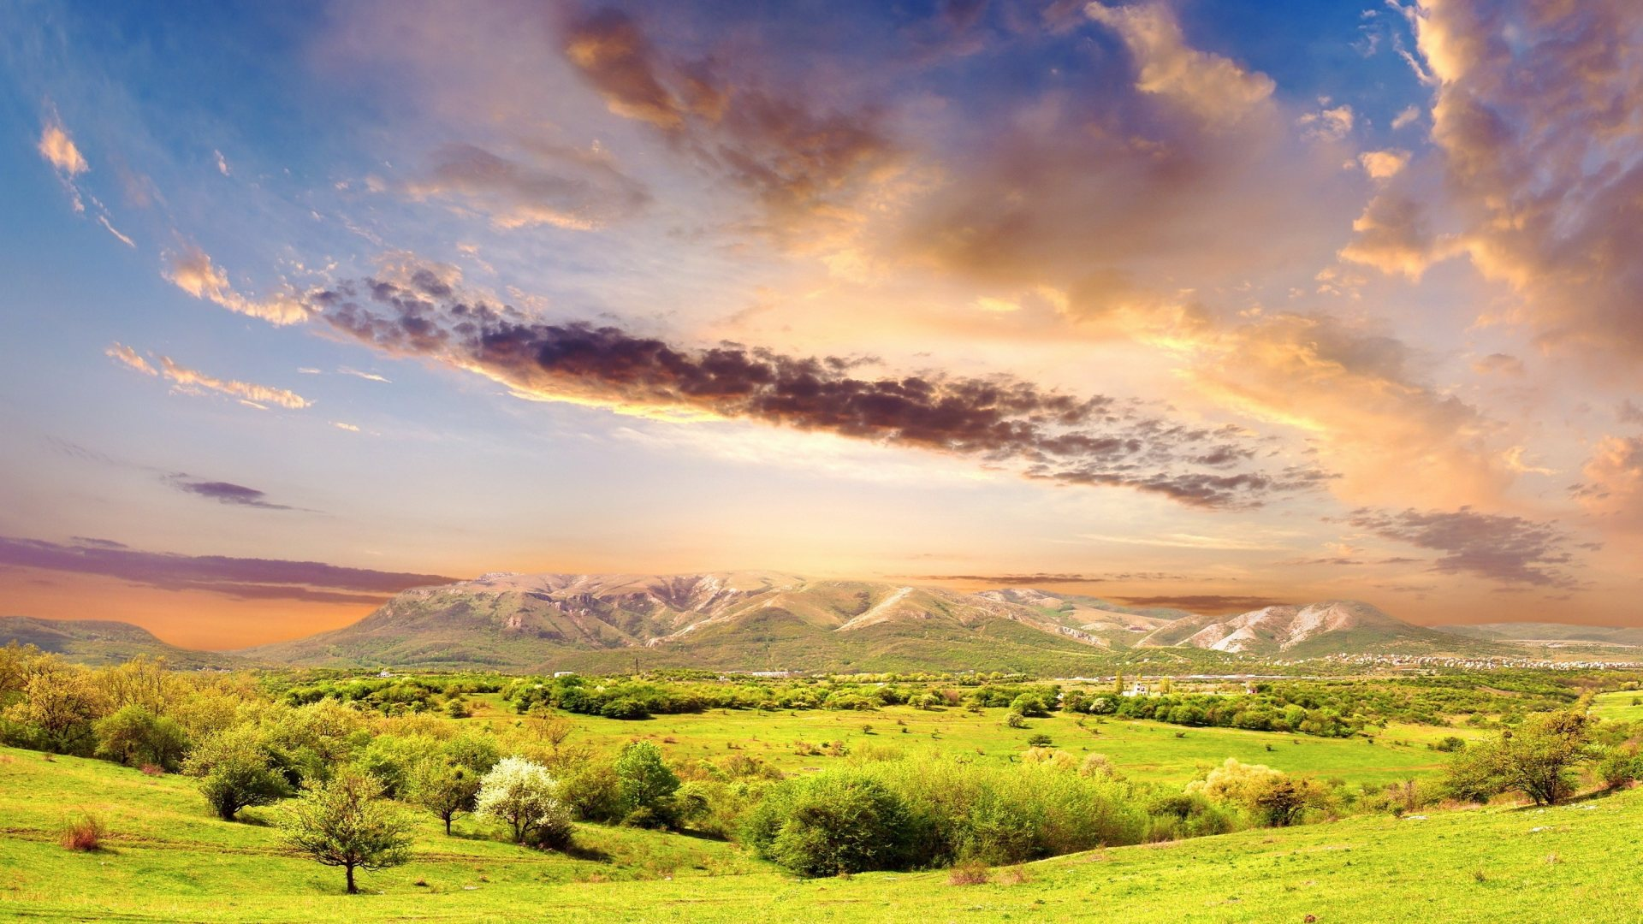
L/O & Success Critera
Define key words related to the water cycle
L/O: To identify the main stages of the water cycle
To be able to apply these key words to describe the process of the water cycle
To understand the process of the water cycle and apply the process within a story format.

Slide 3


Key Words
Precipitation
Evaporation
Condensation
Groundwater flow
Surface run-off
Transpiration
Join the key words with the correct definitions

Slide 4
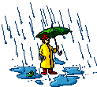

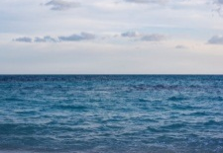
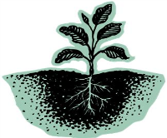
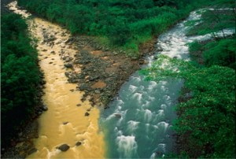

Swap your book with the person sitting next to you
Precipitation
1. Rain, hail, sleet and snow that falls from the clouds
Condensation
2. When water vapour cools and turns into clouds
Evaporation
3. When the sun heats up water from the sea and it goes into the air.
Groundwater flow
4. When water flows through the rocks and soil underground.
Surface run-off
5. When the water runs off the surface of the ground.
Transpiration
6. When the sun heats up water from the leaves of trees.
Task; can you work out what key word goes which each different definition?
Extension; Add in a small picture to help you remember their meanings.

Slide 5
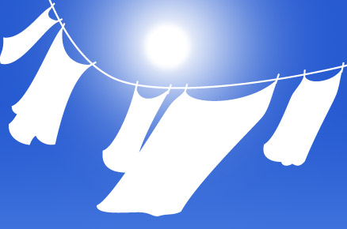
Evaporation
Evaporation is when liquid water turns into water vapour gas without boiling.
This happens you leave your wet washing out to dry.

Slide 6
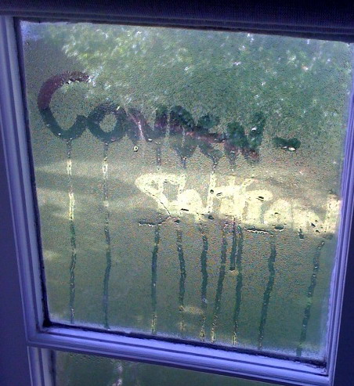

Condensation
Condensation
Condensation is when water vapour gas cools down and turns into liquid water.

Slide 7
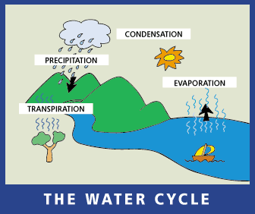
Water never stops moving. Snow and rain fall to the earth from clouds. The rain and melted snow run downhill into rivers and lakes, sometimes crashing over waterfalls.
Eventually the water flows into the ocean.
The water in the oceans rivers and lakes evaporates into the sky where it forms clouds through the process of condensation. Then the cycle begins all over again.
Notes:
https://www.youtube.com/watch?v=zBnKgwnn7i4

Slide 8
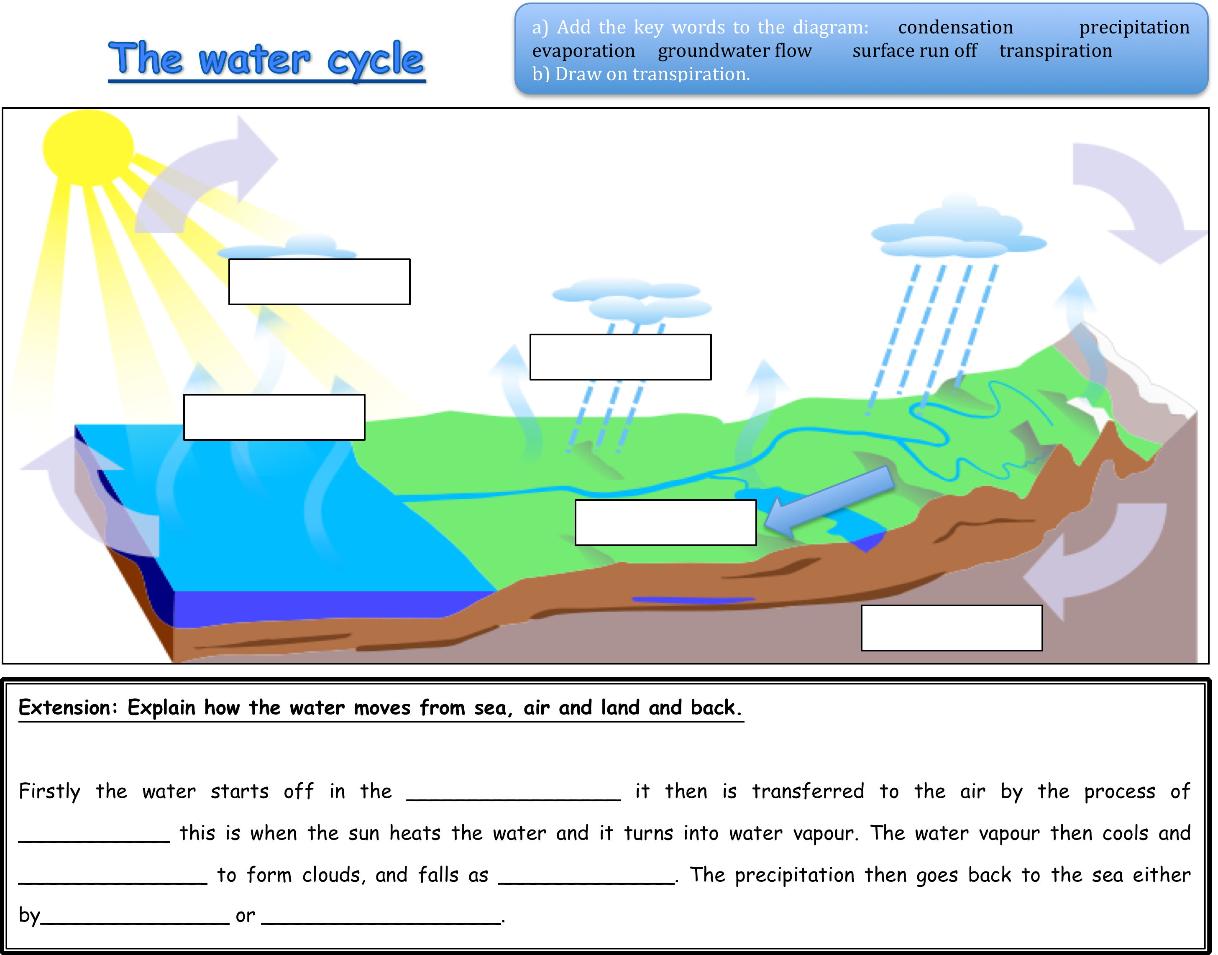

Slide 9
Story Time
Danny the rain droplet
Explain Danny’s journey from sea to air and land around the water cycle.
In your story make sure you use some of the following key terms:
Evaporation
Transpiration
Condensation
Clouds
Precipitation
Surface water
Ground water

Slide 10
How does the water cycle affect us?

Slide 11
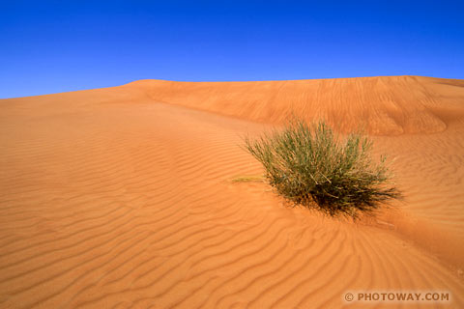
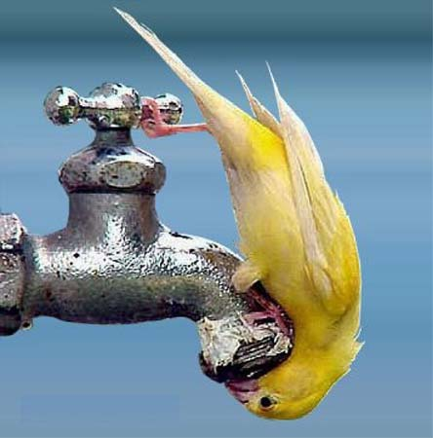
PRECIPITATION-GOOD POINTS
Precipitation – good points
Without precipitation, all of the land on the planet would be desert and we would find it difficult to get a drink.

Slide 12
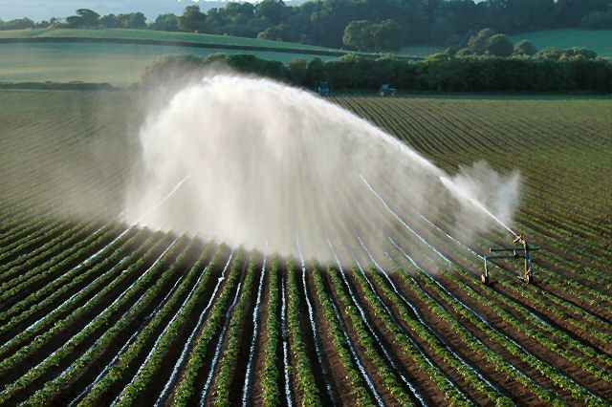
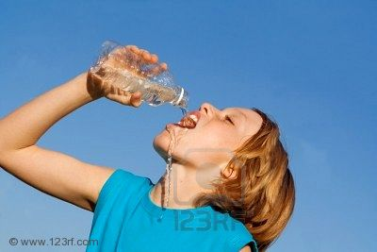
PRECIPITATION-GOOD POINTS
Precipitation – good points
Precipitation helps farmers grow crops and provides a fresh water supply for us to drink.
yourlocalweb.co.uk

Slide 13
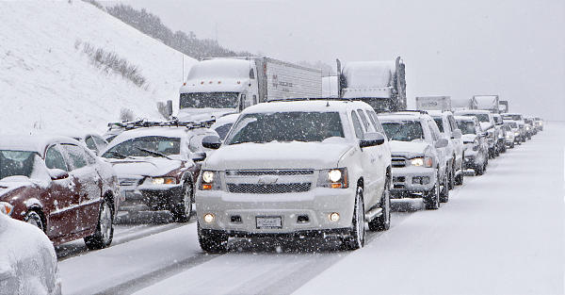
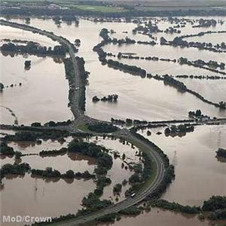
PRECIPITATION-BAD POINTS
Precipitation – Bad points
Precipitation can also be damaging.
Lots of rain and snow can cause flooding and lots of traffic accidents.

Slide 14
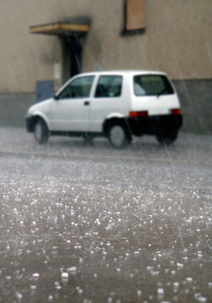
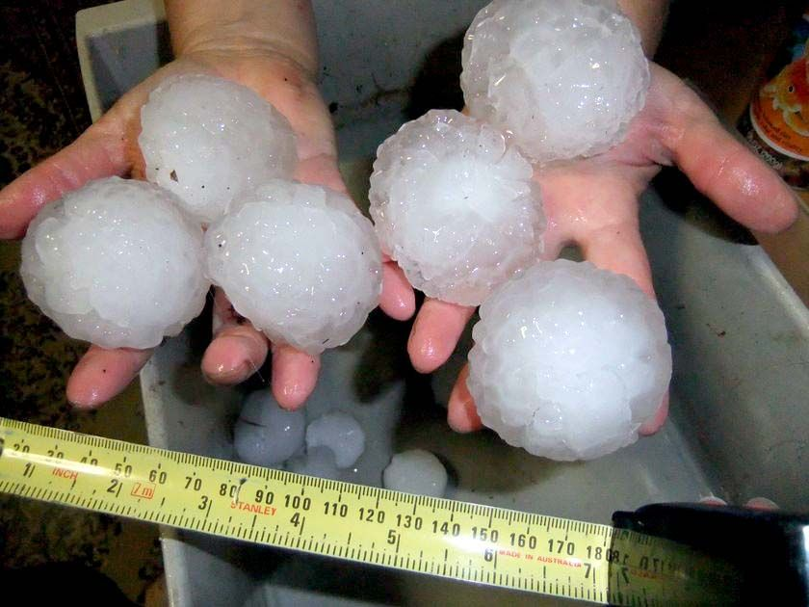
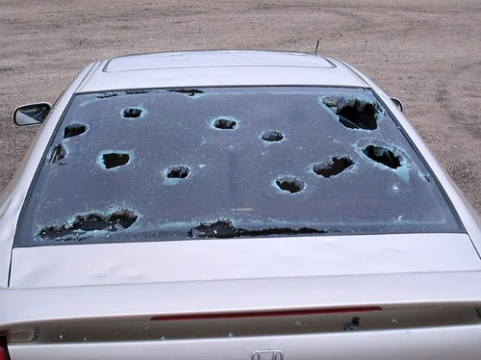
PRECIPITATION-BAD POINTS
Precipitation – Bad points
Hail can damage crops and cars.

Slide 15
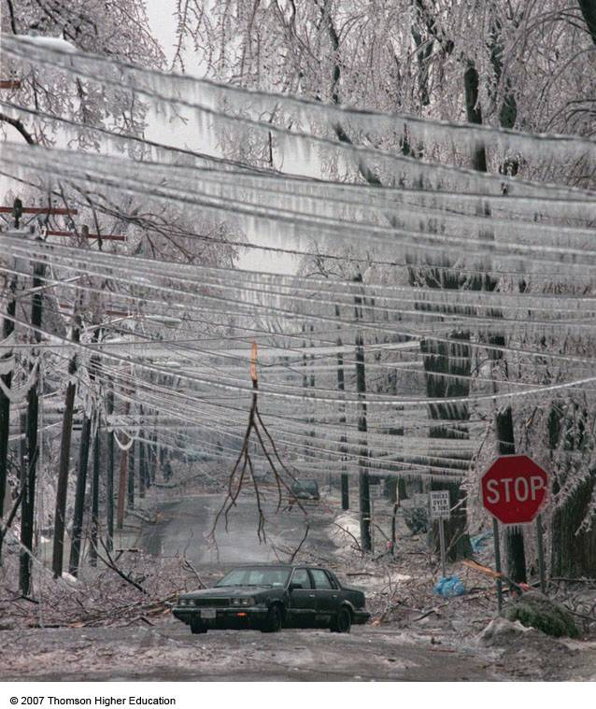
PRECIPITATION-BAD POINTS
Precipitation – Bad points
Freezing rain and sleet can destroy trees and power lines.

Slide 16
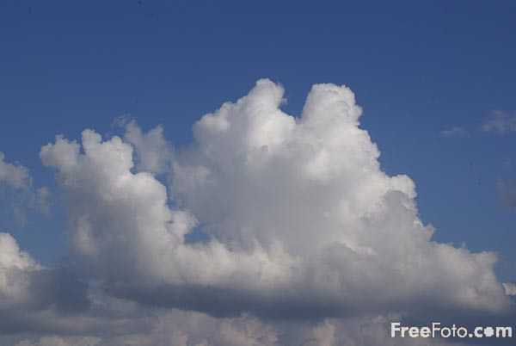
2. CONDENSATION
Condensation
Water vapour cools as it rises.
When this water vapour cools it forms as clouds in the sky. This is condensation in action.
There are lots of different kinds of clouds.
Clouds are also part of thunderstorms and hurricanes.
Think about how this can impact human activity?

Slide 17
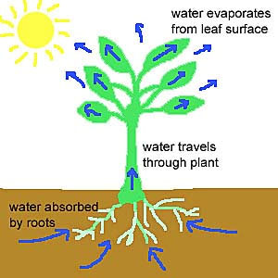
Transpiration
4. TRANSPIRATION
This is the other process that
water moves from earth to the
atmosphere.
Trees, shrubs, grasses and
other plants all need water to
survive. They take up water
from the soil by their roots so
that they can grow.
Just like in the process of
evaporation the sun creates
heat which transpires this
water into the air through tiny
holes in the underside of
leaves.

Slide 18
What have you learned?
What have you learnt?
What can water can be used for?
What is the name for rain which begins with P?
When liquid passes from liquid to gas it is called E___________.
Condensation is when c______ are formed in the sky.
Precipitation, evaporation and condensation are all part of which cycle?

Slide 19
Next Lesson:
Extreme Weather

