Slide 1



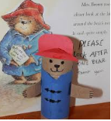
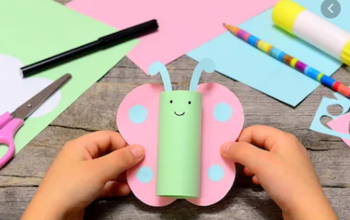

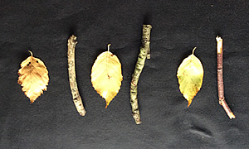

Add your photos and videos onto Tapestry.
We love seeing all the exciting things you are doing!
My Home Learning Journey Grid: Week beginning: 20th April
Phonics
Daily Speed Sound Lesson using RWI facebook/Youtube videos.
See Tapestry for uploaded activities for your child’s RWI group including RWI Get Writing Book.
Special Family Task
Maths
This week in Maths we will be exploring all about Patterns.
Please use the maths challenge grid to help with some ideas to do at home to help.
Can you get crafty using kitchen/toilet roll tubes?
There are endless ideas that you can do superheroes, butterfly, castles etc.
Please share any of your creations.
Learn a nursery rhyme each day and add some moves to go alongside it.
Let’s get physical!
Set up an obstacle course in your home or garden. You could use sheets, boxes, chairs, cushions etc. Time yourself to see how fast you can go. Can you beat your family members?
Can you set the table ready for dinner? Make sure you put the knives and forks in the right places!

