Slide 1
Llandudno 2023
Independence
New experiences
Excitement
Enquiry
Teamwork
FUN!
History
Geography
PE
Art
Literacy
PSHE
Perseverance
Friendship
Outdoor learning
Leadership

Slide 2

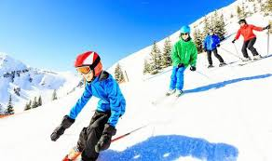



Programme:
All children must have a good breakfast on the morning of the trip.
Wednesday 26th April
9.30am Leave school. Journey by coach
11.00am Arrive at Llandudno Hostel, Llandudno. Drop off bags
11.30am Safety talk
12.00 Own packed lunch picnic at Happy Valley Gardens
1.30pm Arrive at ski centre. Sort out kit.
2.00pm Skiing lesson with instructors.
3.00pm Depart ski centre. Walk back to Llandudno Hostel. Unpack.
5.00pm Evening meal.
6.00pm Beach activities/indoor games if very wet.
8.30pm Supper and story.
9.15pm Bed.

Slide 3
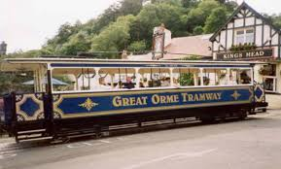
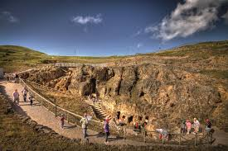
Programme:
Thursday 27th April
8.30am Breakfast, pack, tidy rooms.
10.00am Beach games
11.20am Tram ride to the Great Orme..
11.30am Copper Mine tour.
12.30pm Lunch and visit souvenir shop.
1.30pm Walk up to Great Orme summit.
2.00pm Tram ride down and Ice cream on the pier
3.00pm Back to hostel to collect bags.
5.00pm Return to school

Slide 4
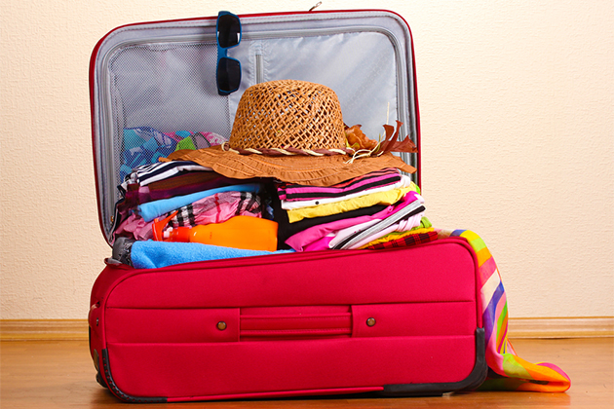
Kit List and Packing
You must pack together with your child so they know what is in their bag!
Gloves- MUST HAVE TO SKI
Warm winter hat
Sun Hat/Cap
Packed Lunch for Day 1
Drink in a re-fillable bottle (No fizzy drinks please)
2x sets of underwear
2x pairs of socks
2x pairs of warm/thick trousers
1x pair of light trousers (in case of hot weather)
1x short sleeve t-shirt
1x long sleeve t-shirts
2x jumpers/fleece tops
Walking boots/sturdy shoes NOT wellies
Pyjamas
Slippers – sensible for walking up and downstairs in
Dressing gown/onsie/jumper for evening
Toiletries
Sun cream (labelled with name)
Toothpaste
Toothbrush
Face cloth (in a zippy bag or sandwich bag)
Soap/facewash
Small hand towel
Hairbrush
Bobbles (long hair)
Deodorant (If your child uses this and must be roll on not spray)
Book
Teddy (that will fit inside a bag)
2 empty carrier bags for wet/dirty clothes
Small rucksack for carrying lunch and drinks.
Named purse with money for souvenirs. (Up to £10)

Slide 5


-Risk Assessments – whole trip and individual. Evolve
-Staff: Mrs Evans,Mrs O’Marah, Mr Kettle, Miss Wilkinson,
Mrs Simmonds
1st Aid. Additional leaders/teachers/guides for the planned activites.
-Expectations for behaviour and conduct are as every other trip out. Dangers made clear to the children before the trip and before each individual part of the trip.
-Medication: to be given directly to Mrs Evans on the morning of the trip. All must be clearly labelled with name, dosage, timings. Inhalers- check in date. Travel sickness tablets for return journey.

Slide 6

Room allocations and bunks
PSHE circle time. Each child writes down the name of 2 friends they would like to share a room with. Mrs Evans uses this to help organise the rooms.
Bunks- please inform Mrs Evans if you do not want your child to sleep on the top bunk. (Sleepwalkers, toilet visits during the evening/night.)
Please inform Mrs Evans about times to limit evening drinks and being taken to the toilet in the night.

Slide 7


Contact details:
Please return forms asap
In the unlikely event of an emergency
Mrs Evans will contact you directly. Please ensure you are able to be contacted all day and night. Phones kept on.
Mrs Powell/Mrs Downing will also be contacted.
Medical forms- will be held by Mrs Evans for the duration of the trip- please ensure you have returned this form ASAP. Can’t legally go without it.
If you don’t have the exact date for tetanus -phone your doctor’s surgery.

Slide 8

Relax and enjoy the quiet for a night- your children are in good hands!
Question time….

