Slide 1

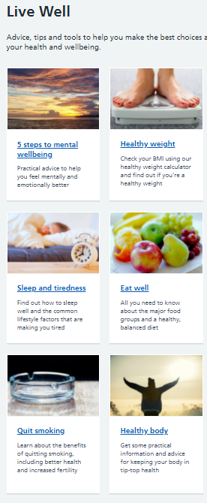


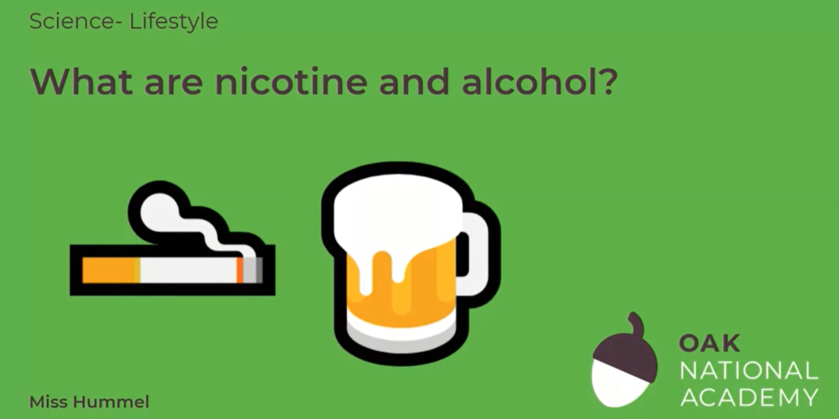
SCIENCE
Diet & Lifestyle
Lesson 6

Slide 2
What are nicotine and alcohol?
In this lesson, we will learn about non-medicinal drugs, such as alcohol and nicotine. We will learn about the effects of alcohol on the body as well as the negative consequences of consuming products with nicotine, like cigarettes or vaping. Finally, we will work on applying our knowledge to real life scenarios.
Click on the following link to watch and take part in the following video lesson. Start with the quiz and the recap of last lesson’s learning.
https://classroom.thenational.academy/lessons/what-are-nicotine-and-alcohol-cgv3ec
Play the audio first before clicking on the link to the lesson.

Slide 3
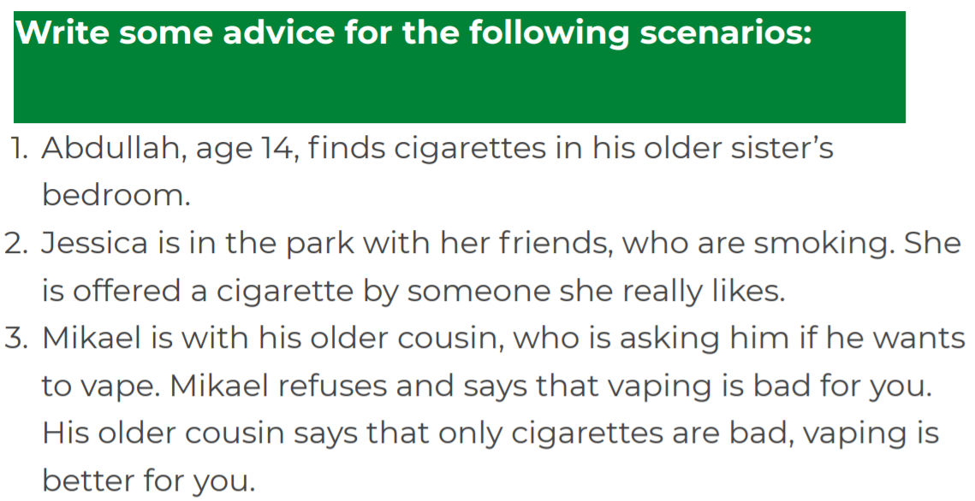
What are nicotine and alcohol?
Click on the following link to complete the activities for today’s lesson:
https://classroom.thenational.academy/lessons/what-are-nicotine-and-alcohol-cgv3ec?step=3&activity=worksheet

Slide 4
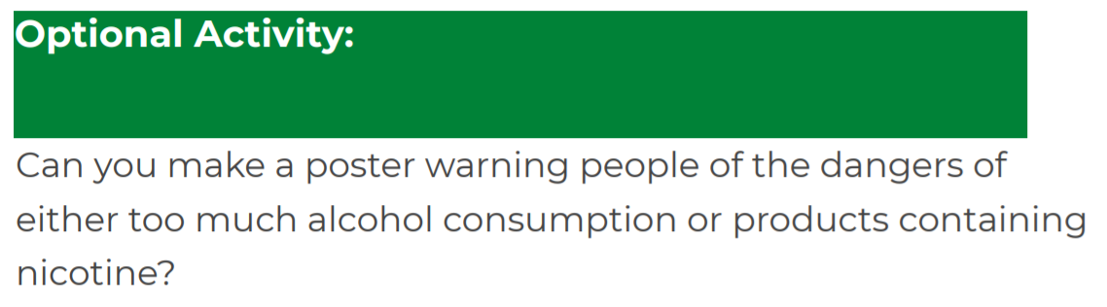
WRITING TASK
Have a go at this final task and optional activity and finish the lesson with the quiz at the end!

